Slide 1
High Needs Update
In place of meeting on 10th July 2020

Slide 2
Finance
High Needs By;
Pupil/Student Numbers
Spend, Institution Type
Spend By Average Cost, Institution Type

Slide 3
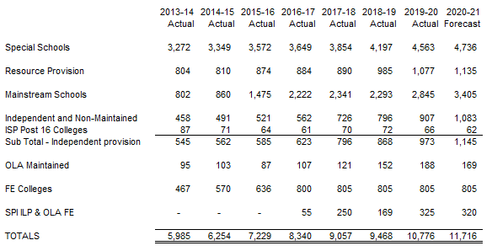
High Needs Pupil/Student Numbers
Key: OLA is Other Local Authority, FE is Further Education, SPI is Special Post16 Institutions and ILP is Independent Learning Provider

Slide 4
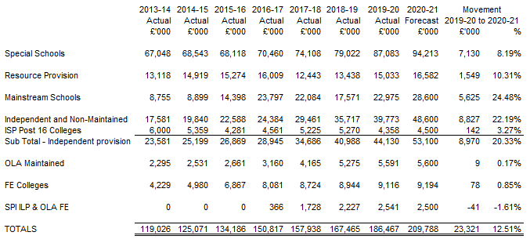
High Needs Spend – By Institution Type

Slide 5
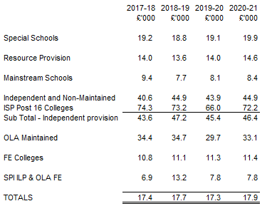
High Needs Average Cost – By Institution Type

Slide 6
SEND Improvement Programme
Delivery; Key Activities for the next 3 months
Working with DFE
Next Steps

Slide 7
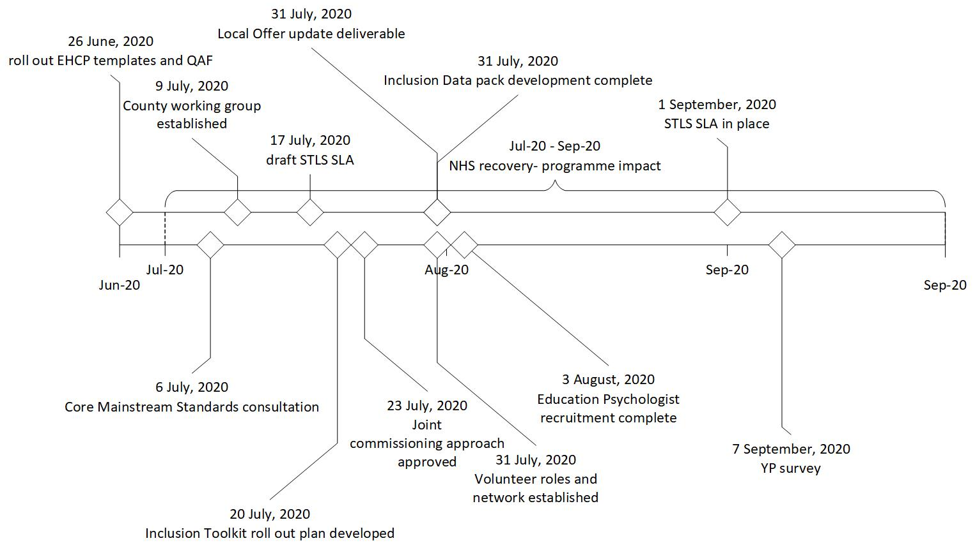
Delivery – Key Activities for the next 3 months

Slide 8
Working with DFE
There have been regular communications with the DFE since March . Regular meetings plus focused on:
Monthly meetings with Mark Walker (Interim Director of Disabilities & SEN), programme SRO
Meetings with Mark Walker and David Adams (Interim Director of Education) to discuss Covid 19 update in light of school closures, returning to education settings for children with SEND and support in that area and transition arrangements for September
Meetings with Jacky Ross (Head of SEN) to discuss EHCP progress and updates.
Quarterly monitoring visit
The next quarterly monitoring visit is on 7th July.
We are currently unclear on the timing of the next OFSTED visit in light of the Covid 19 pandemic.

Slide 9
Next Steps
Continued focus on delivery across all workstreams
Re-planning key activities following Covid 19, with Workstreams D (Joint Commissioning & Governance) & E (Service Provision) restarting over the coming weeks – Health staff were diverted to deal with outbreak
Working with schools as they re-open to ensure support as well as re-starting co production and consultation for key products (e.g. core mainstream standards, STLS SLA)
Re start Co-Production work with KENT PACT to enable further improvements to our SEND service outputs as well as key products (e.g. Co-Production protocol).
Continued improvement of the local offer and its website

Slide 10
Disabled Children and Young People
Delivery; Key Activities
Covid Impact
Next Steps

Slide 11
Expand the offer for disabled children and young people including those with Autistic Spectrum Conditions who do not meet criteria for current service

Slide 12
Ensure inclusion of Social Care needs in Education Health and Care Plans (EHCP’s)
Our new Division has brought together under one Director the SEN and Disabled Children’s and Young People Service (DCYP) – enabling closer/new ways of working
Asst Director of DCYP and Head of SEN meet fortnightly as do wider management teams
Considering opportunities of new Division and move to a case management model to improve experience for CYP and their families
ECHP format has been revised by SEN, agreed with DofE and multi agency partners
Exemplars have been produced with audit process
New EHCP format contains the Preparing for Adulthood markers to support better transitions

Slide 13
Commissioned Services Impact
Covid Impact on Key Services
Community Support Service = COVID IMPACT HIGH
Direct Payment & Support Service = COVID IMPACT HIGH
Shortbreaks Activity Programme = COVID IMPACT HIGH
Notes:
C

Slide 14
Short Break activity Programme – Covid Response
Survey families in May regarding accessing short break activities we had 191 responses - 71% wished to recommence activities
Asked to rate Mental Health and Wellbeing:
Most family members are experiencing a negative impact
56.3% of disabled children and young people were reported to be either a little or a lot worse, and
54.2% of participants (noted as main carer) reported to be either a little or a lot worse.
Siblings mental health and wellbeing was higher on the response of a little worse but overall lower on a lot worse category.

Slide 15
£9.6m
Introduction
Activity Undertaken
Framework for support
Comprehensive Programme of Training to Support Inclusive Practice
Development of Wider School and Community Practices to Promote Inclusion
Supporting Transition for CYPE with SEND
Providing Individual Case Support
Locality Projects and Pilots
Delivery

Slide 16
Introduction
In the School Funding consultation launched in 2019, KCC proposed for 2020-21 to repeat the 1% transfer from the Schools Block into the High Needs Block, estimated at £9.8m. The Cabinet Member for Education and Skills took the decision on 15 January 2020 with the following detail:
“Unlike previous years where we have requested a transfer to help reduce the deficit, this time we want to consider a different approach. This transfer would be used to support much greater inclusion in mainstream schools. It is our intention that this funding, whilst initially retained by KCC, will be paid to mainstream schools and academies that operate inclusively. This will help to address one of the key issues highlighted by Ofsted in the Special Educational Needs and Disability (SEND) inspection of the local area earlier this year.“

Slide 17
Activity already undertaken
ISOS survey collaboration with KAH
ISOS partnership led workshops
Agreed RSC support
Initial County Reference Group meeting
Initial peer to peer training.
Ongoing mapping of services and
Consultation on the inclusion toolkit and the Core Standards, schools and parents.
Review of inclusion data
Feedback from guided conversations and school improvement Deep Dives.

Slide 18
A Framework for support
A comprehensive programme of training to support inclusive practice
Development of wider school and community practices to promote inclusion
Supporting transition for CYPE with SEND
Providing individual case support
Locality projects / pilots

Slide 19
A comprehensive programme of training to support inclusive practice
A countywide core offer provided at all levels
Delivery of a training programme rising from the development of the countywide approach to inclusion, including for example: training on core standards, whole school nurture, NQT and Governor training.
Specialist training for specific needs
For example: ASD and Communication and Interaction needs, SEMH, Mental Health, Emotional Literacy
Targeted training and support
Targeted training and support to individual schools and settings where there is an assessed need - individual action plans

Slide 20
Development of wider school and community practices to promote inclusion
Development of systems and structures supporting inclusion and the sharing of good practice
Forums and execs, for example Lift, IYFA, Inclusion steering groups, how do these work collaboratively with other groups to ensure a countywide approach and drive.
Peer to peer support
Inclusion toolkit
Countywide programme of peer reviews.
Identifying good practice and disseminating this.

Slide 21
Supporting transition for CYPE with SEND
Early Years to Primary
Year 2 to Year 3 (where applicable)
Primary to Secondary
Post 16 /Post 19
Early identification of support
Transfer communication and planning, induction and transition programmes
Development of appropriate provision
Supported employment

Slide 22
Providing individual case support
Individual case support
Specialist advice to schools on individuals
Specialist support to aid integration of CYP with an EHCP
Critical case support - providing immediate crisis support to prevent the escalation of issues and resource.
Speedier intervention where there is a crisis need.

Slide 23
Locality projects / pilots
A mechanism to fund local collaboration pilots which further the inclusion agenda.
Recognising the need to support collaborations in the development of local solutions and supporting schools innovation and creativity in the development of these.

Slide 24
Delivery
The delivery of this framework needs to be coordinated across a range of delivery partners to ensure equity of access and consistency of quality and impact. Partners including:
Schools
KAH
KSENT
TEP
STLS
SEN
LIFT
Headstart
As such, the framework needs to include investment in a robust commissioning cycle.

Slide 25
Commissioning Approach
- KCC Commissioning Cycle
- Analyse
- Plan
- Do
- Review
Commissioning Principles
Commissioning Activities
What this Decision Means

Slide 26
The KCC Commissioning Cycle
What outcomes are we trying to achieve?
How can we reflect this in our plan & specification?
KCC has an agreed set of processes as part of its Commissioning Cycle. This shows four key stages “Analyse”, “Plan”, “Do” and “Review”. The Commissioning Cycle is used widely across the Council and the principles will be applied through this work.
Joint Commissioning was also identified as a weakness in the SEND inspection and our Health partners are also engaged in the four stages of the activities.
More detail is provided in the following slides on each stage, however this is the Council’s approach covering all areas of need.
How will we know if we are improving outcomes?
How can we encourage innovation in the tender?

Slide 27
The KCC Commissioning Cycle - Analyse
Purpose of the ‘Analyse’ stage:
To build up a clear picture of what we need to achieve through this commissioning exercise
1. Analyse
2. Plan
KCC commissioning cycle
Key steps to be undertaken:
Initiate the project
Review the effectiveness of current provision
Assess the market/provision
Analyse the needs of customers in the relevant client group/s - current users of the service as well as other customer groups who may use or be affected by the service and any changes
Consider current and future legislation
Understand baseline cost of service
Complete diagnostic report
4. Review
3. Do
The “Analyse” stage is normally the longest stage to make sure all data sources are sourced, documented and analysed.
It is the initial stages to seek approval on the direction of travel before the planning stage can commence

Slide 28
The KCC Commissioning Cycle - Plan
1. Analyse
2. Plan
Purpose of the ‘Plan’ stage:
To develop an effective plan for how we will address the identified need and achieve the required outcome/s
KCC commissioning cycle
Key steps to be undertaken:
Engage service users and providers
Agree success criteria and expected outcomes
Confirm resources available (including whether we can pool resources and goals with partners)
Test the market
Consider equalities impact of proposed service
Develop commissioning plan including evaluation planning
Develop service specifications
Solution and market development
4. Review
3. Do
Once the planning stage has commenced, we would engage with all stakeholders to discuss an outline of an approach based on what the data tells us.
Whilst it may look like the start of an agreed plan, this is still subject to change based on the stakeholder views.

Slide 29
The KCC Commissioning Cycle - Do
Purpose of the ‘Do’ stage:
To put in place effective services to achieve the required outcomes
1. Analyse
2. Plan
KCC commissioning cycle
Key steps to be undertaken:
Undertake specific market development activities including piloting the approach if necessary
Carry out a fair and transparent procurement exercise (if appropriate)
Support providers to be able to engage with the procurement process
Secure suitable providers
Launch service provision
Carry out initial contract review
Carry out initial contract review
4. Review
3. Do
Under the Do phase, the plan will be implemented

Slide 30
The KCC Commissioning Cycle - Review
Purpose of the ‘Review’ stage:
To ensure that the contract is being fulfilled, that the desired outcomes are being achieved and that we are learning from mistakes and what worked well
1. Analyse
2. Plan
KCC commissioning cycle
Key steps to be undertaken:
Carry out regular contract monitoring
Seek feedback from service users
Carry out formal evaluation of the service including social value achieved and equalities impact
Update evidence base
Identify priorities for next commissioning exercise
Decommission service if not meeting required outcomes
4. Review
3. Do
The Review phase will be undertaken to demonstrate whether the actions have delivered the required outcomes or not.

Slide 31
Commissioning Principles
Principle 1:
Focused on outcomes for our Residents
Principle 6:
Hold all services accountable for the delivery of KCC’s Strategic Outcomes
Principle 2:
A consistent commissioning approach to planning, designing and evaluating services
Principle 7:
Customers at the heart of our commissioning approach
Principle 3:
The Right people involved at the right stage of Commissioning
Principle 8:
A commitment to building capacity
Principle 4:
Open-minded about how best to achieve outcomes
Principle 9:
We will maximise Social Value
Principle 5:
High-quality, robust evidence informing our decisions
Principle 10:
Our supply chains will be sustainable and effective

Slide 32
Commissioning Activities

Slide 33
What this means for the decision
You will know that as this is the first time we are sharing this, we are in the “Analyse” phase of the Commissioning Cycle and that we need to seek views on need, want and expectation as we start the “Plan” phase. We have been collating some data to inform the commissioning exercise required
Co-Production – the need to work together and the importance of hearing from you about what is needed
The Voice of the Child – what are their needs and expectations? What do the parents want/expect?
Evidence base – what data do we have to support the service delivery and effectiveness, what quantities are needed and where?

