Slide 1




Virtual Headteacher Briefing
7th and 8th February 2022

Slide 2
Welcome
Matt Dunkley Corporate Director Children’s Services

Slide 3
Agenda
14:00 | Welcome | Matt Dunkley
14:05 | Introduction | Christine McInnes and Mark Walker
14:15 | SEN strategy and related activity | Siobhán Price and Kerry Greene
14:35 | Inclusion Dashboard | Christine McInnes and Mike Walters
14:45 | Break out room | ALL
15:05 | Budget Update | Karen Stone
15:15 | Case Study | Royal Harbour Academy
15:25 | Break out rooms | ALL
15:45 | KAH update | Mike Walters
15:50 | Closing remarks | Christine McInnes

Slide 4
Introduction
Christine McInnes Director of Education
Mark Walker Director of SEND

Slide 5
SEN Strategy and related activity
Siobhán Price
Kerry Greene

Slide 6

Kent’s Strategy for Children and Young People with Special Educational Needs and Disabilities 2021 - 2024

Slide 7
5 PRIORITIES
Improve the way we work with parents, carers, children and young people
2. Ensure that families have positive experiences at each stage of their journey including a well planned and smooth transition to adulthood.
3. Identify and assess children and young peoples’ needs earlier and more effectively
4. Improve education, care and health outcomes for children and young people with SEND
5. Ensure children and young people with SEND are included in their local community

Slide 8
CATIE – COUNTYWIDE APPROACH TO INCLUSIVE EDUCATION – 5 PRIORITIES
Establish clear expectations about what needs mainstream schools and settings will meet – Mainstream Core Standards and Early Years Standards
2.Backing these expectations with a clear offer of capacity building support.
3. Engaging ‘system leaders’
4. Ensure that schools and settings have access to an explicit offer of targeted inclusion support
5. Ensure that education inclusion support is part of a broader, holistic and joined-up offer of support for young people’s care and health needs

Slide 9
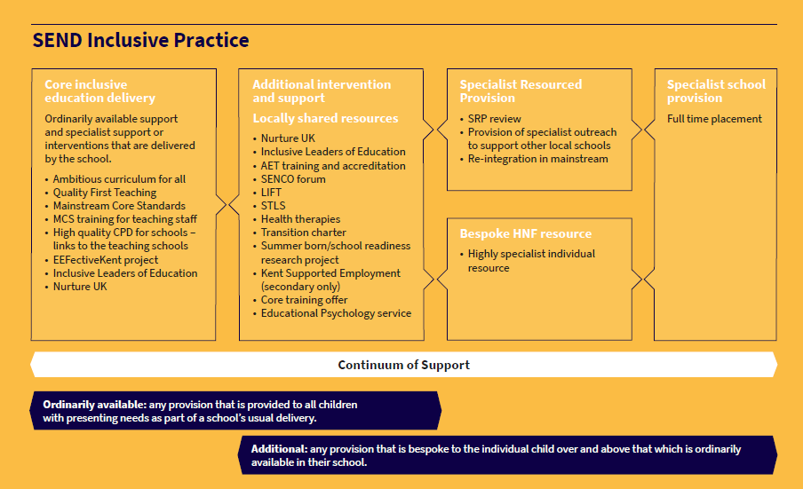
CONTINUUM OF SUPPORT

Slide 10
Related Activity
Inclusive Leaders of Education
Whole School Nurture
Supported Employment
Inclusion Dashboard
Mainstream Core Standards training for Governors, Headteachers, senior leaders and SENCOs
Effective Transitions

Slide 11
INCLUSIVE LEADERS OF EDUCATION
Inclusion Leadership Service provided by Leadership Learning South East Consortium (including NASEN and the Education Development Trust)
A programme of peer-to-peer review and support, bringing together small clusters of schools across Kent, to identify and strengthen inclusive practices at school level.
Outcomes - There is improved inclusion and quality of SEND provision in schools
There is consistent quality of provision and commitment to inclusion in all schools; where standards are achieved, and progress made, by children and young people with SEND is improving and is above the national average for all phases;
Systems to track and quality assure provision are effective, such that the achievement gap for children and young people with SEND is narrowing. There is the opportunity for leaders to enhance their skills and knowledge of the SEND and inclusion agenda and to apply that knowledge in the practice of their current and next stage role in school;
Enable leaders to reflect on and audit their inclusive practices and develop actions for development;
be directly applicable to the role held by the leader and include tasks aligned with in-school responsibilities;
create opportunities for leaders to build professional networks of colleagues in other Kent schools and share practice;

Slide 12
INCLUSIVE LEADERS OF EDUCATION
COHORT ONE - 77 schools
Currently recruiting for Cohort 2 which is due to start in Spring 2022
Also recruiting for Cohort 3 which will start in September 2022
Nicola.taylor@llse.org.uk
Kent Inclusion Leadership Programme Recruitment webinar: Tuesday 1st March 2022, 12:30-1:30pm
Register for this webinar - 01/03/2022 12.30-1.30pm
Kent Inclusion Leadership Programme Recruitment webinar: Wednesday 9th March 2022, 4:00-5:00pm
Register for this webinar - 09/03/2022 4-5pm

Slide 13
Dover | 17 | 22%
Swale | 11 | 14%
Folkestone and Hythe | 8 | 10%
Gravesham | 7 | 9%
Tonbridge and Malling | 7 | 9%
Ashford | 6 | 8%
Thanet | 6 | 8%
Dartford | 5 | 6%
Canterbury | 3 | 4%
Maidstone | 3 | 4%
Tunbridge Wells | 3 | 4%
Sevenoaks | 1 | 1%
INCLUSIVE LEADERS OF EDUCATION

Slide 14
WHOLE SCHOOL NURTURE
Whole School Approaches to Nurture service provided by nurtureuk
A structured, evidence-based programme of training and consultancy support over a period of 18 months (with flexibility) to support schools in implementing their own Whole School Approach to Nurture.
AIM - The aim is to promote inclusion across the county and support pupils with special educational needs (SEMH) to access and enjoy education.
Outcomes
Reduced fixed term and permanent exclusions
Improved Parent/Teacher relationships
Improved Pupil/Teacher relationships
Improved Pupil/Staff wellbeing and morale
Improved understanding of pupils with Special Educational Needs
Improved access to support for pupils with Special Educational Needs
School budgets will be able to be spent more effectively to meet the needs of pupils
Better networking opportunities and best practice across the county

Slide 15
WHOLE SCHOOL NURTURE
Eight cohorts in total
COHORT ONE – FULL 24 schools
COHORT TWO – FULL 36 schools
COHORT THREE – 48 schools. 13 places left. May 2022
COHORT FOUR – 48 schools. 29 places left. Sept 2022
https://www.nurtureuk.org/nurturingkent

Slide 16
WHOLE SCHOOL NURTURE
Thanet | 19 | 15%
Dover | 17 | 14%
Ashford | 14 | 11%
Maidstone | 14 | 11%
Folkestone and Hythe | 12 | 10%
Canterbury | 10 | 8%
Tonbridge and Malling | 10 | 8%
Tunbridge Wells | 9 | 7%
Dartford | 6 | 5%
Sevenoaks | 6 | 5%
Gravesham | 3 | 2%
https://www.nurtureuk.org/nurturingkent

Slide 17
SUPPORTED EMPLOYMENT
Supported Employment in School provided by: Specialist Employment Service
Specialist training and support for secondary schools to develop their own Supported Employment approaches and embed within their Careers Programme, improving outcomes and transitions for young people with SEND. Young people with SEND attending mainstream schools in Years 9 -11 are able to make positive and more informed choices about their future education and employment options through receiving support from staff who have been trained in Supported Employment approaches.
OUTCOMES
Students with SEND and their parents/carers are more confident decision makers and are able to make informed choices about which pathways are suitable for them. This will be reflected within their Education Health and Care Plan (EHCP), where appropriate.
Students with SEND transition successfully into the next stages of their lives be it paid work, work experience, or further education to gain qualifications needed for their informed careers pathway.
Students with SEND are less likely to be Not in Education, Employment or Training (NEET) through receiving appropriate support to explore and prepare for progression routes from an earlier age through their school.

Slide 18
SUPPORTED EMPLOYMENT
Available for all secondary schools to complement careers strategy
https://www.theeducationpeople.org/products/professional-development/an-introduction-to-supported-employment-and-job-coaching/
Charlotte.Burford@theeducationpeople.org

Slide 19
Ashford | 1
Canterbury | 1
Dartford
Dover | 1
Folkestone and Hythe | 2
Gravesham | 2
Maidstone | 1
Sevenoaks
Swale | 1
Thanet
Tonbridge and Malling | 2
Tunbridge Wells
Grand Total | 11
SUPPORTED EMPLOYMENT

Slide 20
MAINSTREAM CORE STANDARDS
Training for Governors, Headteachers, senior leaders and SENDCos. 2021-2022
Outcome – to inform leaders of the mainstream core standards and to outline the responsibility of mainstream schools.
Plans to consider more specialist training elements to influence Quality First Teaching and link to ILE pathway/distributed leadership alongside the SEND Teacher Handbook published by NASEN in December 2021
Scoping due to start in Term 4.

Slide 21
EFFECTIVE TRANSITIONS
TRANSITION WORKING GROUP
Representatives from SEND team, EYFS, Post 16 providers, mainstream senior leaders.
Purpose
Implement Transition Charter and review accordingly (this is to include timelines)
Produce a guidance document for all interdependents to ensure effective transition of children with SEND
Use the guidance document to influence systemic change in how transition is managed across the county
Communicate said improvements to schools and other agencies

Slide 22
PROJECTS PENDING
1. ASC – being scoped in conjunction with NHS
2. Summer born/school readiness
3. Core Training Offer
4. Best Practice Guidance

Slide 23
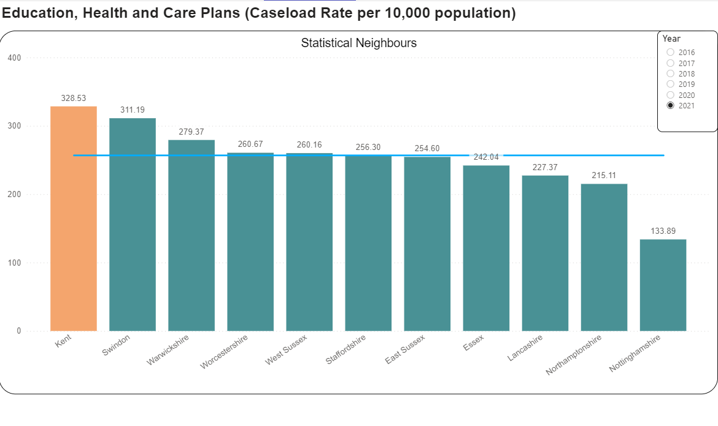
BAR CHART SLIDE

Slide 24
MONITORING AND EVALUATION
How do we know all this work is having an impact?
What will be the change in trends re EHCP applications?
What is the engagement of schools?
What is the geographical spread? Area? District
KPIs around CATIE
Schools can identify SEN needs, implement appropriate effective strategies to ensure high quality teaching and learning outcomes, and work with parents as partners.
Improved engagement and progress in learning improved attendance fewer reduced timetables reduced exclusions.
Schools can share best practice review progress and draw in specialist leadership support to embed inclusive practices.
Schools feel confident to adopt more inclusive practices. Children and young people feel included, and experience improved emotional wellbeing.

Slide 25
School Inclusion Dashboard
The purpose of the dashboard is to:
Provide area and district based data
Give area and district groups hard data to inform local decision making
Allow more strategic use of resources
Provide data for analysis of trends over time
Monitor trends as population increases
Provide evidence to support the progress towards KPIs
Provide data to support evaluation of impact of services at local and county level
Dashboard will be updated after every January census and following exam results.
Dashboard will be distributed via KAH exec, area boards and SEN board
First ‘live’ dashboard will be available in Oct/Nov 2022 with update after Jan census

Slide 26
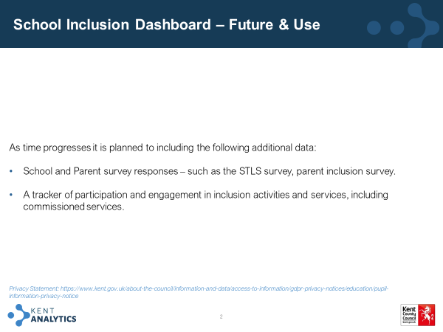
INCLUSION DASHBOARD

Slide 27
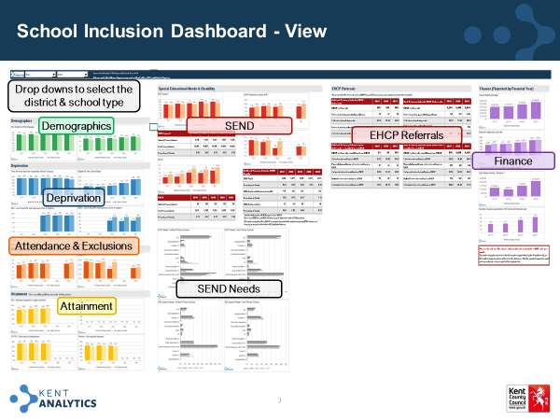

Slide 28
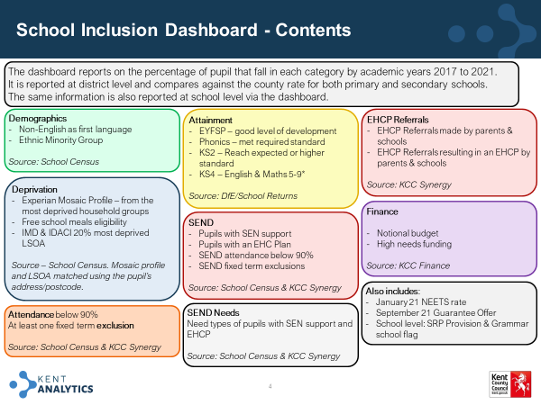

Slide 29
Break out Room – Key Questions
1. How will/have these projects improve partnership(schools and KCC services) working/collaboration in your local area/district?
2. Is the right mix of projects and services available to support all schools to lead and deliver on SEND inclusion?

Slide 30
Budget Update -
Karen Stone – CYPE Finance Business Partner

Slide 31
Latest School Funding Update
2022-23 is final year of a three year commitment to increase Schools Funding by a total of £7.1b compared to 19-20 baseline.
Government has more recently announced additional funding for 22-23 (totalling £1.6b) on top of funding already announced: Schools will get this as an extra grant. Extra funding added to High Needs block
Indicative funding totals announced for 23-24 & 24-25
Schools, High Needs & CSSB National Position | 19-20 £bs | 20-21 £bs | 21-22 £bs | 22-23 £bs | 23-24 £bs | 24-25 £bs | Increase £bs
Total School budget | 44.4 | 47.6 | 49.8 | 52.2 | 55.3 | 56.8
Previous Committed increases in funding (Autumn 19) |  | 2.6 | 2.3 | 2.2 |  |  | 7.1
Autumn 21 Statement increases in funding |  |  |  | 1.6 | 1.5 | 1.5 | 4.7*
High Needs Block increases |  | 0.8 | 0.8 | 0.8+0.3 | 0.45? | 0.45?
Early Years block is separately calculated: 3.6% increase in funding for 22-23 but currently no future commitments to increase funding further in 23-24 and 24-25.
Local Authority Central Services Grant will continue to reduce and School Improvement grant to reduce by 50% in 22-23 & end in 23-24.
3% uplift to pupil premium and COVID recovery grants to continue

Slide 32
Primary & Secondary School Budgets
In July 2021 DFE confirmed:
School Budgets (Primary & Secondary schools) funding rates would increase by:
Over 3% increase in most formula factors except MPPFL (2%) and MFG 0.5%
Sparsity factor: change in calculation & higher increase in rate – beneficial for small rural schools
Local Authorities still responsible for setting Local Funding Formula. Likely to start moving towards NFF from 23-24
Kent’s Consultation in November: continue with current formula, apply funding increases and continue to transfer 1% to High Needs block to support services to support inclusive practices.
Supported by Schools, Schools Funding Forum and Secretary of State
In December 2021 DFE confirmed:
Separate Supplementary Grant for Primary & Secondary Schools to allocate extra funding agreed in spending review to cover national insurance uplift & other costs:
For 5-16yr olds: basic per pupil , ever6FSM pupils, lump sum
Lower rate for early years pupils in schools/maintained nursery schools and students in 16-19 provision in schools

Slide 33
Schools Budget
Average pupil per pupil increase (based on Oct 19 data)
Before Supplementary grant most schools were expected to get a 2-3% increase
Expectation is schools will have sufficient funding to meet commitment to increase teachers starting salaries to £30k over next few years.
Awaiting recommendations from STRB but Government requested 'significant, but sustainable' increase in pay for experienced teachers
Kent to agree pay award on 10th Feb: proposals in include £10 per hour for KR3 and an additional day’s leave for grades KR3 to 12. 3% for a Successful TCP rating
Count of DSG+Supplementary Increase | Column Labels
Row Labels | 3% to 3.9% | 4% to 4.9% | 5% to 5.9% | 6% to 6.9% | 7% to 7.9% | 8% to 8.9% | 9% to 9.9% | 10% to 14.9% | Above 15% | Grand Total
Primary Below 105 | 2 | 3 | 10 | 6 | 7 | 2 | 1 | 18 | 8 | 57
Primary 106 to 140 | 1 | 3 | 11 | 7 | 2 | 2 | 1 | 4 |  | 31
Primary 141 to 175 | 1 |  | 29 | 6 |  |  |  |  |  | 36
Primary 176 to 210 |  | 27 | 57 | 22 |  |  |  |  |  | 106
Primary 211 to 315 | 2 | 18 | 24 | 20 |  |  |  |  |  | 64
Primary 316 to 420 | 2 | 44 | 23 | 26 |  |  |  |  |  | 95
Primary 421 and above |  | 43 | 19 | 8 |  |  |  |  |  | 70
Selective Secondary |  | 19 | 13 |  |  |  |  |  |  | 32
Non Selective Secondary | 1 | 3 | 18 | 42 |  | 1 | 1 |  |  | 66
All through |  |  |  | 3 |  |  |  |  |  | 3
Grand Total | 9 | 160 | 204 | 140 | 9 | 5 | 3 | 22 | 8 | 560

Slide 34
High Needs Update
21-22 Overspend on High Needs estimated to be £43m but includes underspend on inclusion fund activities £9m – without transfer £52m overspend (21%)
Forecasting £105m accumulated deficit (42%) by March 2022
2022-23 HNB allocations – Kent expecting an extra £33m but insufficient to meet current overspend or future demand increases
Assume 5% in 23-24 - estimated Kent allocation: £14m
Assume 3% in 24-25 – estimated Kent allocation: £9m
Uplifts for 22-23: Balancing the significant pressure on the High Needs budget vs acknowledging inflationary pressures Kent’s schools and colleges are facing
Planning on applying 4% uplift across Special Schools, Alternative Provision/PRUs, SRPs
Mainstream top up 1.25% to cover health & social care levy – currently under review
 | 2017-18 Actuals £’ms | 2018-19 Actuals £’ms | 2019-20 Actuals £’ms | 2020-21 Actuals £’ms | 2021-22 Forecast £’ms
High Needs Block DSG | 182.0 | 201.3 | 204.0 | 222.9 | 248.4
Transfer from Schools Budgets | 8.5 | 4.4 | 9.2 | 9.8 | 10.0
Total High Needs income | 190.5 | 205.7 | 213.2 | 232.7 | 258.4
Total Spend | 202.0 | 212.4 | 234.0 | 264.6 | 301.8
Total in-year overspend | (11.5) | (6.7) | (20.8) | (31.9) | (43.4)
Accumulated deficit | (2.1) | (8.8) | (29.7) | (61.5) | (104.9)
Notes:
Other SEN services funded from General Fund: SEN transport over same period has grown from £Xm to a forecast of £Xm
Capital spend: Between 18-19 and 21-22 £26m spend compared to grant of £17.5m but forecasts for next 3 years include a further £Xm.

Slide 35
Early Years Headlines
increase the base rates paid to providers from £5.18 to £5.39 per hour for two-year olds, and from £4.14 to £4.31 per hour for three- and four-year olds.
Early Years Pupil Premium increasing from 53p to 60p per hour for eligible children
Disability Access Fund payment increasing from £615 to £800 per eligible child per year.
Maintain supplementary rates: Quality (qualified leader) 30p or 90p and Deprivation which is a range from 1p to £1.10.

Slide 36
Finally…De-delegation…..Maintained schools
Change to SIMs licence: this will be ending.
Further email will be sent imminently.
Please read and action

Slide 37
Case Study
Simon Pullen Headteacher and Kristian Lasslett SENCo
Royal Harbour Academy - Ramsgate

Slide 38






Slide 39
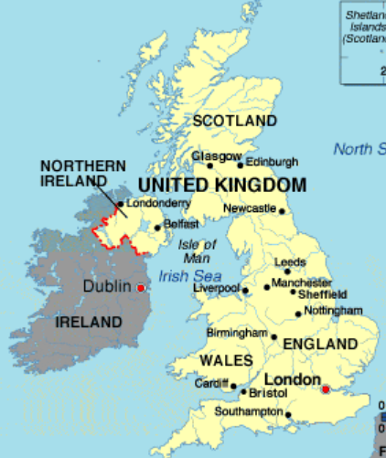

Context
13 Years working in Kent Schools, Currently Head of Lower Site, Head of Year 7, SENCO
Mainly serves one large council estate – cyclical unemployment
Merger of 3 local secondary's, one of which was considered worst performing in the country.
59% PPG

Slide 40

National trend of increasing levels of need.
Context
2016 - 14.4%
2020 - 15.5%
 | Year 7 |  | Year 8 |  | Year 9 |  | Year 10
 | On Roll: 196 |  | On Roll: 195 |  | On Roll: 150 |  | On Roll: 155
 | No. | % | No. | % | No. | % | No. | %
Non-SEN | 139 | 69.4% | 144 | 73.8% | 111 | 74.70% | 118 | 77.70%
SEN | 57 | 30.6% | 51 | 26.2% | 39 | 25.30% | 37 | 22.30%
E | 13 | 6.6% | 11 | 5.6% | 8 | 5.3% | 3 | 1.9%
K | 47 | 24.0% | 50 | 25.6% | 24 | 16.0% | 16 | 10.3%
PP | 112 | 57.1% | 108 | 55.4% | 85 | 56.7% | 80 | 51.6%

Slide 41

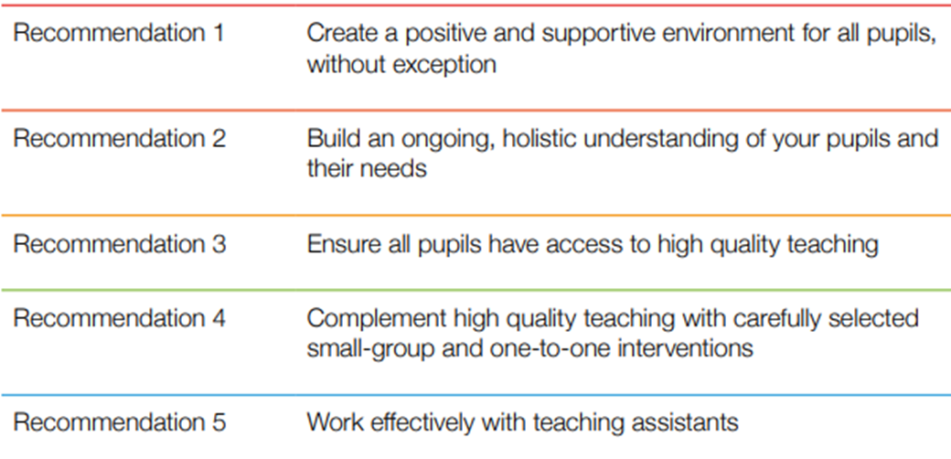


Whole school approaches

Slide 42



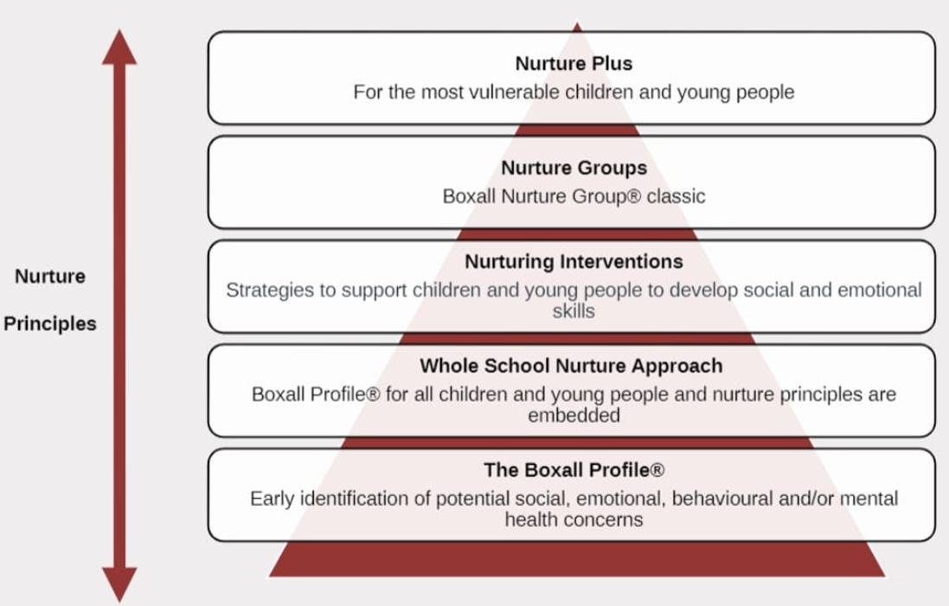
Whole school approaches - Nurture
How does the school ensure consistent management of behaviour?

Slide 43
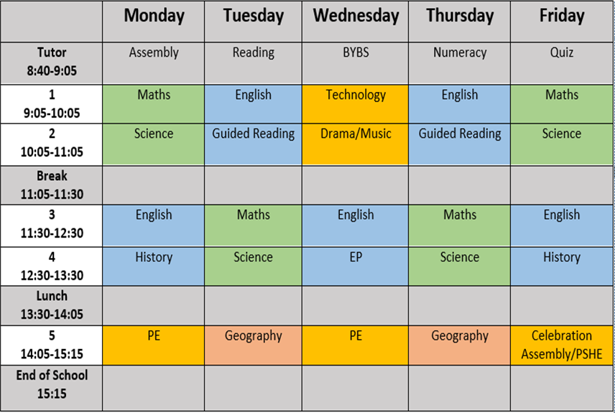
Whole school approaches – Curriculum
What measures do you use to make sure that your curriculum is designed to meet the needs of all learners?

Slide 44
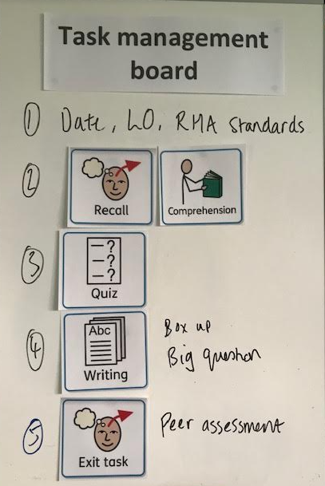

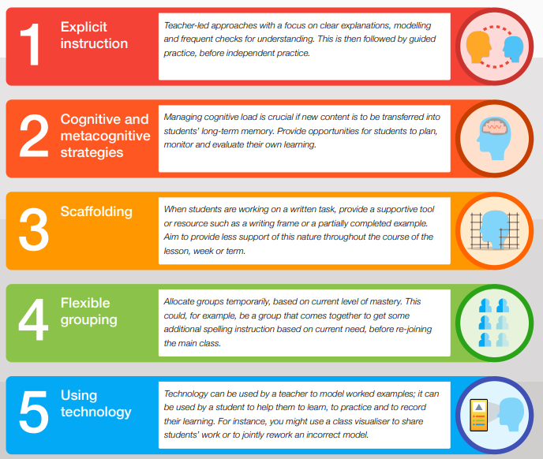

Whole school approaches – Universal strategies

Slide 45
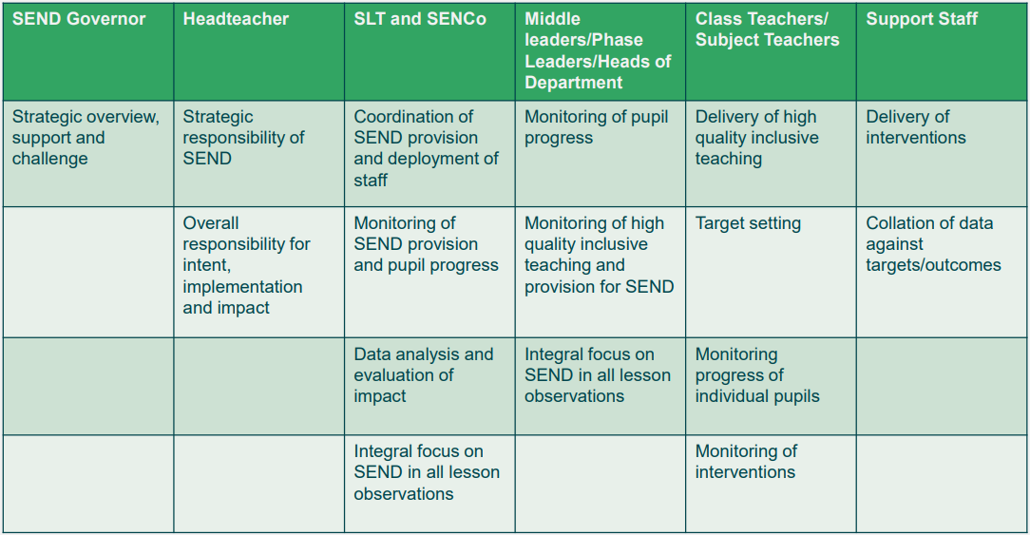
Distributed leadership

Slide 46

Whole school approaches - Mainstream core standards
What have you done to improve the quality of teaching and learning for pupils with SEN and/or disabilities in your school?
Expectations of all schools
Section one outlines the expectations on all schools, according to the needs of the child/young person. Broadly speaking much of this section will be an integral part of the school’s provision for all children.
Section two outlines some of the practices and adaptations that are part and parcel of Quality First Teaching (QFT): the inclusion of all pupils in high-quality everyday personalised teaching. The provision and strategies outlined in this section may be required for children and young people with SEN and/or disabilities but will undoubtedly be of benefit to many of the learners in the school.

Slide 47
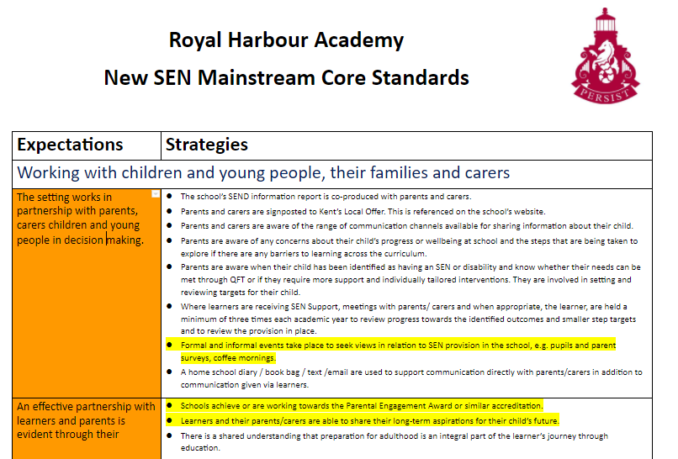
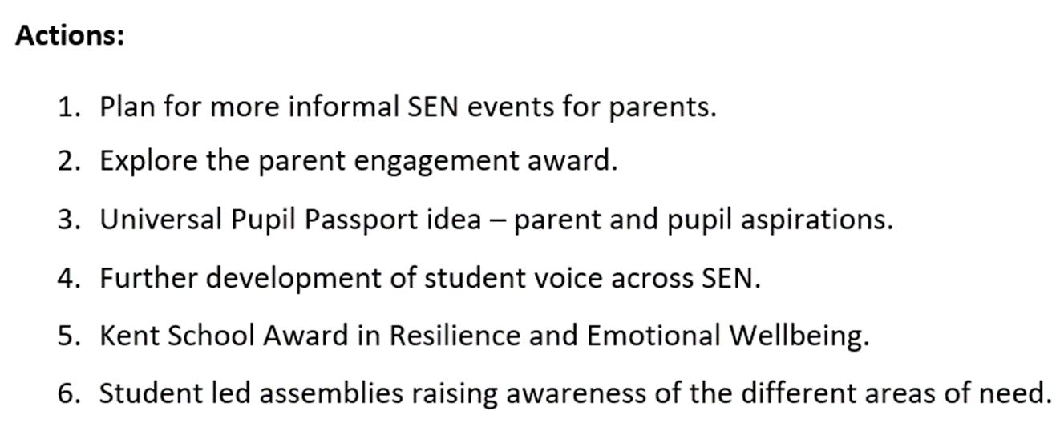
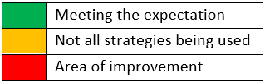
Whole school provision
RAG each expectation

Slide 48
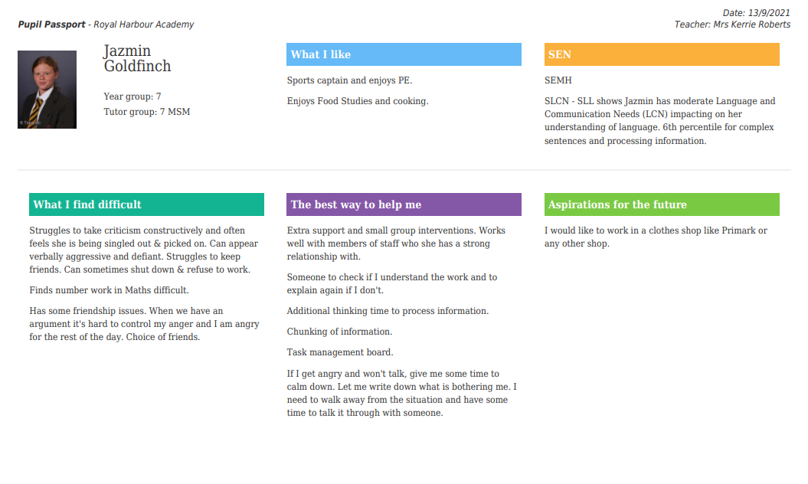


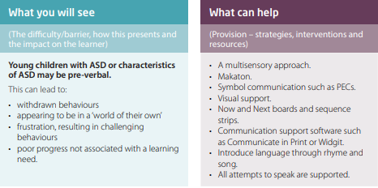
In class provision
Pupil Passports

Slide 49
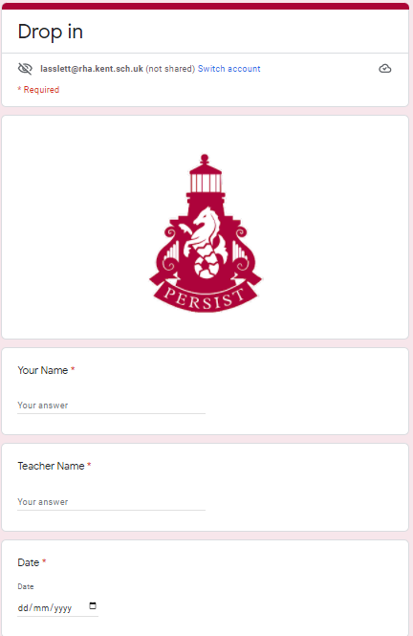
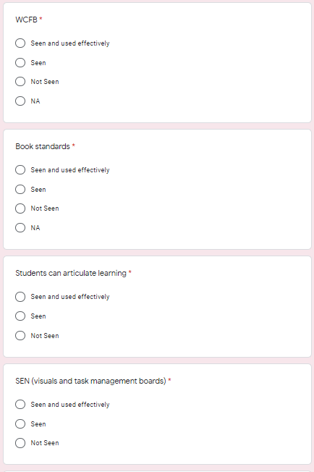
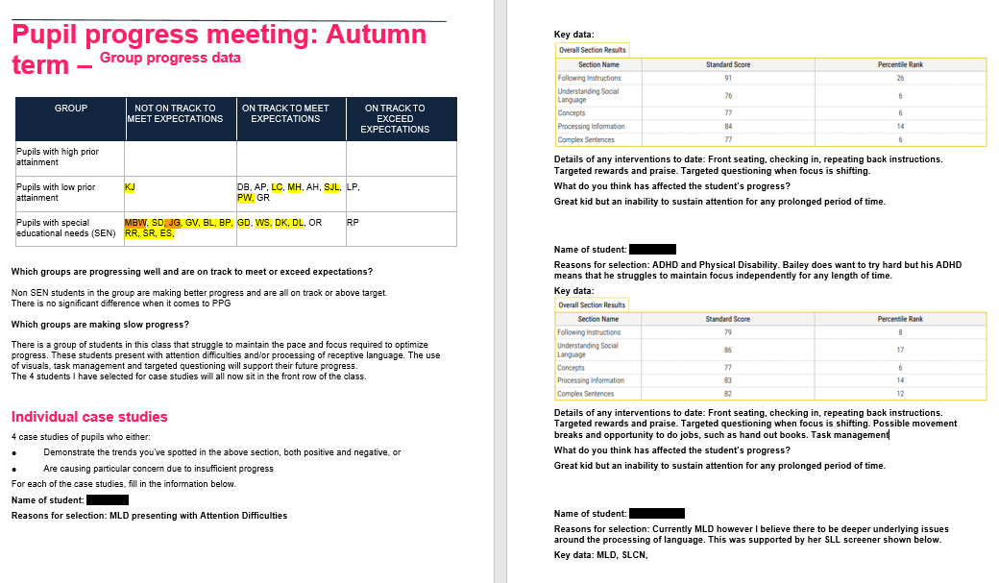
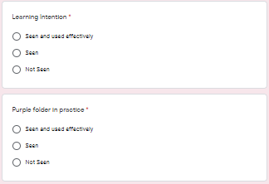

Quality assurance
SEN Focus

Slide 50
Breakout Rooms - Questions
Does your School Improvement Plan have a strategic priority related to SEND?
How do you ensure that your curriculum meets the needs of all students in your school?

Slide 51
KAH update
Mike Walters
Chair of Kent Association of Headteachers

Slide 52
Closing Remarks
All slides will be available after the briefing,
‘Who’s who in SEND’ document will also be distributed.
All feedback from the breakout rooms will be reviewed and used as valuable part of KCC planning
Next HT briefing will be later in the Spring - hopefully face to face

Slide 53

Thank you for attending
Please continue to visit the Kelsi website for key legislation, guidance and latest news and events available to educational professionals.
www.kelsi.org.uk

