Slide 1
High Needs Update

Slide 2
Finance
High Needs By;
Pupil/Student Numbers
Spend, Institution Type
Spend By Average Cost, Institution Type

Slide 3
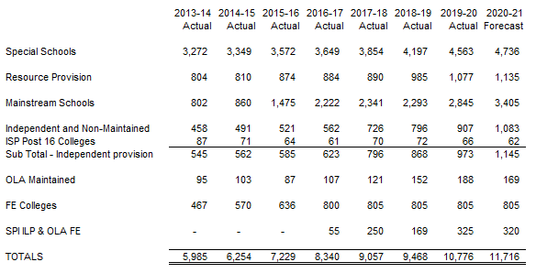
High Needs Pupil/Student Numbers
Key: OLA is Other Local Authority, FE is Further Education, SPI is Special Post16 Institutions and ILP is Independent Learning Provider

Slide 4
High Needs Pupil/Student Numbers - Mainstream

Slide 5
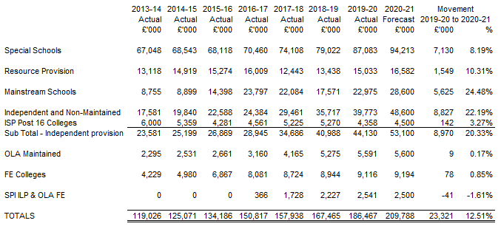
High Needs Spend – By Institution Type

Slide 6
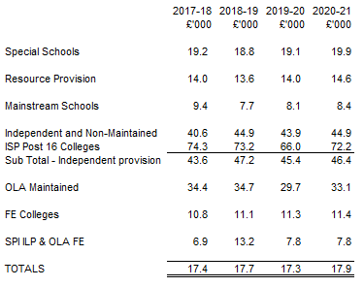
High Needs Average Cost – By Institution Type

Slide 7
SEND Improvement Programme
Delivery; Key Activities that impact the current spending

Slide 8
Delivery – Key Activities that impact the current spending
Continued focus on delivery across all workstreams throughout the Written Statement of Action
High Needs Funding Formula Review:
Special Schools Funding Review
Explore Alternative Models for Funding High Needs including use of Universal Banding System
High Needs Mainstream Top Up (for £6,000)
SRP Review
Commissioning Focus:
Independent and Non-Maintained Schools
STLS Contract
Therapy
Home Tuition
Review of 16+ Provision
EHCP Process Changes including format changes (added in Preparing for Adulthood markers to support better transitions)
Supporting schools with inclusion…..

Slide 9
Supporting Schools with inclusion £9.6m
Introduction
Activity Undertaken
Framework for support
Comprehensive Programme of Training to Support Inclusive Practice
Development of Wider School and Community Practices to Promote Inclusion
Supporting Transition for CYPE with SEND
Providing Individual Case Support
Locality Projects and Pilots
Delivery

Slide 10
Introduction
In the School Funding consultation launched in 2019, KCC proposed for 2020-21 to repeat the 1% transfer from the Schools Block into the High Needs Block, estimated at £9.8m. The Cabinet Member for Education and Skills took the decision on 15 January 2020 with the following detail:
“Unlike previous years where we have requested a transfer to help reduce the deficit, this time we want to consider a different approach. This transfer would be used to support much greater inclusion in mainstream schools. It is our intention that this funding, whilst initially retained by KCC, will be paid to mainstream schools and academies that operate inclusively. This will help to address one of the key issues highlighted by Ofsted in the Special Educational Needs and Disability (SEND) inspection of the local area earlier this year.“

Slide 11
Activity already undertaken
ISOS survey collaboration with KAH
ISOS partnership led workshops
Agreed RSC support
Initial County Reference Group meeting
Initial peer to peer training.
Ongoing mapping of services and
Consultation on the inclusion toolkit and the Core Standards, schools and parents.
Review of inclusion data
Feedback from guided conversations and school improvement Deep Dives.

Slide 12
Activity since previous funding forum.
Collated and mapped all the current training offer.
Launch of the Observation and Assessment Pilot.
Launched a countywide discussion on Inclusion in our Schools, focused on:
Statement of Inclusion
Inclusion Framework
Mainstream Core Standards (MCS)
System Leadership of Inclusion
Inclusion Dashboard
Parent Voice
Characteristics of an Inclusive School
https://www.kelsi.org.uk/news-and-events/news/primary/sen-inclusion-discussion-paper

Slide 13
A Framework for support
A comprehensive programme of training to support inclusive practice
Development of wider school and community practices to promote inclusion
Supporting transition for CYPE with SEND
Providing individual case support
Locality projects / pilots

Slide 14
A comprehensive programme of training to support inclusive practice
A countywide core offer provided at all levels
Delivery of a training programme rising from the development of the countywide approach to inclusion, including for example: training on core standards, whole school nurture, NQT and Governor training.
The current offer has been mapped and is undergoing a quality assessment to identify:
Gaps in relation to the Mainstream core standards and the proposed Inclusion framework
Quality and impact of delivery.
Current access and Attendance
A core offer of training for all schools will provide:
Twilight and E- learning workshops on the Inclusion framework, the mainstream core standards and what good inclusive practices are in schools.
Training on successful peer to peer systems and relationships.
Additional modules on inclusive practices are to be included as part of NPQ suite of qualifications at all levels, middle and senior leadership, Head teacher and Executive.
Lead professionals will be trained as Inclusion Leaders of Education, as part of the KLE programme and support and facilitate peer to peer clusters.

Slide 15
A comprehensive programme of training to support inclusive practice
Specialist training for specific needs
For example: ASD and Communication and Interaction needs, SEMH, Mental Health, Emotional Literacy
Specialist providers, including STLS, will be commissioned to deliver training in the areas outlined by the Inclusion framework and Mainstream Core Standards, these will provide a directory of support for schools to access as identified in their improvement planning.
Targeted training and support
Targeted training and support to individual schools and settings where there is an assessed need - individual action plans
Subsidies will be considered, especially where the training is supporting countywide priorities or a specific targeted need, identified by the Inclusion Leaders of Education through their work with schools.

Slide 16
Development of wider school and community practices to promote inclusion
Development of systems and structures supporting inclusion and the sharing of good practice
Forums and execs, for example Lift, IYFA, Inclusion steering groups, how do these work collaboratively with other groups to ensure a countywide approach and drive.
Early work has begun to look at the alignment of the various inclusion forums across the county.

Slide 17
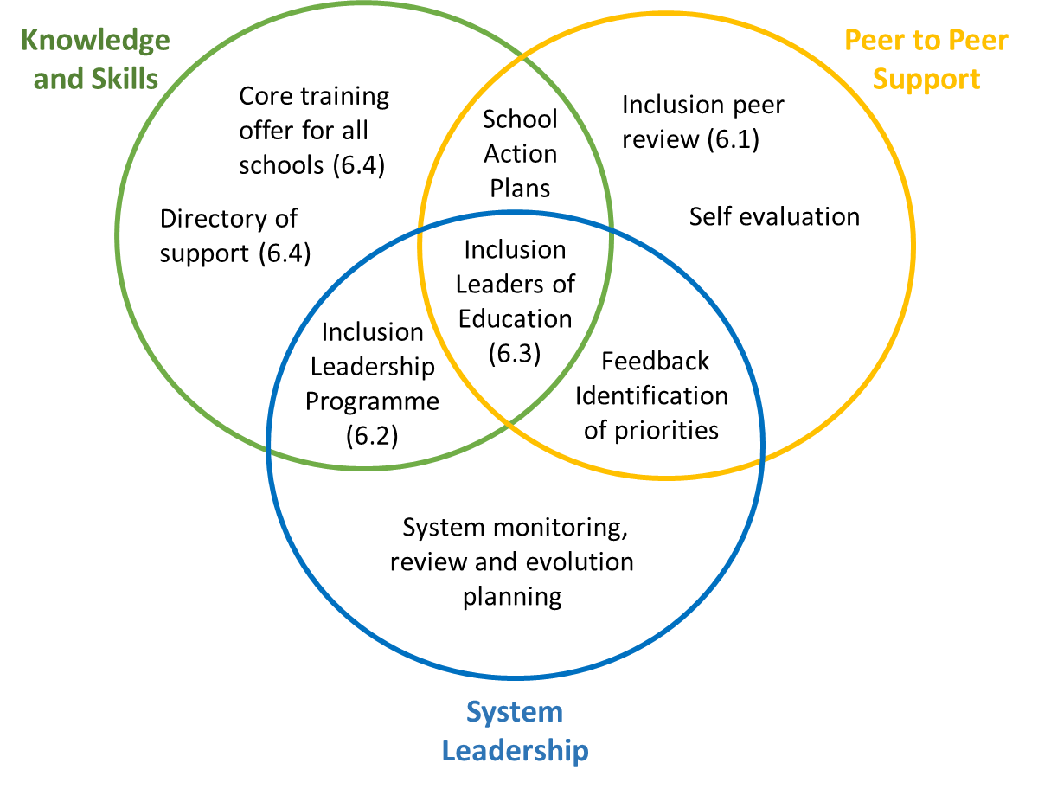
Development of wider school and community practices to promote inclusion
A system of school to school peer support
Currently being discussed, in partnership with KAH:
Inclusion Peer Review –operating in clusters of 6, schools are supported in engaging with self evaluation and peer review, based on the agreed inclusion framework.
Inclusion Leadership Programme - Building on the local delivery of NPQs for middle and senior leaders, Headteachers and Executive Leaders we propose to introduce a new leadership development programme – Inclusion Leadership
Inclusion Leaders of Education
A key feature of a self-improving system is the presence of leaders from the system with capacity to support their peers in leading change and improvement.

Slide 18
Supporting transition for CYPE with SEND
Early Years to Primary
Roll out the current pilot Year R Observation and Assessment (O&A) provision in similar lines to present nursery O&A, across the county
Year 2 to Year 3 (where applicable)
Primary to Secondary
Post 16 /Post 19
Early identification of support
Transfer communication and planning, induction and transition programmes
Development of appropriate provision
Supported employment

Slide 19
Providing individual case support
Individual case support
Specialist advice to schools on individuals
Specialist support to aid integration of CYP with an EHCP
Critical case support - providing immediate crisis support to prevent the escalation of issues and resource.
Speedier intervention where there is a crisis need.
A mechanism to fund local collaboration pilots which further the inclusion agenda.
Recognising the need to support collaborations in the development of local solutions and supporting schools innovation and creativity in the development of these.

