Slide 1
30 Hours of Free Childcare Kent Seminars June 2017

Slide 2
30 Hours of Free Childcare Kent Seminars June 2017
Welcome
and
Introductions

Slide 3
Agenda
General Update
SEN Inclusion and Disability Access Funds
Kent Provider Agreement highlights
Processes and systems for claiming funding, eligibility checking and the Grace Period
Opportunity for Questions
Slides available on Kelsi at the end of June

Slide 4
Ways to ask questions
In this seminar
Post-its on the flip chart
Your Childcare Sufficiency Officer
Prospects
30HoursFreeChildcare@Kent.gov.uk
Please always read the 30 Hours of Free Childcare Bulletin (last Friday of each month)

Slide 5
General Update
National
Additional Operational Guidance
Kent
Provider and Parental Surveys
March Seminars ‘Good ideas’
30 Hours of Free Childcare Local Partnerships

Slide 6
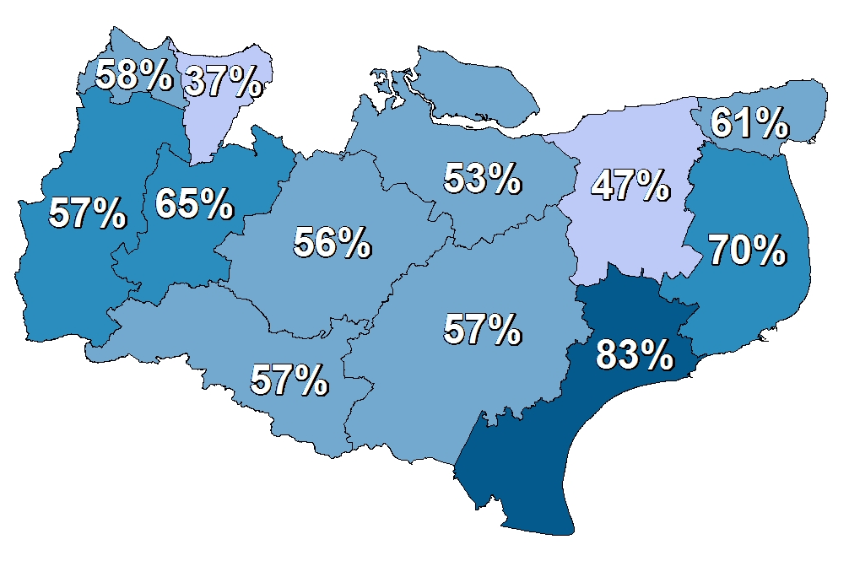
30 Hours Provider Survey
RESPONSE RATE
59% of Childcare providers in Kent have responded to the survey
78%
35%
Childminders
Establishments
All completed surveys up to 17th May 2017

Slide 7
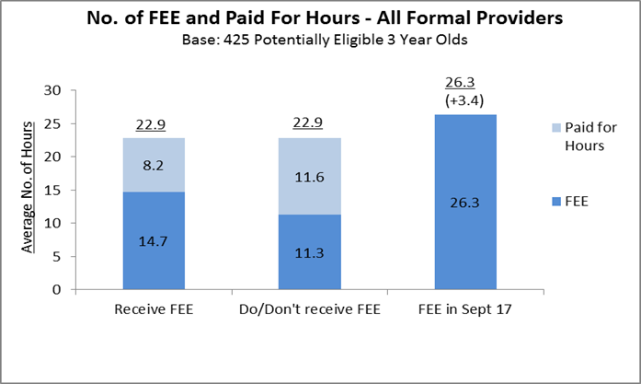
High level of awareness of increase to 30 hours amongst eligible parents
Increase in FEE will result in increased usage of Formal Childcare of 3.4 hours per eligible child per week overall
Greatest demand increase will be in Pre-school/Playgroups (up from 17.5 hours to 24.4 hours). Most expect to use in same setting

Slide 8
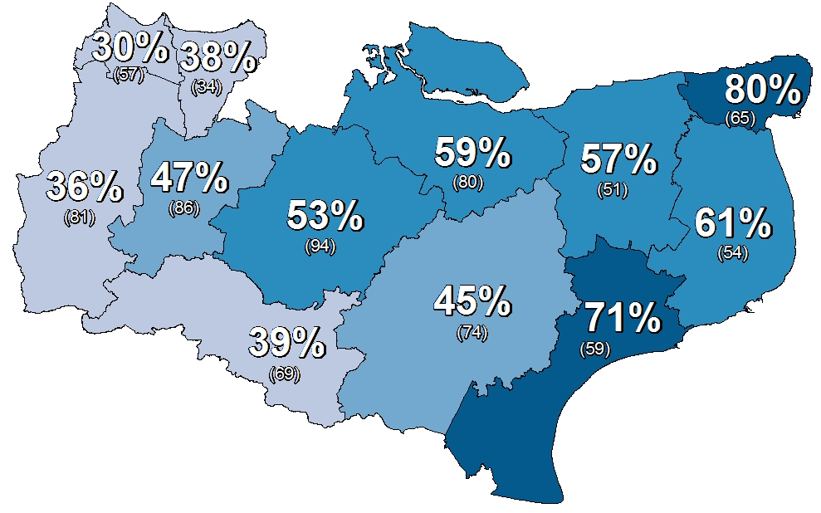
30 Hours Provider Survey
CONSIDER OFFERING THE 30 HOURS FUNDING
51% of Childcare providers in Kent said YES they are considering offering the 30 hours of nursery funding
30% said NO
19% didn’t know
Numbers in brackets are total survey responses
All completed surveys up to 17th May 2017

Slide 9
30 Hours of Free Childcare Local Partnerships
Good communication
Information sharing
Facebook pages
Share resources
Group settings working with childminders
Term time settings working with holiday provision
Proactive communication with parents
Know and maximise use of your USP

Slide 10
30 Hours of Free Childcare Local Partnerships
Many providers expressed an interest in being involved and gave permission to share their details
In the process of collating into local groups
Group information to be emailed out to everyone in the group
Kent 30 Hours of Free Childcare Toolkit
Transition – Focus on 30 Hours of Free Childcare

Slide 11
Special Educational Needs Additional Funding
30 Hour Briefing Sessions

Slide 12
Special Educational Needs Inclusion Fund (SENIF)
Disability Access Fund (DAF)

Slide 13
SENIF
Statutory requirement for SEN Inclusion Fund for 3 and 4 year olds in all authorities from April 2017
Implementation of extended entitlement (30hrs)
No scope to increase the SEN budget in Kent

Slide 14
How to apply
All forms and guidance will be available on KELSI and must be completed electronically, attached to a secure email and sent to SENIF@Kent.Gov.Uk and copied to the Early Years Specialist Teacher or Portage worker involved with the child.
If a secure email isn’t available, paperwork must be sent by recorded delivery to the County SENIF Funding Officer and EY STLS or Portage.
If you don’t have but require an EGRESS account please email karen.mckinley@kent.gov.uk

Slide 15
Key changes
SENIF funding, if agreed, will usually be for 1 year and paid monthly directly into setting bank accounts - no need for invoices
Applications can be made at any time in the year, there won’t be any deadline dates. Applications will be considered as they are received.
County SEN Inclusion Funding Officer
Early Years SENIF Practitioners.
Early Years SENIF Monitoring Officers.
Introduction of termly Early Years Multi Agency Planning meetings (MAP) to coordinate and plan additional support for settings supporting children with SEND.

Slide 16
September 2017
Paperwork can be submitted at any time and if eligibility criteria is met funding will be agreed from the following month and paid monthly.
MAP Meetings will take place in the penultimate week of the term and settings notified of additional support / training via the Specialist Nursery Practitioners.

Slide 17
Disability Access Fund (DAF)
Disability Access Fund introduced from April 2017 to support children with disabilities or SEN who are in receipt of Disability Living Allowance (DLA)
An annual payment of £615.00
Aids access to early years places by supporting providers in making reasonable adjustments to their settings (Equality Act 2010)

Slide 18
Eligibility for Disability Access Fund
DAF funding is paid to one childcare provider as a one-off payment
One childcare provider nominated by the parent
If the child moves to another childcare provider during the year then the DAF funding is not transferable

Slide 19
Claiming the DAF
Parents must complete claim form and return to childcare provider
Setting needs a copy of the child’s Disability Living Allowance letter of confirmation
The childcare provider will keep a copy of the form and DLA confirmation letter as proof of eligibility
The setting must email both documents to:
eyfe@kent.gov.uk or send by recorded delivery to: Management Information, Kent County Council, 2nd Floor, Invicta House, Maidstone, ME14 1XX to claim the funding.

Slide 20
Provider Agreement
Sent out in Draft Thursday 26 May 2017
Currently with KCC Legal Services
Final version expected imminently

Slide 21
What’s new or different in the Provider Agreement
Checking validity of codes for 30 hours
Minimum session length
Polling days and other closures
Refundable Deposits
QTS and EYTS supplements
One funding pattern

Slide 22
Highlights from the Kent Provider Agreement
Providers must sign the declaration
Providers can choose to offer one or all of the entitlements
The new declaration form will have tick boxes for each entitlement
Providers do not need to be open for 30 hours to be part of the 30 hour offer

Slide 23
Key Provider Responsibilities
Comply with all relevant legislation and insurance requirements
Safeguarding
Consistency across 15 and 30 hours
Clear communication with parents
Update information at least three times a year

Slide 24
Key Provider responsibilities continued
Support children with SEND
Clear approach to identifying and responding to SEND
Deliver effective support through the SEN Inclusion Fund and Disability Access Fund
Make information available to parents about your SEND offer

Slide 25
Free Early Education
Free Early Education is the:
Two year old Entitlement
Universal Entitlement
Extended Entitlement

Slide 26
Patterns of delivery
Providers must publish their totally free 15 and 30 hour patterns
Providers must make clear in their Fee Structure how they deliver Free Early Education and what they charge for optional activities outside of the entitlement

Slide 27
Charging
Government funding is intended to cover the cost to deliver 15 or 30 hours a week of free, high quality, flexible childcare.
It is not intended to cover the cost of meals, consumables, additional hours or additional services
KCC requires providers to ensure that where it is reasonably practicable and wherever possible, children are able to take up their free hours in continuous blocks and avoid artificial breaks being created throughout the day, for example over the lunch period.

Slide 28
Delivery requirements
Eligibility checked for all Free Early Education
Evidence kept
Data protection
ICO registration
Parental Declaration Forms
No enforced settling in periods

Slide 29
Eligibility Checking
Parents and Providers

Slide 30
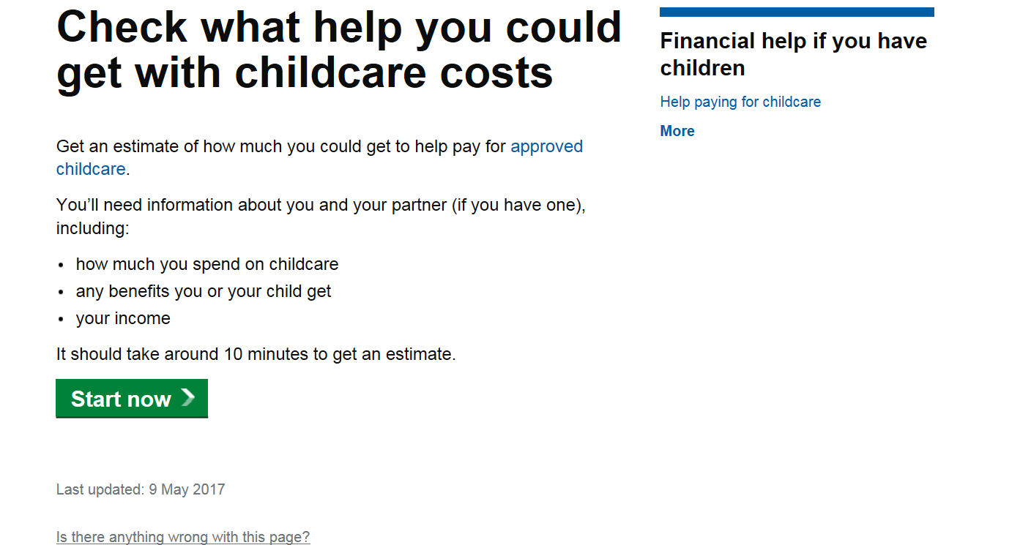
Eligibility - parents
The government is introducing new ways to help parents with childcare costs.
Whether you have toddlers or teens, you could get support.

Slide 31
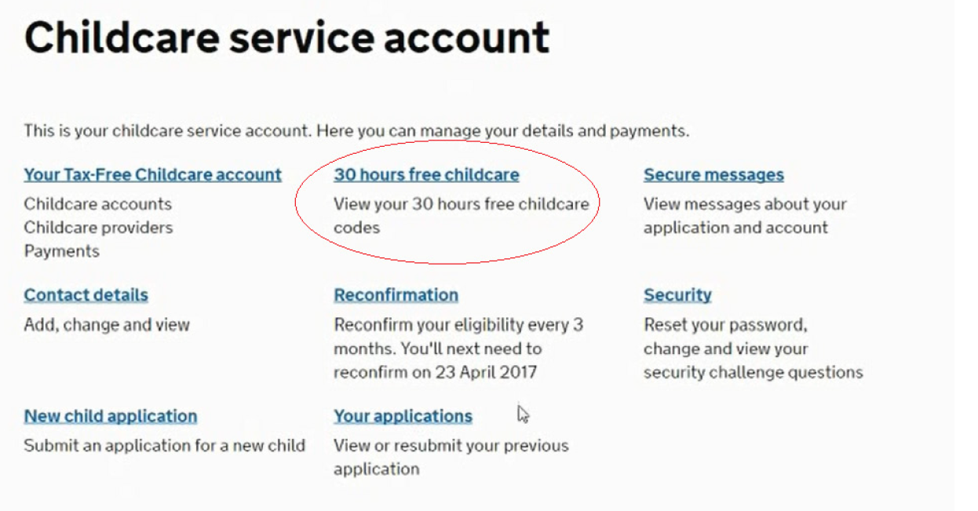
Eligibility - parents

Slide 32
Customer Interaction Centre
0300 123 4097

Slide 33
Eligibility - parents

Slide 34
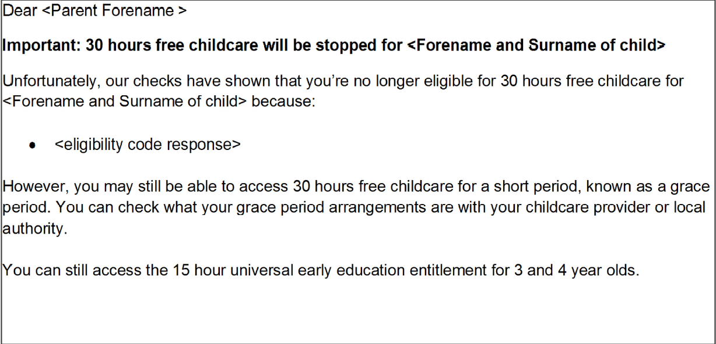
Eligibility - parents

Slide 35
The Grace Period
The Grace Period only applies to the Extended Entitlement
Providers will be notified by KCC when a child is entering their Grace Period
When the Grace Period has expired children will revert back to their 15 hours of Universal Free Early Education

Slide 36
Review of Systems
KCC has procured a new ICT system called Synergy which is designed to work with HMRC and the DfE’s Eligibility Checking System (ECS)
Between June and August 2017 Management Information will be testing this system

Slide 37
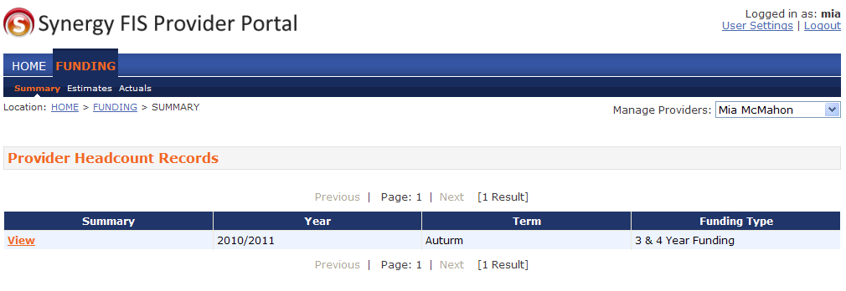
What does this mean for you?
When testing is complete, you will be given access to the Synergy Provider Portal.
MI Nursery
Autumn

Slide 38
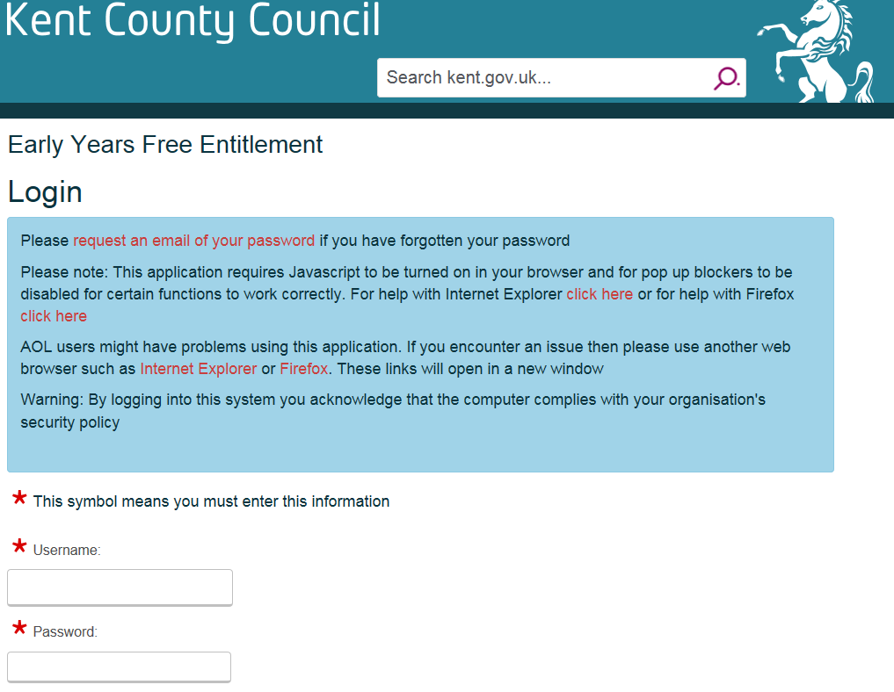
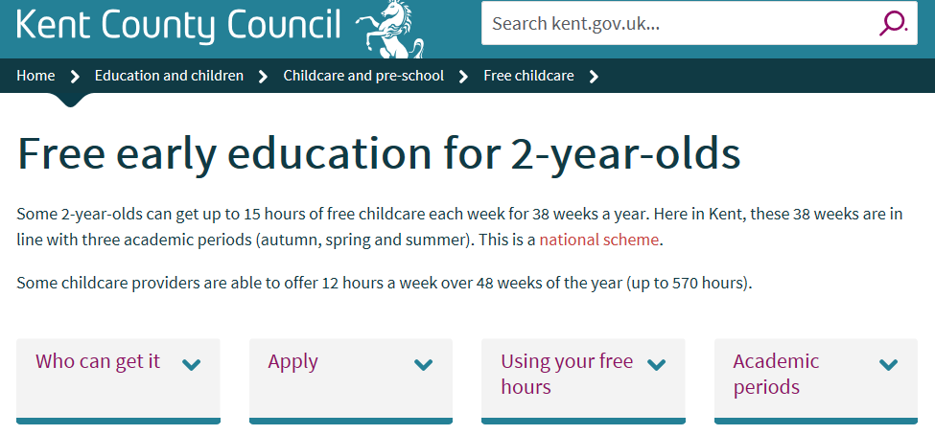
This portal will replace the Free for Two process and the Early Years Web 3 & 4 year old funding claiming websites
This means the submission of your estimate/headcount and Free For 2 claims will be in one place and will remain as a record for you to refer to at a later date

Slide 39
The Synergy system will also include the 30 Hour Funding and Early Years Pupil Premium
Management Information will communicate further details as soon as implementation and testing is completed by;
Sending emails to your nominated Early Years Web and Free For 2 contact.
Updating our Kelsi webpages with the latest guidance.

Slide 40
30 Hours – Interim Checker
To allow you to start checking codes, Management Information will introduce an interim 30 hour eligibility checker

Slide 41
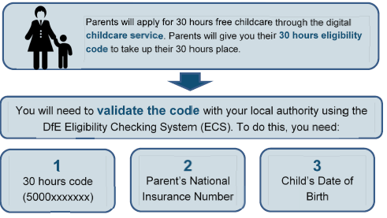
30 Hours – Interim Checker

Slide 42
30 Hours - Interim Checker
KCC’s 30 Hours of Free Childcare Interim Checker will go live on 26th June.
You can access the checker via the KELSI website on the Free Early Education for 3 to 4 year olds page:

Slide 43
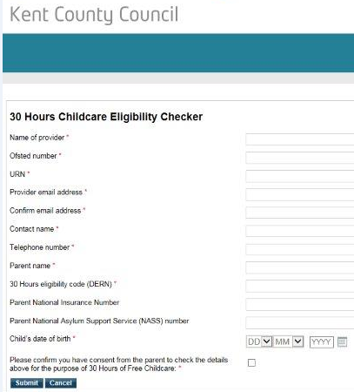
30 Hours - Interim Checker

Slide 44
30 Hours - Interim Checker
Once a check has been submitted, you will receive an on screen response thanking and informing you it has been sent to Management Information.
It is at this point you can print a copy of the form for your records if you wish to do so. You will also receive an email confirming submission.

Slide 45
Eligible Result
Management Information will then complete a check and will email you with either an ‘Eligible’ result or a ‘Not Found’ result.
The ‘Eligible’ email will provide you with the start date, end date and grace period end date.
The ‘Not Found’ email will contain information as to why the check has not produced an eligible result.
Once you have received an eligible result back, you can secure a place for the child in your setting.

Slide 46
KCC Auditing of Eligibility Codes KCC will audit eligibility codes at six fixed points in the year as below

Slide 47
The Grace Period
Enables parents to retain their child’s place for a short period if they become ineligible
Parents reconfirm every three months
3 dates attached to each code which only KCC and the provider sees
ECS automatically assigns grace period end dates to every eligibility code
When KCC audits the codes six times a year they will inform providers which children are in their grace period and for how long

Slide 48
Ineligible for the Grace Period
Child will be four years old before next term and will be starting reception
The parent’s code was issued on 7th April and the child’s fourth birthday is on 7th May.
The provider should explain to the parent that as their child will be starting full-time reception in a maintained school or academy from September the child will not be able to claim 30 hours with that provider from September as they cannot claim 30 hours in addition to reception

Slide 49
If you have any questions regarding the eligibility checking system please email eyfe@kent.gov.uk
If you would like be part of the Synergy testing process and you are available throughout July/August 2017, please email; eyfe@kent.gov.uk and a member of the Synergy project team will be in contact.

Slide 50
Sufficiency and Sustainability sufficiencyandsustainability@kent.gov.uk Equality and Inclusion eyinclusion@kent.gov.uk
Prospects Services ProspectsEYS.Kent@prospects.co.uk
30HoursFreeChildcare@Kent.gov.uk

