Slide 1

Headteacher Meetings
Education and Young People’s Services

Slide 2

Key priorities and service developments
EYPS Vision and Priorities for Improvement 2016 – 2019
Vulnerable Learners Strategy
NEETs Strategy
Early Help Strategy and Three Year Plan
Education Commissioning Plan Update
School Improvement Strategy
Government direction of travel in relation to Academisation, Education and Adoption Act, reductions in ESG and White Paper

Slide 3
Proposed Education Trust
Patrick Leeson, Corporate Director

Slide 4
What Does the Future Look Like?

Slide 5
Background
Autumn Headteacher briefings
Discussion at KAH meetings
Meetings with Headteachers on13 January and 26 February
An options appraisal and outline business case developed

Slide 6
Future service delivery
Sustain and develop education services in Kent, avoid future fragmentation
Continue with strong focus on improving educational outcomes
Most impact when we act in partnership with schools and bring together our combined resources
Separate legal entity provider with more freedoms

Slide 7
Strategic context
Schools in Kent have been improving for the last five years
The education landscape is changing rapidly, with more academy schools, role of the RSC etc
LAs are having to reassess their role in delivering education and young people's services
Two thirds of LAs considering different business operating models
Want to secure the future of a quality service to schools and continue to achieve positive outcomes for the children and young people

Slide 8
Service scope option 1
School Improvement
School Improvement team
Governor training and clerking
Targeted intervention funding
CPD
Expanded traded service

Slide 9
Option 1 - benefits
Achievable, proven and tested model
Could deliver more school improvement capacity through trading and less funding from KCC
Link easily to the work of the Regional Schools Commissioner re statutory work, school interventions and academy conversion and sponsorship

Slide 10
Option 1 – risks / issues
Limited option with small scale
Could have to become dependent solely on income generation if government policy develops as we believe it will
Creates silos with other parts of the Education service
Small scale may make this less appealing or interesting to schools

Slide 11
Service scope option 2
All of option 1 (School Improvement) PLUS
SEN
Admissions and transport
Early Years and Childcare
Skills and Employability
Community Learning and Skills
Education Psychology service
EduKent
AEOs and School Place Planning
Children missing education / elective home education

Slide 12
Service scope option 3
All of Option 2: School Improvement / SEN / EduKent /
Admissions and transport / Early Years and Childcare /
Skills & Employability / Community Learning & Skills /
Education Psychology service / AEOs and School Place planning / Children missing education / elective home education - PLUS
Education safeguarding
Attendance and inclusion
PRUs
NEET support
Education element of Management Information

Slide 13
Option 2 and 3 benefits / risks
The increasing size of options 2 and 3 give the obvious benefits of scale, coherence, integration and resilience.
Resembles a lot of current service delivery
But the options either split education functions or split Early Help

Slide 14
Service scope option 4
All of Option 3: School Improvement / SEN / education element of MI / Admissions and transport / PRUs /
Early Years and Childcare / NEET support /
Skills & Employability / Community Learning & Skills /
Education Psychology service / EduKent /
Education safeguarding / Attendance and inclusion PLUS:
Early Help
Youth services and Youth offending services
Troubled Families
Children’s Centres
Early Help teams and commissioned services

Slide 15
Option 4 benefits
Strengthens the current partnership arrangements with schools
Critical mass / economies of scale
Early Help included to strengthen joined up work with schools in supporting vulnerable learners and families
Opportunity to maintain the integrity of existing service configuration
Promotes further integration of services and the cross fertilization of ideas and practice

Slide 16
Option 4 benefits contd.
Increased menu of services which directly respond to schools, pupils and families’ needs
A vehicle for the future growth and expansion
Encourages innovation
Coherence and continuity with current ways of working and delivery of services

Slide 17
Option 4 risks / issues
Potential separation of Early Help from Specialist Children's Services
More services could be affected by the failure of the company to deliver
Puts more demand on KCC commissioning and contract management
Within a separate body, Early Help could be more vulnerable for potential budget reductions

Slide 18
Service scope option 5
All of Option 4: School Improvement / SEN / Admissions and transport / PRUs / Early Years and Childcare / NEET support /
Skills & Employability / Community Learning & Skills /
Education Psychology service / EduKent /
Education Safeguarding / Attendance and inclusion /
Youth services / Youth offending services /
Troubled families / Children’s centres / MI
Early Help teams and commissioned services PLUS
Specialist Children’s Services (Children’s Social Care)

Slide 19
Option 5 benefits and risks
Option 5 has all of the benefits of option 4 and could be argued that it enhances option 4.
However, the risks of taking on the whole of the specialist children’s service outweigh the benefits at this stage

Slide 20

Legal entity options
Charitable Trust (unincorporated)
Industrial Provident Society
Charitable Incorporated Organisation
Community Interest Company
Company limited by shares
Company limited by guarantee
Company limited by guarantee with charitable status + wholly owned trading entity (Co ltd by shares)

Slide 21
Vehicle Option 3
Feature | Specifics
Flexibility | Commercial T&C Can attract specialist expertise to act as Trustees(Directors)
Funding | Can raise loan capital and can apply for funding streams available to charities Cannot raise share capital
Governance & Control | Articles of Assoc/Guarantors agreement Schools can have Board membership Trustees must act in best interests of charity
Taxation (CT & VAT) | No corp tax on surplus in NewCo. Trading must be through subsidiary that will pay CT, but can gift aid to NewCo to remove tax liability Irrecoverable VAT could be additional cost Possible business rates benefits
“Return” to owners | NewCo Cannot make dividend distributions Making returns to contributors is difficult
Regulation | Companies House, HMRC, Charities Commission, other advisors particularly tax, legal & pensions
KCC (guarantor)
Schools (guarantors)
Company Limited by Guarantee (NewCo)
(Charity Status)
Company Limited by Shares
(Trading; non charitable)
Legal have confirmed
Teckal compliance i.e. guarantors can award work to NewCo without public procurement process
NewCo can purchase services from KCC/schools without proct process
NewCo can undertake statutory functions on behalf of KCC
Notes:
Outstanding risks/points to note
NFP structure
Charitable status will depend on Charities Commission view on how constitutional documents phrased etc. But fact that BLT has done this is a good indication.
The burdens do not outweigh the potential benefits
Academies can be controlling and won’t affect Teckal status
Definition of how the control actually equates in practice in order to ensure Teckal compliance
Quantification of pensions bond, VAT issue etc dependent on scope agreed.
80/20 issue is a problem ie if turnover of non owners exceeds 20%. Mitigation is to ensure that if sign up new customers then the become guarantors also. Difference here is that that if all trading done in CLS, then the only 20% that will be relevant will be the sales from New co to trading subsidiary. So this will definitely be worth exploring.
Buying support services – can do though there is risk due to Counsel advice as not 100% owned by LA. Hamberg exception may help as this is NFP
The NewCo would need to sell to the CLS the support services that it needs to undertake traded services. Would be useful to make new staff employed by the trading company over time to reduce sales from charity to trading company.
In my view this needs specialist charity lawyer advice but would not suggest till get OK to progress to final business case.

Slide 22
Governance
Schools and other bodies
Cabinet
NEWCO
Delivering services
NEWCO
KCC
Strategic Commissioning Board
Board of directors / trustees
Schools / KCC
Education Strategic
commissioning board
Senior Management Team
CONTRACT

Slide 24
Timetable
March 2016 – outline business case
June 2016 – first draft of full business case
August 2016 – final business case
October 2016 – KCC “decision” for establishment of alternative service delivery vehicle (ASDV)
October 2016 – establish shadow board and ASDV
April / Sept 2017 – ASDV goes live.

Slide 25





Education and Young People’s Services
Kent’s Strategy for Vulnerable Learners
2016-2018

Slide 26
Vulnerable Learners Strategy
2016-19
The Vulnerable Learners Strategy brings together:
The actions we are taking in partnership with schools to improve outcomes for vulnerable and disadvantaged children and young people
Examples of good practice in schools
Strategies that are having some impact in narrowing achievement gaps and promoting greater social mobility.

Slide 27
The principles
To bring together and strengthen activities currently in place to support vulnerable children and young people
To challenge existing systems and structures to do more
Across Kent, there are significant gaps between the attainment of the majority of children and young people and those from particular groups that are vulnerable to underachievement and these gaps remain persistently wide.
These poorer outcomes are unacceptable.

Slide 28
The challenges in Kent
In 2015
27% of children did not achieve a Good Level of Development at the end of the Early Years Foundation Stage
27% of learners who were in receipt of free school meals obtained 5 A* - C grades, including English and mathematics, at GCSE compared to 61% of those who are not
Learners in receipt of free school meals are nearly six times as likely to be permanently excluded as those who are not
30% of the NEET cohort in January 2016 were vulnerable learners
14% of FSM learners in school gained entry to the top third Higher Education Institutions (HEIs) compared to 30% of non-FSM.

Slide 29
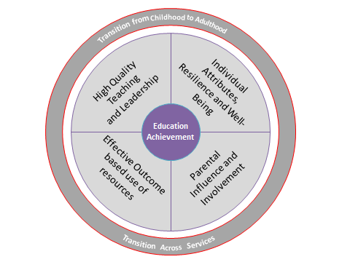
Key factors that influence children’s development, progress and educational achievement:
Individual attributes, resilience and emotional well-being
Parental influence, support and involvement
High quality teaching and school leadership with moral purpose
Effective use of resources to improve outcomes.

Slide 30
Who are vulnerable learners
For the purposes of developing this strategy vulnerable learners are
Children in Care and Children in Need
Pupils who receive the Pupil Premium Grant
Pupils with Special Educational Needs and Disabilities
Children who qualify for a free place as a two year old and for the Early Years Pupil Premium at age three and four
Young Carers
Young people Not in Education, Employment or Training (NEET)
Pupils missing education through prolonged or persistent absence and those excluded from school
Pupils at risk of sexual exploitation
Pupils with mental health issues
Pupils from disproportionately affected ethnic minority groups

Slide 31
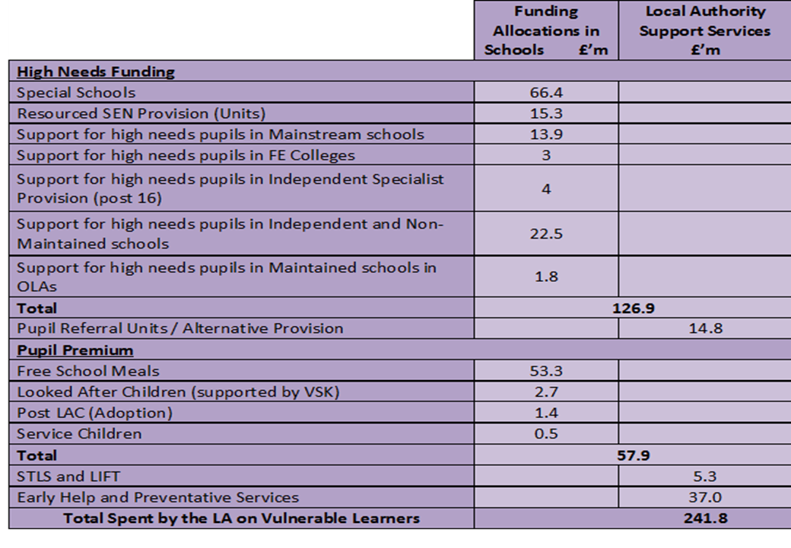
Resources for Vulnerable Learner Support in Kent
Significant resources are allocated to support vulnerable learners across the county. 184 million is allocated directly to schools and colleges and a further 20.1 million is used to deliver early interventions and specialist support services.
Funding for vulnerable learners for 2015-16 is given below.

Slide 32
“Great schools are great schools for all children”...
‘The Pupil Premium – next steps’
Sutton Trust, July 2015

Slide 33
Use of Pupil Premium - Outcome based, effective use of resources
Since 2011 – Pupil Premium has added an additional resource to support the work of an inclusive school and accelerate the impact on achievement for disadvantaged learners – to make the best use of it Leaders need:
accurate and timely data analysis
tracking systems to identify need and monitor progress
informed target setting to close the attainment gap

Slide 34
Evidence from the Sutton Trust and Education Endowment Fund shows that significant improvement in narrowing the gap can be made when schools target funding towards:
Improving feedback between teachers and learners
Paired teaching
Flexible small group teaching
One to one tuition
The teaching of independent learning strategies
Peer mentoring and assessment
Active encouragement of parental involvement in learning

Slide 35

In Kent – case studies of effective practice leading to impact are included in the strategy.
The Education Endowment Foundation’s Toolkit
highlights best value/high impact practice, ‘best
low cost proven approaches’ in particular “ “feedback
between teachers and pupils” and “peer to peer tutoring”
91% of school leaders saw the high correlation between
family engagement and family interaction and attainment at school but only 57% had an intervention in place to address this concern.

Slide 36
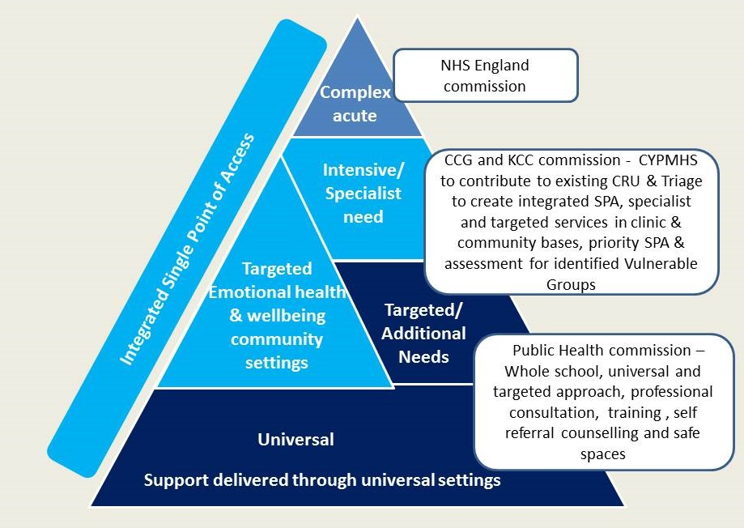
Early Help and Preventative Services
Individual and personalised pathways for Emotional Health and Wellbeing - ensuring a whole system approach
Notes:
Developing individual and more personalised learning pathways supported by approaches that address emotional well-being and barriers to learning.

Slide 37
Early Help and Preventative Services
Supporting parental engagement and involvement throughout child’s learning journey
Promote the importance of early parental involvement in children’s learning that builds foundations for future engagement
Parents active in District advisory boards and other community involvement and volunteering
Systemic family casework – Signs of Safety
Building Family strengths and resilience - not reliance
Parenting Programmes that focus on attainment as well as behaviour
Challenge where change is not taking place – use of parenting orders, education supervision orders
Family engagement in literacy and numeracy programmes
Develop and enhance Parents own skills and learning
Notes:
Ensuring parental engagement and involvement - improving outcomes for vulnerable learners by supporting parents to be more involved in their children’s learning and progress, with high aspirations for the future.

Slide 38
Key Priorities for Action
The first strategy is to support schools, and collaborations between schools, to do the core business well, quality teaching first
Support schools to pay more attention to character education, that is, focusing on developing children’s and young people’s emotional wellbeing, attitudes and aptitudes
Promote greater engagement by vulnerable learners in enrichment activities that help to develop confidence and resilience
Promote a ‘growth’ culture or mindset in schools whereby all children can do well
Support all schools to make the best use of Pupil Premium funding and to undertake Pupil Premium Reviews, where gaps are not closing

Slide 39
Priorities for Action (cont’d)
Encourage all schools to make good use of the devolved resources for special educational needs, LIFT and High Needs
Ensure the Early Help and Preventative Service, in working closely with schools, identifies the right vulnerable children for support
Extend the access to, and range of, parenting support and parenting programmes, through Early Help’s family work to support parent's involvement in their children’s learning
Support and monitor the impact of spending on the Early Years Pupil Premium
Develop a new District vulnerable learner data pack

Slide 40
Priorities for Action (cont’d)
Develop resources and support for emotional well being and mental health
Re-commissioned CAMHS
Health Needs Education Service
Headstart programme
Commission more services for emotional wellbeing through Early Help

Slide 41
High Needs Funding Update

Slide 42
Funding for High Needs pupils
National Funding Reforms introduced £6,000 threshold as a criteria with notional top up where necessary
Senior school leaders worked with KCC to develop a fair and transparent approach to implementing the funding reform:
To resource Kent schools to be able to intervene earlier and improve outcomes for Kent children and young people
To increase Kent funded high needs pupils to est. 3,200 (from 920) and high needs funding to £19.0m (from £9.0m)
To ensure the most inclusive schools no longer carry a disproportionate share of the cost
To reduce the need for lengthy statutory processes (and the related bureaucracy) in order to access support
Notes:
Emphasise we needed a fair and transparent way of implementing the national reforms in Kent
New Heads may not know that they all bought into this as an approach to distributing the funding, and that schools helped us develop, test and refine the eligibility

Slide 43
Kent’s High Needs system
Eligible applications funded to reflect actual interventions
Timely: early applications were agreed within 2 weeks but October peak of 6 weeks. Prompt payments, backdated.
  Guidance and feedback on unsuccessful applications from a specialist team, in writing and face to face in school
  ICT based application and eligibility; ; inbuilt rates to validate and calculate costs, now has with ‘reapply’
  ICT System improving but not yet perfect
Notes:
We developed an ICT system so SENCOs didn’t have to know spreadsheets or do calculations and paper forms.
We’ve set up a user group to ensure feedback irons out the glitches. We know there are still problems with the timetable. We made changes so it can now be printed separately but the audit level of detail (which records 5 minute slots) is causing some challenges so we are looking at how we can maintain accuracy and have flexibility. SOME SENCOS in WEST KENT ARE PARTICULARLY AGGITATED ABOUT THIS
We have developed a ‘reapply’ function that reactivates the previous application as the template
We can see SENCOs who have become expert at provision planning now need to become familiar with annual reviews of EHCP as well as LIFT paperwork. So very importantly, we are working on removing duplication where we can e.g. with provision planning.

Slide 44
Forecast demand for high needs
 | 2013-14 | 2014-15 | 2015-16 | 2016-17 | 2017-18 | 2018-19 | 2019-20
Total High Need Pupils | 5,183 | 5,394 | 5,688 | 6,030 | 6,414 | 6,837 | 7,303
% increase in Numbers |  | 4.1% | 5.5% | 6.0% | 6.4% | 6.6% | 6.8%
High Needs Cost ALL SEN (£m) | 110.3 | 116.2 | 119.4 | 125.4 | 132.6 | 140.5 | 148.9
% increase (£) |  | 5.4% | 2.8% | 5.0% | 5.7% | 5.9% | 6.1%
High Needs cost as a % of Schools delegated budgets | 14.2% | 14.8% | 14.7% | 15.1% | 15.7% | 16.3% | 17.0%
Notes:
This slide illustrates the year on year increase in the number of Kent children and young people identified as high needs and the resource implications for the future. The next slide shows how these pupils are distributed by type of placement.
We need to point out that these numbers and cost do not include the first 6k in mainstream

Slide 45
Forecast high needs pupils
 | September | September | September | September | September | September | September
 | 2013-14 | 2014-15 | 2015-16 | 2016-17 | 2017-18 | 2018-19 | 2019-20
High Needs Numbers - By Institution Type | Actual | Actual | Q2 forecast
Special Schools | 3,272 | 3,349 | 3,462 | 3,579 | 3,700 | 3,824 | 3,953
Resource Provision | 804 | 810 | 871 | 937 | 1,007 | 1,083 | 1,165
Independent - pre 16 | 458 | 491 | 538 | 589 | 646 | 708 | 776
Independent - post 16 | 87 | 71 | 61 | 53 | 53 | 53 | 53
Independent | 545 | 562 | 599 | 642 | 699 | 761 | 829
OLA Maintained | 95 | 103 | 87 | 87 | 87 | 87 | 87
FE Colleges | 467 | 570 | 669 | 785 | 922 | 1,082 | 1,269
TOTALS | 5,183 | 5,394 | 5,688 | 6,030 | 6,414 | 6,837 | 7,303
Year on Year % increase (No.s) |  | 4.1% | 5.5% | 6.0% | 6.4% | 6.6% | 6.8%
Total cost (£m) | 110.2 | 116.1 | 119.3 | 125.4 | 132.6 | 140.4 | 148.9
Additional cost per year (£m) |  |  |  | 6.0 | 7.2 | 7.8 | 8.5
Year on Year increase (£) |  | 5.4% | 2.8% | 5.0% | 5.7% | 5.9% | 6.1%
% in relation to ISB share of school block | 14.2% | 14.8% | 14.7% | 15.1% | 15.7% | 16.3% | 17.0%
Notes:
The number of High Needs is increasing at a greater rate than overall growth in pupil numbers.
an increase of 4.1% in 2014-15 and anticipated at around 5.5% in 2015-16.
If this trend continues from 2016-17 high needs placements will increase annually by around 6%.
We have been addressing the funding pressure from headroom generated from the schools block. This is only a time limited solution until we start to see an increase in pupils in the secondary phase, the fear we have beyond this point is that we will need to consider reducing school funding rates to meet this cost, unless we can stem the flood of high need placements.

Slide 46
Funding for High Needs pupils
A fair and transparent approach:
Intervene earlier and improve outcomes
Reduce the need for statutory processes to access resources
Enabling schools to be inclusive of local children and young people
Average actual costs
per pupil with autism:
High Needs £15k
SRP £17.3k*
Kent special £19.1k*
Non maintained £41.1k*
Notes:
This is an example of the average costs we are actually paying at the moment, by need type – for autism
Previous slide Mainstream £17.6 K related to 25 hours 14-15 - New £6k process for 15-16 is £15k
*excludes the cost of home to school transport in case anyone believes these are a cheaper option!
Placement in mainstream is more cost effective than using the non-maintained and independent sector.
In conclusion, we are still at an early stage in the new process but there are already over 500 pupils funded without a Statement (253 of these were approved in October alone)
our summer review will provide us with a clearer picture of the overall number of high need pupils and the associated cost and whether the new process is reducing the number of EHCPs (one of our key objectives).

Slide 47
To achieve the best value and improved outcomes for SEND learners
Make effective use of the LIFT process and focus on early intervention
Ensure high needs funding is used effectively to improve educational needs, attainment and progress, and attempt to avoid the need for statutory EHC plan unless there are social and health needs also
Ensure key staff are trained and become more skilled in addressing ASD, speech and language and emotional and behavioural needs
Use local expertise in Special schools (outreach funding) and in schools with Resourced Provision
Notes:
Emphasise we needed a fair and transparent way of implementing the national reforms in Kent
New Heads may not know that they all bought into this as an approach to distributing the funding, and that schools helped us develop, test and refine the eligibility

Slide 48
Thank you for attending
Please complete the green forms on your tables and return to the registration desk

