Slide 1
Learner Guide

Slide 2
What happens after Year 11?
If you are around 16 years old, it’s time to start thinking about your future. You need to stay in education or training until you’re 18. How you do this is up to you but you must do one of the following:-
Study full time in a school, college or with a training provider
Work full time with learning attached, like an apprenticeship
Study part time if you are working part time, self-employed or volunteering

Slide 3
Need some advice or guidance?
Talk to your school – they have a legal responsibility to provide you with independent, impartial careers advice
Speak to your careers advisor, teachers, parents, family and friends
Contact The National Careers Service for advice and guidance https://nationalcareersservice.direct.gov.uk/
Visit www.kentchoices.co.uk to see the options available to you
Attend open days at other schools or colleges to see what they offer (you do not have to stay at your current school, another school or college may offer courses more suitable for you).

Slide 4
Your future – your choice
Visit www.kentchoices.co.uk
KentChoices will explain your options after leaving Year 11, help you to decide on what you want to do, advise on you what you need to do and by when.
You can also find useful information on:-
Open days/evenings for 6th forms and colleges in your area
Application open and close dates for 6th forms and colleges
Course entry requirements for 6th forms and colleges
Apprenticeships, traineeships and other training options
Work experience or volunteering opportunties
Money and travel advice

Slide 5
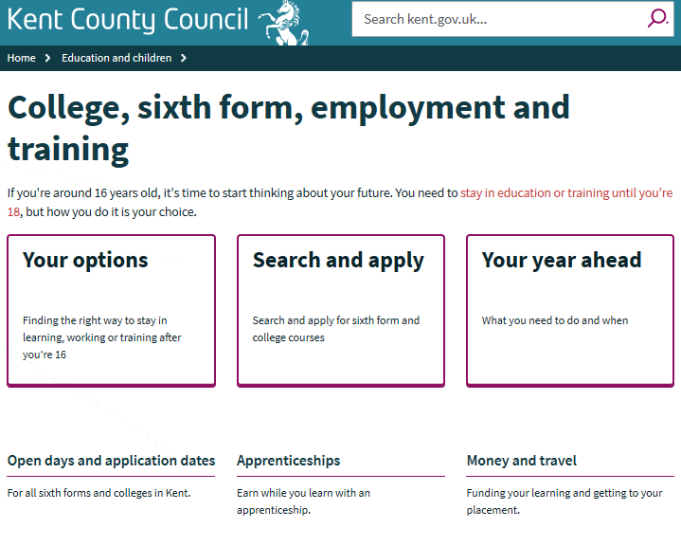
www.kentchoices.co.uk
Click on the boxes or headers for more information:-

Slide 6
KentChoices also has an online prospectus for Kent 6th forms and colleges. Here you can:-
Search for courses by provider, sector or qualification
View full course details, entry requirements, location etc
Add courses you are interested in to your ‘favourites’
Apply for courses all in one place (you only need to complete one application)
Accept offers
You can apply for as many options as you wish – you do not need to decide until nearer the time which one to accept. (We recommend that you have at least two options, these can be a mixture of school, college or training)

Slide 7
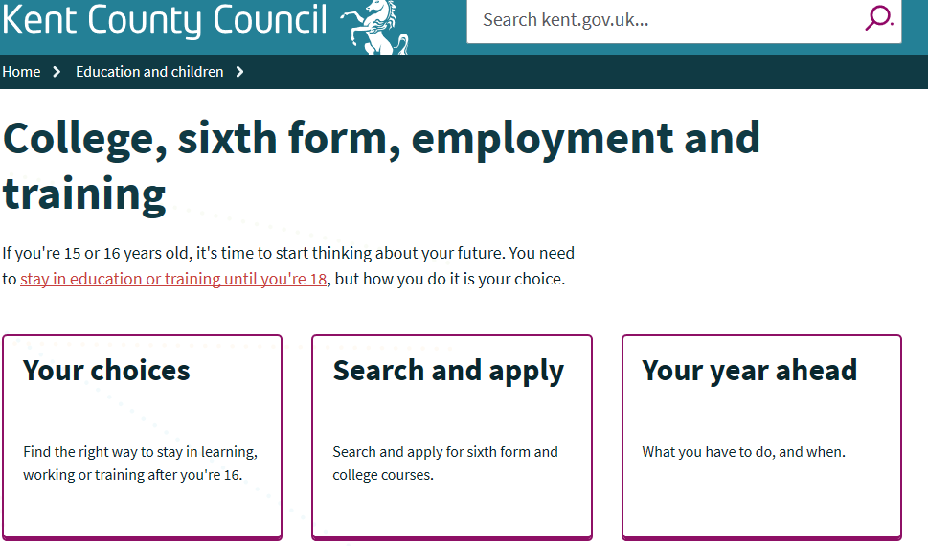
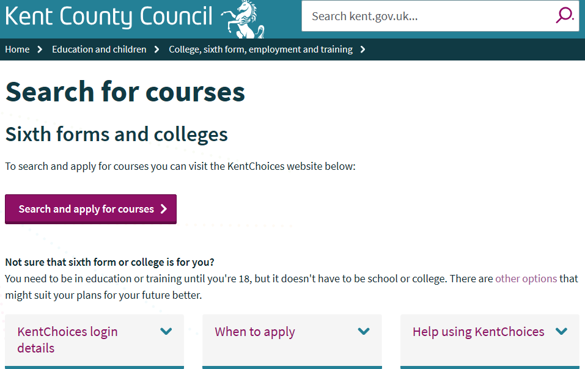
Search & Apply
Go to www.kentchoices.co.uk and click the ‘Search & Apply’ box
Then click on the purple ‘search and apply for courses’ button

Slide 8
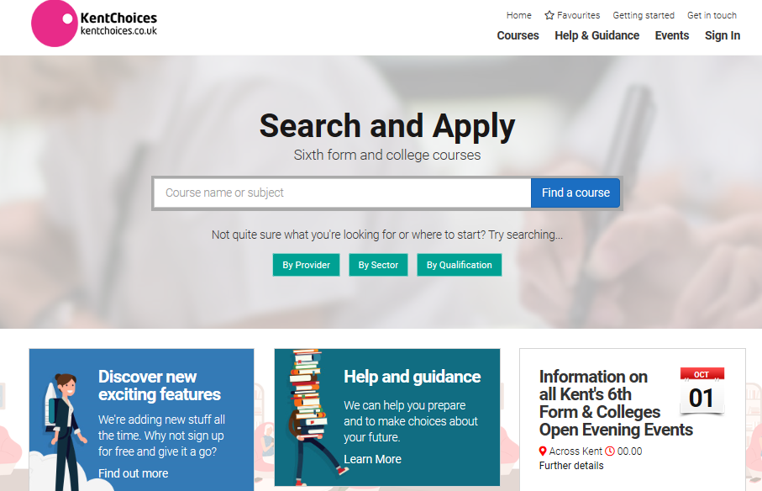
Log on to KentChoices
Click on the ‘Sign in’ button.

Slide 9
Your log in details
All Kent’s students are created a log on so they can access the KentChoices site. Your school will supply these to you.
When you first log onto KentChoices you will be asked to change your password. Keep your username and password in a safe place as you will need these details to keep track of your applications and accept any offers in the future.
Add your email address straight away (then if you forget your password, you can easily reset it).

Slide 10
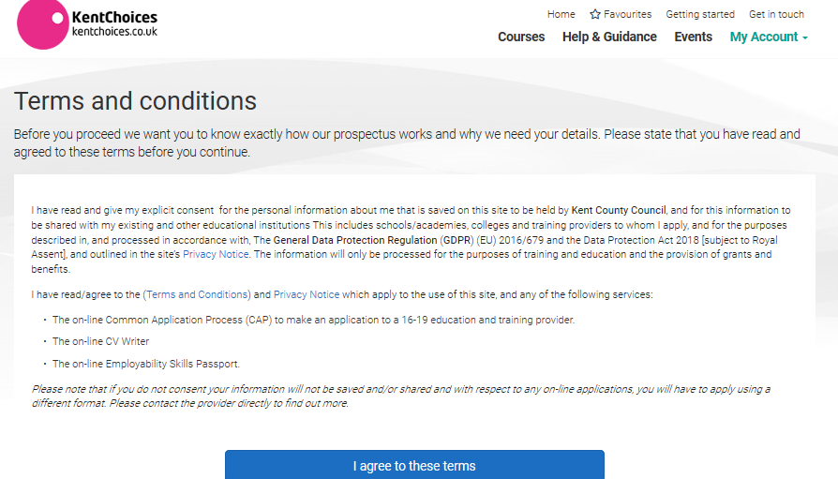
Agree to conditions
Agree to the terms and conditions to get started.

Slide 11
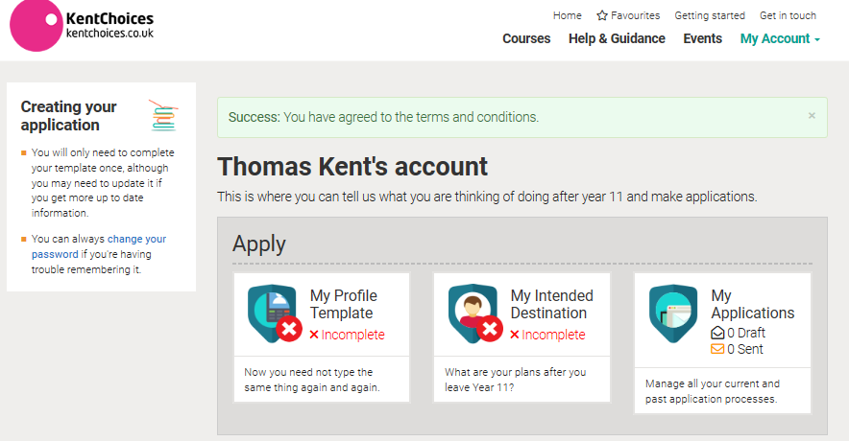
Your Dashboard
Here is your dashboard where you can get an overview of your account. You can come back here at any time by visiting the My Account tab.
Click on My Profile Template to begin.

Slide 12
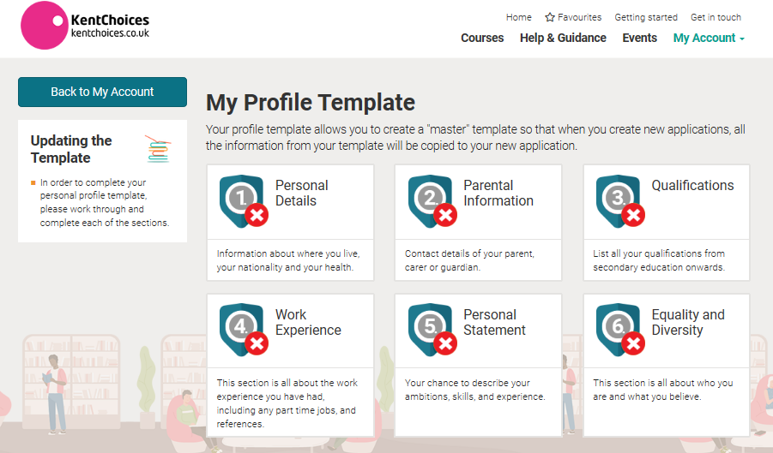
Completing your Profile Template
You need to complete all the sections before applying for courses.

Slide 13
Complete your profile – Personal & Parental Details
Personal Details
Check your address is correct, add your telephone numbers and home and school email addresses. You need to enter all fields with the red asterisk. (*)
Click the green Save and Update Template button to move on to the next section.
Parental Information
Enter the details of one parent/carer in here - if you do not know their email address enter your own – you can always amend this at a later date but you need to enter an email address here to continue.
Click the green Save and Update Template button to move on to the next section.

Slide 14
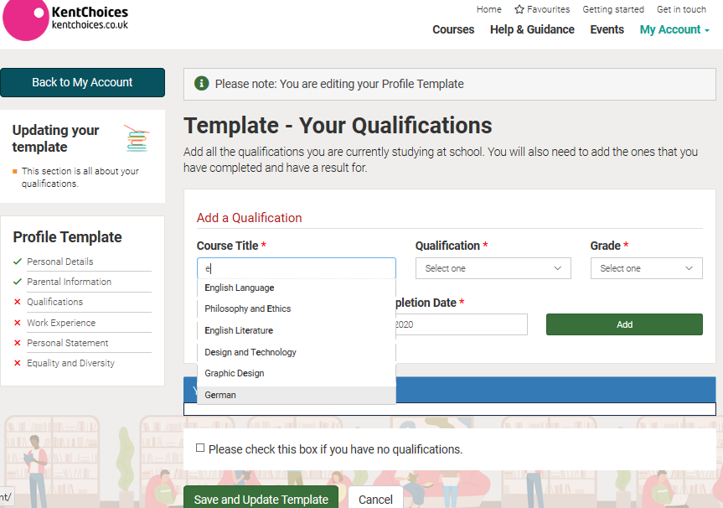
Complete your profile - Qualifications
Qualifications
Add your predicted or actual grades in here (if these have not been already uploaded by your school).
If you start typing in the fields, prepopulated text will appear for you to choose from. Enter all details and click the green Add button to add your qualification(s).
If you make an error you can delete any entry at any time.
After entering all your qualifications, click the green Save and Update Template button .

Slide 15
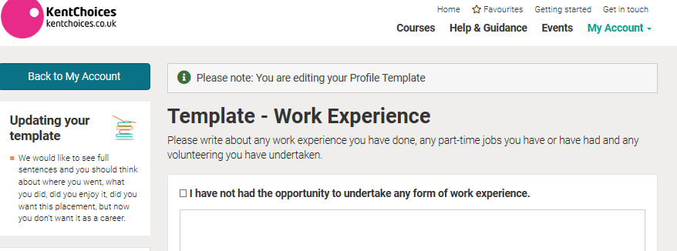
Complete your profile – Work Experience
If you have undertaken any type of work experience, enter the details in here.
If you have not had the chance to do any work experience, tick the box highlighted.
There is no need to enter any reference information so click on the green Save and Update Template button to continue.

Slide 16
Complete your profile – Personal Statement
Personal Statement –
The Personal Statement is a chance to talk about your skills, experiences and any future ambitions or aspirations.
Entering a statement will strengthen any applications you make and is good practice by preparing you for any future job or university applications but is not mandatory.
There is a minimum (40 characters) and maximum (4,000 characters) value – but if you do not want to enter anything in here - enter 40 spaces.
Click the green Save and Update Template button when you are happy with your statement.

Slide 17
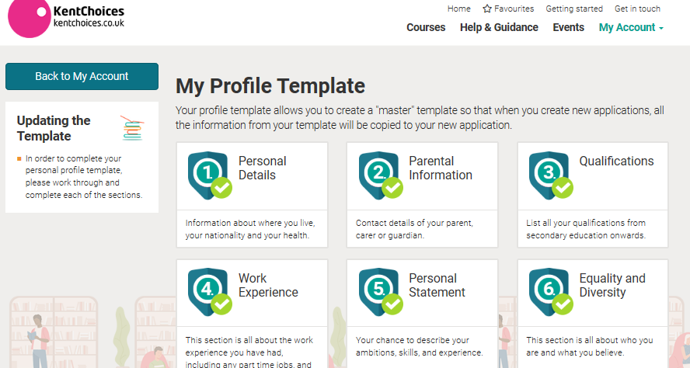
Complete your profile – Equality and Diversity Information
We do not collect this information, so click on the green Save and Update Template button to continue.
Your Profile Template is now complete and you can begin to search and apply for courses.

Slide 18
Searching for Courses
You can search for a course by name, provider, sector or qualification. ….

Slide 19
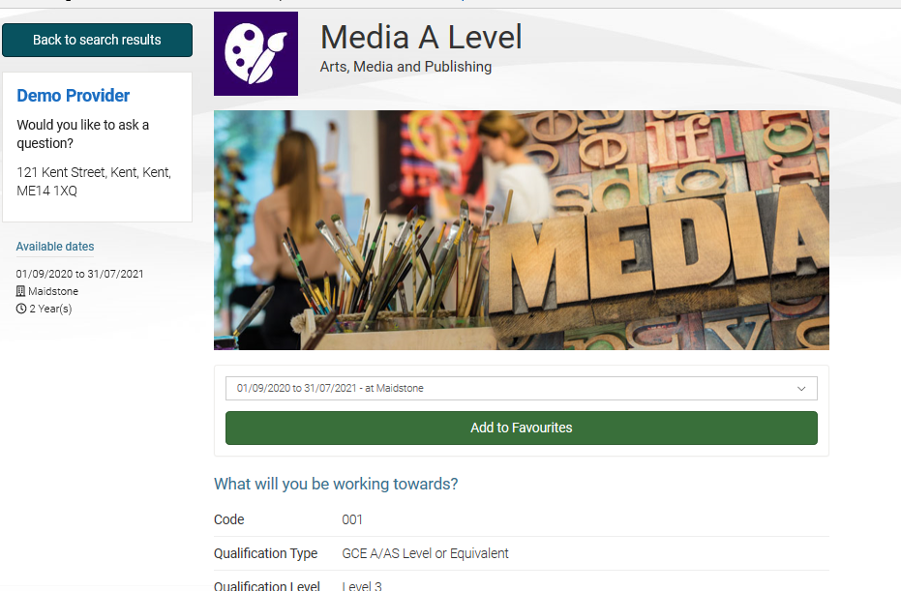
Add to your favourites
Click on a course that is of interest to view further details – and if you would like to consider applying, save it to your favourites for later.

Slide 20
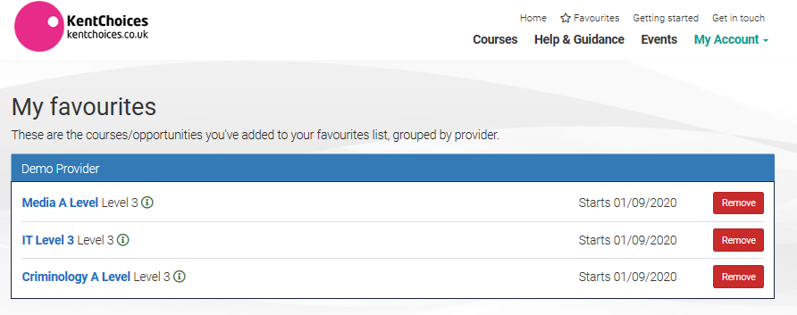
Your Favourites
You can view your favourites and add more courses at any time by clicking on the My Account or Favourites tabs.

Slide 21
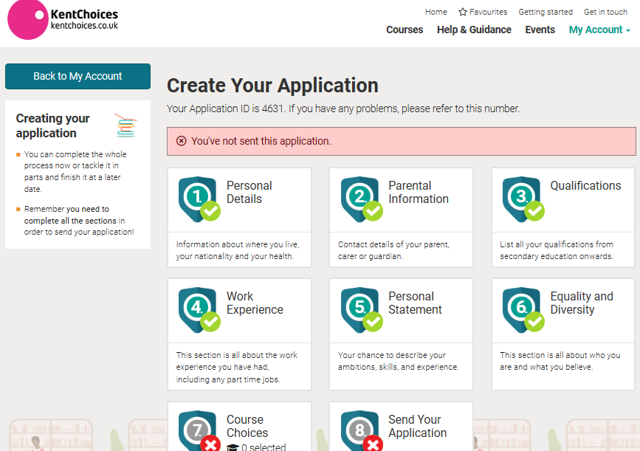
Applying for courses
When you are ready to apply, go to My Account and choose My Applications and click on the green Start an Application button.
This will take you to the next screen – click on Course Choices.

Slide 22
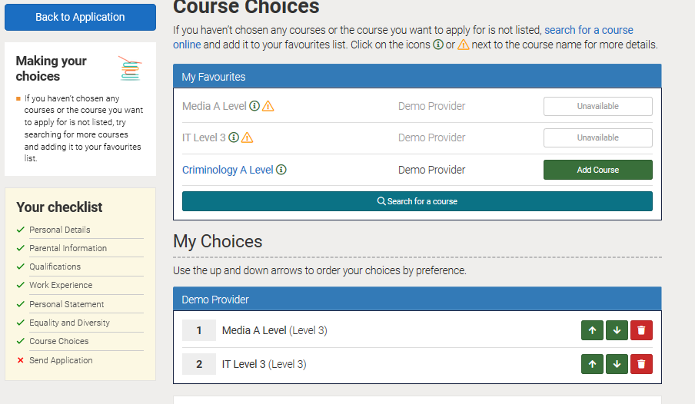
Choose your course(s)
Choose you course(s) from your favourites by clicking the Add Course button. If you have chosen more than one course for a provider you can put your courses in preferred order by using the arrow up or down buttons.
Give a brief description of why you would like to apply for this course (again there is a 40 character minimum). Click Save and Continue.

Slide 23
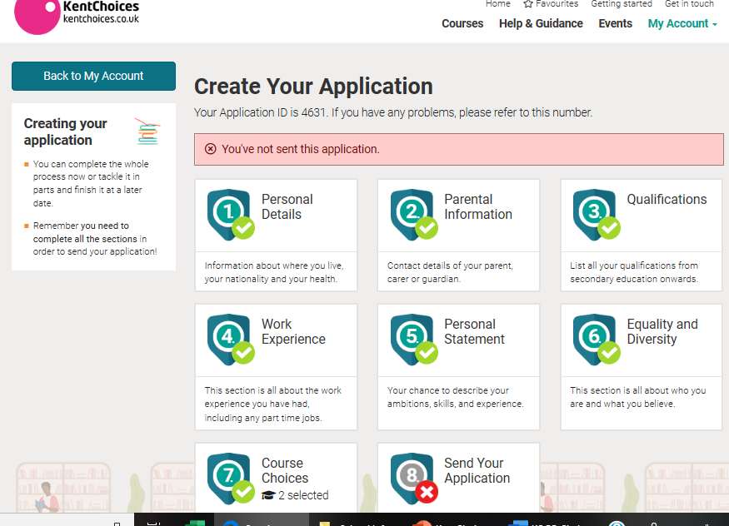
Send your Application
Click on Send your Application.

Slide 24
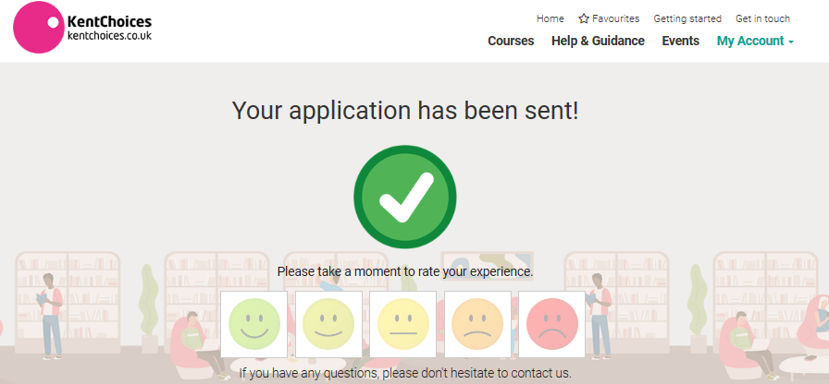
Review and send your Application
You will now have a chance to review your application and edit any sections if needed.
When you are happy with your application, click your preference (i.e. this is my 1st choice, 2nd choice or not chosen), tick the conditions boxes and the green Send Application button.
You will get a message to say that your application has been sent.

Slide 25
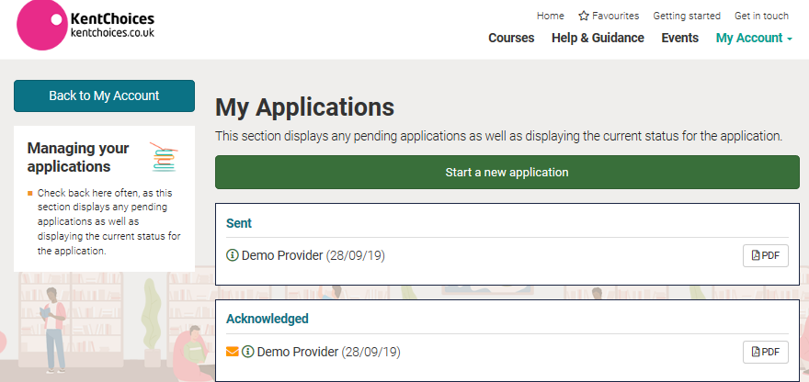
Track your Applications
You need to visit your account regularly for updates (if you have supplied a valid email address you will get a reminder to do this when you have a new message or update regarding your application(s)).
Check for messages or updates in My Applications in the My Account tab to see what stage your application is at.

Slide 26
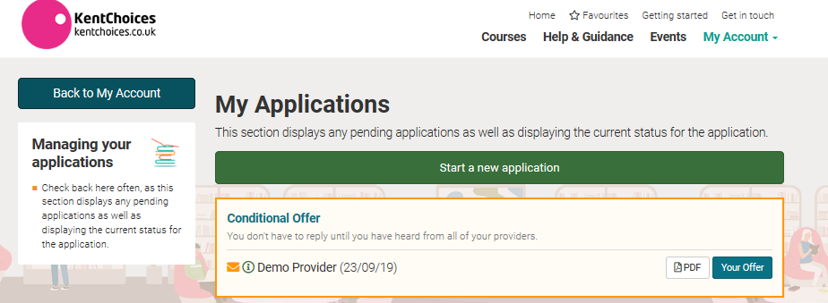
View/Accept your offers
Here you can see that you now have an offer regarding your application:-
Click on Your Offer to accept or reject. (If you want to look at your application, click on the PDF next to your offer)

Slide 27
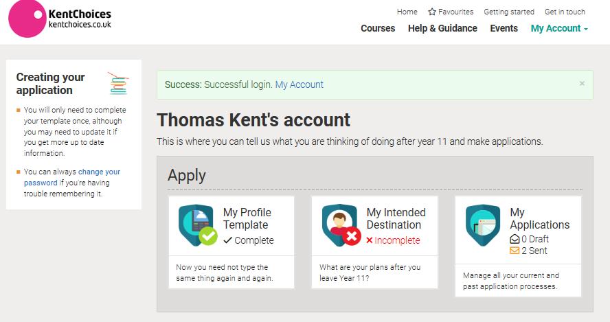
Intended Destination
Please complete the My Intended Destination box – this will give your school an idea of what you plan to do after Year 11 so they can support you with your choice.
You can come back and amend this at any time if your plans have changed.

Slide 28
Useful Tips
Have a back up option – just in case things do not go to plan
Be aware of your chosen school or colleges open and close dates for applications (you don’t want to miss any deadlines check www.kentchoices.co.uk – open days and application dates)
Make sure your phone number and email address are up to date on your profile
Check your account regularly for updates (why not add KentChoices to your home screen on your mobile phone so you can access the site easily?)
Don’t forget your username and password (you could add a contact on your mobile with these details).

Slide 29
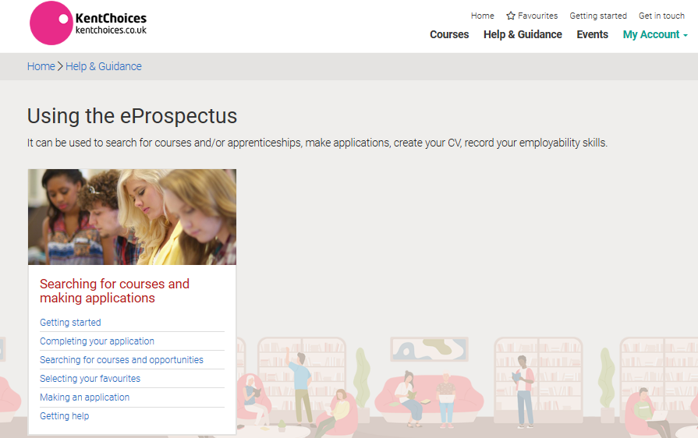
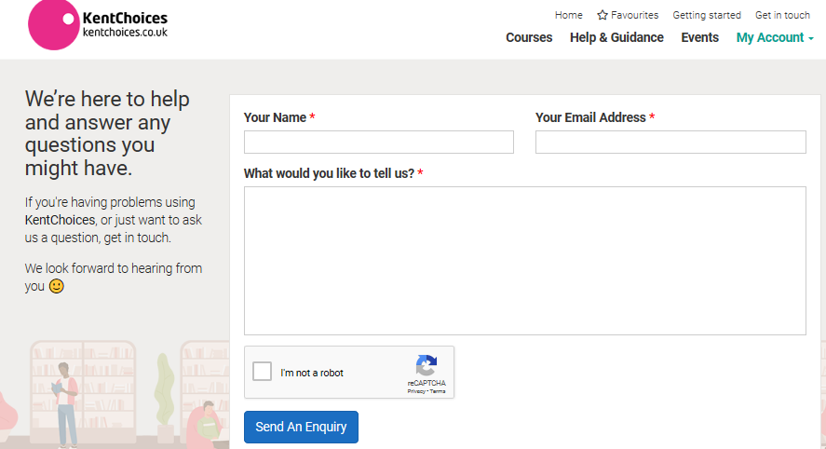
Need help using KentChoices?
Visit the ‘Help & Guidance’ section of the website for step by step instructions
Use the ‘contact us’ form if you have any questions

Slide 30
Frequently asked Questions
Q. I never received my log in details
A. Ask your school to get in touch with the KentChoices team who will be able to create an account for you
Q. I have lost my log in details
A. Contact your school they will have a record of these.
Q. I have forgotten my password
A. If you have logged into your account previously and registered your password, you can use the ‘forgotten your password’ link on the site

Slide 31
FAQ’S cont.
Q. I need to update my details
A. You can change any information in the ‘My Account’ section
Q. Why cannot I apply for my chosen course?
A. Check to see if applications are open or closed for this provider. You can check this on www.kentchoices.co.uk. (Open days and applications dates). Have you added this course to your favourites? (you need to do this before making your application)
Q. I have missed the deadline for applying
A. You will need to contact the school direct to see if they can still accept your application – they will advise you of your next steps

Slide 32
FAQ’S cont.
Q. I have not heard anything since making my application, what should I do?
A. Log on to your KentChoices account – you may have missed a message from the provider regarding important updates. Some providers may prefer to write to you to confirm your offer so contact them direct to see how your application is progressing.
Q. I have missed the deadline for putting my offers in preference
A. Do not worry – but do this as soon as possible as it helps schools and colleges to plan who will be attending in September

Slide 33
If you still require assistance
We hope that you find the site easy to use. If you still need assistance:-
Ask your school/teacher to help you
Visit the help pages on KentChoices www.kentchoices.co.uk
Get in touch with the KentChoices team by email kentchoices@theeducationpeople.org or by phone 03000 416 401.

