Slide 1

Headteacher Meetings
November 2016
Education and Young People’s Services

Slide 2
Patrick Leeson
Corporate Director of Education and Young People’s Services

Slide 3
PRIORITIES
0-25 Transformation
Education Services Company
Early Help and Preventative Services
Emotional Health and Wellbeing Strategy
Education Commissioning Plan
High Needs Funding and SEND Provision
NEETS Strategy
Post 16 performance

Slide 4
CHALLENGES
Our achievement gaps for Pupil Premium pupils and learners with special educational needs are still too wide and their outcomes are not good enough.
Our NEET figures are still too high and too many 16-18 years are either not participating in education or training or they do not have the right options, support and provision to ensure they achieve success.
Too many 16-18 year olds and some older students with learning difficulties and disabilities do not have the right educational provision available for them in their locality, including the support they need to access training and employment.

Slide 5
CHALLENGES
We still have 10% of schools that are not yet good or outstanding, which limits the opportunities for the children and young people attending those schools.
Like many parts of this country our educational success is put at risk by the challenges of recruiting the right teachers, headteachers and other staff in key services.

Slide 6
CHALLENGES
As more schools become academies, and form multi-academy trusts, there is a big challenge in the system to develop the kinds of leadership and governance that will deliver success in the future.
And as the system changes there is a challenge for the local authority to adapt its services and to work in even more robust partnership with schools to ensure the right services are available and all children are supported, with a sense of shared responsibility for the needs of all children and young people.

Slide 7
EDUCATION SERVICES COMPANY
Update - November 2016

Slide 8
OUR OBJECTIVES
To increase the resilience and long-term sustainability of Education Services in Kent
To maintain and enhance strong bonds between KCC and Kent schools, allowing schools to have a greater say in how services operate and continuing the focus on improving attainment and standards
To realise the additional opportunities for growth in traded Education Services to better support the delivery of high-quality statutory services.

Slide 9
GOVERNANCE
A new Education Services Stakeholder and Commissioning Group is proposed
It is proposed that this group will have decision-making responsibility across all Education Services, as well as influence over commissioning of the Education Services Company
Providing the ability to jointly shape future service provision in Kent.

Slide 10
PROPOSED GOVERNANCE STRUCTURE
Education Services Stakeholder and Commissioning Group
Member and school representation
EYPS Corporate Director
Sponsor MATs
Education Services Co. Board
EYPS
Core Services
KCC
Group Services (e.g. KCS)

Slide 11
MAT SPONSORSHIP
Education Services Stakeholder and Commissioning Group
Education Services Co. Board
EYPS
Core Services
MAT
Structure assumes a change in legislation that would allow an LA MAT to be created
Overarching structure must be able to support KCC in being able to sponsor a MAT
Education Commissioning and Stakeholder group expected to have a role in supporting that MAT.

Slide 12
EDUCATION SERVICES COMPANY SCOPE
The Education Services Company will be responsible for delivering directly a number of services that are currently delivered from KCC
It will continue with the EduKent model, by providing a ‘single front door’ to all traded services for schools
It is proposed that the new company will have clear accountability for performance and quality of all services that it offers.

Slide 13
PROPOSED SCOPE FOR DETAILED ANALYSIS
IN the new Company | REMAINING in KCC
School Improvement incl. Governor Services | Early Help and Preventative Services
Outdoor Education | SEN
Schools Financial Services | Fair Access
Early Years and Childcare | Area Education Officers
Education Psychology | Planning and Operations
Skills and Employability
Community, Learning and Skills (CLS)
Safeguarding
Building on the profitability of the services outlined by E&Y - this scope groups services allowing the company greater potential to grow and offer an integrated service
No splitting of services - statutory and traded elements remain together.

Slide 14
TIMELINE
To December 2016
Develop the Full Business Case
January - March 17
KCC governance and approvals
Working alongside schools and KAH to support implementation planning
April 17
Approval to Implement
Set up shadow board and initiate Education Services Stakeholder Group
Sept 17
Agree shadow board and set up proposed Education Services Stakeholder Group
Execute implementation plan
Proposed launch date of new Education Services Company

Slide 15
SCHOOL RESULTS
2016

Slide 16
EARLY YEARS FOUNDATION STAGE - OVERALL
% | 2014 Kent | 2015 Kent | 2016 Kent | 3 Year direction of travel | 2016 Kent Target | 2016 National | Kent v National
Percentage of children achieving a GLD | 68.5 | 72.9 | 74.8 | ↑ | 77 | 69.3 | Above
Kent schools attaining at or above the national average for the proportion of pupils achieving a Good Level of Development:
2016 - 336 out of 427
2015 - 345 out of 420.
Notes:
The 2016 figure of 74.8% reflects an improvement from the 2015 figure of 72.9% and an 11.4 percentage point improvement since 2011.

Slide 17
EARLY YEARS FOUNDATION STAGE - BY AREA/DISTRICT
Area/District | 2014 % GLD | 2015 % GLD | 2016 % GLD | 3 Year direction of travel
East Kent | 65.5 | 72.2 | 73.1 | ↑
Canterbury | 69.2 | 73.7 | 75.6 | ↑
Swale | 67.5 | 72.0 | 73.4 | ↑
Thanet | 60.0 | 71.1 | 70.6 | ↑
North Kent | 68.6 | 71.1 | 74.4 | ↑
Dartford | 68.1 | 72.5 | 73.6 | ↑
Gravesham | 64.7 | 63.9 | 72.5 | ↑
Sevenoaks | 73.1 | 76.7 | 76.9 | ↑
South Kent | 67.7 | 72.6 | 74.3 | ↑
Ashford | 66.0 | 73.2 | 75.1 | ↑
Dover | 69.7 | 73.9 | 74.6 | ↑
Shepway | 67.9 | 70.5 | 73.1 | ↑
West Kent | 72.6 | 76.4 | 77.4 | ↑
Maidstone | 70.5 | 75.8 | 75.4 | ↑
Tonbridge and Malling | 73.7 | 75.7 | 79.5 | ↑
Tunbridge Wells | 74.0 | 78.3 | 77.7 | ↑
Kent LA - All Schools | 68.5 | 72.9 | 74.8 | ↑

Slide 18
EYFS ACHIEVEMENT GAP - FREE SCHOOL MEALS (FSM EVER)
Achievement Gap for children in the EYFS ever in receipt of FSM | 2014 | 2015 | 2016
Kent | 18.5% | 15% | 18%
National | N/A
Notes:
In the Early Years Foundation Stage, the FSM achievement gap has widened to 18.0% in 2016 from 15.0% in 2015. This is disappointing and of concern.

Slide 19
KEY STAGE 1 - OUTCOMES
 | 2013 %2B+ | 2014 %2B+ | 2015 %2B+ | 2016 % pupils met or exceeded the expected standard | 2016 National | Kent v National
Combined English Reading, English Writing and Mathematics | 77.4 | 66.9 | 78.4 | 66.6 | 60.3 | Above
English Reading | 79 | 82 | 84 | 78* | 74 | Above
English Writing | 67 | 70 | 74 | 71* | 65 | Above
Mathematics | 79 | 82 | 84 | 78* | 73 | Above
*Kent is ranked first among its statistical neighbours for these measures

Slide 20
KEY STAGE 1 - OUTCOMES
  Kent schools attaining at or above the national average:
  2016 - 320 schools (for pupils achieving the ‘expected standard’ for the combined RWM measure)
  In 2015:
    286 schools (for pupils achieving L2B+ in Reading)
    273 schools (for pupils achieving L2B+ in Writing)
    281 schools (for pupils achieving L2B+ in Mathematics).
Notes:
Performed above national for every indicator in 2016.

Slide 21
KEY STAGE 1 - 2016 OUTCOMES BY AREA/DISTRICT
Area/District | Reading % EXS+ | Writing % EXS+ | Maths % EXS+ | % Achieving EXS+ In RWM
East Kent | 76.3 | 69.5 | 75.4 | 64.9
Canterbury | 77.8 | 71.9 | 76.7 | 67.7
Swale | 76.2 | 70.1 | 76.1 | 64.8
Thanet | 75.0 | 66.7 | 73.6 | 62.5
North Kent | 78.1 | 72.3 | 77.9 | 67.1
Dartford | 77.7 | 71.6 | 77.6 | 65.4
Gravesham | 73.8 | 70.5 | 74.9 | 64.3
Sevenoaks | 83.0 | 74.9 | 81.3 | 71.7
South Kent | 78.2 | 70.2 | 77.3 | 65.6
Ashford | 76.3 | 68.8 | 76.6 | 63.7
Dover | 80.5 | 73.2 | 79.1 | 69.0
Shepway | 78.4 | 69.0 | 76.3 | 64.8
West Kent | 80.3 | 73.2 | 79.6 | 68.8
Maidstone | 77.4 | 70.2 | 75.6 | 65.3
Tonbridge and Malling | 81.7 | 75.2 | 82.5 | 71.0
Tunbridge Wells | 82.5 | 75.2 | 81.7 | 71.1
Kent LA - All Schools | 78 | 71 | 78 | 66.6

Slide 22
KEY STAGE 2 - OUTCOMES
 | 2013 % L4+ | 2014 % L4+ | 2015 % L4+ | 2016 % At the expected standard | 2016 National | Kent V National
Combined English Reading Test, English Writing TA and Mathematics Test | 74 | 79 | 80 | 58* | 53 | Above
English Reading Test | 85 | 89 | 90 | 69* | 66 | Above
English Writing TA | 83 | 86 | 88 | 80* | 74 | Above
Mathematics Test | 83 | 86 | 87 | 71* | 70 | Above
English Grammar, Punctuation and Spelling Test (GPS) | 71 | 74 | 78 | 72 | 72 | =
*Kent is ranked first among its statistical neighbours for these measures

Slide 23
KEY STAGE 2 - OUTCOMES CONTINUED
Kent schools attaining at or above the national average:
2016 - 277 schools (for pupils reaching the ‘expected standard’ for Reading, Writing and Mathematics combined)
2015 - 260 schools (against the historic measure of Level 4+ in the Reading, Writing and Mathematics combined).

Slide 24
KEY STAGE 2 - 2016 OUTCOMES BY AREA/DISTRICT
Area/District | % At the expected standard
 | Reading Test | Writing TA | GPS | Maths Test | RWM
East | 66.8 | 81.1 | 71.3 | 71.3 | 56.8
Canterbury | 72.6 | 84.4 | 75.3 | 76.2 | 63.1
Swale | 63.9 | 79.3 | 70.9 | 70.5 | 54.2
Thanet | 64.2 | 80.0 | 67.6 | 67.4 | 53.5
North | 69.6 | 77.8 | 74.9 | 73.3 | 58.8
Dartford | 71.8 | 77.3 | 75.3 | 77.0 | 61.2
Gravesham | 60.6 | 76.0 | 70.0 | 65.1 | 50.2
Sevenoaks | 76.4 | 80.4 | 79.5 | 77.6 | 65.1
South | 69.5 | 79.1 | 70.3 | 69.9 | 57.2
Ashford | 69.4 | 78.0 | 71.1 | 68.7 | 56.7
Dover | 70.9 | 82.5 | 72.0 | 72.0 | 59.9
Shepway | 68.1 | 76.9 | 67.5 | 69.1 | 55.0
West | 71.4 | 81.5 | 73.6 | 70.9 | 59.6
Maidstone | 70.1 | 80.0 | 73.4 | 69.7 | 58.4
Tonbridge and Malling | 72.6 | 82.6 | 75.3 | 72.4 | 60.8
Tunbridge Wells | 71.7 | 82.2 | 71.7 | 70.8 | 59.8
Kent - All Schools | 69 | 80 | 72 | 71 | 58

Slide 25
KEY STAGE 2 - 2016 OUTCOMES FOR VULNERABLE GROUPS
 |  | % Achieving the expected standard
 |  | Reading Test | Writing TA | GPS | Maths Test | RWM
Gender Gap | Kent - All Schools | 7 | 12 | 10 | 0 | 6
 | National | 8 | 13 | 11 | 0 | 7
FSM Ever Gap | Kent - All Schools | 20.0 | 17.2 | 21.0 | 19.7 | 23.2
 | National | N/A
SEN Gap | Kent - All Schools | 45.0 | 56.8 | 54.4 | 48.0 | 50.7
 | National | N/A
Children in Care (12+ Months) Gap | Kent - All Schools | 27.6 | 28.9 | 28.2 | 29.7 | 36.8
 | National | N/A

Slide 26
KEY STAGE 4 - 2016 RESULTS
% | Kent (Schools and Academies) |  |  | 3 Year direction of travel | 2016 National (Schools and Academies) | Kent v National
 | 2014 | 2015 | 2016
% 5+ GCSEs A*-C including English and mathematics | 58.1 | 57.4 | 58.6 | ↑ | 57.0 | Above
% GCSEs A*-C in English and mathematics | 61.0 | 59.8 | 63.5 |  | 62.8 | Above
% GCSEs A*-C in English | 71.8 | 70.4 | 76.0 |  | 74.7 | Above
% GCSEs A*-C in mathematics | 67.7 | 66.6 | 68.0 |  | 68.5 | Below
% English Baccalaureate | 26.8 | 26.5 | 29.5 |  | 24.6 | Above
Progress 8 Score |  |  | -0.04 |  | -0.03 | Below

Slide 27
KEY STAGE 4 - 2016 RESULTS CONTINUED
Kent schools attaining at or above the national average for the proportion of pupils achieving Grade C or above in English and mathematics:
2016 - 40 out of 98 Kent schools and academies
2015 - 43 out of 99 Kent schools and academies.

Slide 28
POST 16 - 2016 PROVISIONAL RESULTS
 | 2016 Kent (State Funded Schools) | 2016 National (State Funded Schools) |  | Kent v National
A Levels only
Average Point Score per entry | 30.8 |  | 30.7 | Above
% students achieving AAB or above of which at least two are in facilitating subjects | 16.8 |  | 15.4 | Above
Academic qualifications
Average Point Score per entry | 32.0 |  | 30.9 | Above
Technical Level 3
Average Point Score per entry | 36.8 |  | 37.0 | Below
Applied General Level 3
Average Point Score per entry | 37.0 |  | 38.0 | Below
Technical Baccalaureate (TechBacc)
No. of students achieving a TechBacc | 20 |  | 130 | Kent ranked 1st against Stat Neighbours and nationally

Slide 29
POST 16 2016 RESULTS CONTINUED
Apprenticeships
  In the last three years we have seen an 18% increase in the number of 16 to 18 years old starting an apprenticeship.
  2013/14 - 2,560 apprenticeship starts
  2015/16 - 3,026 (provisional data) apprenticeship starts.

Slide 30
% OF SCHOOLS WITH A GOOD OR OUTSTANDING OFSTED JUDGEMENT
KENT V NATIONAL V STATISTICAL NEIGHBOUR (SN) AVERAGE

Slide 31
Kent’s Strategy for Children and Young People with Special Educational Needs and Disabilities
WORKING TOGETHER, IMPROVING OUTCOMES

Slide 32
WORKING TOGETHER, IMPROVING OUTCOMES
Aims
Improve educational, health and emotional wellbeing outcomes
Deliver the changes in the Children and Families Act 2014
Address the gaps in provision; improve the quality; develop the range and a mixed economy.
Vision
Good local schools; core standards, earlier intervention and inclusion
Partnerships; school to school, workforce development, outreach support
Creating capacity; provision and places
Co-production, providers engaged with changes
Good progress for every Kent child and young person with SEN

Slide 33
WHAT HAS ALREADY BEEN ACHIEVED
(2013-16)
Improving quality
More children attending a better school
LIFT and Early Years LIFT.
Delivering statutory changes
Local Offer, Assessment timescales, conversions
Joint commissioning; family advice or short breaks with IASK; Integrated Equipment; dispute resolution and mediation; therapies project
High needs funding; 47% without EHCP, 500+ ASD, 300 SLCN and 300 SEMH. Largest group Y1, then Yr2. Secondary schools make fewer applications but 63% non-Grammar and 47% Grammar schools applied. We are tracking Y6 into Secondary school.
Addressing the gaps in our provision
Increased Special school places; SRP.

Slide 34
WHAT’S LEFT TO DO
Greater expertise in mainstream; skilled teachers
Improved attendance, inclusion in the classroom
Parental confidence and good relationship with settings and schools
Linked resources and better transition between pre-school and school
Demand for specialist places, particularly Secondary age
The cost of home to school transport needs to reduce
Preparation for adulthood; good providers at post 16; personalised and high quality work experience, internships and support for apprenticeships.

Slide 35
WHAT’S LEFT TO DO
Early identification by Health Visitors, earlier involvement of speech and language services
Tackle inequalities that arise from gaps in therapy, missed treatment and follow up to ensure no safeguarding or accessibility concerns.
Access to mental health services; timely assessment, diagnosis and action
More effective commissioning for complex health needs
Good collaboration for integrated commissioning.

Slide 36
ACTION PLAN FOR 2016-19
Priority areas for action
Identifying the right children and young people at the right time
Ensuring assessment is effective and meeting needs
Our local arrangements mean young people achieve better outcomes
Children and young people with SEND and their parents are involved in decision making
Adding to the specialist provision where it is needed locally and reduction in need for transport.

Slide 37
OUTCOMES
By 2018 we will
Ensure all services prioritise children in public care
Demonstrate that Health visitors are making effective early referrals to SEN services
Have transferred all Statements to good quality EHCPs
Have specialist school nursing for complex health
Have closed gaps in speech and language support 0-18
Commission Post 16 SEND provision from a range of providers delivering evidence-based practice and preparation for adulthood, to increase choice

Slide 38
OUTCOMES
By 2018 we will
Tackled persistent absence or pupils with SEND through a feedback system with schools
Reduced SEND NEETs and have increased the range of 19-25 pathways developed.
Deliver greater local co-ordination of education, health and care services and plans for children and families.
Ensure Short breaks are widely available.

Slide 39
OUTCOMES
By 2018 we will
Continue to promote awareness of the Local Offer
Have reduced parents frustrations with delay or accessibility
Embed a culture of evaluating the impact of what we do to regularly monitor and review parent experiences of systems
Have a high quality statutory assessment process which delivers to timescales and engages parents at each step.

Slide 40
WE WILL KNOW WE ARE ACHIEVING WHEN
Parents feel listened to and their views are acted upon and there is evidence of high levels of parental involvement in SEND assessment and review
Young people are influencing decisions about them
The local offer is informative, well known and used
Parents are highly satisfied with SEND provision and have confidence in the support provided
High needs funding has more impact on SEND progress and attainment
Fewer EHCPs needed in mainstream schools
Statutory assessment is timely

Slide 41
SCHOOLS FUNDING AND HIGH NEEDS FUNDING UPDATE 2016

Slide 42
NATIONAL FUNDING FORMULA
Implementation of the new national funding formula delayed until 2018-19
Expecting response to the stage 1 (principles) along with stage 2 consultation (detail and rates) shortly
DfE plan to publish decisions in the New Year
Early Years NFF consultation closed 22/9 - not good news for Kent.

Slide 43
SCHOOL BUDGETS 2017-18
For 2017-18, MFG of -1.5% now confirmed
Seven years of flat cash - no increases for inflation
Maintained nurseries could be adversely affected by changes to Early Years NFF
DfE are proposing to introduce some changes to the data used to calculate school budgets
  Secondary low attainment (KS2 assessments)
  New bandings for deprivation (IDACI).

Slide 44
SCHOOL BUDGETS 2017-18
The ring-fencing of the DSG schools block will not start in 2017-18 - this is helpful
Education Services Grant is being removed from September 2017 - big issue for LAs and Academies
We are looking to make some savings as well as grow our trading with schools, academies and other LAs.

Slide 45
HIGH NEEDS - PUPIL GROWTH
Adjusted to reflect change to mainstream high needs process

Slide 46
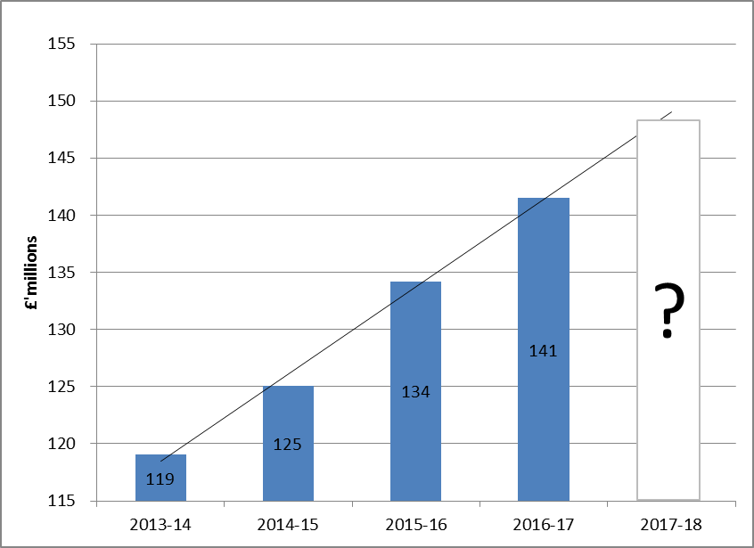
SPEND ON HIGH NEEDS IN KENT

Slide 47
HIGH NEEDS 2017-18
Return to EFA to be submitted at the end of this month
Likely to show continued growth
9 Dec - Seek Funding Forum agreement in principle to how this pressure should be funded
DSG settlement confirmed in late December
School budgets and High Needs funding rates confirmed in January.

Slide 48
KEITH ABBOTT
DIRECTOR
EDUCATION PLANNING AND ACCESS
Kent Commissioning Plan Update 2017 - 2021

Slide 49
WHAT WE ACHIEVED IN 2015-16
Added 14FE of permanent places and 184 temporary Reception places across 25 Primary schools
6FE of permanent Secondary provision, and 263 temporary Year 7 places were added across 17 schools
4 Special school builds/refurbishments were completed. Two Special Schools were expanded for September 2016
We commissioned 85 new places in Specialist Resourced Provisions based in Primary schools
Sufficient Early Years places existed for all children eligible for Free for 2 childcare
87.2% of families secured their first preference Primary school, exceeding our target
On average we maintained 5% surplus places in Primary schools and 9% in Secondary Schools.

Slide 50
PUPIL NUMBERS
Births in Kent increased by 24% in the period between 2002-12. The number of births dropped in 2013, but has risen since
The number of Primary aged pupils is expected to continue to rise from 119,943 in 2015-16, to 127,859 in 2020-21 - almost 8,000 extra pupils over the next five years. Long term forecasts suggest that the number of Primary pupils will continue to rise until 2030
The number of Secondary age pupils (Years 7-11) in Kent schools is expected to rise significantly from 78,007 in 2015-16 to 93,749 in 2022-23- over 15,000 extra pupils.
Long term strategic forecasts indicate a continuing rise in pupil numbers.

Slide 51
PRIMARY AND SECONDARY COMMISSIONING OF PLACES
by 2017-18 | by 2018-19 | by 2019-20 | between 2020-21 and 2022-23
Primary 9.5FE* permanent 150 Year R places 30 Year 2 places 30 Year 3 places Secondary 10FE permanent | Primary 12FE* permanent 30 Year R places Secondary 26FE permanent | Primary 13FE* permanent Secondary 17FE permanent 60 Year 7 places | Primary 51FE* permanent Secondary 26FE permanent 210 Year 7 places
*NB the FE figures above are rounded to the nearest 0.5FE

Slide 52
SEND
7,043 Education Health and Care Plans (ECHPs) and Statements (Jan 2016). Kent’s combined total is the third highest in England. A 6% increase in the number of pupils with Statements during the last year
Significant increases in ECHPs/Statement for pupils with ASD and PMLD over the last 5 years
38% of all pupils subject to a Statement or EHCP were recorded as having ASD as their primary barrier to learning. Nationally this is 24.5%
54% of Kent pupils with an EHCP for ASD are supported in a Kent Special School. The number of ASD placements in Kent Special Schools increased by over 200 since 2014.

Slide 53
COMMISSIONING SPECIALIST PROVISION
A proposal to expand Oakley School (PSCN)by adding an Observation and Assessment nursery is being taken forward
To provide further provision needed free school applications are encouraged for a PSCN Secondary provision in Dover, a B&L Secondary Special school in Isle of Sheppey and ASD secondary provisions in Maidstone and Dartford/Gravesham.

Slide 54
EARLY YEARS AND POST 16
Analysis of childcare places for 0-4 year olds shows that currently we have sufficient places in all Districts except Gravesham
We are working with providers to encourage the establishment of additional provision where this is required either for Free for 2 places or the delivery of the 30 hours places by September 2017
We work closely with schools, colleges, training providers and workplaces offering apprenticeships to ensure that sufficient provision exists to enable all young people aged 16-19 years (up to 24 years for some pupils with SEND) to engage in education and training.

Slide 55
Early Help and Preventative Services
Stuart Collins
Interim Director for Early Help and Preventative Services

Slide 56
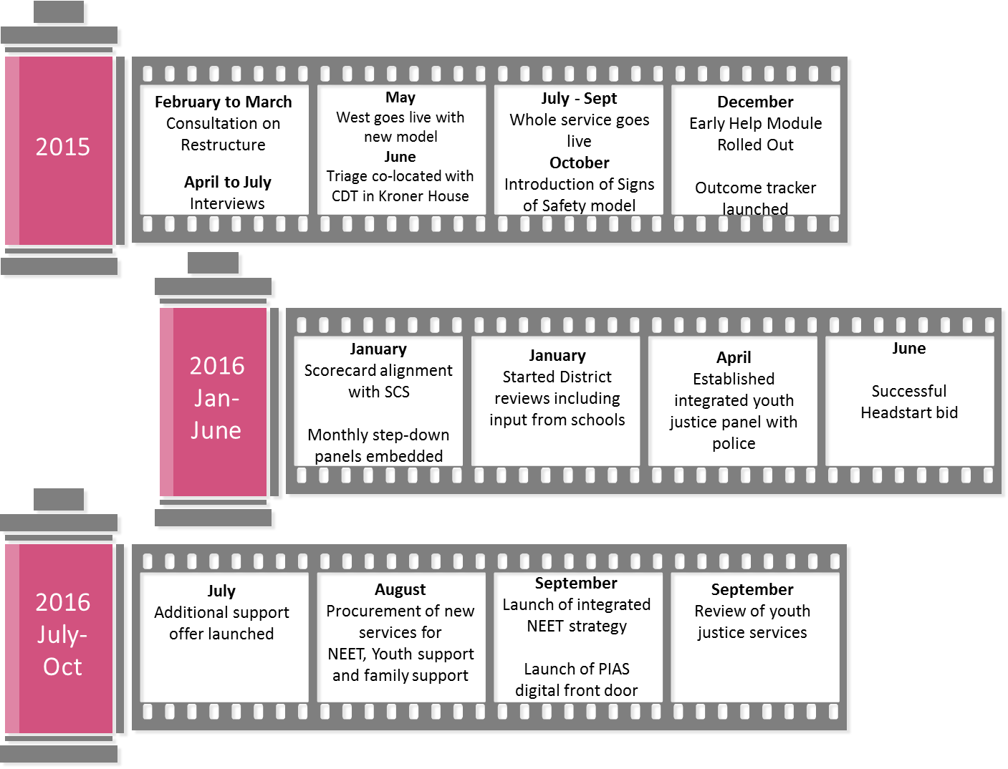
EHPS timeline………

Slide 57
Four Workstrands
Whole system partnership approach across the range of EHPS
Develop effective family focused practice approaches
Support good health and emotional well-being
Promote educational and vocational achievement.
Four Principles
Involve children, young people and families
Improve life chances, build family resilience and use the strengths of families
Practice is informed by professional judgement and the working relationship with the child and family
Work is outcome focused, informed by evidence, performance and evaluation.
Performance and Quantitative Data
Audits and Qualitative Information
Partnership and service user feedback
Staff competence and the employment deal

Slide 58
EARLY HELP - RANGE OF SERVICES
Children and families with additional needs who would benefit from or who require extra help to improve education, parenting and/or behaviour or to meet specific health or emotional needs or to improve material situation. Child’s needs can be met by universal services working together or with the addition of some targeted services
Children and/or family members are likely to suffer significant harm serious and lasting impairment without the intervention of specialist services, sometimes in a statutory role such as youth justice services.
All children and families have core needs such as parenting, health and education. Children are supported by their family and in universal services to meet all their needs.
Vulnerable children and their families with multiple or complex needs. Life chances would be impaired without coordinated support. A multi-agency plan is developed with the family. A wide range of services, including SCS or Early Help Units, might be involved
Universal
Additional
Intensive
Specialist

Slide 59
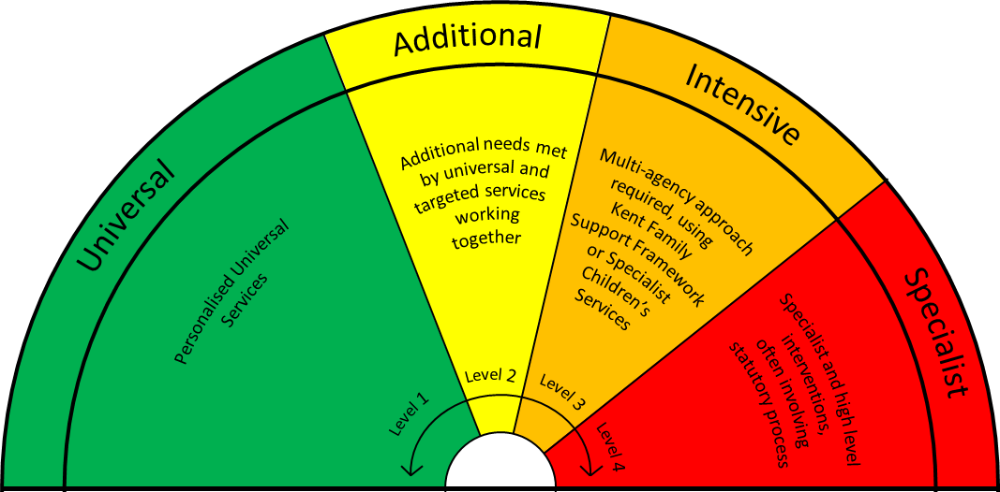
ENSURING THE RIGHT RESPONSE FOR THE LEVEL OF NEED AND RISK
Universal provision, educational progress and attainment are at the heart of the very best safeguarding and future wellbeing for children
Significant support can be given within universal provision. The safeguarding leads within schools and settings should be the first point of contact when there is a concern about a child
We must not overload the system but ensure that demand is managed
There must be clarity about risk assessments, the front door, referral pathways and threshold application including effective transition processes.
Work is well underway to further integrate the SCS and Early Help referral pathways, structures and systems to embed one single point of access

Slide 60
May 2016 - 22.7%
Step-Downs to EHPS
Not Known (NEETS)
Early Help Notifications received
Permanent Exclusion
(Academic Year)
Fixed Term Exclusions
(Sept - Mar)
Number of young people who have completed a D of E Award
Dec 2014 20%
July 2015 - 818
Aug 2015 - 31.14%
Aug 2015 - 8.64%
2015 - 10,593
July 2015 - 77.5%
2013/14 - 2,202
Numbers of CYP&F supported by EHPS in units 0-18 year olds
Sep 2015 – 5,211
Sep 2016 – 6,300
There are also 92,000 children supported by EHPS in universal settings
Aug 2016 - 6.08%
NEETS (Year 12, 13 and 14)
Aug 2016 - 8.81%
July 2016 - 1,061
2015/16 - 60
2014/15 - 109
2016 - 9,853
Cases Closed with Outcomes Achieved
July 2016 - 81.5%
2015/16 - 2,592
Notes:
Early Help receives approximately 800-1000 referrals per month. 50% of them referrals are sent from schools. The most often used primary reason for a school referral is Mental/emotional health and well being.

Slide 61
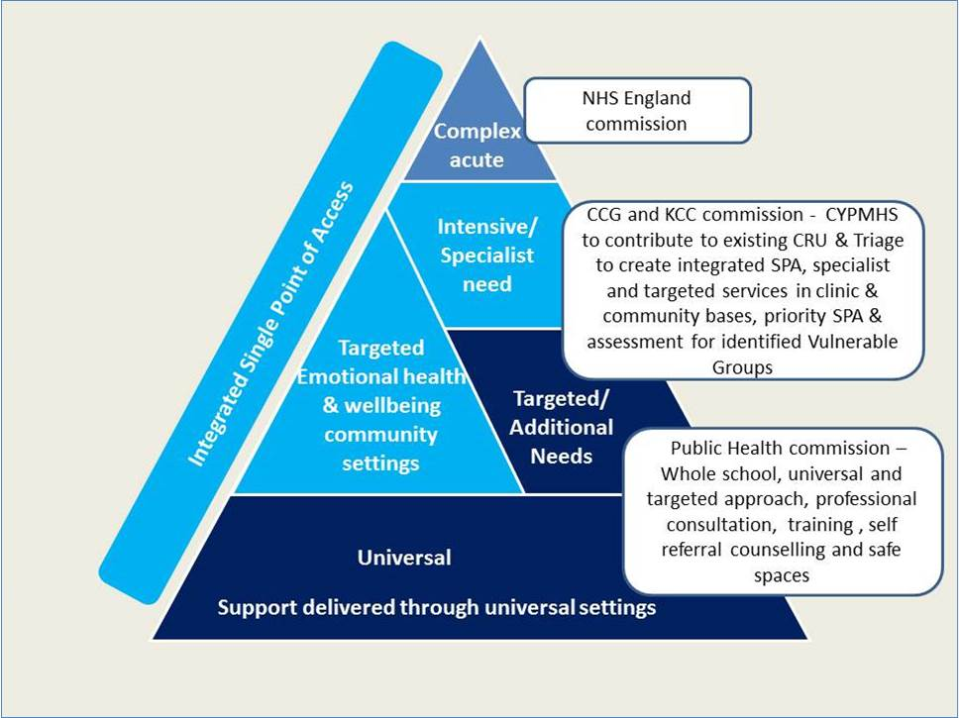
THE KENT EMOTIONAL HEALTH AND WELLBEING MODEL IS CURRENTLY PROGRESSING THROUGH PROCUREMENT AND WILL BE IN PLACE FOR APRIL 2017. THE SYSTEM HAS FIVE KEY ELEMENTS
Single Point of Access/Early Help Triage: Will direct partners to the relevant part of these systems
Specialist: Assessment, diagnosis and treatment. Supporting children who need a Targeted or Specialist mental health service, including behaviour issues or where the impact of trauma, abuse, neglect or attachment needs that are severely impacting on their mental health
Targeted: Interventions for emotional wellbeing issues, or undiagnosed/unspecified mental health needs. Aligned with the Early Help and Preventative Service with a clinically qualified Emotional Health and wellbeing worker based in every Early Help Unit
Health Needs PRU: clinical specialists working alongside the Health needs PRU to assist with re -integration to mainstream school where there has been a diagnosed mental health concern
School Public Health Service: Supports schools to promote good general health and emotional wellbeing.

Slide 62
KENT EMOTIONAL HEALTH AND WELLBEING MODEL AND OFFER
Public Health
Universal Primary Service (5-11)
Universal Adolescent Service (11-19)
  Including a targeted emotional health service which will cover both age groups
on track to award contracts early in 2017
New service to commence in April / May 2017.
KCC and 7 CCGs
New CAMHS model at Tier 2/3
22 targeted primary mental health workers based in EH units
Targeted primary mental health workers based in health needs PRU
On track to award contracts in April 2017
New service to go live September 2017

Slide 63
FEATURES OF NEW SERVICE MODEL
Emotional Health and Wellbeing
More visible and accessible
Focus on whole school and wider population
  Health improvement alongside individual Public Health improvement
Packages of evidence based intervention, drop-ins, individual short term interventions
Promoting Healthy Weight and Active Lifestyles, Key role in supporting wider individual health needs.

Slide 64



HEADSTART KENT PHASE 3
@HeadStartKent - #headstartmatters - #bounceback

Slide 65
HEADSTART KENT PHASE 3 VIDEO
https://vimeo.com/156168943

Slide 66
PHASE 3 SCHOOL GROUPINGS
Swale and Gravesham
BIG Investment October 2016 -
September 2018
Grouping Commitment to July 2021
Ashford, Shepway and Canterbury
BIG Investment August 2017 -
January 2019
Grouping Commitment to July 2021
Thanet and Maidstone
BIG Investment August 2018 -
January 2020
Grouping Commitment to July 2021
Tonbridge and Malling and Dover
BIG Investment
August 2019 -
January 2021
Grouping Commitment to July 2021
Resilience Hub
BIG Investment
August 2016 -
July 2021
Investment: In Kind Adolescent Health Service
All Areas run to July 2021

Slide 67
FRONT DOOR MANAGEMENT
We are working hard to achieve the most efficient and effective way to ensure that children, young people and families who require services receive them in the most appropriate and least intrusive way.
As part of this work, we are looking to integrate CRU and Triage. This will involve :
Consideration of a single referral form for intensive level services
Ensuring partners receive prompt and regular feedback on requests for services
Ensuring that partners have the opportunity to talk through their concerns with Designated Safeguarding Leads and through consultation with staff at the Front Door

Slide 68
NEXT STEPS ON THE HORIZON FOR EHPS
November
Launch of new youth justice model based on addressing wider adolescent risk factors.
December
Start of new NEET, family support and Youth contracts.
January
Development of new SCS and EHPS Front door.
Launch of new parenting offer.
April
Implementation of new emotional health and wellbeing model
2016/17

Slide 69


THANK YOU FOR ATTENDING
www.kelsi.org.uk
A fantastic offer! “Lottie” Child Sexual Exploitation Training and resources at a 70% discount.
Please continue to visit the Kelsi website for key legislation, guidance and latest news and events available to educational professionals.
Operation Willow has negotiated with the University of Kent’s Centre for Child Protection to offer you a special price of £60 per delegate for the next academic year (usually £199).
Flyer available at registration desk

