Slide 1


EYCS1 Countywide Early Years SENCO Forum

Slide 2
Agenda
Welcome with Zenia Ford and Jenny Jarvis
Early Years PRG with Paula Freathy
Early Years SEND Surgeries with Debbie James
Questions
Effective use of Visuals with Lisa Wild
Starting Strong for Families & Supporting parental confidence with Jenny Jarvis
Support for Providers with Zenia Ford
Evaluation and summary

Slide 3

Early Years Professional Resource Group (EY PRG) Update – Autumn 2026
Paula Freathy, SENIF Finance Manager

Slide 4
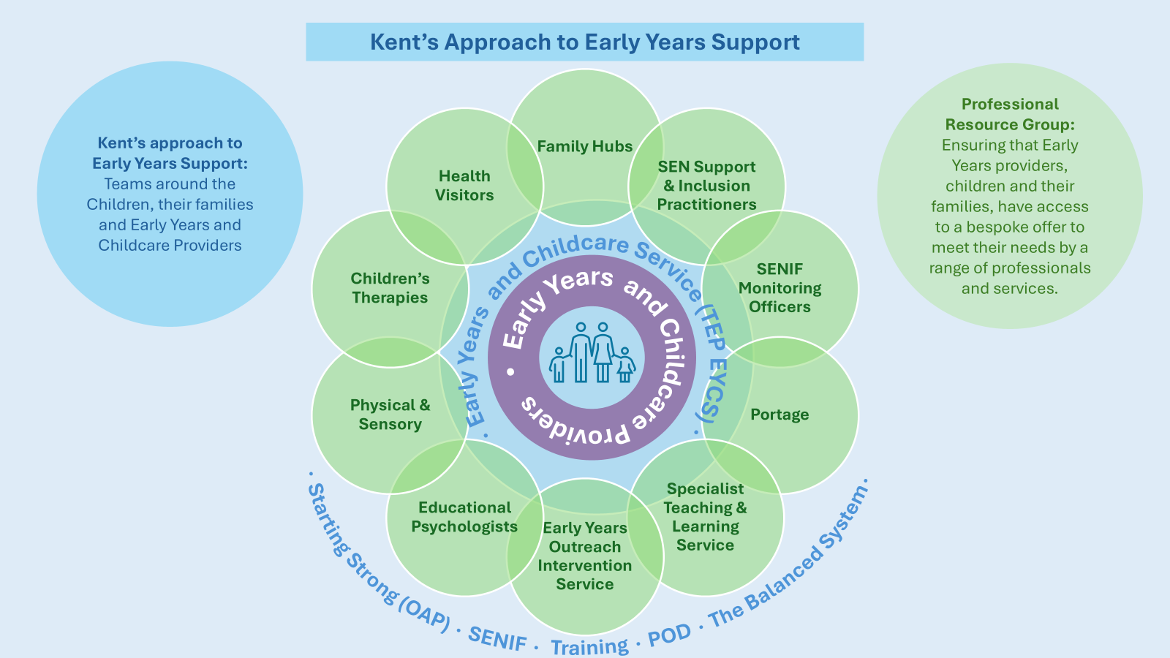

Slide 5
The Change
Continuous review and feedback from the sector
EY Providers are able to submit a Request without first contacting their EYQA/CQSA
Requests made through existing processes
EY PRG Meetings will continue to operate in same format
Exceptional Discussions continue weekly, if required

Slide 6
Expectations
Let the child settle, if they are new to your provision
You are an expert in your own setting
Implement strategies from your own knowledge/experience
Devise a Support Plan capturing what you’ve implemented
Review it – at least one review cycle (6-8 weeks)
Celebrate small steps of progress

Slide 7
EY PRG Request Form
Tell us what the child has difficulties with on a regular basis
Not a referral for a specific service
Requesting funding processes (SENIF) remain standalone
Not an outcome from the EY PRG:
Early Years STLS or Portage
Support for transition to school
Completing appendices for Statutory Needs Assessments
Decisions about school places

Slide 8

Early Years SEND Surgeries
Debbie James
SEND Support & Inclusion County Co-ordinator – Early Years

Slide 9

What are Early Years SEND Surgeries
An opportunity for Early Years Providers to access general SEND advice and guidance
Informal support from Early Years SEND professionals
Anonymous – no child details required
Individual sessions for Early Years Providers

Slide 10
Frequency of the Early Years SEND Surgeries
Held in each of the 12 districts across Kent
Fortnightly across each term
Bookable online sessions
Dates are released at the end of each term for following term

Slide 11
How to book an Early Years SEND Surgery
Bookable online sessions
Confirmation of booked session and cancelling sessions
Individual and cohort discussions
Each surgery session is up to 20 minutes long

Slide 12

Early Years SEND Surgery KELSI page
All the information you need can be found on KELSI - follow the link from the Early Years SEND Support & Inclusion Team page
Follow

Slide 13

This Photo by Unknown Author is licensed under CC BY-SA

Slide 14


Slide 15


Slide 16
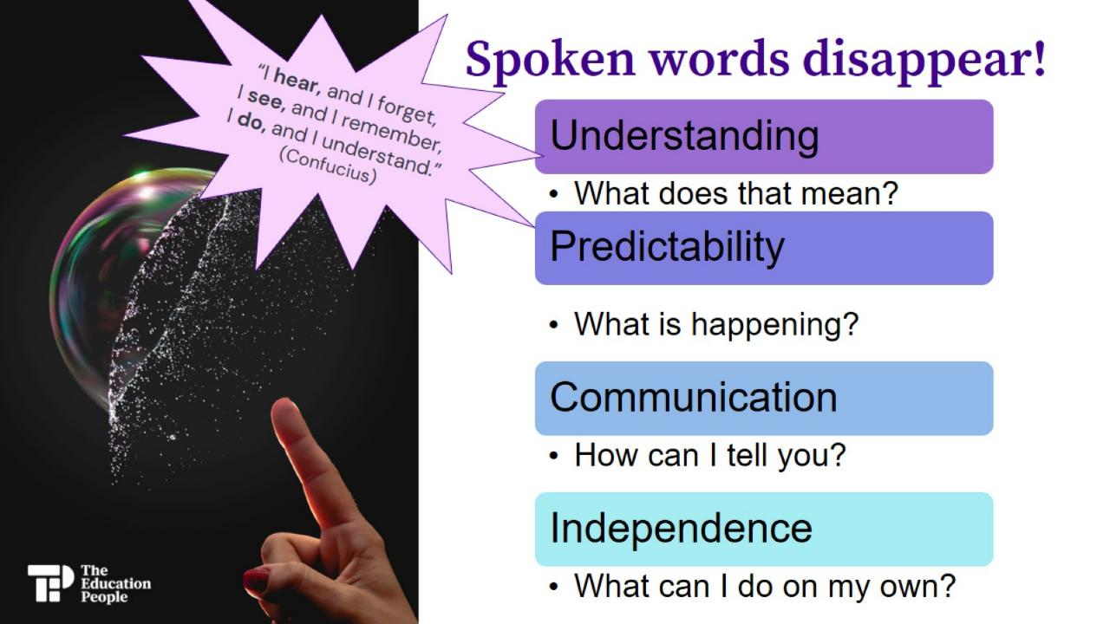

Slide 17


Slide 18
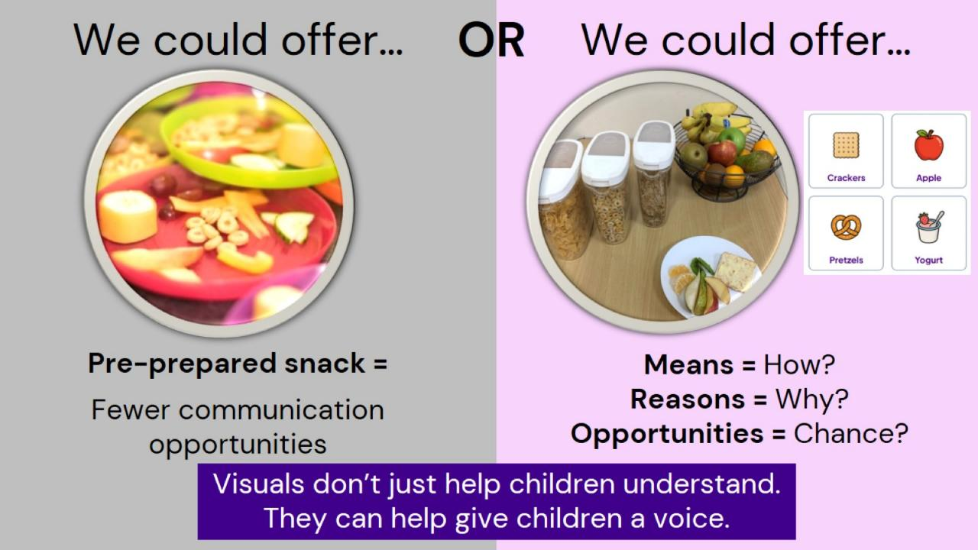

Slide 19
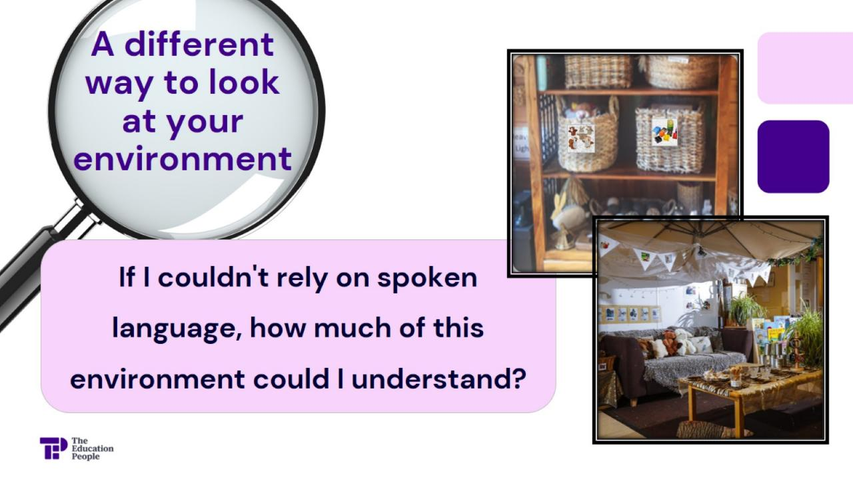

Slide 20
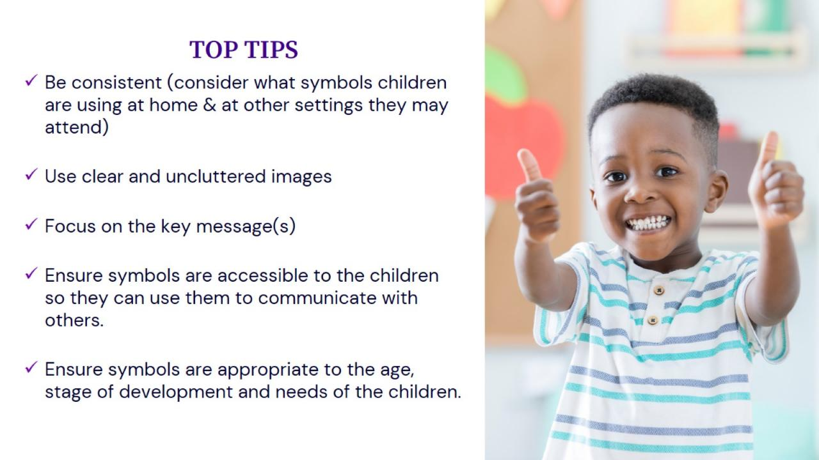

Slide 21


Slide 22

Starting Strong for Families and Supporting Parental Confidence.

Slide 23

Starting Strong – A guide for my family.

Slide 24



Supporting Parental Confidence:
Helping Families believe their child’s needs can be understood, supported and met.

Slide 25

Supporting Parental Confidence:
Will my child cope with someone they don’t know?
Will people understand them?
Will they be included?
Will their needs be met?
Will they be safe?
What happens when I’m not there?
Will people see their strengths?
Will they be happy?

Slide 26

Supporting Parental Confidence:

Slide 27
Supporting Parental Confidence:
Listen before you advise – that’s where trust begins…
Start with ‘Tell me about your child’ – and genuinely listen.

Slide 28
Supporting Parental Confidence:
Find the positives – and mean it…
Specific observations tell parents; ‘You know my child.’

Slide 29
Supporting Parental Confidence:
Give parents something practical to take away…
When parental confidence increases, they think ‘Actually, I can help my child.’

Slide 30
Supporting Parental Confidence:
Don’t underestimate the power of reassurance…
A child will have people around them who understand their needs and will advocate for them.

Slide 31
Supporting Parental Confidence:
Confidence is contagious…
Difference doesn’t have to mean limitation.

Slide 32

Supporting Parental Confidence:
A confident parent is more likely to:
Ask questions
Share what they know
Challenge something when it doesn’t feel right
Celebrate success
Work collaboratively with professionals
Believe that their child’s voice and needs matter

Slide 33

Supporting Parental Confidence:
We don’t have to know everything today in order to start helping your child today.

Slide 34

Support for EY Providers
KELSI – the go to place for all SEND support for providers
Early Years SEND Support & Inclusion Team - KELSI
Whistle stop tour of the site
“Google” with the words – Early Years SEND Kelsi

Slide 35

Bonus discount
If ordering with Kent County Supplies (KCS)……
Don’t forget to use the code TEP20 for 20% off your shopping basket!

Slide 36

Future EY SENCo Forums
In future you will need to book onto the Forums via Kelsi and not TEP.
We hope to be able to add the slides to KELSI, so they are more widely available following the Forums.
Thursday 11th February 2027 12pm
Thursday 11th February 2027 15:30pm
Thursday 20th May 2027 12:00pm
Thursday 20th May 2027 15:30pm

Slide 37


