Slide 1
High Needs and DSG Deficit Recovery Update
Background Information to support discussions
Karen Stone, Finance Business Partner
Christine McInnes, Director of Education
Matt Dunkley, Corporate Director of Children, Young People and Education

Slide 2
High Needs Block Forecast Update
Forecast spend for 21-22 has increased further since reported at last SFF meeting (further £3m)
21-22 funding includes grant £248m & £10m block transfer
Total spend £299m includes £2m inclusion fund
Overspend on High Needs: £41m but includes underspend on inclusion fund activities £8m – without transfer £49m overspend (19%)
£102m accumulated deficit (40%)
Impact on overall Dedicated Schools Reserve:
DSG Block | 31 Mar 21 £’ms | 31 Mar 22 £’ms | + Deficit - Surplus
School | -10.9 | 0.0 | TTO settlement as agreed with SFF
High Needs | +61.5 | +102.0 | Recovery unlikely to impact until 22-23
Early Years | +0.5 | +1.0 | Pressure on free entitlement payments likely to continue
Central | 0.0 | 0.0 | Underspends support offset High Needs
DSG Deficit | 51.1 | 103.0

Slide 3
DSG In-Year Position
Block | 2018-19 £’ms | 2019-20 £’ms | 2020-21 £’ms | 2021-22 £’ms
High Needs Block | 6.7 | 20.8 | 31.8 | 40.5
Schools block | -3.0 | -5.2 | -2.6 | 10.9 (TTO)
Early Years block | 0.7 | -0.7 | 0.4 | 0.5
Central block
In-year Surplus (-) or Deficit (+) | 4.4 | 15.0 | 29.5 | 51.4
2017-18 B/fwd | 2.2
Cumulative Deficit at year end | 6.5 | 21.5 | 51.0 | 103.0
School to HN transfer | 4.4 | 9.2 | 9.8 | 10.0

Slide 4
Main areas of Spend on High Needs
 | 2017-18 Actuals £’ms | 2018-19 Actuals £’ms | 2019-20 Actuals £’ms | 2020-21 Actuals £’ms | 2021-22 Forecast £’ms
High Needs Block DSG | 182.0 | 201.3 | 204.0 | 222.9 | 248.4
Transfer from Schools Budgets | 8.5 | 4.4 | 9.2 | 9.8 | 10.0
Total High Needs income | 190.5 | 205.7 | 213.2 | 232.7 | 258.4
Total Spend | 202.0 | 212.4 | 234.0 | 264.6 | 298.9
Total in-year overspend | (11.5) | (6.7) | (20.8) | (31.9) | (40.5)
Accumulated deficit | (2.1) | (8.8) | (29.7) | (61.5) | (102.0)

Slide 5
Impact on Related Council Budgets
Council Funded Services (Council Tax)
Not all services for SEN are funded from Dedicated Schools Grant
Capital Grants: Increasing Places
DFE funding for 2 new Special Schools
Insufficient Basic need High Needs Capital Funding
Between 18-19 and 21-22 £26m spend compared to grant of £17.5m
 | 18-19 £’ms | 19-20 £’ms | 20-21 £’ms | 21-22 £’ms
SEN Transport | 30.2 | 34.6 | 28.6 | 41.8
SEN Services | 2.0 | 5.1 | 6.0 | 6.9
Education Psychology | 2.8 | 2.8 | 4.0 | 4.8

Slide 6
Predictive Modelling: Current Trend: Number & Age of EHCPs

Slide 7
Predictive Modelling: Current Trend: Provision Types Required
This assumes adequate provision can be made.
The importance of the transfer from School Block
Notes:
Use of probability matrices based on trend in the last 2 years to predict likely requirement of places until 2026.

Slide 8
DFE & MHCLG Guidance: DSG Deficits
Legislation was changed so Councils must:
Carry all DSG deficits forward to set against the schools budget in the next financial year; or future years (where that is not possible).
Not use general funds to eliminate any part of the deficit, or top up its schools budget, without express consent of the Secretary of State
Statutory override introduced for 2020-21 council accounts and currently ending after March 2023 – Councils record DSG deficits in an unusable reserve so doesn’t affect councils overall accounts BUT deficit still remains within councils overall finances.
The use of the statutory override for future years is under review
Where a council is facing cashflow problems as a result of holding the accumulative deficit within their overall reserves, the DFE will consider applications for forward funding future DSG allocations.
Deficit recovery plans need to focus on bring the overall DSG account into within a timely period (where possible)
Where this is not possible, plans need to demonstrate a strategy to balance in-year: where in-year spending is brought in line with in-year funding before department will consider funding historic deficits

Slide 9
Kent’s position in relation to National Comparators

Slide 10
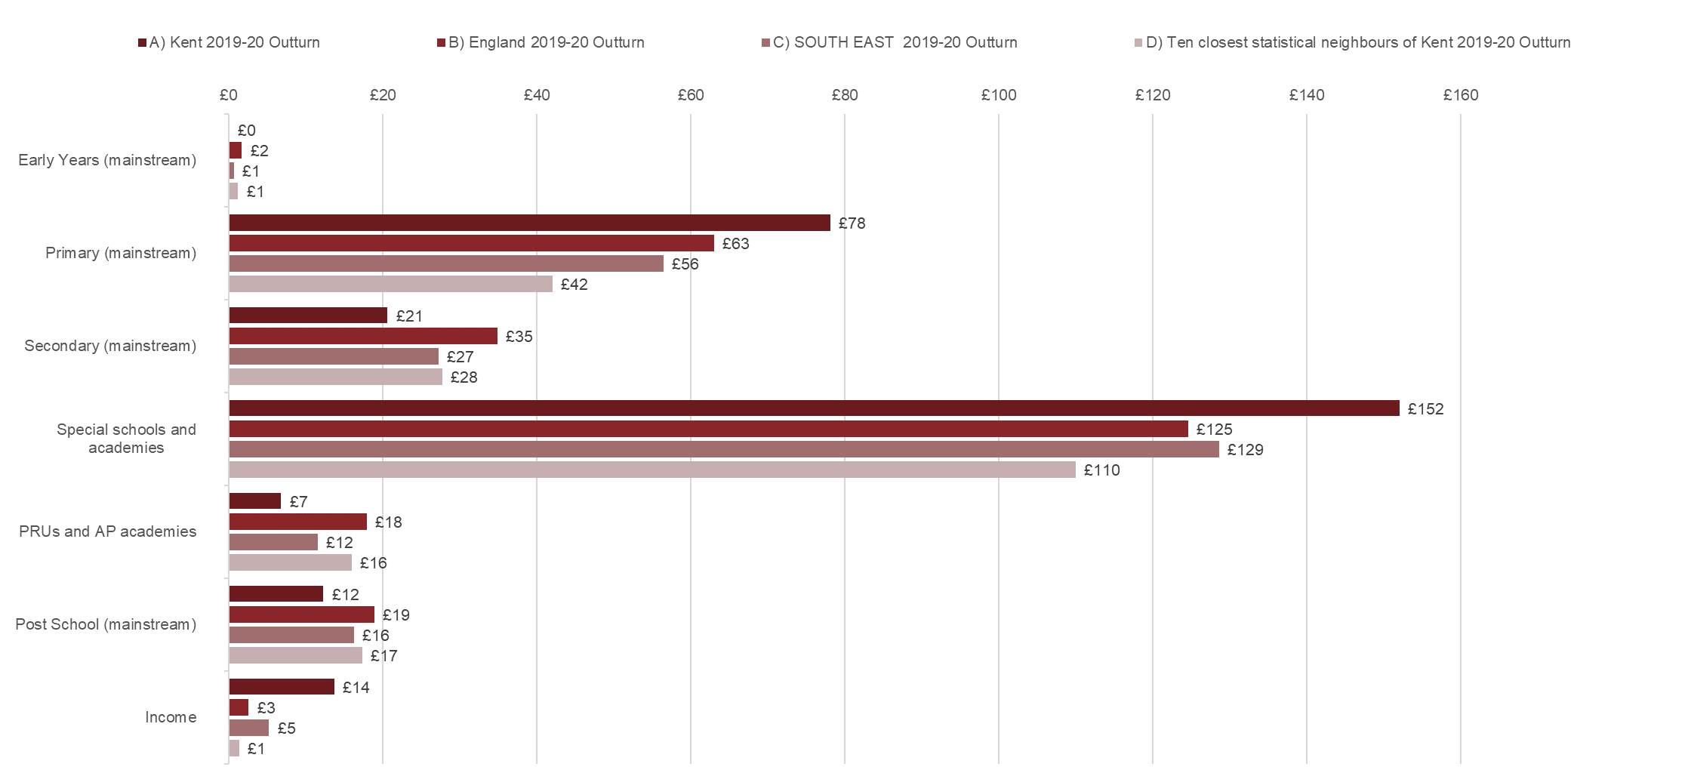
Average spend on key areas (2019-20)
In Kent: 90% of high needs top-up goes to primary schools
Reflection of higher numbers in special schools
…..Lower spend on PRUs but higher spend on wider AP services
High needs spend per head of 2-18 population - top up funding (maintained schools, academies, free schools and colleges)
Split by phase (mainstream) & institution type
The following graphs are 2 years out of date but give an indicator of spend on High Needs block by other Local Authorities

Slide 11
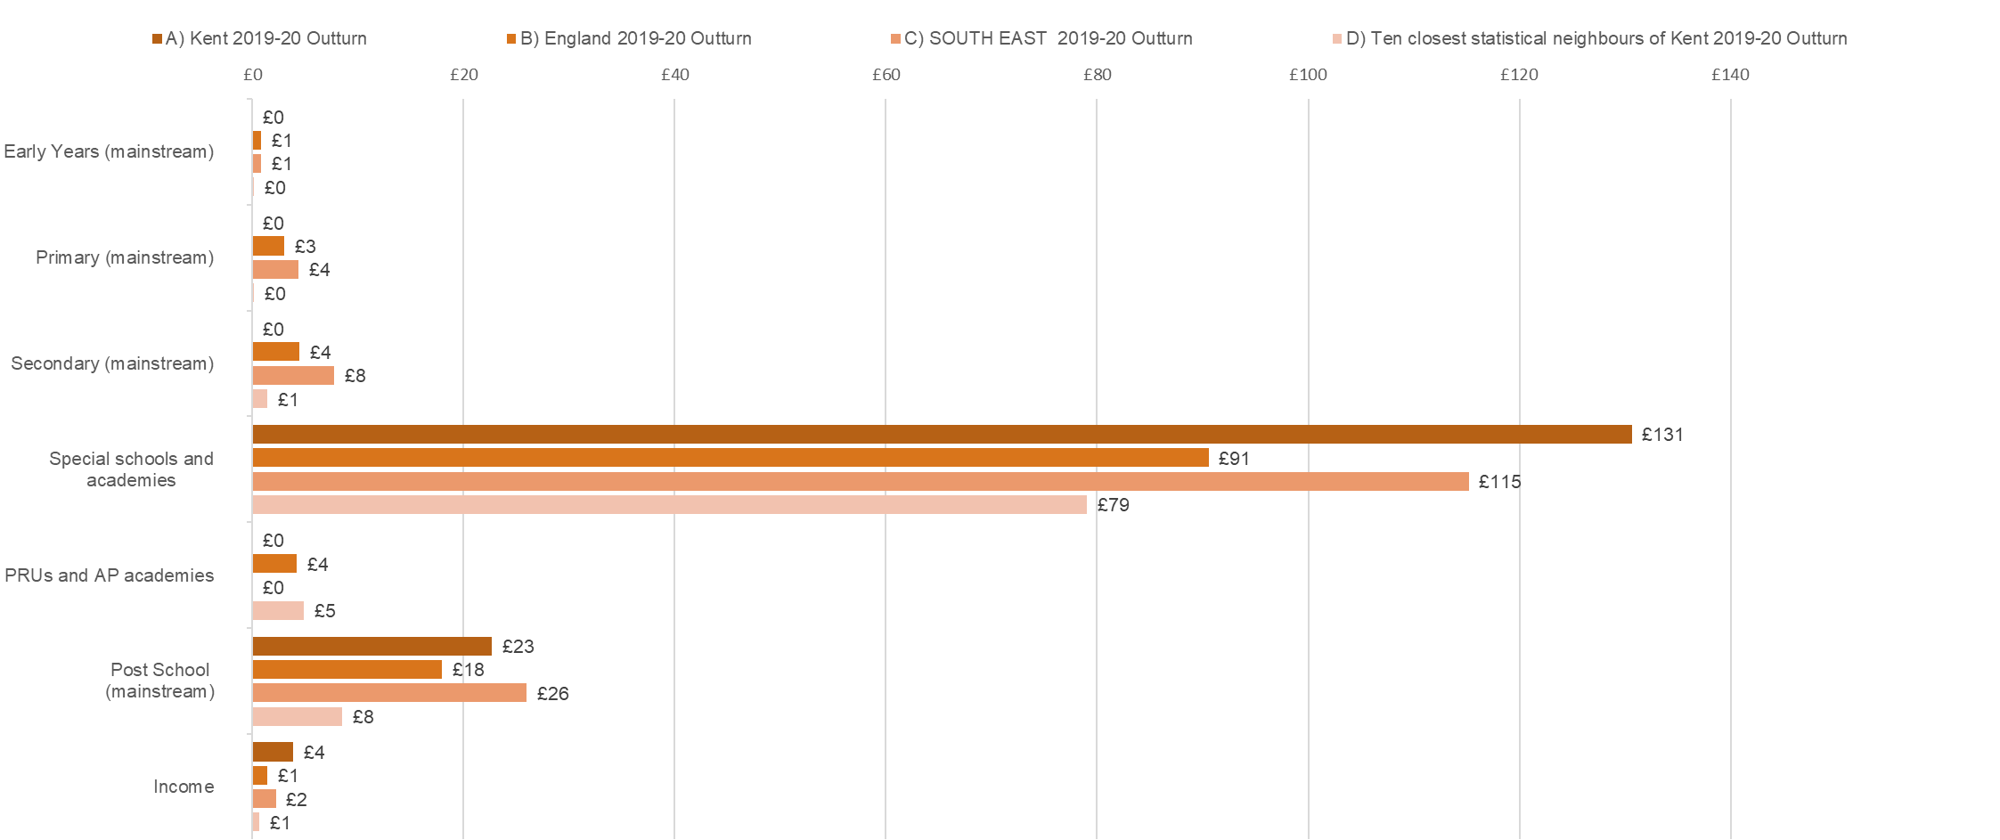
Average spend on key areas (2019-20)
Reflection of higher numbers in independent schools
High needs spend per head of 2-18 population - top up funding (non-maintained and independent schools and colleges)
Split by phase (mainstream) & institution type

Slide 12
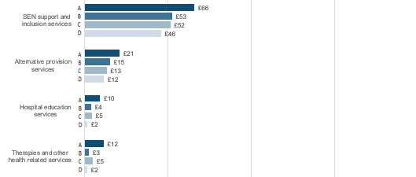
Average spend on key areas (2019-20)
Indicates higher spend on SEN support services including therapies (last bar chart)
…..Lower spend on PRUs but higher spend on wider AP services
…Not all LAs have hospital schools
High needs spend per head of 2-18 population – other services

Slide 13
EHCPs 0-25 year olds
12%
7%

Slide 14
EHCP Placements

Slide 15
EHCPs in Mainstream
12%
6%

Slide 16
EHCPs in SRPs
12%
8%

Slide 17
EHCPs in Special & Independent

Slide 18
The Growth in Special Schools Places
Overall the number of special schools places has grown by 33% in past 5 years
Significant additional investment in capital programme
2 new special schools, expansions & creation of satellites
Largest increase in primary school age children educated in special schools
Special School places increased at higher rate than other local authorities
Not resulted in a lower dependency in independent (increased by 866 places in last 5 years or 144% increase).
Number of Special School Places:
Number of Special School Places:
Number of Independent Places:
Notes:
This shows that Kent has responded to increases in demand for specialist placement. They have built more capacity (high increases that OLAs) but this hasn’t stopped increases in independent.

Slide 19
High Needs Funding and SEN Review Update

Slide 20
High Needs Funding Formula
Current Formula Allocations:
a High Needs national funding formula
Uses a basket of indices; pupil population, disability living allowance, children in bad health, low prior attainment, free school meals and deprivation (IDACI).
Not beneficial for Kent – formula provides a lower level of funding then Kent had been spending historically….
Kent is protected by the Historic Spending Factor - tops the funding to better reflect historic levels of spend (£.
Kent is Floor Authority – minimum increases each year
The funding floor = minimum funding guarantee applied to schools
Kent’s ranking national:
Schools block: 31st lowest funded authority,
Kent HN block: 106th (or 43rd highest) based on pupil numbers

Slide 21
Future High Needs Funding
DFE confirmed 2022-23 HNB allocations – extra £0.8b nationally (10% increase), Kent to receive £0.2m (8% increase).
October spending review announcements included:
Planning on tripling national allocation of high needs capital funding allocations from £0.3b to £0.9b by 24-25 (Kent 21-22 allocation: £6.3m)
£4.7b - extra school funding including £1.6b in 22-23 (on top of what has been announced) along with extra £1.5b per year in 23-24 and 24-25.
Extra £1.6b in 22-23 likely to cover national insurance & minimum wage increases across primary, secondary & special schools
Not yet confirmed HNB allocations in future years but likely there to see similar increases to previous years.
Positive: Funding will increase in future years BUT will still be insufficient to meet current spend commitments

Slide 22
SEND Review Update
Will Quince MP, Minister for Children and Families, has written an open letter om the SEND review https://educationhub.blog.gov.uk/2021/11/10/an-open-letter-to-parents-and-carers-of-children-and-young-people-with-special-educational-needs-and-disabilities-from-children-and-families-minister-will-quince/
The new group set up to assist the department conclude the SEND and advise on proposals to be set out in a SEND Green Paper to be published in the first three months of 2022. SEND Review Steering Group - GOV.UK (www.gov.uk)
SEND Review aims to improve outcomes for children and young people with SEND, to improve the experiences of their parents and carers, and to deliver reforms that will bring financial sustainability to the SEND system. Some specifics:
- Proposals offer a way forward to reduce local variation.
- Improve early intervention,
- Make clearer the support and services everyone should be able to expect
- Funding and accountability systems to support recommendations
- Need to be supported and understood across health and care services, as well as education providers.

Slide 23
Plans for Recovery

Slide 24
A Summary of Actions Being Taken
Previous discussions at the Schools Funding Forum and within the Council (Scrutiny Committee July 2019) have referred the three-legged stool analogy as the solution to addressing the high needs deficit. The three-legged stool consists of;
Lobbying central government on two matters; increased funding in both the short and medium term, and structural changes to government policy to help reduce the demand.
Recent letters to new Secretary of State regarding the SEN Funding Crisis. Dependent on SEND Review (see previous slides for update)
Transferring funding between the blocks within the DSG.
  Continue to request support for transfer to support SEN support services in mainstream schools.
Review of KCC policies and processes to deliver savings locally

Slide 25
Future of transfers from Schools Block
Kent has requested transfers from the School Block to High Needs block
Since 2020-21 funding has specifically been identified to fund services that support inclusive practices in mainstream schools.
With move to National Funding Formula – this option will reduce but...
Recent consultation on future of schools funding suggested DFE are exploring possible alternatives: Following the recommendations from the SEND Review, future consultations will consider whether a new mechanism, in place of the current block transfers, and which is consistent with a hard NFF, needs to be developed for situations in which LAs continue to face significant, unavoidable, pressures on their high needs spending – for instance, in areas where particularly high usage is being made of special schools, which are fully funded through LAs’ high needs budgets, and relatively low proportions of children with EHCPs are being educated in mainstream schools
Table 4 | Transfer value | Transfer % of the Schools Block
2018-19 | £4.4m | 0.5%
2019-20 | £9.2m | 1.0%
2020-21 | £9.8m | 1.0%
2021-22 | £10.0m | 1.0%

Slide 26
A Summary of local Actions Being Taken: Update
Review and Develop Early Intervention and SEN Support Offer:
Development and adoption of Countywide Approaches to Inclusive Education (CAtIE)
Review of Specialist Teaching & Learning Service (STLS) : due to go to consultation in November (see separate paper)
Mainstream High Needs Review:
- Exploring alternative options to fund individual children with SEN (see separate paper)
Wider contracting & provision planning for specialist services:
Support value for money and most efficient use of resources
Contracting approach for independent and non-maintained placements (previous SFF discussion)
Future service delivery for SEN home tuition (previous SFF discussion)
Contracting approach for therapy services (previous SFF discussion)
Provision tracking and modelling tools
Provision Planning and Review: Special, SRPs, Mainstream. Ensure funds are focused on the most cost effective way and provide improved outcomes
Invest in additional specialist provisions including increasing the number of special school places to reduce the reliance on external placements (Kent Commissioning Plan)

Slide 27
Focus on Early Intervention & SEN Support:
CATIE principles
Supporting the highest quality core inclusive education delivery
Providing additional intervention and support with engagement and integration.
Ensuring that education inclusion support is part of a broader, holistic, and joined-up offer of support of support for young people’s care and health needs.
Ensuring smooth transition between education phases
Notes:
CATIE is based upon the LGA / ISOS principles and refines them into 4 key areas for focus in Kent:
Core inclusive education delivery (Combining MCS, training and peer support)
Additional intervention and support with education inclusion – alternative provision funding, Kent Health needs, local authority inclusion and attendance support – supporting attendance in school.
Linked to a broader, holistic offer (multi-agency) – integrated children’s service, early help services, broader multi-agency partnerships – Health (mental health, ND pathway).
Smooth and effective transitions – identified by Kent leaders as a key priority underpinning all other elements.

Slide 28
Continuum of Support linked to CAtIE
Specialist
Bespoke HNF resources / Specialist Resourced Provision
Specialist Interventions (inc. STLS/ Therapy)
Strategies delivered with school
Locality Support: multi-agency professional resources, e.g. STLS, Education Psychologists, Provision Evaluation Officers, PIASS, ND Parenting Support, Therapies (referral pathways will differ).
Locality Hubs
Flexible Locality Resources – pre-emptive & targeted
Additional
Core Training Offer
MCS Online Resources/ Training – Schools and Governors
STLS : Information, Advice, and Training
Transition Charter and guidance (inc. research)
Parents and Carers – MCS resources, Parent Engagement Training & Award
Best Practice Guidance / Inclusion Mark
Resources & tools: Resource Directory, Provision Planning Software
Core & Training/ Inclusion to Support Core
Strategies delivered by the school
Whole School Approaches: Nurture, SPELL, SLCN Scheme for Schools, Education Endowment Fund, Kent Supported Employment
Inclusion Leadership & Peer to Peer Review
Notes:
Diagram takes the previous models and ‘tiers’ them to show how the different inclusion commissions / service developments could align across this continuum of provision. Areas in bold indicate those where commissioning is co-ordinating / leading; many of the other areas will be support / contribution from commissioning and led by the services.
(Core Inclusive Delivery shown as two related boxes here – whole-school activity (universal) and SEN-focussed (i.e. delivery around the MCS).
Brief overview of the upcoming priorities: (bottom up)
a) Whole School Approaches
In addition to Nurture, Kent Supported Employment and Leadership
SPELL Training: (whole school approach re. ASC awareness) initial bank of trainers – STLS/SRP leads, looking to phase roll-out (learning from early implementation from SRP leads). Supported by Tizard Centre at UKC – may need further commissioning of additional trainers / materials.
SLCN: Funding 4 x Locality Network roles within the SCLN ‘Scheme for Schools – Balanced System’ – 5 year plan to develop capacity within schools. Additional locality roles to help connect the roll out of the offer to local schools.
Education Endownment Fund Cohorts – ‘SEND & Learning Behaviours’, fully funded. 2 cohorts taken place, approx 50 schools, further two cohorts planned for later in Autumn. Potential for further cohorts next year – awaiting feedback and data.
Core Training offer – building on work begun last year, aim to develop a graduated pathway. Will feed directly into STLS review and may identify further areas for commissioning. Needed to progress at pace to align with STLS review – which sits across both the core inclusive education delivery (training, IAG as well as potentially within Locality Resources). Already aware of some likely priorities that may need commissioning from core training review – WSOA priority around ASC targeted training. Some need to be partnership led – e.g. relationship with ND Pathway / pilot work underway and link to ASC commissioning for schools.
Inclusion Resource Directory & MCS Online Training Resource
- Aim to bring together information about training / support opportunities into one place for schools (signposting, not live dates). Scoping document now in place, looking to progress through the CCS Framework using our existing provider of the KCC directories. Support longer-term from Sharon’s team in maintaining. Also looking to develop online training resource for schools & governors re. MCS and application – building on feedback from early pilot sessions in Spring.
d) Provision Planning Software
- Currently c.100 schools use Edukey (although other options available) – software that supports provision planning within schools, also has wider potential benefits to the LA in being able to analyse anonymised data from the system to identify needs, trends, potential commissioning gaps etc. Surveyed existing school users with positive feedback; needs further scoping re. licences.
e) Parents and Carers
Family Charter, Engagement Award and Training – in development with PACT. First draft of Family Charter has been drafted, then PACT to work with us in defining further training / guidance for schools in working with parents/carers and then an award to recognise good practice. Early stages of development.
Looking at a parent/carer online resource around the Parent version of the Mainstream Core Standards to complement, support families in understanding / using, variety of routes to access the document etc.
f) Best Practice Guidance
Currently being scoped with TEP – would have application across a number of these commissions. Suggestion to look at an Inclusion Quality Mark for schools too, based on practice in other areas.
g) Transitions:
Charter in place, developed through Schools Working Group, actions to be identified as a result – will link to locality resources in terms of funding. Also link to research here – Summer born children / school readiness.
Transition Charter – working group has drafted a Charter, activities likely to fall out of this – allocation for development of guidance, pilots. Transition funding could be included within locality resources. To continue to work with Transition Group.
2. Locality Shared Resources
Locality resources are being scoped as part of the HNF Review– combining in-kind resources (models for bringing together professionals within localities) and a system for allocating flexible funding for pre-emptive & targeted work:
pre-emptive work: trends, needs at district / county level, transition activities, large new cohorts moving in
b) short term and emerging issues both for individuals and for groups, either in a school or across a group of schools. These might be CYP with SEND who for number of reasons, reach points where they struggle to access education in the same way as they had previously. These CYP may experience a range of circumstances which alters the way they present, cope and engage with education. These experiences include:
A change in environment, home stability, family breakdown, new sibling, stepparent arrangements etc
Transition between education providers both at key points and mid-year.
Growing up, changes to hormones, social groups.
Access to alcohol or drugs.
Bullying at school.
Other recent Adverse Childhood Experience.
Overall the aim is to create a system based on local collaboration and responsibility for all CYP. Proposals to HT working group in late Sept / early Oct; aim for consultation in Nov.

Slide 29
New inclusion commissioned services
Nurture
Structured & evidence-based programme of Whole School Nurture, inc. Boxall Profiling and nurture group training.
Nurtureuk, 3 year contract
Leadership
Peer-to-peer reviews for school leaders and Inclusion Leadership Development Programmes
LLSE Consortium (LLSE, EDT, nasen), 2.5 year contract
Supported Employment
Programme of training and consultancy support to embed SE approaches in school careers plans.
Includes Travel Training, employer engagement, vocational profiling etc.
funded opportunity for up to 15 Inclusion Leaders of Education
National Nurturing Schools Award
Specialist Employment Service, 3 year contract.
Notes:
Quick overview of the three new commissioned inclusion services, for anyone new to the group.
(Further detail below if required):
Nurture:
The offer:
National Nurturing Schools Programme provided by nurtureuk. Approx 18 month, structured & evidence-based programme that builds on schools’ existing strengths. Includes access to Boxall Profiling and nurture group training (implementation at schools’ discretion).
Outcomes for CYP: = social and emotional wellbeing benefits for all CYP, but particular focus on those with SEMH needs. Indicators will include whole-school benefits as well as specific outcomes for pupils with SEMH – emotional wellbeing (Boxall) as well as attendance, exclusions, engagement measures.
Contract:
- Minimum of 300 schools to complete the programme over next 3 years.
Core part of spec is on sustainability and the need for close working / training opportunities for partners too, to enable them to support longer-term embedding of the model. Engagement model will therefore be tiered so we prioritise the work with core district partners. All partners: termly networking opportunities, newsletter. Tiers 1 & 2 – opportunities to access elements of the training so we are building a collaborative approach, reflect the same values and principles to support longer-term sustainability. Work underway with partners to identify this.
Leadership:
The offer:
Programme of peer-to-peer reviews for school leaders and Inclusion Leadership Development Programmes (Middle and Senior Leaders) to review, support and challenge one another in implementing inclusive practices for CYP with SEND.
Will include funded release time for school leaders to access, as well as funded opportunity for up to 15 Inclusion Leaders of Education to support school Clusters– applications will be opened shortly.
Outcomes: school-level outcomes for staff in terms of knowledge, skills, confidence, and inclusive practices; longer-term CYP outcomes around FT and PT exclusions, % with EHCPs in mainstream, parent confidence etc.
Contract:
2.5 year contract (31.03.24), front-loaded: LLSE Consortium.
Aiming for 360 schools to be actively participating by the end of Year 2
75% of Kent schools will have at least 1 Headteacher (for every Trust or school) and 1 senior leader who has completed an Inclusion Development Programme (by end of Year 2).
Supported Employment
The offer:
Structured programme delivered by Specialist Employment Service to work with secondary schools in embedding a Supported Employment approach for YP with SEND as part of their Careers Plan. Will include core modules – Travel Training, Vocational Profiling, Employer Engagement etc – and support schools through a process of self-evaluation to implement these approaches.
Outcomes for YP: Improved transitions for YP with SEND at post-16, including % of YP with SEND in participating schools who have a September Guarantee in place and % who become NEET etc.
Contract: SLA with Specialist Employment Services for 3 years (31.08.24)

Slide 30
New inclusion commissioned services
Phased implementation; multiple joining points.
First delivery cohorts from January 2022
Mobilisation: Terms 1 – 2 priorities:
  Communications and engagement with schools
  Engagement with partners and stakeholders
  Scorecards
  ILE recruitment (Leadership)
Notes:
New services coming on-stream now, fully funded for schools – phased implementation for schools, multiple joining points from Jan, emphasis on flexibility.
Comms activity beginning now – this term will be about engagement with schools and partners to raise awareness of the opportunities (webinars and engagement opportunities planned)
Schools – scheduling comms, prioritisation exercises for targeted comms, identifying early adopters / existing case studies (nurture). Webinar opportunities planned, as well as linking into other opportunities – SENCO briefings etc.
Partner engagement: specifications have been written with emphasis on sustainability through working with partners, as well as schools. Particularly so for nurture – tiered opportunities – making direct approaches to key teams and partners to identify opportunities for a) access to training b) networking groups c) strategic input / steering group – inc. evaluation. Individual introductory meetings being booked with key partners over next few weeks.
First active delivery cohorts beginning from January (preparatory work from Nurture in Dec).
Flexibility in all cohorts for schools – method of delivery, flexible completion windows, active follow-up from services etc.

Slide 31
Raising the profile:
Feedback from recent Headteacher Briefings
Headteachers were recently asked about their experiences & what additional actions could be taken to help address the DSG deficit.
The following slides are a summary of their responses

Slide 32
HT Responses: How do we move demand for and proportion of pupils with EHCPs to be nearer national averages this year, then beyond ?
Schools not supporting the need for EHCP are bypassed – role of GPs, other services (KCC?)
- manage the process to enable dialogue between parent & school; strong recommendations to visit school
communications with all partners re direction of travel and rationale
communication strategy for KCC, partners and parents with key messages/narratives from parents and school staff a/ challenging need for EHCPs b/ examples of children with EHCPs being successfully educated in mainstream school to build confidence in mainstream schools- use social media
EHCP age request. They have got younger and more children with EHCP’s in primary. Special Schools getting filled up early and quickly.
EHCPs in Early Years and Primary
No EHCP’s in reception? Most children should be accommodated in mainstream reception unless in extreme needs, this would create places in special schools.
Observation and Assessment pilot- very positive outcomes
Year R pupils with needs that have had involvement with services, working with nurseries
Pre school to Primary transition; money attached to the child transfer automatically to EYs

Slide 33
HT Responses: How do we move demand for and proportion of pupils with EHCPs to be nearer national averages this year, then beyond ? (continued)
Secondary transition
Start transition work early (year 4 or 5)
Resourcing for secondary schools
Adjustments to Kent Test and monitoring selective schools statutory compliance and support
Primary HT anticipating that a Secondary school will not work for a child and applying for EHCP
Structural and resourcing issues
SEN team don’t know the schools – need to develop closer working relationships
More robust application process
Review and cease EHCPs
Invest more retained funding in training and particularly release of staff, build on and use existing good practice; case studies of good practice
More consistent practice and less variation across Kent – STLS and LIFT strong in Ashford but not in other areas (would be useful to look for co-relation with number of EHCP requests). Successful NQT programme in Canterbury
Role of PEOs and evidence of impact
Improve transparency and communications

Slide 34
HT responses: How do we change the current financial trajectory this year and beyond?
What are schools doing to hold others to account re Inclusion? What is the LA doing to challenge schools?
Make sure schools have the same understanding about being inclusive.
Year 5 have a sudden influx for EHCP’s for year 6 transitioning to secondary. How do Primary work with Secondary on these transitions?
Professional career development for staff who work with children with SEN to improve recruitment and retention, similar to an HRTA, with financial recompense
Specialist resource provision – put support in all schools so they all had a nurture group plus CPD and progression, wouldn’t save money for the first year but after that you would have less children to independent schools which costs a huge amount. Short term pain for long term gain
Now less regulated on getting a diagnosis – looking at that data to understand it further
Need to stop the deficit growing so we can have a discussion with government about paying back the outstanding money !

Slide 35
HT responses: What approaches have most impact & are most cost effective in mainstream schools?
Specialist/investing in own school has the biggest impact – long term cheaper than outsourcing and have more control. A lot of schools least trained staff work with those with the most complex needs
Collaborating/linking with special schools
Evaluate & QA training – ensure quality and value for money Small schools have to source for wherever they can – difficult to find resources.
Really challenging time for children with EHCPs and many were not in schools; staff have had to work very hard with them on an individual basis
Early support can make a difference
Parents are not sufficiently aware of the offer from schools which could avoid them going for an EHCP – what parents can expect from SEN support
Need to strengthen partnership between schools and LA
Annual reviews – not rigorous enough
High Needs top up could be a pump primer at certain key transition points

Slide 36
Scenario Planning: balancing the budget

Slide 37
Options to balance the
Dedicated Schools Grant in-year
Key considerations
Need to focus on the drivers of the deficit in High Needs Block
What is controllable expenditure?
Increasing percentage of the HNB is spent on special and independent provision leaving little to support the rest of the system.
Is it possible to achieve breakeven without changing current trends in activity?
Are the current actions enough to achieve a breakeven position? Are we investing in the right services to support mainstream schools?
How quickly should we aim to balance the budget?
How realistic is budget planning?

Slide 38
Moving towards National Averages
Based on the 2021 SEN return if Kent reflected national average today then there would be:
1,900 less children in specialist provision (special schools & independent schools)
600 less children supported in SRPs
800 more children with EHCPs in mainstream
1,700 more children supported at SEN support level
Would this achieve breakeven? Yes
Is this aim realistic??
How do we build a sustainable SEN support system which can support this?
This assume the average cost of special school place remains static…is this realistic?
MODEL ONLY

Slide 39
Moving towards National Averages
If the number of EHCPs grew in line with national average and….
Kent flatten the growth in the number of children supported in specialist provision how long would it take to get to breakeven? Is this reasonable? And how realistic?

