Slide 1
Early Years Local Inclusion Forum Team (EY LIFT) Process & Pre-requisites
Concerns identified in setting
Setting staff will have identified that the child would benefit from additional support within the setting to develop their skills and learning. Setting staff will have shared their observations with the family and consulted the Best Practice Guidance (BPG) to ensure that good universal practice is in place.
Support can be accessed via the Equality and Inclusion Team or Childminding Advisers who will be able to offer Universal or Targeted support to settings, they can either visit your setting or they may offer you telephone/virtual support. Any advice they give will need to be actioned and evidenced.
For children with a Physical Disability or identified medical/health needs it is advisable to make a referral to EYs LIFT to ensure your setting has everything in place to support the child before they start attending.
Request support from Early Years Equality and Inclusion or Childminding Advisers
https://www.kelsi.org.uk/early-years/equality-and-inclusion/equality-and-inclusion
To make a request for support settings should use the following link, childminders should use the form found on the webpage address above.
https://kentcc-self.achieveservice.com/service/Equality_and_Inclusion_Request_for_Support_form_Process
It may be appropriate to put a Targeted Plan in place.
Targeted Plan to be reviewed after 6 weeks and further Targeted Plan to be implemented for a further 6 weeks.
If there is limited progress, for some children it may be appropriate to create a Personalised Plan, at this stage with the family and with advice from multi-agency colleagues if already involved.
Concerns remain – Individual progress
Having consulted the Best Practice Guidance, evidenced all the support that has been implemented and evaluated within the Targeted / Personalised Plan, it may be appropriate to speak to the child’s family again, seek parental / carer consent and refer to Early Year’s LIFT for more support and advice specific to the child's needs.
There are occasions when a child will start at a setting with a Personalised level of care already in place and this can be added to the Plan.
Referral to EY LIFT
To make a referral, complete the EY LIFT referral form which can be found on the following Kelsi page: https://www.kelsi.org.uk/special-education-needs/special-educational-needs/local-inclusion-forum-teams
The form will provide information about the child’s needs and the support you may require, you will need to gain parental/carer consent to raise the child at EY LIFT.

Slide 2
Early Years Local Inclusion Forum Team (EY LIFT) Process & Pre-requisites continued
Identify EY LIFT group and date / time of the next meeting
Details of EY LIFT meetings can be found on the District special school website.
Urgent cases can be raised at an EY LIFT meeting outside of your group.
Please contact the District STLS administrator for further meeting details.
Send completed EY LIFT referral form to the District STLS administrator
On receipt , the STLS administrator adds the referral to the EY LIFT group agenda for the next termly meeting. STLS Administrator may request further supporting evidence prior to the meeting.
Ensure relevant supporting paperwork is collated to bring to the EY LIFT meeting
It is good practice to include the appropriate Best Practice Guidance Audit Tools and other evidence as recommended on the bottom of the EY LIFT referral form.
Attend the District EY LIFT meeting for discussion and support
Each case will be discussed with the group, advice given and next steps agreed with the specialists in attendance. This could include support from the District Early Years Specialist Teacher, Speech and Language Therapist, Children’s Centre Early Help worker, Health Visitor or Equality and Inclusion Adviser.
If a training need is identified this may also be recommended for the setting staff.
Children can be discussed anonymously at the meetings for general advice and support.
Post EY LIFT Meeting – Sharing Outcomes
If agreed, the relevant professionals will arrange to visit the child for observations in the setting or make contact with the family.
Records of intervention will be prepared following the contact made sharing advice and strategies for the setting.
There is an expectation that the setting will implement the advice provided and evidence reflected in the Personalised Plan.
If training has been recommended the setting practitioner / SENCo should raise this with the setting manager/ childminder and arrange training as appropriate.

Slide 3
Actions by Role
Setting
Follows Graduated Approach as outlined in the SEN Code of Practice, implements Universal support alongside Best Practice Guidance (BPG).
Discusses child’s strengths and difficulties with family.
Creates Targeted Plan.
Refers to Early Years Equality & Inclusion or Childminding Adviser for support.
For some children it may be appropriate to create a Personalised Plan allowing time for strategies to embed.
If necessary, seek parental/carer agreement to make a referral to an EY LIFT meeting.
Completes and sends EY LIFT referral form and parental agreement form to District STLS Administrator.
Attends EY LIFT meeting to discuss child’s needs and gain advice.
Feeds back recommendations to key setting staff and family to support the child and implements strategies suggested/ agreed.
If not in place, devise a Personalised Plan incorporating recommendations from EY LIFT meeting.
Works in collaboration with multi-agency colleagues to implement and embed strategies recommended.
Review and update Early Years Personalised Plans every six weeks / termly alongside family to include their views.
Early Years Equality and Inclusion or Childminding Adviser
Provides advice and Universal /Targeted level support to settings.
Provides advice and strategies for settings to try which should be included in an EY LIFT request.
Gives support with EY LIFT requests and Best Practice Guidance Audit tools.
Post EY LIFT visits available on request.
Recommends appropriate training available.
Specialist Teaching and Learning Service - District Administrator
Collates EY LIFT referrals for each meeting.
Requests supporting evidence if required.
Shares agenda securely with attendees, including Equality and Inclusion adviser.
Prepares EY LIFT meeting confidentiality agreement for each meeting.
Minutes the EY LIFT meeting and shares outcomes securely where appropriate.
Specialist Teaching and Learning Service – District Lead / Specialist Teacher
Chairs the EY LIFT meeting.
Facilitates discussion and offers focused advice and strategies.
Allocates, where appropriate, a specialist teacher to support the child and setting to make progress.
Multi-agency support
Attends district EY LIFT meeting and gives advice as appropriate.
Arranges contact with the setting / family if agreed.

Slide 4
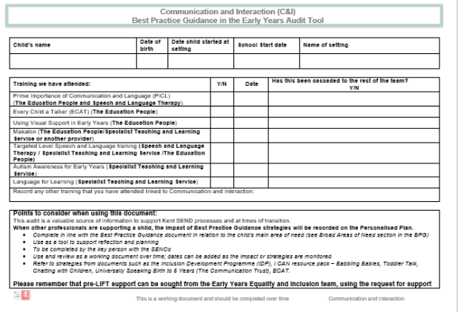
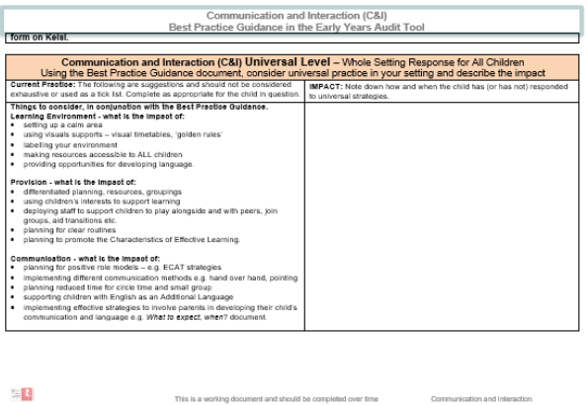
Universal Level Support Cycle flow chart
First time that a concern has been raised? Start at Universal.
Other professionals already involved with child? Start at Personalised.
Child is within a year of starting school?
Move through stages more rapidly.
Start here
Universal level
Child’s progress gives cause for concern (raised by parent or Key Person ) Identified through starting points, observations, Progress Checker at Two, summative assessment etc.
What is the nature of the concern? Key Person monitors and gathers information to build a picture of what the child can do and finds difficult.
Key Person informs SENCO. They use Best Practice Guidance document to evaluate how child has responded to the Universal offer and record in relevant Best Practice Guidance audit tool. A request for Equality &Inclusion support is advisable.
Key Person and SENCO work together to liaise with parents, share evidence, agree adjustments to be made and timescale for review (usually 6 weeks). Possible advice from Early Help, Health Visitor 2 year health check.
Practice at Universal is meeting child’s needs. Key Person and SENCO monitor as part of everyday practice.
If practice at Universal is not enough, insufficient progress made. Put Targeted support in place.

Slide 5
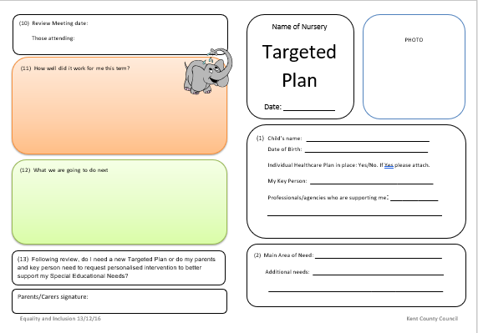
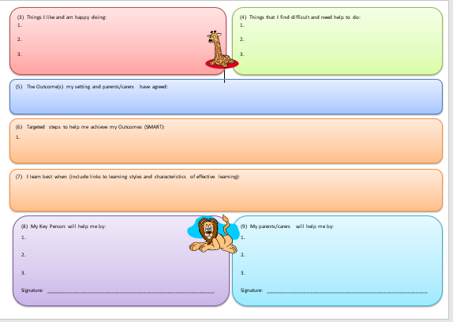
Targeted Level Support Cycle flow chart
Practice at Universal level is not having required impact and child has made insufficient progress. Setting needs to put Targeted support in place.
Targeted level
Key Person, SENCO and parents agree strategies to be implemented in setting and at home, timescale for review (usually 6 weeks) and record on Targeted Plan.
Key Person and/or SENCO continue to use Best Practice Guidance document to identify appropriate strategies to support child and BPG audit tool as a working document to record impact on child’s progress. A request for Equality & Inclusion support is advisable.
Key Person, SENCO and parents review Targeted Plan and evaluate whether Targeted support is meeting child’s needs. If yes, Key Person, SENCO and parents write new Targeted Plan and monitor progress. This stage may be repeated several times.
Targeted support is no longer needed. Return to Universal. Key Person and SENCO monitor as part of everyday practice.
If practice at Targeted is not enough, insufficient progress made child has an identified SEND. KP and SENCO liaise with parents, share evidence and discuss seeking Personalised support.

Slide 6
Personalised Level Support flow chart
Practice at Targeted level has not had the desired impact, child has made insufficient progress and there is increasing awareness that the child has identified SEND.
Key Person and SENCO liaise with parents, share evidence and discuss seeking Personalised support from professionals from outside setting.
Personalised level
Education - Personalised support requested through EY LIFT
Key Person and SENCO collate evidence, update Best Practice Guidance audit tool, complete EY LIFT request form, parents complete agreement to engage form. A request for Equality & Inclusion support is advisable.
SENCO and/or Key Person attend EY LIFT meeting.
*Health – Personalised support requested through NHS referral routes
Key Person and SENCO work with parents to complete relevant referral form. Refer to One Stop Document e.g. SALT, NHSCCCT.
A request for Equality & Inclusion support is available to complete documentation.
Personalised intervention in place from health and/or education professionals.
Key Person, SENCO and parents work together to complete Personalised Plan (targets taken from professional reports). Agree timescales for review (usually 6 weeks).
This stage will be repeated several times.
Practice at Personalised level, where appropriate liaise with STLS and discuss seeking additional support e.g. SENIF.
SENCO records relevant information on SEN and/or AEN Record.

