Slide 1
Specialist Teaching and Learning Service – consultation outcome and recommendations
Christy Holden – Head of Strategic Commissioning – Children and Young People Services

Slide 2
Context of meeting:
Forum’s Role: Consultative
LA’s Role: To take into consideration views of schools, wider stakeholders and School Funding Forum when making the decision.
Due to be shared with CYPE Cabinet Committee 11th January before formal decision is made by Cabinet Member.
Summary paper and presentation made on 26th November on the background of STLS including outstanding financial considerations

Slide 3
Background:
Review commenced in Summer 2020 – initial remit was to better understand quality of service delivery and value for money
Development of KPIs
Wide stakeholder discussions including surveys and meetings
Concluded in five sections to consult upon – consultation ran from 3 November 2021 to 7 December 2021:
• Structure of STLS
• Access to Specialist Advice, Support and Interventions
• Core Training Offer
• Communication and Engagement
• Sensory STLS and Physical Disability STLS
Consultation considered online responses, face to face meetings, virtual meetings, emails and posted documents

Slide 4
Profile of Responses:
557 questionnaires completed:
462 questionnaires were completed online
95 questionnaires (all from one Special School) were delivered in person
Question 1: Respondents were asked to tell us in what capacity they were completing the questionnaire.
Key message: Majority of respondents were education professionals (76%)
Respondents by type | No. | %
As a parent / carer of a child or young person with SEND | 37 | 7%
As a resident of Kent | 58 | 11%
As an education professional | 421 | 76%
As a health or social care professional | 8 | 1%
Other | 28 | 5%
Total | 552 | 100%

Slide 5
Profile of Responses:
Question 1a: If responding as an ‘education professional’, respondents were asked to select from a list which area they work in.
Key message: Majority of respondents were from mainstream primary schools (37%), closely followed by respondents from special schools (34%).
If responding as an education professional | No. | %
Special school | 144 | 34%
Early years setting | 48 | 11%
Mainstream school (primary) | 153 | 37%
Mainstream school (secondary) | 19 | 5%
Further Education college | 2 | 0%
Other | 53 | 13%
Total | 419 | 100%

Slide 6
Profile of Responses:
Question 1b: If respondents selected ‘Other’ to question 1(a), they were asked to specify what other education setting best describes their situation.
Key message: Majority of the 'Other' education professional respondents are from the STLS Service with 70%
If responding as 'Other' education professional | No. | %
STLS | 37 | 70%
KCC Teams | 7 | 13%
Mainstream with SRP | 4 | 8%
Mainstream across phases | 2 | 4%
PRU | 1 | 2%
Specialist training provider | 1 | 2%
SRP | 1 | 2%
Total | 53 | 100%

Slide 7
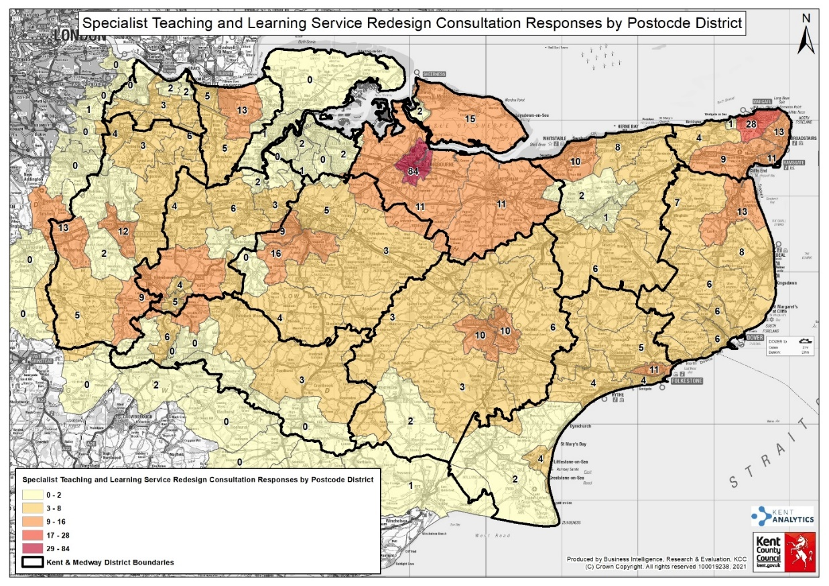
To help us understand and analyse the geographical spread of feedback to the consultation, respondents were asked to provide the first five characters of their postcode or that of the organisation on whose behalf they were completing the questionnaire

Slide 8
How they heard about the consultation:
Question 3: Respondents were asked how they found out about this consultation
Key message: 57% of respondents received an email from KCC to respond to the consultation
How did you find out about the consultation | No. | %
An email from KCC | 268 | 57%
From a friend or relative | 25 | 5%
Social Media (Facebook or Twitter) | 10 | 2%
Kent.gov.uk website | 37 | 8%
Other | 133 | 28%
Total | 473 | 100%
‘Other’ channels included 42% from STLS, 33% from school/ workplace and the remainder from a blend of other sources, such as Kent Association of Headteachers (KAH), Kelsi website, LIFT Executive.

Slide 9
A: Structure of STLS:
The proposals for the structure of STLS offered two options:
Question 4: Respondents were asked to indicate their preferred option for the structure of the Specialist Teaching and Learning Service.
Option 1: The STLS district offer to continue to be aligned with and managed by 12 Special Schools operating in Kent’s 12 districts
Option 2: The STLS district offer to be aligned with and managed by four Special Schools across Kent in North, South, East and West. Each of these Special Schools to co-ordinate and manage the STLS offer in their area for three districts.
Key message: 76% of the respondents selected Option 1, which is to maintain the current district model of delivery for the district STLS teams.
STLS Structure preferred option | No. | %
Option 1 (District model) | 421 | 76%
Option 2 (Area model) | 69 | 13%
No preference | 36 | 7%
Don't know | 23 | 4%
Total | 549 | 100%

Slide 10
B: Access to Specialist Advice, Support and Interventions:
Question 5: Respondents were asked to what extent they agreed or disagreed with the proposal for a consistent countywide tiered access to Specialist Advice, Support and Interventions at district level, based on need, urgency or complexity.
Key message: 69% of the respondents either agreed or strongly agreed with the proposed tiered access to Specialist advice, support and interventions; with 12% disagreeing or strongly disagreeing
Tiered access to Specialist Advice, Support, Intervention | Nos | %
Strongly agree | 172 | 31%
Mostly agree | 207 | 38%
Neither agree nor disagree | 67 | 12%
Mostly disagree | 28 | 5%
Strongly disagree | 40 | 7%
Don't know | 33 | 6%
Total | 547 | 100%

Slide 11
C: Core Training Offer:
The feedback from schools and settings is that the training provided by STLS is of good quality and frequency, however, there are variations in what they can access.
Schools have told us that they would like the training offer from STLS to be more targeted and specialist, above the Mainstream Core Standards, to build their knowledge, skills and confidence in supporting children and young people with SEND across all their needs.
Question 6: Respondents were asked to what extent they agreed or disagreed with the proposal that the STLS Core Training Offer should focus on the Targeted and Specialist levels, that is training which is above the basic or awareness level.
Key message: 63% of the respondents either agreed or strongly agreed with the proposal that the STLS Core Training Offer should be at the Targeted and Specialist levels; with 24% disagreeing or strongly disagreeing
STLS Core Training to be targeted and Specialist | No. | %
Strongly agree | 158 | 29%
Mostly agree | 186 | 34%
Neither agree nor disagree | 54 | 10%
Mostly disagree | 55 | 10%
Strongly disagree | 75 | 14%
Don't know | 19 | 3%
Total | 547 | 100%

Slide 12
C: Core Training Offer:
Question 7: Respondents were asked to what extent they agreed or disagreed with the proposal that, where a need is identified which cannot be met through the STLS Core Training Offer, settings / schools may request STLS to design and deliver a chargeable bespoke training package.
Key message: 70% of the respondents either agreed or strongly agreed with the proposal to have access to chargeable bespoke training; with 18% disagreeing or strongly disagreeing
Access to chargeable bespoke training | No. | %
Strongly agree | 209 | 38%
Mostly agree | 176 | 32%
Neither agree nor disagree | 45 | 8%
Mostly disagree | 37 | 7%
Strongly disagree | 61 | 11%
Don't know | 16 | 3%
Total | 544 | 100%

Slide 13
C: Core Training Offer:
Suggestions | No. of mentions | %
Pre and post questionnaires for parents | 17 | 12%
Ask parents/ Listen to parents | 15 | 11%
Single point of contact or dedicated co-ordinator for help and support to parents | 15 | 11%
Blended training approaches for parents - face to face and online real time/ recorded webinars | 14 | 10%
Existing good practice | 14 | 10%
SENCO/ School | 13 | 9%
Parent forums | 12 | 9%
Kent PACT/ We are Beams/ IASK/ Space2BMe | 10 | 7%
Informal coffee drop-ins | 6 | 4%
Feedback method to interact with Service and clear route to escalate issues | 5 | 4%
Allow referrals to LIFT by parents | 4 | 3%
Separate countywide service to train parents | 4 | 3%
More awareness and sharing of information | 3 | 2%
Co-ordinated support and training from healthcare and social care available to parents | 2 | 1%
Less education speak! | 2 | 1%
Parents on the LIFT Executive Board | 2 | 1%
Targeted telephone conversations | 1 | 1%
Total | 140 | 100%
Voice of parents/ carers
Feedback from parents and carers of children and young people with SEND indicates that their access to training varies greatly and the offer to parents needs to be equitable and available at different times during the year.
Question 8: Respondents were asked to use a free text box to share any suggestions to further involve the voice of parents/carers in developing and quality assuring the training offer specifically for parents/ carers. There were 140 suggestions for this question. These have been grouped into theme.

Slide 14
C: Core Training Offer:
Question 9: Respondents were asked to what extent they agreed or disagreed with the proposal that Specialist Teachers should have, or be working towards, relevant high levels of accredited qualification in at least one area of SEND, maintained through continuous professional development
Key message: 82% of the respondents either agreed or strongly agreed that Specialist Teachers must maintain high level of specialist knowledge through accredited qualifications and membership of national bodies
Specialist Teacher Qualifications | No. | %
Strongly agree | 235 | 44%
Mostly agree | 205 | 38%
Neither agree nor disagree | 69 | 13%
Mostly disagree | 18 | 3%
Strongly disagree | 6 | 1%
Don't know | 7 | 1%
Total | 540 | 100%

Slide 15
D: Communication and Engagement:
Feedback from families suggests there are some gaps in effective communication and engagement in decisions regarding the additional support that children and young people receive. The ambition is to increase parental confidence by creating opportunities where parents/ carers, setting/ school staff and practitioners work together as equal partners, thereby reducing the risk of misunderstanding, confusion or the adoption of fragmented, piecemeal approaches.
Question 10: Respondents were asked to use a free text box to share any suggestions that would support improved communication and engagement. 130 suggestions were recorded for this question. These have been grouped into themes
Suggestions | No. of mentions | %
Parents to have decision-making ability in core processes | 30 | 23%
Existing good practice | 23 | 18%
Robust communication processes to be developed and implemented | 20 | 15%
Single point of contact | 17 | 13%
Better use of technology and social media | 11 | 8%
Improved multi-agency communication | 10 | 8%
Use accessible language | 5 | 4%
Local provision improves communication | 4 | 3%
High caseloads hinder communication | 3 | 2%
Directory of local services | 2 | 2%
Not Kelsi | 2 | 2%
360 feedback process | 1 | 1%
Case work discussion in LIFT meetings | 1 | 1%
Link teacher | 1 | 1%
Total | 130 | 100%

Slide 16
E: Sensory STLS and Physical Disability (PD) STLS:
Sensory STLS and Physical Disability STLS are highly rated services. However, feedback from some families suggest that when considering the totality of the provision of services for children and young people with sensory impairments and physical disabilities, sometimes these services feel fragmented. A family member at a Parents Focus Group meeting hosted by Kent PACT summed it up by saying: “If we ask for support from the wrong people, we won’t get the right support”
Question 11: Respondents were asked to indicate to what extent they agreed or disagreed with each of the following proposals:
Sensory STLS to return to being managed by Kent County Council so that all related support becomes easier to access
There were 528 responses. 170 strongly or mostly agree; 232 strongly or mostly disagree
Realign the Physical Disability STLS with the Local Authority | No. | %
Strongly agree | 65 | 12%
Mostly agree | 105 | 20%
Neither agree nor disagree | 99 | 19%
Mostly disagree | 64 | 12%
Strongly disagree | 168 | 32%
Don't know | 27 | 5%
Total | 528 | 100%

Slide 17
E: Sensory STLS and Physical Disability (PD) STLS:
Physical Disability STLS to return to being managed by Kent County Council so that all related support becomes easier to access
There were 541 responses. 175 strongly or mostly agree; 237 mostly or strongly disagree
Realign the Sensory STLS with the Local Authority | No. | %
Strongly agree | 70 | 13%
Mostly agree | 105 | 19%
Neither agree nor disagree | 103 | 19%
Mostly disagree | 64 | 12%
Strongly disagree | 173 | 32%
Don't know | 26 | 5%
Total | 541 | 100%
Join up the Habilitation Service with the Sensory STLS to be delivered as one integrated service
There were 535 responses. 205 strongly or mostly agree; 120 strongly or mostly disagree
Integrate the Habilitation Service with the Sensory STLS | No. | %
Strongly agree | 76 | 14%
Mostly agree | 129 | 24%
Neither agree nor disagree | 148 | 28%
Mostly disagree | 34 | 6%
Strongly disagree | 86 | 16%
Don't know | 62 | 12%
Total | 535 | 100%

Slide 18
Context of Decision:
What’s changed since 2020?
4,000 more ECHPs (30% rise)
200 more children supported in Specialist Resource Provisions (20% rise)
900 more children supported in Special Schools (20% rise)
450 more children supported in non-maintained and independent schools (37% rise)
2021 national data showed for every 1,000 2-18 year olds in Kent were educating 5 more children in either Special or Independent Schools than national averages (1/3rd more)
Ended 2020-21 with £32m in-year deficit (compared to £21m in 19-20)
Financial Position is not improving: Forecast spend on High Needs set to increase by c£35m in 21-22 with only c£25m extra funding. In-year Deficit increasing to £42m.
We have to align our resources to supporting greater numbers of children in mainstream schools

Slide 19
Recommendations:
Extend the existing STLS district Service Level Agreements (SLAs) for five months (April to August 2021, inclusive), and new three-year dynamic SLAs to be fully implemented from September 2022
Improved strategic governance and monitoring of the SLAs as part of the wider Children and Young People Outcomes Framework knitting together the SEND Strategy, the priorities set out in the Countywide Approach to Inclusive Education (CATIE) and the STLS Key Performance Indicators.
Implement proposals for a consistent countywide tiered model of access to specialist advice, support and interventions from September 2022, including Drop-in clinics, Solution focussed Local Inclusion Forum Team (LIFT) Meetings, Intensive Specialist Support to model specialist interventions and strategies, and allocation of a named Link Teacher to settings and schools as a single point of contact.
Implement proposals for STLS to focus on targeted and specialist level Training. This work will be linked to the development of the Kent Directory of Resources.
STLS to offer the opportunity for chargeable bespoke training where a need is identified which cannot be met through the existing Kent training offer
6. Improve outcomes for children and young people with SEND by ensuring that all Specialist Teachers have access to an equitable programme of Continuous Professional Development (CPD), and that they have or be willing to work towards accredited quantifications in an area of SEND or membership of relevant national professional bodies. 7. Incorporate the voice of parents/carers as equal partners in design, development and monitoring of specialist training for parents/carers of children and young people with SEND, and in service design, identification of gaps, evaluation and improvement. 8. Ensure greater transparency and accountability as part of annual financial audit to ensure resources are targeted and outcome driven. 9. Extend the Physical Disability and Sensory SLAs for 17 months commencing April 2022, with the intention to work through the consultation responses to plan and manage the next steps to create a fully integrated inhouse provision. 10. The Kent Association of the Blind Habilitation Service Grant to be extended in line with the Sensory STLS provision, with a full review of the service in the interim period.

Slide 20
Considerations:
All decisions on services must be taken in the context of a developing SEN system in Kent and introduction of new or changing service. Need to consider:
Fit for purpose
Ability to adapt and respond to changing needs
Recognition of what schools likes but in the context…
It must achieve the outcomes that are needed to support principles of deficit recovery
Finance Proposals:
Current budget to be maintained £8.5m (including £0.3m pension grant)
The budget for District based SLAs will be maintained at existing levels for the first year whilst alternative funding models are considered to ensure resources are distributed equitably across the county. Also provides time to manage any resulting change.
A consistent method for charging overheads by SLA holding schools will be co-produced with Special Schools
Annual financial review to be completed
Separate Process to consider cost pressure in line with outcomes

Slide 21
Questions

