Slide 1

200 Years of Braille
STLS Sensory Service
Date: 2024 to 2025

Slide 2

Outcomes
To have an understanding of what vision is and how it works.
What is Braille and why do we need it?
Who invented braille and how did they do it?
Notes:
What is an eye condition?
Do you know anyone with an eye condition?
What is braille? Why do we need braille?
Do you think they could be letters?

Slide 3


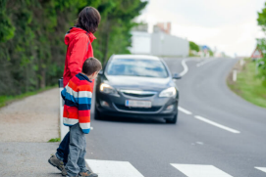

What is vision?
Vision enables us to see:
Form – the shape of things
Colour
Movement – including how fast something is moving.
Depth – how far away something is, or judging how deep a step is…

Slide 4

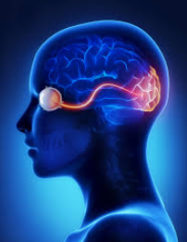
What is vision?
Using our vision involves the brain and the eyes working together.
Your eyes are tools, the brain does the seeing.
The optic nerve carries signals to the brain which interprets it.

Slide 5
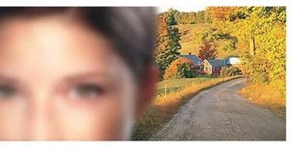

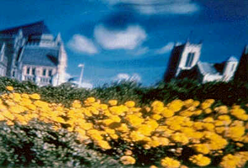
I wear glasses, do I have a vision impairment?
No! Not unless your glasses don’t correct your vision fully.
These are called refractive errors.
Long-sighted Short-sighted Astigmatism
(see things far away well) (see things up close well)
(a common eye condition that can cause blurry vision)

Slide 6
How do you think having poor vision impacts on everyday life?
Mobility:
  ability to move around familiar and unfamiliar environments
Access to information:
  far (landmarks, signs, whiteboard, location of players in PE)
  near (pictures, print, precise tasks – practical Science, DT, Food Tech).
Social interaction:
  recognising people and interpreting facial expressions.

Slide 7
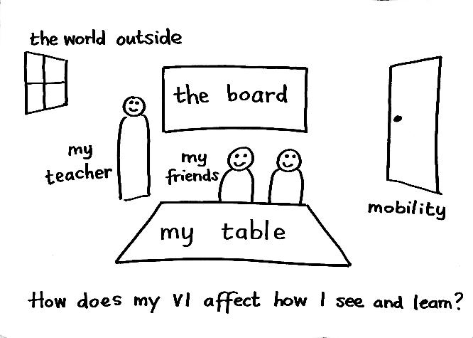
If you have a vision impairment
what can you see?

Slide 8
How can you support someone with a
vision impairment?
Say their name before speaking to them.
Find them at break time so they can socialise with you.
Give them extra time to process visual information.
Ask them how they would like to be supported.
Allow them to go to the centre and front for demonstrations.
In PE and games you can adjust the rules to allow them access e.g. give them more time to pass the ball before being tackled or clap so they know where you are to pass the ball.

Slide 9
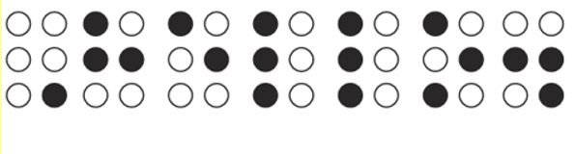
Can you work out the secret code?
Notes:
Teacher could ask open questions such as:
What do you think the dots mean?
Can you see any patterns?
Do you think they could be letters?

Slide 10
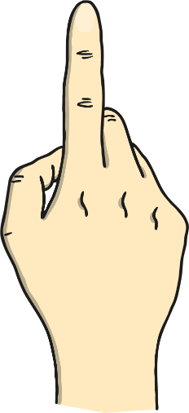
What is braille?
Braille uses six raised dots in different patterns. There are 63 patterns, so it can be used in many languages.
People with a vision impairment read braille by feeling the dots with their fingers.
hello

Slide 11
When was Braille Invented?
About 200 years ago, a teenage boy invented a special way of writing called braille.
Braille uses raised dots that you can feel with your fingers. It helps people who have a vision impairment or have trouble seeing to read and write just like everyone else.

Slide 12
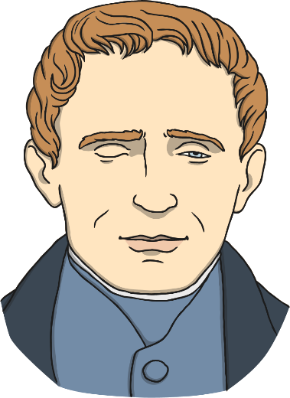
Who Invented Braille?
Louis Braille invented braille.
He was from France and became blind when he was three after an accident.
He went to a special school for children with a vision impairment. When he was fifteen, he created the braille code.

Slide 13

??????
Magic Grandad video

Slide 14








What came before Braille?
When Louis Braille was in school, people with a vision impairment read big books with raised letters.
They used their fingers to feel each letter, but it was slow. It was like feeling the raised letters and numbers on coins today.

Slide 15
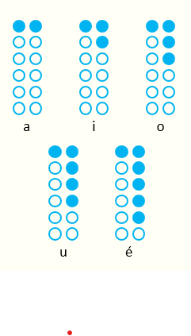
If you have a vision impairment
what can you see?
While Louis Braille was in school, a man named Charles Barbier visited his class.
He was a captain in the French army and invented a way for soldiers to read in the dark using raised dots.
His system had twelve dots and was hard to understand. Louis took this idea and made a simpler version for blind people to read and write.

Slide 16
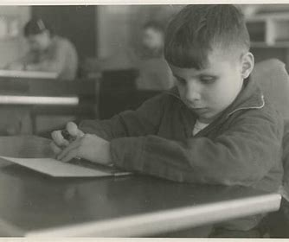
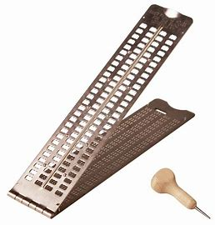
How was it written?
Louis made a tool for writing braille called a 'planchette,’ or 'little plank' in French. It was a small piece of wood with holes. He used it to make small dips in the paper.
When he turned the paper over, the dips became raised bumps. He had to write the codes as mirror images because he was working on the back of the paper.

Slide 17
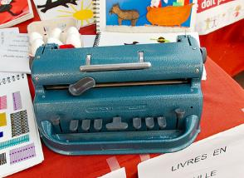
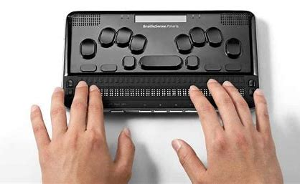
How is Braille Written Today?
Today, we have braille writers, which are like typewriters that can type braille.
There is also amazing computer technology being developed all the time like the electronic brailler.

Slide 18
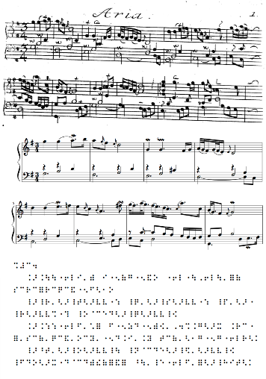
Developing the Code
Louis Braille continued to develop his braille code right up until his death in 1852, but it wasn’t officially used until after he died.
There are sixty-three possible combinations of patterns using the six dots of the braille cell.
Louis also went on to create a braille code that covered numbers, mathematical symbols and
musical symbols.

Slide 19

When did Braille develop?
Even though braille was getting more popular and people thought it was a great system, it was not made official in France – Braille’s home country – until 1854, which was unfortunately a year after Louis Braille died.
Since then, braille has spread all over the world and came to Britain in 1861.

Slide 20
Further Resources:
https://www.rnib.org.uk/about-us/braille-200/
https://www.youtube.com/watch?v=0WlrBlalP5A
https://www.twinkl.co.uk/search?q=braille
The Lots of Dots Pack by RNIB:
chrome-extension://efaidnbmnnnibpcajpcglclefindmkaj/https://media.rnib.org.uk/documents/APDF-SV240805__Lots_of_Dots_Activity_Booklet-v02.pdf

