Slide 1
30 Hours of Free Childcare
District Seminars March 2017
Tunbridge Wells

Slide 2
Early Years and Childcare in
Tunbridge Wells
Key Facts and Figures
 | Kent | Tunbridge Wells
EYFS GLD 2016 | 74.8% | 77.7%
EYFS FSM Achievement Gap 2016 | 19% | 28.9%
Percentage of providers good or outstanding (December 2016) | 96.8% | 98.3%
Percentage of childminders good or outstanding | 97% | 96.8%
FF2 Take up (December 2016) | 74% | 73.7%
Percentage of providers in a collaboration | 62% | 64.5%

Slide 3
30 Hours of Free Childcare
The scale of the challenge in Tunbridge Wells
Predicted take up of 15 Hours by three/four year olds
Autumn 2017 1,330
Spring 2018 1,786
Summer 2018 2,135
Estimated children eligible for 30 hours of Free Childcare
Autumn 2017 842
Spring 2018 1,131
Summer 2018 1,353
N.B. The demand/supply maps in this presentation should only be used as an indicator of potential need and anyone considering setting up or expanding their existing childcare provision should carry out their own market research to establish the likely demand.

Slide 4
Tunbridge Wells – Demand Model
The three areas which require a significant increase in capacity are:
Tunbridge Wells Town
Tunbridge Wells South
Paddock Wood

Slide 5
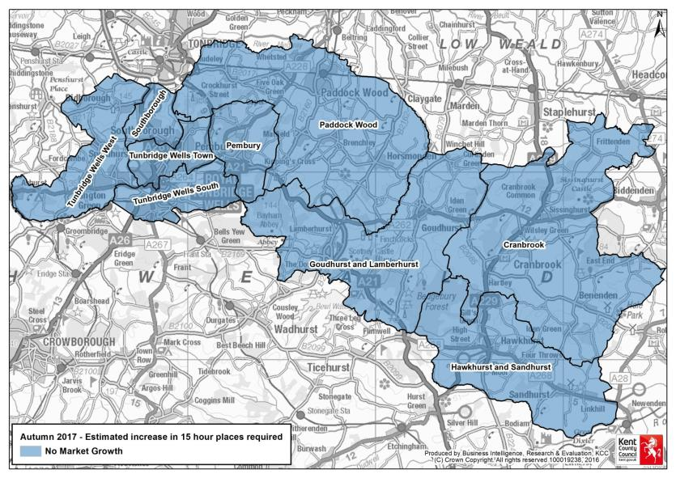
Tunbridge Wells Demand – Autumn 2017

Slide 6
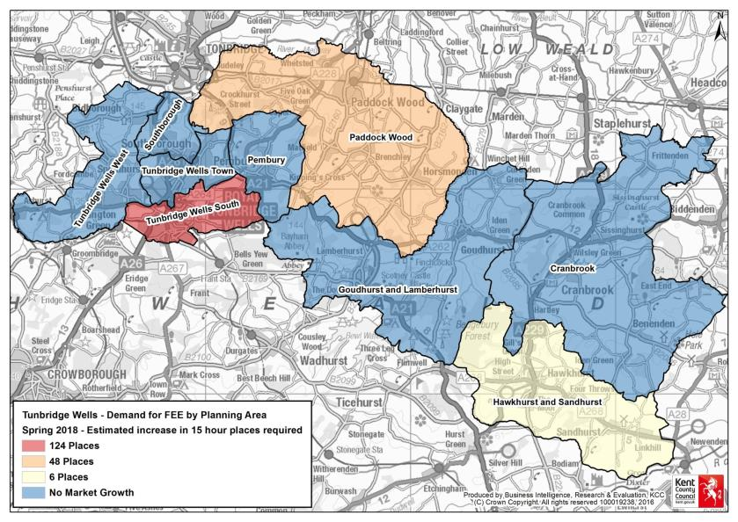
Tunbridge Wells Demand – Spring 2018

Slide 7
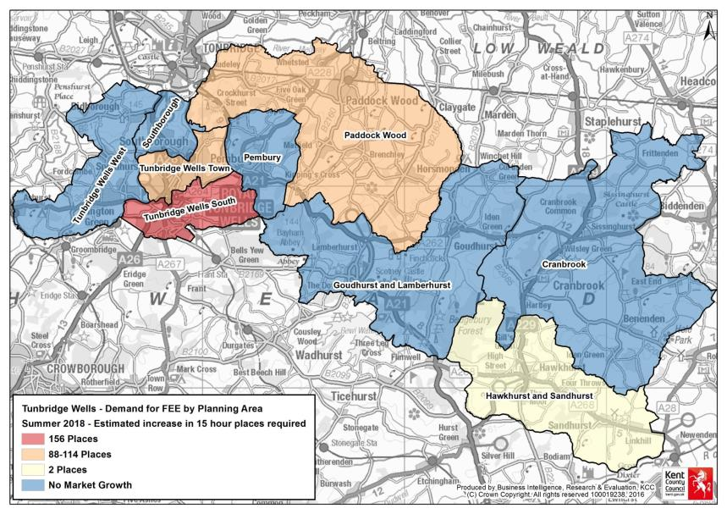
Tunbridge Wells Demand – Summer 2018

Slide 8
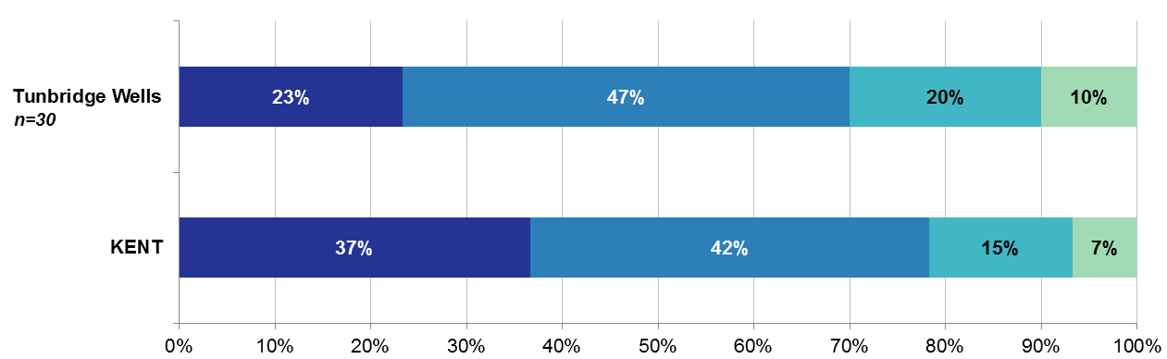
Tunbridge Wells
Establishments: 71
Childminders: 51
Total Childcare providers: 122
Survey Responses: 30
Response Rate: 25%
Are you considering offering the 30 hours of nursery funding when it is implemented for working parents?
Yes
No
Not Sure
Don’t Know

Slide 9
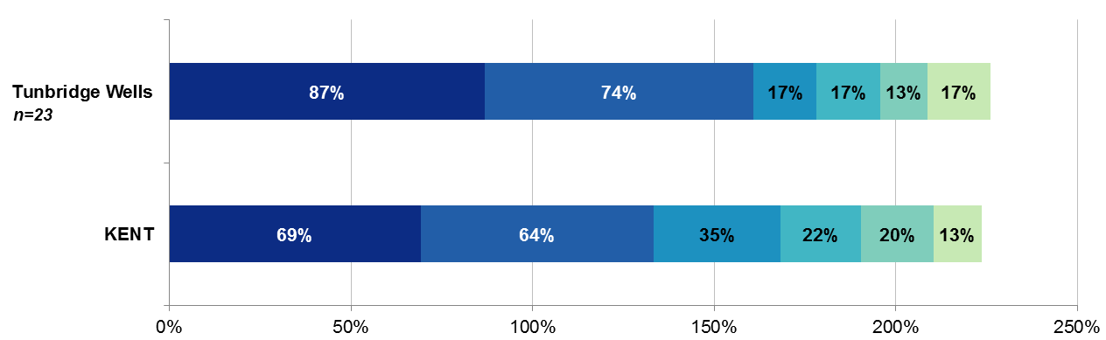
Tunbridge Wells
Establishments: 71
Childminders: 51
Total Childcare providers: 122
Survey Responses: 30
Response Rate: 25%
What are you reasons for not considering offering the 30 hours of nursery funding when it is implemented for working parents?
Reduced revenue/income
Lack of staff
KCC funding unknown
Facilities/building issues
Restrictions with opening hours
Impact on places for FF2

Slide 10
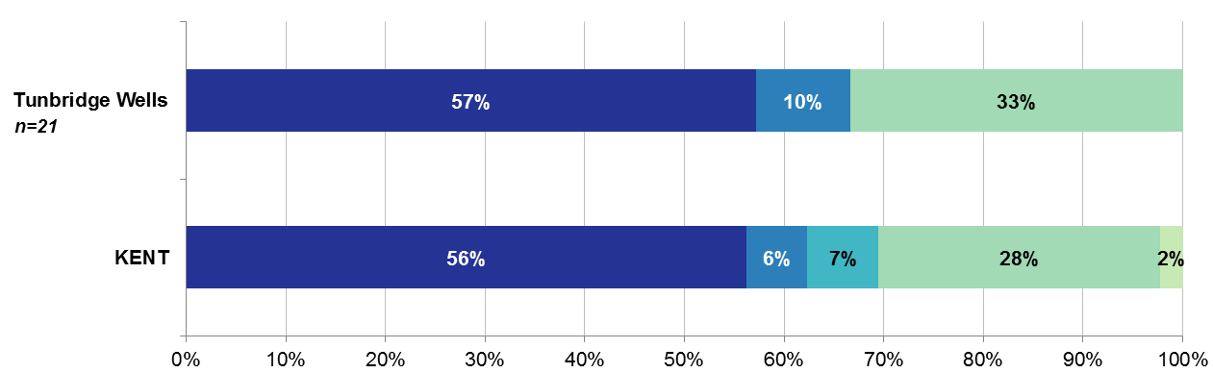
Tunbridge Wells
Establishments: 71
Childminders: 51
Total Childcare providers: 122
Survey Responses: 30
Response Rate: 25%
For those that said yes or were not sure, how do you plan to offer the 30 hours funded places?
Over 38 weeks
Don’t know
Stretched places
Not applicable
Over 38 weeks & stretched places

