Slide 1

200 Years of Braille
STLS Sensory Service
Date: 2024 to 2025

Slide 2
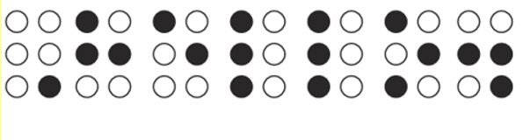

Can you work out the secret code?
Notes:
Teacher could ask open questions such as:
What do you think the dots mean?
Can you see any patterns?
Do you think they could be letters?

Slide 3
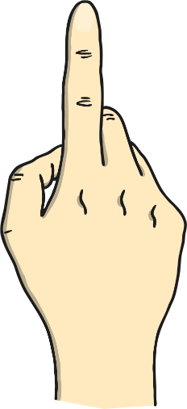
What is braille?
Braille uses six raised dots in different patterns. There are 63 patterns, so it can be used in many languages.
People with a vision impairment read braille by feeling the dots with their fingers.
hello

Slide 4
When was Braille Invented?
About 200 years ago, a teenage boy invented a special way of writing called braille.
Braille uses raised dots that you can feel with your fingers. It helps people who have a vision impairment or have trouble seeing to read and write just like everyone else.
Let's learn more about its amazing history in the next slides!

Slide 5
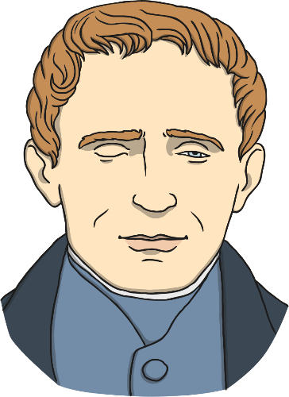
Who Invented Braille?
Louis Braille invented braille.
He was from France and became blind when he was three after an accident.
He went to a special school for children with a vision impairment. When he was fifteen, he created the braille code.

Slide 6

??????
Magic Grandad video

Slide 7
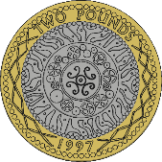
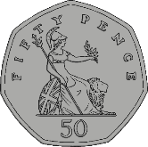
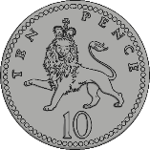
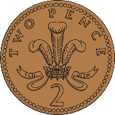

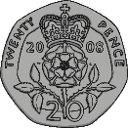


What came before Braille?
When Louis Braille was in school, people with a vision impairment read big books with raised letters.
They used their fingers to feel each letter, but it was slow. It was like feeling the raised letters and numbers on coins today.

Slide 8
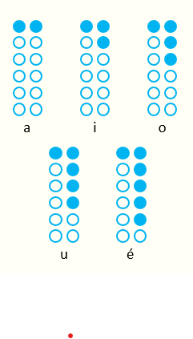
If you have a vision impairment
what can you see?
While Louis Braille was in school, a man named Charles Barbier visited his class.
He was a captain in the French army and invented a way for soldiers to read in the dark using raised dots.
His system had twelve dots and was hard to understand. Louis took this idea and made a simpler version for blind people to read and write.

Slide 9
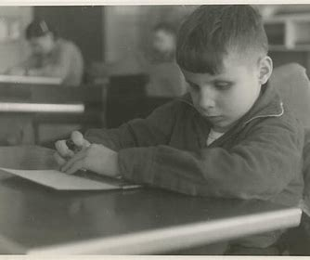
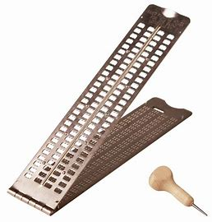
How was it written?
Louis made a tool for writing braille called a 'planchette,’ or 'little plank' in French. It was a small piece of wood with holes. He used it to make small dips in the paper.
When he turned the paper over, the dips became raised bumps. He had to write the codes as mirror images because he was working on the back of the paper.

Slide 10
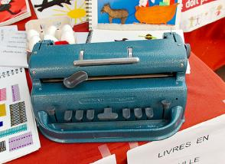
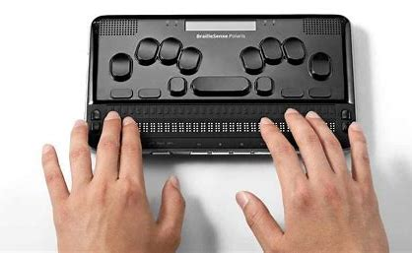
How is Braille Written Today?
Today, we have braille writers, which are like typewriters that can type braille.
There is also amazing computer technology being developed all the time like the electronic brailler.
Notes:
Teacher could ask open questions such as:
What do you think the dots mean?
Can you see any patterns?
Do you think they could be letters?

Slide 11
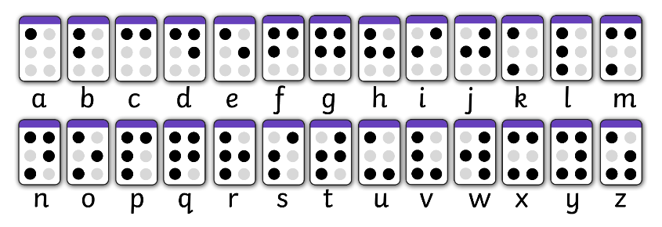
Have a Go…
Use a white board or paper to try writing your name using the braille code.

Slide 12
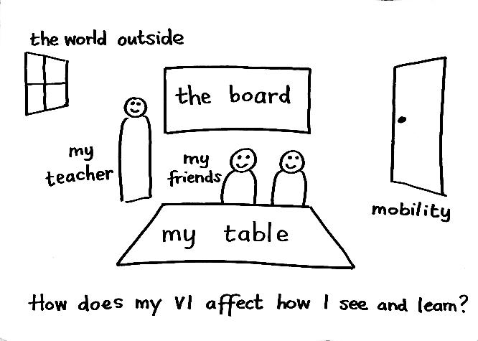
If you have a vision impairment
what can you see?

Slide 13
Further Resources:
https://www.rnib.org.uk/about-us/braille-200/
https://www.youtube.com/watch?v=0WlrBlalP5A
https://www.twinkl.co.uk/search?q=braille
The Lots of Dots Pack by RNIB:
chrome-extension://efaidnbmnnnibpcajpcglclefindmkaj/https://media.rnib.org.uk/documents/APDF-SV240805__Lots_of_Dots_Activity_Booklet-v02.pdf

