Slide 1
SCHOOLS FINANCE OFFICERS MEETINGS
Records Management, “Paper-Lite” Environments and Procedures when a school closes
Elizabeth Barber

Slide 2
Records Management
Schools need to comply with the Section 46 Code of Practice on Records Management
The larger the school the more formal the process will need to be
Everything you need is in the Information Management Toolkit for Schools

Slide 3
Records Management Policy
Sample Records Management Policy can be found in Appendix A of the IM Toolkit for Schools
It can be amended to suit the school’s requirements
Needs senior management approval
Should be reviewed annually

Slide 4
Organisational Requirements
Section 46 Code lays out organisational requirements.
Requirements are laid on pp2-3 of the IM Toolkit for Schools
Smaller schools may find that they don’t need the same level of organisational structure as larger schools or federations will

Slide 5
Organisational Requirements Summary
Recognition of records management as a core corporate function (4.1)
Inclusion of records and information management in the school’s risk management framework (4.2)
A governance framework that includes defined roles and lines of responsibility (4.3)
Clearly defined instructions, applying to staff at all levels in the school to create, keep and manage records (4.4)

Slide 6
Organisational Requirements Summary
Identification of information and business systems that hold records and provision of the resources needed to maintain and protect the integrity of those systems and the information they contain (4.5)
Consideration of records management issues when planning or implementing ICT systems, when extending staff access to new technologies and during re-structuring or major changes to the authority (4.6)

Slide 7
Organisational Requirements Summary
Induction and other training to ensure that all staff are aware of the school’s records management policies, standards, procedures and guidelines and understand their personal responsibilities. (4.7)
An agreed programme for managing records in accordance with this part of the Code (4.8)
Provision of the financial and other resources required to achieve agreed objectives in the records management programme (4.9)

Slide 8
Records Storage
Records (whether physical or electronic) must be managed to ensure that they cannot be lost, damaged or destroyed. This will usually involve the purchase of high quality storage equipment. It may not always be necessary to store non-core records in the same high quality storage. (section 5.5)
Key action is to identify which records are principal copies and which are non-core records

Slide 9
Information Security
Schools do not need to have a protective marking scheme, however, identifying and marking records which contain sensitive information can be useful. The protective marking can be recorded in the Information Asset Register and will give members of staff an indication of how sensitive records are. [section 5.3]
A possible protective marking scheme could be as follows:
NOT PROTECTIVELY MARKED
All information which could be disclosed
OFFICIAL
All information which is politically and commercially sensitive
OFFICIAL SENSITIVE
All information which contains personal/sensitive personal data

Slide 10
Information Risk Management
Assessing information risk is very similar to other forms of risk assessment. Information risk assessment needs to cover:
whether the information is a principal copy;
whether the information is business critical;
what the consequences would be if the information was lost, stolen or damaged including damage to individuals and reputational damage;
how easy the information would be to replace;
where the information is stored (e.g. is personally sensitive information stored in locked cabinets to avoid theft).

Slide 11
Reporting Information Security Breaches
Information can be found on the information security page on KELSI.
Each school must have its own information security breach protocol and process for reporting breaches.
Each school must be aware of its responsibilities to report certain breaches to the Information Commissioner’s Office for investigation

Slide 12
Records Disposal
Records should be routinely identified for disposal using the retention schedule (see p12ff in the IM Toolkit)
Records should be disposed of securely in line with their protective marking

Slide 13
Business Continuity Plans
All vital records should be included in business continuity plans as well as equipment.
Vital records can be identified using an information audit process
Business continuity plans should be tested periodically

Slide 14
Transferring Records
Primary Schools transfer records to Secondary Schools who are responsible for retaining the record
If a child dies whilst at Primary School, the educational record should be sent to the Records Manager to be archived
If a child moves school then the record should go to the new school. If the Primary School is not aware of where the pupil has gone then the record should be sent to the Records Manager to be archived

Slide 15
Any Questions?

Slide 16
Paper Free or Paper Lite?
It is difficult to achieve a completely paper-free environment usually there will be some copy paper documentation for staff to use operationally

Slide 17
Understand Your Objectives
The school’s management team needs to understand what their objectives are:
To save money
To save paper
To save space
To enhance flexible working
To allow collaboration on different documents
To ensure there is a “single source of truth”

Slide 18
Capturing Documents
Size of the scanned image
Quality of the scanned image
Legibility of the scanned image
Legal admissibility of the scanned image
The requirements will differ depending on whether you are planning to dispose of the paper copies you are scanning

Slide 19
Retrieving Documents
Formal file structure or file classification scheme or an EDMS appropriately secured
File Naming Conventions
Sustainable file formats
Legibility/readability of the image
Business continuity and back-ups
If you are planning to dispose of the paper then each image captured must be checked for legibility

Slide 20
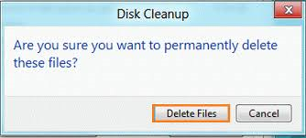
Document Disposal
File retention/disposal policy
There should be routine deletion of files including those which may be held on people’s hard drives

Slide 21
Any Questions?

Slide 22
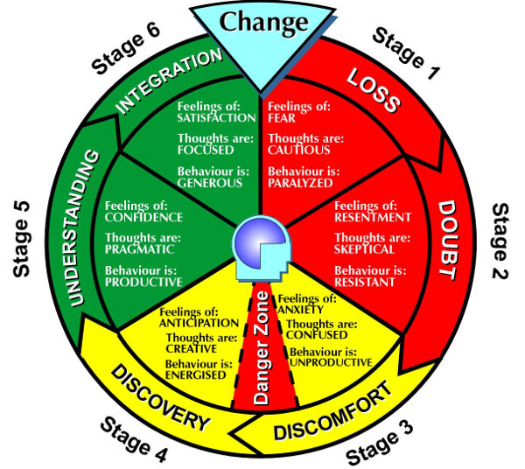
Records Management and School Closures

Slide 23
Records Management and School Closures
Closing everything down and preparing for transfer will always take longer than you think it will.

Slide 24
Records Management and School Closures
As soon as notification is received that the school is to be closed, a thorough review of all the records on the premises needs to take place.
Identify pupil and other records which need to be transferred to a new establishment
Identify records which need to be disposed of
Identify records to be archived

Slide 25
Records Management and School Closures
Once pupil records have been identified create a schedule of transfer
Schedule the date for transferring the records and arrange the handover

Slide 26
Records Management and School Closures
Using the retention schedule identify all the records which can be securely disposed of.
Make a schedule of the records which are being destroyed
Arrange for secure destruction of the records.

Slide 27
Records Management and School Closures
Using the retention schedule identify all the records which need to be retained but which should not be transferred to any new organization.
It is the local authority’s responsibility to maintain these records until the end of their statutory retention period.
Liaise with the Records Management Service to transfer physical records
You may need to seek advice about archiving electronic records

Slide 28
Don’t Leave it To The Last Minute

Slide 29
Any Questions?

