Slide 1
Procurement - Spending the Council’s Money
Bursars Presentation Sessions 2014/15
Notes:
Explain not the Councils Money take a copy of spending the councils money and use as prop

Slide 2
Introductions
Procurement
Henry Swan - Head of Procurement
Sam Hatton - Procurement
Danny Lee - Procurement

Slide 3
Aims of this Presentation
Explain why procurement is important.
Explain what Strategic Sourcing and Procurement is.
Outline the updated Spending the Councils Money.
Introduce the Kent Business Portal

Slide 4
Procurement
The acquisition of goods or services
In todays financial climate can save money to spend on key areas e.g. staff
Important that rules are followed because we are spending public money; it needs to be a transparent, fair and open process

Slide 5
Strategic Sourcing & Procurement
SSP’s Key Drivers
Value for Money
Support Kent Business
Manage Risk
Small Team
Professional Procurement for KCC
Notes:
Value for money £18 million MTFP and £56 million overall.
Kent Business more than 50% of our spend with Kent businesses.
Manage Risk ensures the Council has the correct contracts in place etc

Slide 6
Spending the Council’s Money (The Rules)
Procurement for schools
Section on Kent Education Learning Skills Information(KELSI).
E Bulletin will be sent to schools when this section goes live
Route will be School management / Schools Financial Services / Procurement
Will show information on Spending the Council's Money with links to flowcharts
Important to follow the school’s Finance Policy and the Scheme for Financing Schools

Slide 7
Spending the Councils Money

Slide 8
Helpful Documents
Idea/requirement checklist
Contacts - Property, Commercial Services, EduKent
Specification Guide
Request for Quotation
Successful/Unsuccessful Letters
Notes:
Mention Contract Management

Slide 9
The Kent Business Portal
https://www.kentbusinessportal.org.uk/procontract/portal.nsf/vLiveDocs/SD-DEVV-6UGE9Y?OpenDocument&contentid=1.001

Slide 10
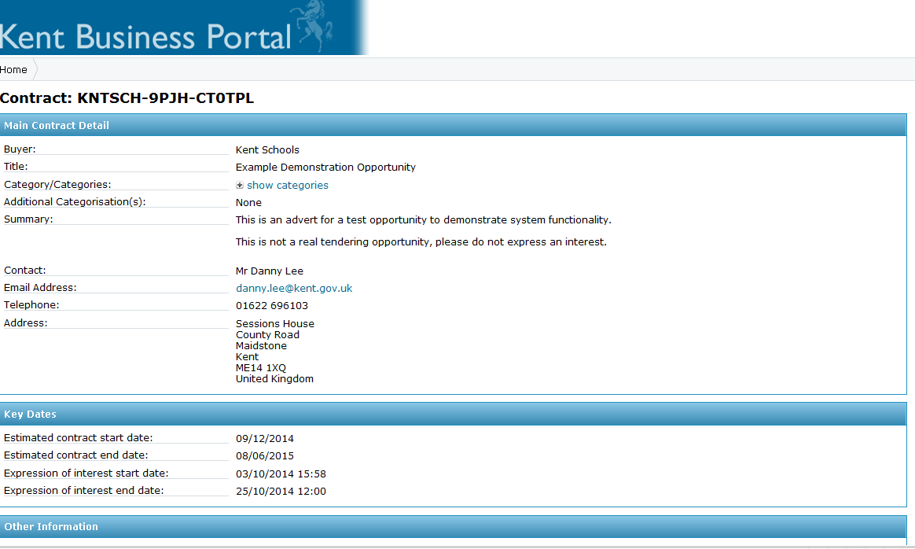
The Kent Business Portal

Slide 11
Contacts
Commercial Services –
0808 1685808 info@commercialservices.org.uk
EduKent –
03000 412424 edukent@kent.gov.uk
Procurement – procurement@kent.gov.uk

