Slide 1

200 Years of Braille
STLS Sensory Service
Date: 2024 to 2025

Slide 2
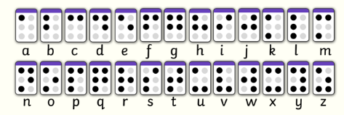

Activities
The following slides show ideas that can be used with learners to support the understanding of braille.
Tactile exploration of resources using fine motor skills.
Exploration of the importance of building strength in the fingers in order to create braille through creative dot making activities.
Using the braille alphabet to make letters and words or solve problems.

Slide 3
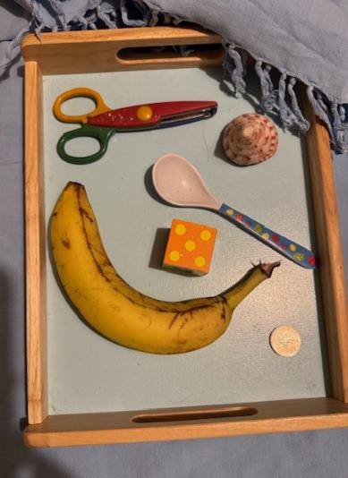
Tactile Kim’s Tray Game
Guess the objects under the cloth:
This game can be played as a small group or as a pair.
Place several objects 4 to 6 on a tray.
Cover with a cloth – prior to showing the players.
Ask the players to feel the objects.
They could name them, count them etc. They can discuss this, depending on level of difficulty that the teacher wants to make the game.
Then removing one object at a time can the players guess which one has been removed?

Slide 4
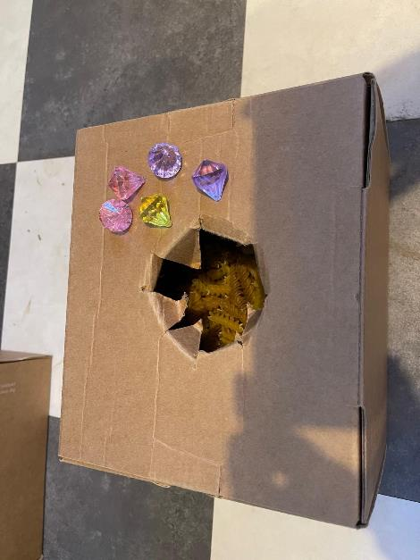
Feely Box
Guess the object inside the box:
Place an object of interest inside the box.
Learners take turns to feel inside the box and their ideas of what it might be are recorded.
In each box there were gem stones, paper clips. Three boxes so the group of six children could work in pairs.

Slide 5
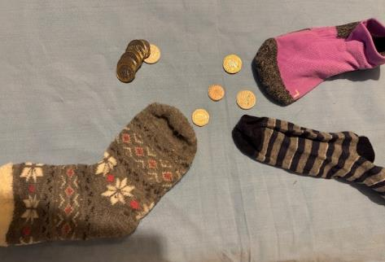

Guess the coin– tactile game
At a table each child has a sock with a different real coin in it. They have to feel the coin in the sock and only take it out when a timer set for perhaps 30 seconds goes off.

Slide 6
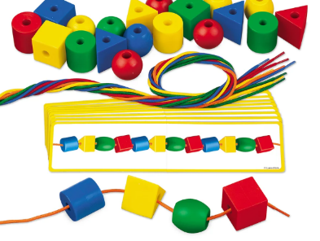
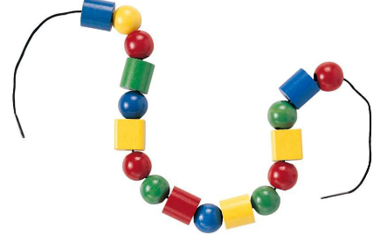
Tactile patterns - beads
Guess the shape pattern:
Learners string shaped beads to make patterns.
Another learner can then feel the string of beads with their eyes closed to guess the repeat pattern. For example: circle, square, circle, square. Or circle, square, oval…. Etc.

Slide 7
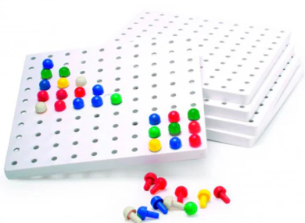
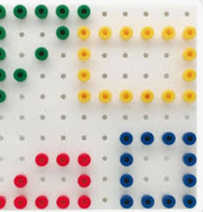
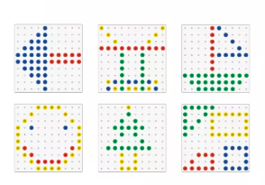
Peg board – patterns, pictures or braille
Guess the shape:
one learner closes their eyes and attempts to guess the shape.
Guess the picture:
Make simple patterns

Slide 8
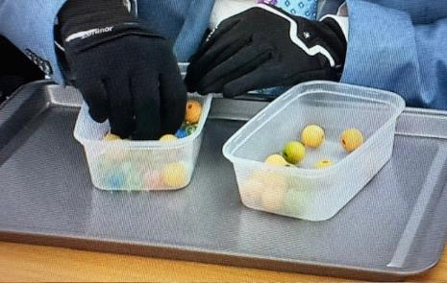
Sorting two objects
Set up a challenge table with two boxes. One empty, one full of two different objects. Cover the boxes with a cloth so that they cannot see inside the boxes.
The learner then has to sort the two objects from one another.
To make the game more difficult you could ask the learners to wear gloves.
Each learner could be timed and then the learner who is fastest wins!

Slide 9
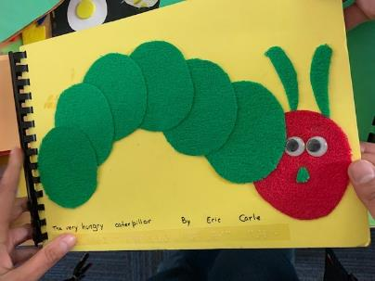
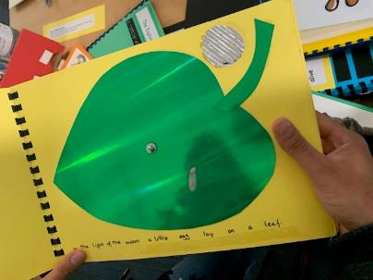
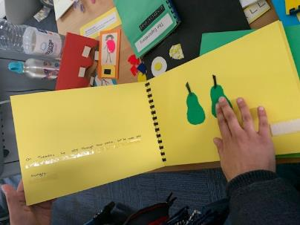
Make a Tactile Story
Working as a group learners could make a tactile page in a story. Perhaps ‘The Hungry Caterpillar’ or ‘We’re Going on a Bear Hunt’. Or even a nursery rhyme, for example; ‘The Wheels on the Bus’.

Slide 10
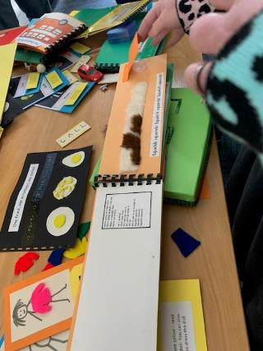
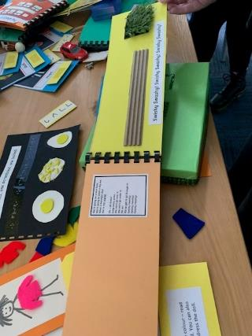
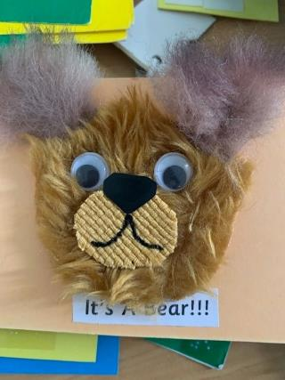
Make a Tactile Story
‘We’re Going on a Bear Hunt’

Slide 11
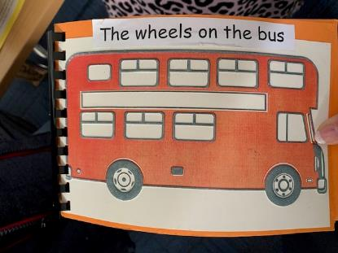
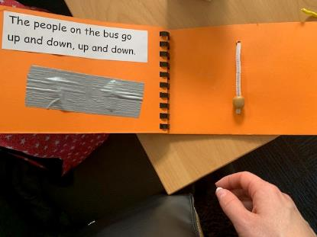
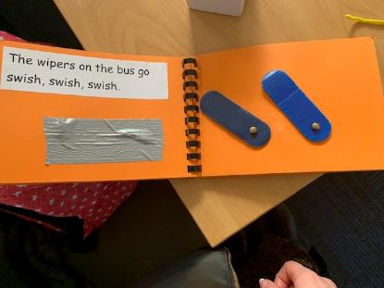
Make a Tactile Story
‘The Wheels on the Bus’.

Slide 12
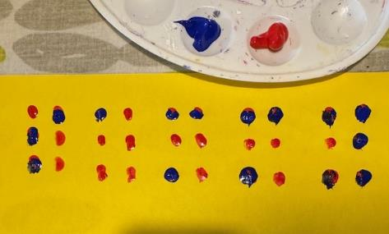
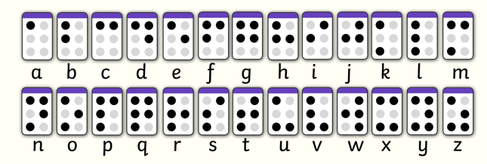
Fingerpainting
Depending on the age group of the children you can either have free tactile experience of making pictures using fingers to create dots and patterns to more advanced six cell dots and adding a different colour to indicate a letter, word or name.
s a m m y

Slide 13
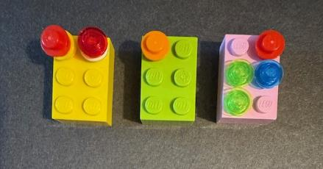
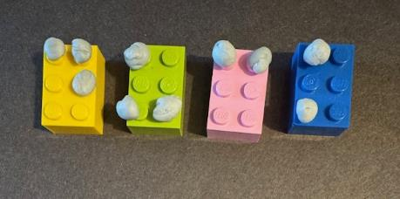
Lego – six cells
Using Lego six cell bricks, Lego beads or blue tack to stick on the top.
Working in pairs learners can take it in turns to refer to the braille alphabet to make simple words for their partner to decode.
Learners can record their answers on white boards and see who guesses the most words correctly by keeping a tally.
c a t
d u c k

Slide 14
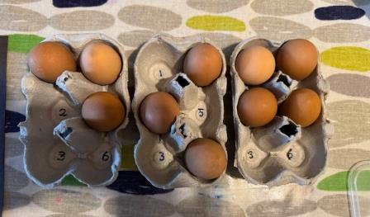
Egg boxes and balls/shaker eggs
Working in pairs learners can play a game of guess the letter.
One learner makes a letter and the other learner can decode it and record their answer on their white board. This can be made more challenging by giving access to more egg boxes to make whole words.
d o g

Slide 15
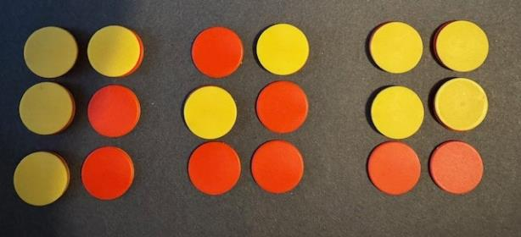
Maths counters – six cells
Using maths counters is a quick and easy way to build six cells.
Learners could work in pairs to make words using the reversible colour counters on plain dark coloured paper.
p i g

Slide 16
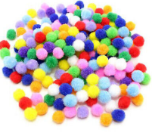
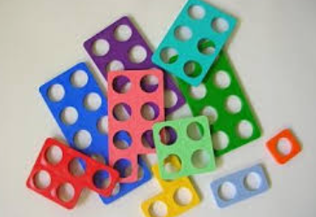
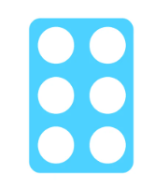
Numicon – six cells
Using maths Numicon – six cells learners can place art pom poms in each circle to make braille letters.

Slide 17
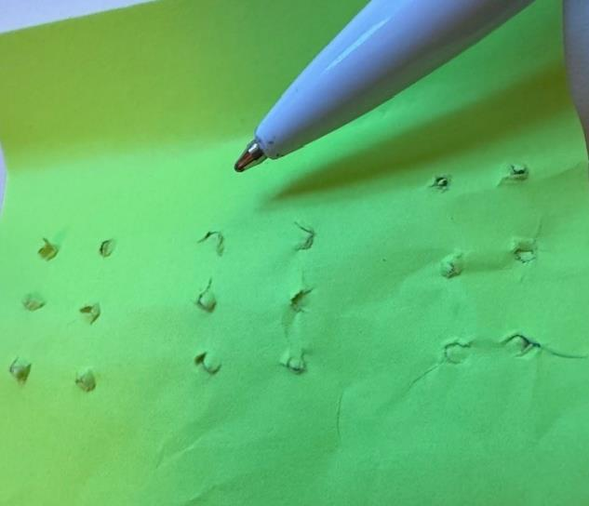
Punching holes into paper
Using a pencil or biro and paper learners can experiment pushing the pen or pencil through the paper in a six cell pattern and then feel the dots on the other side.
To add difficulty learners could add blue tack dots to make letters or simple words.

Slide 18
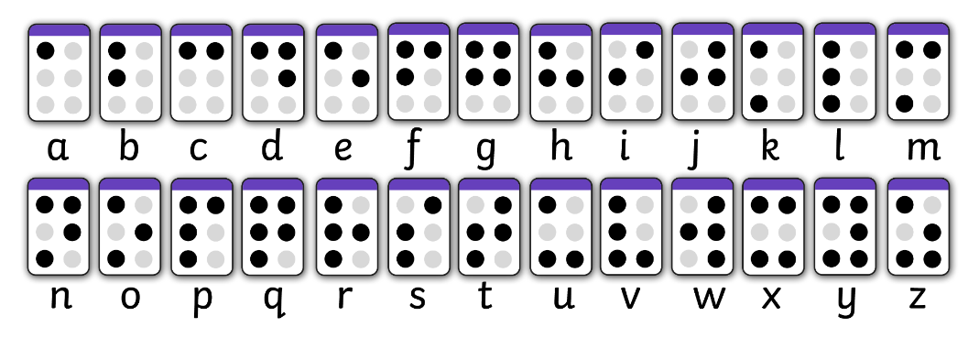
Can you write your name in braille?
Using the braille cell templates can you find each letter of your name using the braille alphabet?

Slide 19
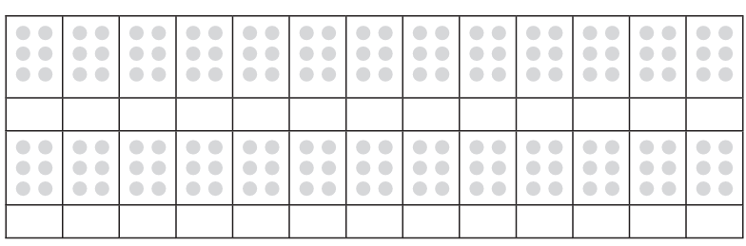
Empty Braille Cell Templates
Please photocopy this resource.

Slide 20
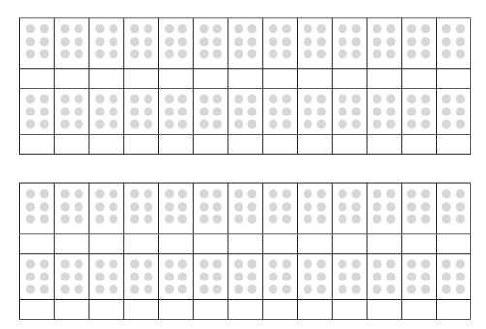

Slide 21
Can you solve the secret code?
Using the braille cell templates can you look at the secret messages and crack the code?

Slide 22
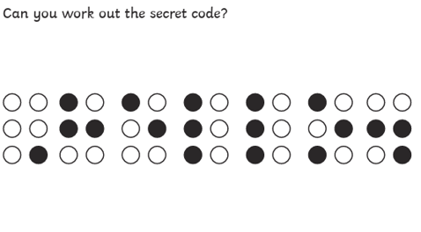
Can you solve the secret code?
Using the braille alphabet can you look at the secret messages and crack the code?
Notes:
Teacher could ask open questions such as:
What do you think the dots mean?

Slide 23
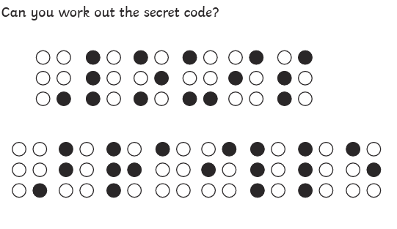
Can you solve the secret code?
Using the braille alphabet can you look at the secret messages and crack the code?

Slide 24
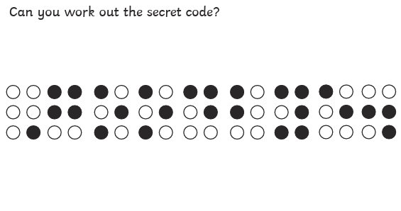
Can you solve the secret code?
Using the braille alphabet can you look at the secret messages and crack the code?

Slide 25
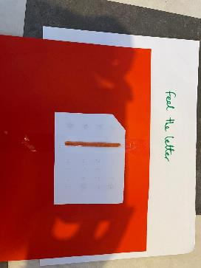
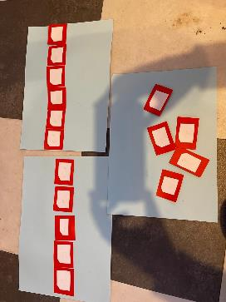
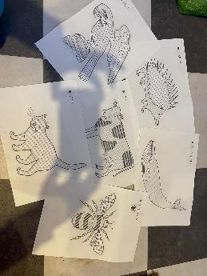
If you have a Braillist at your school…
Here are some activities you can make if you have a Braillist at your school and the resources to make tactile pictures or create braille text:

Slide 26
Further Resources:
https://www.rnib.org.uk/about-us/braille-200/
https://www.youtube.com/watch?v=0WlrBlalP5A
https://www.twinkl.co.uk/search?q=braille
The Lots of Dots Pack by RNIB:
chrome-extension://efaidnbmnnnibpcajpcglclefindmkaj/https://media.rnib.org.uk/documents/APDF-SV240805__Lots_of_Dots_Activity_Booklet-v02.pdf

