Slide 1
High Needs Funding Review
Item 6: Appendix B – Background to the High Needs Funding Review

Slide 2
HNF Review Background
Core Education Funding (E1)
Additional Support Funding (E2)
Top Up Funding (E3)
School Budget (Primary & Secondary)
High Needs Funding
Notional SEN Top Up Funding
Element 1 (E1) Core Education Funding - the funding that any pupil would attract (school budget)
Element 2 (E2) Additional Support Funding - the additional cost that a school would be expected to provide without the pupil being considered ‘high needs’
Element 3 (E3) Top Up Funding - this is any extra funding necessary to meet the needs of the pupil.
High Needs Funding in a mainstream: named pupils with additional needs costing more than £6,000
(in Kent we have applied this definition equally to both those with and without an EHCP)

Slide 3
HNF Review Background (Current System in Kent)
The first £6,000 is met from the notional SEN funding in a schools budget allocation:
Factor 2 - IDACI and Ever 6 FSM
Factor 4 - EAL
Factor 6 – Low Prior Attainment
An element of lump sum (£120k) primary £6,235 and secondary £5,580
Minimum Per Pupil Funding Level & Minimum Funding Guarantee
Notional SEN Top Up (element 2): No school or academy will pay more than 10% of its notional SEN budget towards the £6,000 E2 for an individual pupil. Capped for the year at a max of 28% of the annual notional SEN budget. Automatically calculated
Top Up (element 3): SENCo applies for top up funding via an online portal (Kelsi). The HNF officer reviews the application and calculates the total cost of the provision set out in the provision plans. This amount is then slotted in to the Needs Specific Top Up Rates. The school are informed by email of the outcome of their application. Funding is reviewed annually (with some exceptions), and a new submission is needed for a change of phase of education or change of school

Slide 4
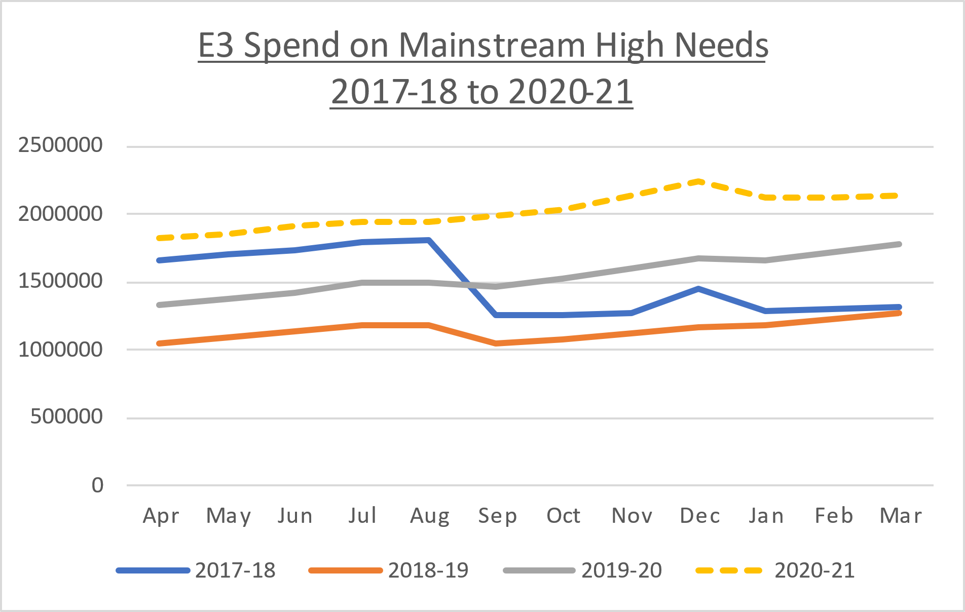
HNF Review Background: Current Process in Kent
Claims are predominately paid to primary schools
Reduction following 20% cut in rates
Distribution of children with an EHCP in mainstream schools:
60% Primary
40% Secondary
 | Financial Year | Element 3 £ | Year on Year Increase | Year on Year % Increase | Cumulative Increase
 | 2018-19 | £13,716,162
 | 2019-20 | £18,606,214 | £4,890,052 | 36%
 | 2020-21 | £24,255,641 | £5,649,427 | 30% | £10,539,479

Slide 5
HNF Review Background: Current Process in Kent
 | Dec 18 and Dec 20 Snapshots - Reason for Increase
 |  |  |  |  |  |  | Rate Totals
 | Sum of Dec 2020 Needs Specific Top Up Rates |  |  |  |  |  | £26,767,599
 | Sum of Dec 2018 Needs Specific Top Up Rates |  |  |  |  |  | £13,974,166
 | Increase |  |  |  |  |  | £12,793,433
 |  |  |  | Pupils | Rates |  | Approximate Annual Increase
 | Dec 18 pupils @ Dec 18 rate |  |  | 2,391 | £5,844 |  | £13,974,166
 | Dec 20 pupils @ Dec 18 rate |  |  | 3,619 | £5,844 |  | £21,151,195
 | Approx increase in spend due to additional pupils |  |  |  |  |  | £7,177,029 | 56%
 | Dec 20 pupils @ Dec 18 rate |  |  | 3,619 | £5,844 |  | £21,151,195
 | Dec 20 pupils @ Dec 20 rate |  |  | 3,619 | £7,396 |  | £26,767,599
 | Approx increase in spend due to higher rates |  |  |  |  |  | £5,616,404 | 44%
 | Dec 18 cohort of pupils - EHCP status @ Dec 20
 |  |  | Dec-18 |  | Dec-20
 | Pupils with EHCP |  | 1045 | 44% | 1688 | 71% | *
 | Pupils without EHCP |  | 1346 | 56% | 703 | 29%
 |  |  | 2391 |  | 2391
 | * A further 75 pupils (3%) are undergoing assessment
Approximately 50% of those without an EHCP were issued with an EHCP at a later date
We have seen an increase in those at applying for the highest rates of funding

Slide 6
HNF Review Background: Current Process in Kent
Total value of SEN “top up funding” paid by LA and number of schools receiving funding to support with Element 2 (first £6,000 funding):
10%: No school or academy will pay more than 10% of its notional SEN budget towards the £6,000 E2 for an individual pupil.
28%: total value of first £6,000 to be funded by schools is capped for the year at a max of 28% of the annual notional SEN budget.
 | 2018-19 | 2018-19 | 2019-20 | 2019-20 | 2020-21* | 2020-21*
Phase | 10% | 28% | 10% | 28% | 10% | 28%
Primary | £976,717 | £2,586,065 | £804,182 | £3,620,593 | £598,421 | £4,039,225
No. of Primary Schools | 162 | 179 | 136 | 211 | 91 | 222
Secondary | £11,968 | £78,956 | £5,604 | £56,189 | £1,565 | £58,963
No. of Secondary Schools | 6 | 2 | 2 | 2 | 1 | 1
Total £ | £988,684 | £2,665,021 | £809,786 | £3,676,782 | £599,986 | £4,098,189
Total No. of Schools | 168 | 181 | 138 | 213 | 92 | 223
Total 10% & 28% Notional SEN Top Up |  | £3,653,705 |  | £4,486,568 |  | £4,698,175

Slide 7
HNF Review – Feedback & OLAs
Summary of Feedback
Inconsistent use of HNF across the schools (perverse incentives)
Few secondary schools access HNF
Limited criteria for accessing HNF
Significant amount of time taken to apply for funding
Not automatic
Need to reapply at transition points
Lack of transparency in decision making
Individual vs Group applications?
OLAs
LAs are either investigating or have moved to a banding system to determine HNF top up.
Generally moving away from a claim approach
Funding is distributed automatically where an EHCP is in place.
Supplementary process for those without an EHCP. Can be limited.
Over 50% of LAs fund additional top-up (Notional SEN top up)

Slide 8
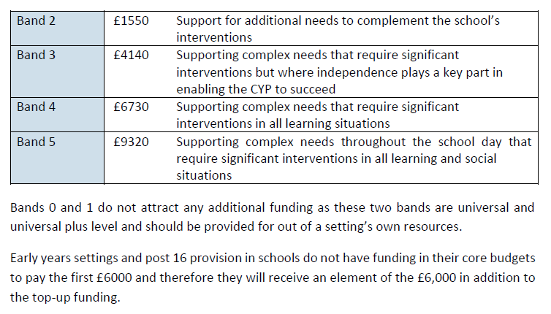
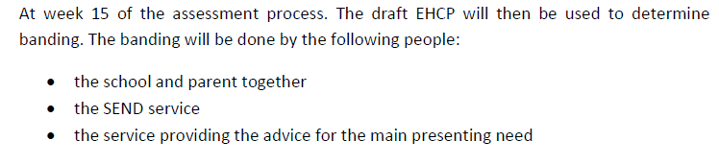
HNF Review – Example of Banding System: OLA
Key Principles:
Rates are predetermined
On issue of a EHCP (and annual review) the support banding is determined
Rate is automatically applied to a school

Slide 9
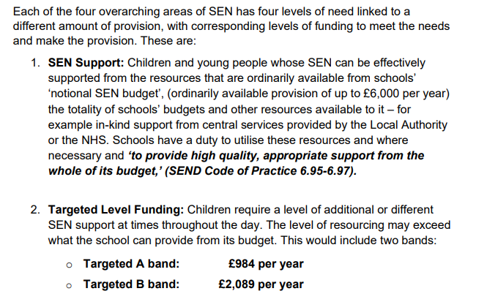
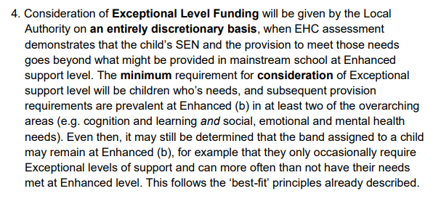
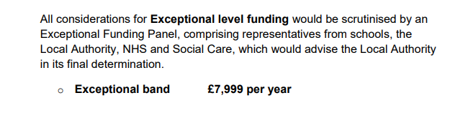
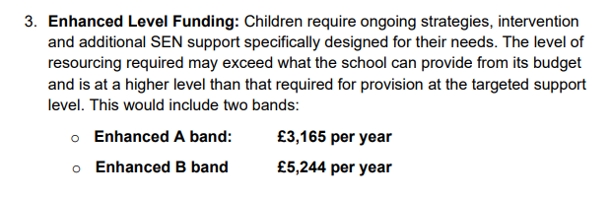
HNF Review – Example of Banding System: Different OLA

Slide 10
HNF Review - Objectives
Objectives:
Aligns with wider SEN Strategy and wider offer
Develop a HNF system that supports inclusive practices in mainstream schools and complements other services
Funding is allocated to support successful outcomes for children with SEN
Increased flexibility for schools to meet needs: greater accountability
Effective HNF system which is both transparent and accessible
Funding is allocated equitably across all schools dependent on the needs of the child
Scope:
Review the system of HNF in Kent and propose alternative options to funding High Needs in mainstream schools:
- review and consider options to improve the current system
- explore and develop the use of a banding system in Kent and appropriate funding levels
Recommend whether HN funding should be limited to children with an EHCP
Review the application of additional funding to mainstream schools and make recommendations
Explore mechanisms for distributing funding including use of locality based resources
Plan and implement agreed recommendations
Application of the proposed system to other providers including Early Years, Post 16.

Slide 11
HNF Review – Timeline / Milestones
The mechanism for issuing HNF can be agreed independently of other SEND projects
The funding allocations are dependent on the outcome of other inclusion related activities
Recommendations are dependent on agreement of the whole system approach to SEND in Kent
Schools Funding Forum & SEN Improvement Board
Cabinet Committee & Cabinet Member Decision
Phased Implementation
All Schools Consultation
Develop proposals and engage stakeholders
Present Recommendations
Oct – Mid Nov 2021
Apr – Aug 2021
Sep 2021
Nov – Dec 2021
Jan 2022
Apr – Sep 2022
Explore application of a banding system in Kent
How could the existing HNF system be improved?
HNF for children without an EHCP
Schools with high incidence of SEND
To be determined
Affordable and Reasonable Funding Levels

Slide 12
HNF Review – Key Groups and Next Steps
HNF Working Group:
Roles & Responsibilities:
Oversight and ensuring it meets strategic objectives
Operational perspective
Draw on experiences from OLAs
Identification of blockers and provide solutions
Ensure it aligns and complements wider SEN offer
Membership: Louise Hickman (Head of SEN); Dan Jones (Head of Educational Psychology); Teri Rutherford (Senior SEN PEO); Marisa White (AEO); Celia Buxton (AEO, Inclusion lead); Commissioning Representation - Sholeh Soleimanifar (Commissioning STLS lead); Schools Finance
HNF Schools Advisory Group:
Roles & Responsibilities:
Explore future operation of high needs funding for mainstream schools
Feedback on banding system approach
Focus on options for funding children without an EHCP and funding for those schools with high incidence of SEN.
Explore locality based resources vs individually assigned school/pupil resources
Support generation of options
Feedback and testing ideas
Membership: cross section of primary & secondary headteachers
Frequency: 2 focused sessions during the summer term. At least 2 further sessions in September.
County Education Reference Group:
Roles & responsibilities:
Feedback on approach with schools
Feedback on proposals and options
Main work expected to be undertaken by SEN and Schools Finance

