Slide 1



Slide 2



Slide 3

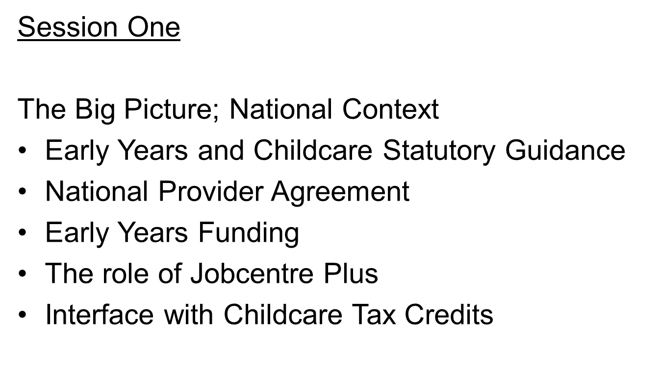

Slide 4
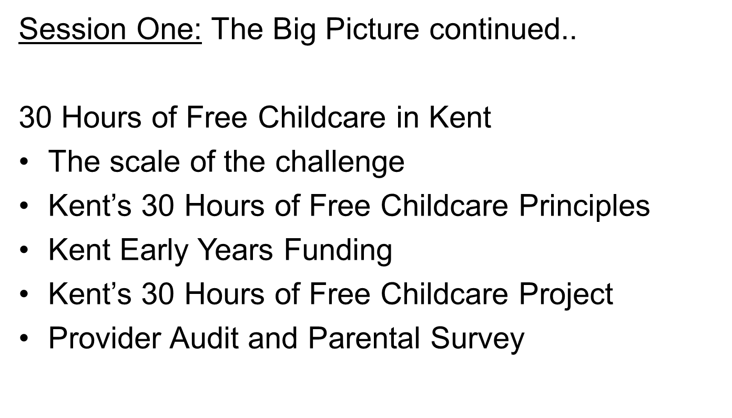

Slide 5
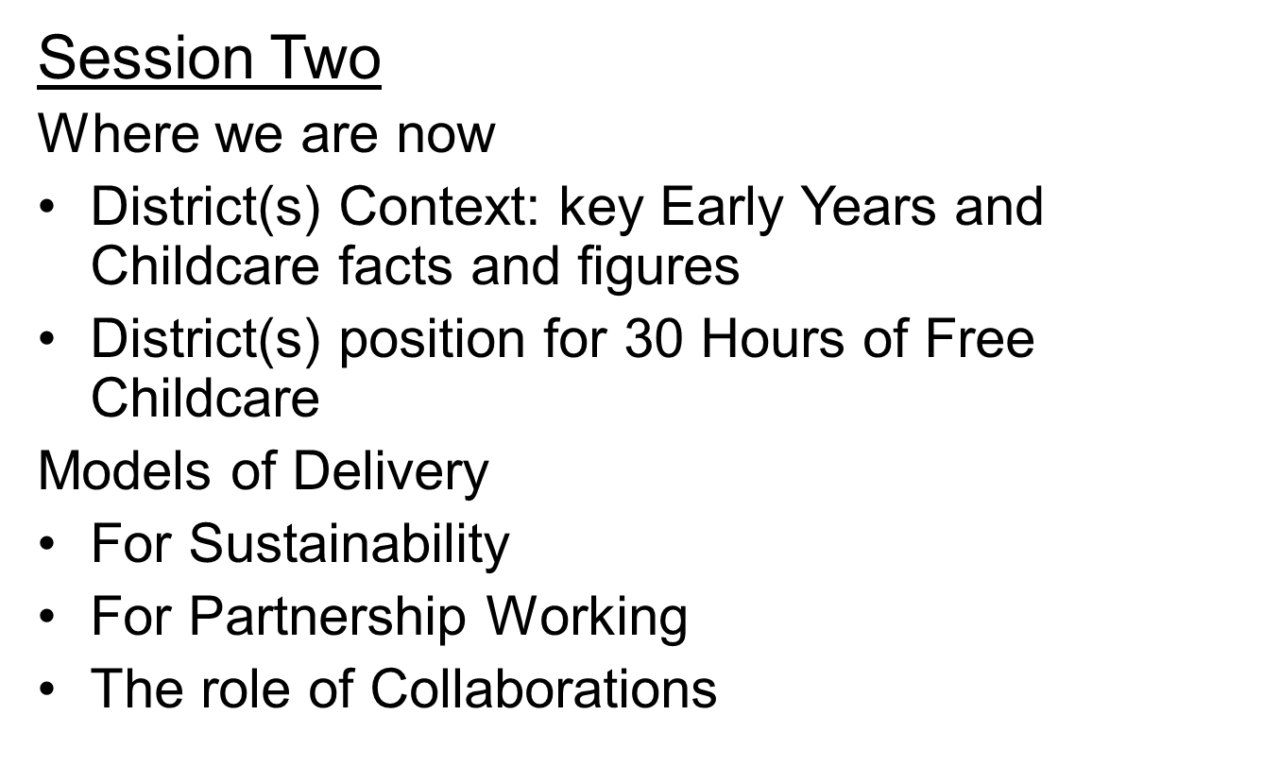

Slide 6
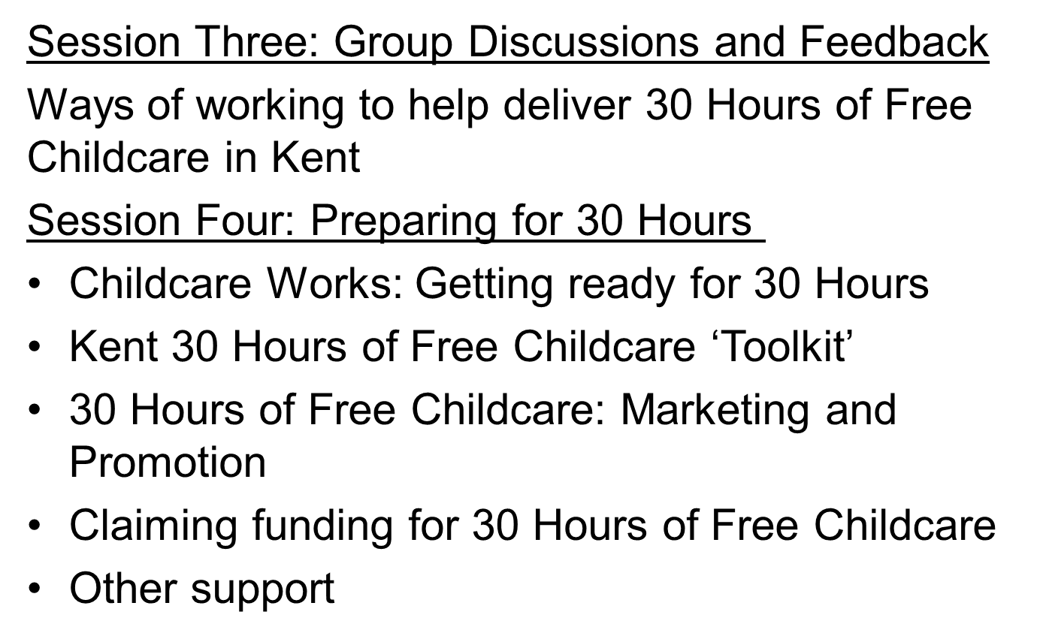

Slide 7

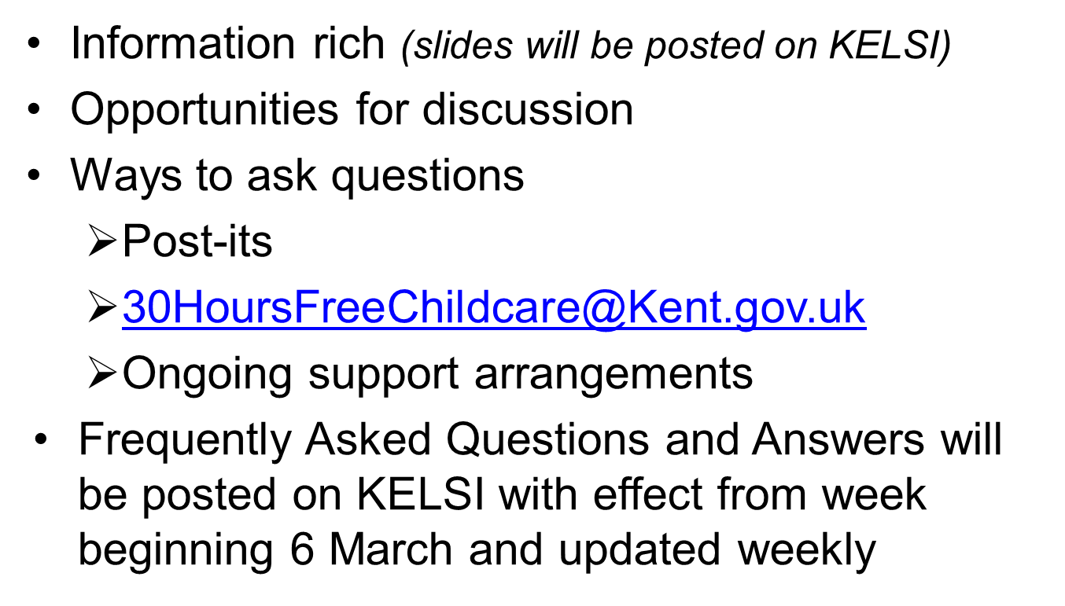

Slide 8

Out of School Childcare providers are eligible to register to deliver 30 Hours of Free Childcare if
They are on the Early Years Register
They are exempt from registration i.e. schools
The newly published revised EYFS Statutory Framework states
‘Providers offering care exclusively before and after school or during the school holidays for children younger than those in the Reception class age range, should continue to be guided by, but do not have to meet, the learning and development requirements. All such providers should discuss with parents and/or carers (and other practitioners/providers as appropriate, including school staff/teachers) the support they intend to offer’

Slide 9



Slide 10
The National Picture
Early Years and Childcare Statutory Guidance (September 2017)
Early Years Funding (April 2017)
The Model Provider Agreement

Slide 11
Statutory Guidance
Content
Part A: Free places for two, three and four year olds
Eligibility
Flexibility
Quality
Funding places
Part B: Securing sufficient childcare
Part C: Information to parents
Part D: Information to childcare providers

Slide 12
Eligibility
Two year olds
Three and four year olds (universal entitlement)
Three and four year olds of working parents (extended entitlement)
  A child will be entitled to the additional free hours from the beginning of the term after the child is three and the child’s parent has a current positive determination of eligibility from HMRC

Slide 13
Eligibility Criteria
The parent(s) should be in qualifying paid work (set out in regulations). Each parent or the single parent in a lone parent household will need to expect to earn the equivalent of 16 hours at NMW or NLW over the forthcoming quarter
Where one or both parents are in receipt of benefits relating to sickness, parenting, caring, incapacity for work or limited capability for work they are treated as though they are in paid work
Where a parent is in a ‘start-up period’ (i.e. they are newly self-employed) they do not need to demonstrate that they meet the income criteria for 12 months in order to be eligible
If either or both parents’ income exceeds £100,000 they will not be eligible for the extended entitlement

Slide 14
Eligibility Checking
A new national Eligibility Checker is being developed that will check eligibility for
Two year old places
30 Hours places
Childcare Tax Credits
Early Years Pupil Premium
This will also automatically calculate the Grace Period, minimising administrative burdens on local authorities and providers

Slide 15
Childcare Tax Credits
Tax Free Childcare will be introduced during 2017. Parents will be able to set up an online account where they can bank payments for childcare. For each £8 a parent pays in, the Government will add an additional £2 up to a maximum of £2,000 per year (up to a maximum of £4,000 for families of disabled children)
Tax Free Childcare is being rolled out gradually and will eventually cover all families with children under 12, if they meet the required work and income criteria.
There will be an upper income limit per parent of £100,000 and a minimum weekly income level per parent equivalent to 16 hours worked at the NLW
Charity run settings requiring a Unique Tax Reference call HMRC Childcare Service Helpline on 0300 123 4097

Slide 16
The Role of JobCentre Plus
Once the Eligibility Checking System is in place, JobCentre Plus, in advising parents on employment issues, should be able to also support them in checking their eligibility for 30 Hours of Free Childcare
In Kent we have had an early conversation with Job Centre Plus about the potential to support parents by working together in this way

Slide 17
The Grace Period
LAs should continue to fund a place for a child whose parents cease to meet the eligibility criteria and ensure that providers are aware of this
LAs will be able to access this information via the Eligibility Checking Service, which will automatically encode the Grace Period end date
LAs should complete an audit check on eligibility codes at six fixed points in the year, both at half-term and at the end of term across the year
LAs should communicate the Grace Period (through providers) to parents who are found to be ineligible for the extended entitlement at the audit check date

Slide 18
The Grace Period
Date Parent receives ineligible decision on reconfirmation | LA audit date: | Grace Period End date:
1 January – 10 February | 11 February | 31 March
11 Feb – 31 March | 1 April | 31 August
1 April – 26 May | 27 May | 31 August
27 May – 31 August | 1 September | 31 December
1 September – 21 October | 22 October | 31 December
22 October – 31 December | 1 January | 31 March
LAs should consider extending the Grace Period for a short time in very exceptional circumstances if the parent has been forced to leave their home and paid employment, for example, where the parent is a victim of domestic abuse or other serious crime

Slide 19
Flexibility
Local authorities should…
Encourage providers to offer flexible packages of free hours
Not before 6.00am or after 8.00pm
With no minimum session length
With no session to be longer than 10 hours
A maximum of two sites in a single day
Ensure that parents and providers are aware that free places can be delivered
Over up to 52 weeks of the year
Outside of maintained school term times
At weekends

Slide 20
Charging
‘Funding is intended to deliver 15 or 30 hours a week of free, high quality, flexible childcare. It is not intended to cover the costs of meals, other consumables, additional hours or additional services.
LAs should ensure that providers are aware that they can charge for meals and snacks, consumables such as nappies or sun cream and for services such as trips and yoga.
These charges must be voluntary for the parent.’

Slide 21
Support for children with SEND
Disability Access Fund
SEN Inclusion Fund
Best Practice Guidance being developed to improve the quality of Early Years sections of Local Offers
Examples to be published of good practice and effective systems of SEND support for children in their early years

Slide 22
Childcare information for parents
Local authorities must
Maintain a service that provides information for parents and prospective parents on childcare in their area
From September 2017 publish this information electronically on the LA website and update it at a minimum termly on 1 January, 1 April and 1 September
During the period 1 April 2017 to 31 August 2017, provide information regarding persons who intend to provide the extended 30 hours entitlement
Clearly publish how those without access to the internet or from different groups, including people with special educational needs and disability, can access information

Slide 23
Scope of requirements on providers
Local Authorities are required by legislation to limit the requirements they place on any provider to those which ensure
places are delivered completely free of charge to parents
places are provided flexibly in a pattern which meets the needs of parents
that the funding provided is used properly and in accordance with any arrangements made with providers
that the provider meets the needs of disabled children those with SEN

Slide 24
Scope of requirements on providers cont
effective safeguarding and promotion of welfare of the children
that providers actively promote fundamental British values and not promote views or theories as fact which are contrary to established scientific or historical evidence and explanations
that the early years provider takes any measures identified in a report from Ofsted to improve the overall effectiveness of the provision
are necessary for the effective administration of the arrangements

Slide 25
Early Years Funding
Champagne Nurseries, Lemonade Funding (CNLF)
CNLF has been looking at ways to challenge the Government over the underfunding of Early Years Free Entitlements
A complaint against the Government has been submitted to the Competition and Markets Authority regarding the Government’s abuse of its position as the biggest purchaser of childcare
The case is that the Government is controlling the price at which providers must ‘sell’ their services, by legislating that funded places must be given to parents for ‘free’, and is also controlling the price at which it buys services by deciding how much to award each LA and by directing the LA as to how much of that money it can retain for its services
The CMA route means that the laws around funding should be looked into and is a key step in the right direction in terms of trying to get the law changed to remove the word ‘free’ and allow the funding to be used as a subsidy

Slide 26
Early Years Funding in Kent
In the context of views expressed by providers in the Kent consultation, with effect from the 1 April 2017 KCC has agreed to make the following changes to the Early Years Funding Formula for all providers:
Three and Four Year Olds | 2016-17 Hourly rates | 2017-18 Hourly rates
Base Rate | £3.91 | £3.91 (Increasing by 5p to £3.96 from 1 September 2017)
Deprivation | £0.01 to £0.90 | £0.01 to £0.90
Quality – QTS | £0.90 | £0.90
Quality – QTS/EYPS | £0.30 | £0.30
Quality – System Leadership (in Kent, Collaborations) | n/a | £tbc
Quality – Ofsted | £0.05 per hour + £300 lump sum | No longer applicable
Flexibility | £0.05 | No longer applicable

Slide 27
Early Years Funding in Kent
Funding for 2 year olds
From 1 April 2017 an increase of 7p from £4.95 to £5.02 per hour
Communication of individual funding rates
Each provider has been sent a letter informing them of their individual funding rate for 2017-18
Future intentions
It is our intention to further increase the Base Rate in the future as affordability allows. We anticipate that this will be possible from the growth in the take up of the 30 Hours. The amount of the increase and the timing of the increase will depend on the level of take up

Slide 28
Model Provider Agreement
Can be implemented from April or from September
Not too prescriptive as DfE trying to meet the needs of both providers and local authorities
Operational guidance will be published ‘in due course’ which will be more explicit (We have been asked to continue to attend the ‘Expert’ Group)
We are currently working on the local (Kent) elements of the Model Agreement (including seeking provider views), to be complete late April/early May

Slide 29
30 Hours of Free Childcare
The scale of the challenge in Kent
Predicted take up of 15 Hours by three/four year olds
Autumn 2017 18,723
Spring 2018 24,828
Summer 2018 29,509
Estimated eligibility for 30 hours of Free Childcare
Autumn 2017 11,404 children
Spring 2018 15,128 children
Summer 2018 17,983 children

Slide 30
30 HOURS OF FREE CHILDCARE - KEY PRINCIPLES
The Child
The child's welfare and well-being are paramount with their differences being welcomed and valued
All eligible children should be able to access 30 Hours in quality Early Years provision
The needs of children not eligible for 30 Hours should not be compromised
The Child
The Parent/Carer
Parent/Carers should be empowered and supported to:
Have high expectations for themselves and their families
Access quality childcare for their child(ren) that enables them to work
The Provider
The Parent/Carer
30 HOURS
The Provider
Providers should have available to them:
Timely accurate information about 30 Hours
Services that support sustainability and high quality, inclusive childcare
Continuous professional development for their staff

Slide 31
30 Hours of Free Childcare in Kent
Project Plan with various work streams
Sufficiency
Sustainability
Promotion and Communication
Workforce Development and Maintaining Quality
Equality and Inclusion
In-house Systems
Evaluation

Slide 32
Predicting Demand for 15 and 30 Hour Places
Uses a methodology developed by Sheffield City Council to estimate demand for Free Early Education places in three terms in the 2017/2018 Academic Year
Demand calculated using a range of sources:
  GP Data- Eligible 3 & 4 year olds in each term
  HMRC - Benefit recipients to calculate the proportion of working households
  Census Data - Households eligible for 30 hours i.e. both parents working, single-parent working households
  KCC Service Data - Take up and where children travel to access childcare
  KCC Childcare Survey 2017 Findings

Slide 33
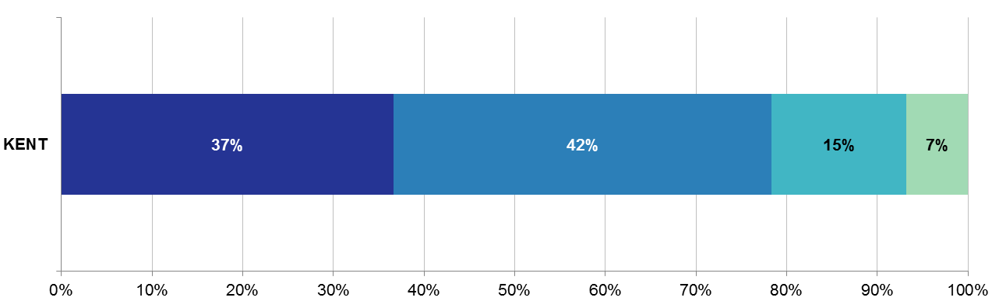
Kent Provider Survey
Establishments: 760
Childminders: 612
Total Childcare providers: 1,372
Survey Responses: 502
Response Rate: 37%
Are you considering offering the 30 hours of nursery funding when it is implemented for working parents?
Yes
No
Not Sure
Don’t Know

Slide 34
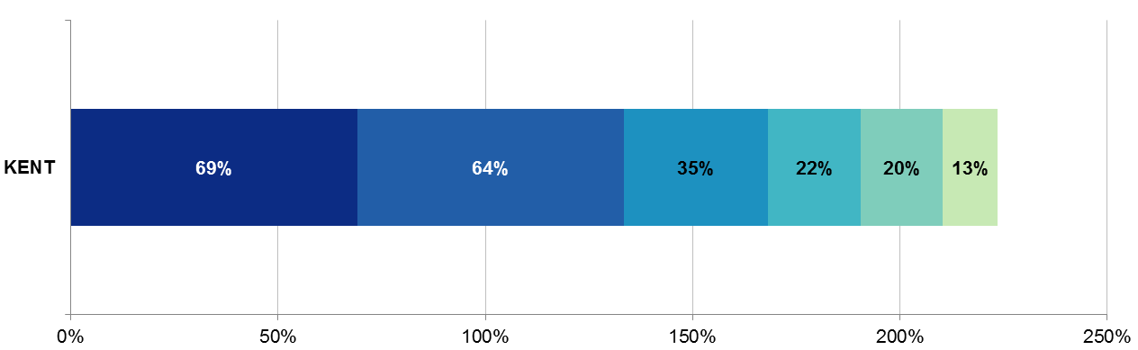
Kent Provider Survey
Establishments: 760
Childminders: 612
Total Childcare providers: 1,372
Survey Responses: 502
Response Rate: 37%
What are your reasons for not considering offering the 30 hours of nursery funding when it is implemented for working parents?
Reduced revenue/income
Lack of staff
KCC funding unknown
Facilities/building issues
Restrictions with opening hours
Impact on places for FF2

Slide 35
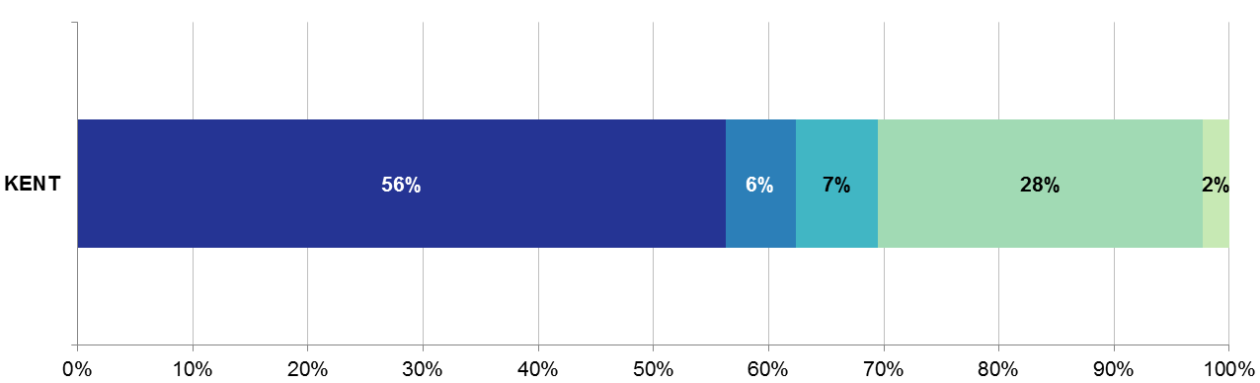
Kent Provider Survey
Establishments: 760
Childminders: 612
Total Childcare providers: 1,372
Survey Responses: 502
Response Rate: 37%
For those that said yes or were not sure, how do you plan to offer the 30 hours funded places?
Over 38 weeks
Don’t know
Stretched places
Not applicable
Over 38 weeks & stretched places

Slide 36
KCC Parents Survey – February 2017
739 respondents (90.7%) indicated that they intended to take up some of the extra 15 hours childcare available
471 (64%) 26-30 hours per week
140 (19%) 21-25 hours per week
96 (17%) 16 - 20 hours per week

Slide 37
Relevant District Slides

Slide 38
Models of Delivery
To support sustainability
For working in partnership
The role of collaborations

Slide 39
Models of Delivery
1. Supporting Sustainability
Examples
Totally free pattern, term time only provision
Totally free pattern, year round full day care
Totally free pattern, stretched
Additional patterns, not stretched
Additional patterns, stretched

Slide 40
Model of Delivery example
Totally Free Pattern
Term time only provision
Opening 9.00-15.00
38 weeks per year
Child attends 5 full days per week for 38 weeks with no costs attached
Provider offers parents 5 full days per week, subject to availability.
Provider offers a free lunch or child brings a packed lunch.

Slide 41
Model of Delivery example
Stretched Additional Pattern
Full day care
Open 8.00-18.00
50 weeks per year
A child attending a full time place each week
(50 hours)
24 hours free childcare per week plus 26 hours chargeable for 48 weeks per year.
Free childcare is 1140 hours per year. As this is stretched over 48 weeks, the child will be accessing 1152 hours. The additional 12 hours will be chargeable in addition to the remaining 2 weeks.

Slide 42
Models of Delivery
2. Working in partnership
The Government has stated that it anticipates the partnership working will be key in the successful delivery of 30 Hours of Free Childcare and has particularly looked to the Early Implementers to trial and champion this

Slide 44
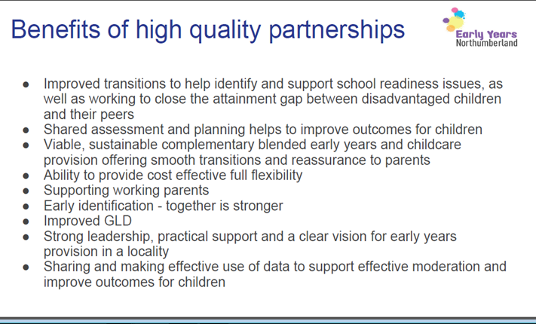

Slide 45
Models of Delivery
3. The Role of Collaborations
Collaborations are a way in which settings and childminders can support each other, share good practice and ideas and purchase training more cost effectively
Collaborations may be one way in which you can organise some partnership working between settings and between settings and childminders
If you are interested in leading or joining a collaboration, please make sure you complete this section of the Expression of Interest and Evaluation form at the end of the Seminar.

Slide 46
Collaborations – North Kent
 | County | Dartford | Gravesham | Sevenoaks
Number of collaborations | 53 | 1 | 1 | 6
Number of PVI settings in a collaboration | 419 | 26 | 21 | 45
Number of childminders in a collaboration | 3 | 0 | 0 | 0
% of settings in a collaboration | 62% | 56.5% | 72.4% | 63.8%

Slide 47
Collaborations – South Kent
 | County | Ashford | Dover | Shepway
Number of collaborations | 53 | 5 | 7 | 5
Number of settings in a collaboration | 419 | 42 | 31 | 44
Number of childminders in a collaboration | 3 | 0 | 0 | 0
% of group settings in a collaboration | 62% | 73.7% | 63.8% | 80%

Slide 48
Collaborations - West Kent
 | County | Maidstone | Tonbridge & Malling | Tunbridge Wells
Number of collaborations | 53 | 5 | 4 | 4
Number of settings in a collaboration | 419 | 33 | 38 | 39
Number of childminders in a collaboration | 3 | 0 | 0 | 3
% of group settings in a collaboration | 62% | 40% | 60% | 64.5%
*There will soon be a meeting to start a new collaboration in Maidstone

Slide 49
Collaborations – East Kent
 | County | Canterbury | Swale | Thanet
Number of collaborations | 53 | 5 | 5 | 5
Number of settings in a collaboration | 419 | 40 | 36 | 24
Number of childminders in a collaboration | 3 | 0 | 0 | 0
% of group settings in a collaboration | 62% | 71.4% | 61% | 51.1%
* A new collaboration should form in Thanet in March

Slide 50
What Kent Collaboration Leaders said about 30 Hours of Free Childcare
Collaborations are a positive thing in delivering 30 Hours of Free Childcare
We have a strong moral purpose to do this, for our children and families
We can work together, sharing ideas and problem solving
We can work together to drive down some costs
This could be a chance to expand our businesses
We are a strong, resilient sector and we can do this

Slide 51
Session Three
Ways of Working
In Session Two you heard ….
What the current position for 30 Hours of Free Childcare is, as far as we can predict this, in the district(s) in question
About models to support sustainability
About models for working in partnership
About the role of Collaborations

Slide 52
Group Discussions
How can all providers (i.e. private, voluntary and independent Early Years and Out of School Childcare settings, childminders, schools with maintained nurseries) work in partnership to fill gaps in the provision 30 Hours of Free Childcare?
Which partnership models might you/your setting offer?
Are there any other ‘ways of working’?
Feedback one ‘good idea’ per table

Slide 53
Session Four: Preparing for 30 Hours
Information, Advice, Guidance and Support: Overview
Regular information
Childcare Works: Getting Ready for 30 Hours
Kent 30 Hours of Free Childcare ‘Toolkit’
Transition (KCC Early Years and Childcare Service, Threads of Success ‘Transition Matters’)
Kent 30 Hours of Free Childcare Marketing and Promotion
Claiming Funding
Bespoke Support

Slide 54
30 Hours of Free Childcare Information
Provided in Kent via
30 Hours Monthly Update (posted on KELSI on the last Friday of each month)
Termly (six times a year) Early Years and Childcare Bulletin
30 Hours of Free Childcare March Seminars
Early Years and Childcare Briefing and Networking Sessions (next round in Term 5)

Slide 55
(National) Childcare Works
Getting Ready for 30 Hours
Ten Steps:
Understanding the business
Understanding the local market
Understanding the needs of families
Understanding finances
Managing and monitoring money
Considering the options available
Using market research to create a business/action plan
Implementing the plan
Communicating and promoting the entitlement to families
Ongoing review and monitoring the plan
Accessible via link on Kent’s 30 Hours Monthly update or directly via the Childcare Works website www.childcareworks.co.uk

Slide 56
Kent 30 Hours of Free Childcare Toolkit
(Available by the end of March)
Kent 30 Hours of Free Childcare Principles
Sections One to Four will offer a framework for self-evaluation, guidance and practical examples.
Section One: Sustainability and Sufficiency
Sufficiency Survey
Capacity and Sustainability
Patterns of Delivery and Blended Models
Section Two: Improvement and Standards
30-Hour Quality and Improvement

Slide 57
Kent 30 Hours of Free Childcare Toolkit continued
Section Three: Equality and Inclusion
Early Years and Childcare for families with a child with a special educational need and/or disability
Accessing and using additional funding
Making the Local Offer visible in your setting
Section Four: Partnership and Integration
The role of Collaborations
Partnership working case studies

Slide 58
Kent 30 Hours of Free Childcare Toolkit continued
Section Five: Focus on Childminders
SWOT Analysis, USP and Sustainability
Risk Assessment
What next?
Section Six: Focus on Out of School Childcare
Registration
Sections One to Four (applied to Out of School Childcare)

Slide 59




Slide 60
Marketing and Promotion:
Resources
The following promotional resources for 30 Hours of Free Childcare will be made available to providers:
Leaflet for parents – for group settings and childminders, available at the seminars
“Empty belly” posters – A3 for group settings, A4 for childminders, available early April
Railings banners – for group settings and Children’s Centres, available late March
Imagery for Facebook pages/websites
Notes:
Empty Belly posters will have a space for settings to write any information they wish to get across to parents
Railings banners will promote free childcare for two, three and four years olds and will replace existing banners

Slide 61
Claiming Funding for
30 Hours of Free Childcare
Process still to be determined pending release of the Eligibility Checker
Once received and in the context of it, KCC will establish its system and process for payments well in advance of September and communicate this accordingly

Slide 62
Bespoke Support
Childcare Sufficiency Officers to offer 30 Hours specific visits to group provisions during April/May
Childminders being consulted on what support they would like via Prospects (Evaluation Form)
Group provisions being consulted on what support they would like in relation to quality and equality (Evaluation Form)

Slide 63
Childcare Business Grant
The Childcare Business Grants Scheme is funded by the DfE. There is a fixed amount of funding available. The scheme is due to end by 31 March 2018, or sooner if all funds have been exhausted
Grants available are £500 - £1,000 for childminders setting up a new business
Grants are criteria based and amongst other things you must be planning on offering the 30hrs childcare entitlement for 3-4 year olds
To check availability and ensure you meet the criteria go to https://www.gov.uk/childcare-business-grant#what-you-need-to-know. To contact them email childcarebusinessgrants@ecorys.com or telephone 0207 444 4268
Page 3 of the application form asks: Where did you hear about this grant scheme? Please write Prospects under the ‘Other’ option; unless you were already aware of the scheme
Notes:
The scheme is only open to newly registered businesses. These are those which have been registered with Ofsted or a CMA within the last 12 months. From 1 May 2017, a newly registered business will be one registered with Ofsted or a CMA within the last 3 months.
How much you can get
£500 - £1,000
Eligibility
You could get a childcare business grant to help with the costs of setting up a childminder business or agency (CMA) in England.
You’ll get a grant if:
you’re registered with Ofsted or a childminder agency
you have your early years registration certificate
you’re going to offer, either on your own or in partnership with other providers, the 30 hours of childcare entitlement for 3 and 4 year olds
What you’ll get
You could get a one-off payment depending on the type of business you’re setting up:
£500 if you’re setting up as an early years childminder
£1,000 if you’re setting up as an early years childminder agency
£1,000 if you’re planning on being an early years childminder for disabled children
The money can help you pay for:
public liability insurance
Disclosure and Barring Service (DBS) clearance
a local authority approved childcare training course
Ofsted or child minder agency registration
a first aid course
equipment
This scheme will run until March 2018.
In order to apply for the grant you must first register online to create an account. This is quick and easy to do. In your account you can then complete and submit your application online and keep up to date on the progress of your application.
In order to apply for the grant you should have an electronic version or of your Ofsted/CMA certificate to hand. You cannot submit your application without it.

Slide 64
Group Discussion
Is this framework of information, advice, guidance and support comprehensive?
If not, what else could be added?
Time permitting, ideas will be invited to be shared (one per table). If not please make a note of your suggestions and leave on your table to be collected. Following all the March Seminars, feedback will be provided and ideas taken forward as appropriate

Slide 65
Next Steps
KCC’s 30 Hours Monthly Update continues
Following all of the March Seminars, feedback will be made available through the usual information sources
Frequently Asked Questions and Answers will being posted on KELSI and updated weekly
Bespoke support as previously described

Slide 66
And for now…
Please complete and hand in your evaluation form
For any unanswered questions, please put these on a post-it and place on the flip-chart
Don’t forget to collect your parent leaflets
Thank you for your time and contributions
Have a safe onward journey
Hope to see you soon ☺

