Slide 1
Applying for 6th Forms, Colleges and Apprenticeships in Kent
www.kentchoices4u.com and www.UCASprogress.com/search

Slide 2
Raising the Participation Age
Remember what you choose to do after Year 11 is important, and you have a responsibility until you are 18 years old to stay in one of the options below:
full time education in school or college;
full time work with learning attached to it, like an apprenticeship; or,
part-time education (if you are self-employed or volunteering).

Slide 3
So, if you would like some advice or guidance:
talk to your school: they have a legal responsibility to provide you with independent, impartial careers advice;
talk to your careers teacher, teachers, family and friends;
get advice and guidance from https://nationalcareersservice.direct.gov.uk; or,
use kentchoices4u.com and UCASprogress.com

Slide 4
www.kentchoices4u.com
Will help you decide what you want to do and how to plan making decisions.
Look here for local information on:
open evenings and course entry requirements.
Click on the links to:
apprenticeship vacancies;
sources of careers help;
careers information, videos and tools

Slide 5
www.UCASProgress.com/search
Is where you:
login to your personal account;
research school and college options;
apply online;
track your application;
Your school careers tutor will be able to monitor applications to see if you need any support.

Slide 6
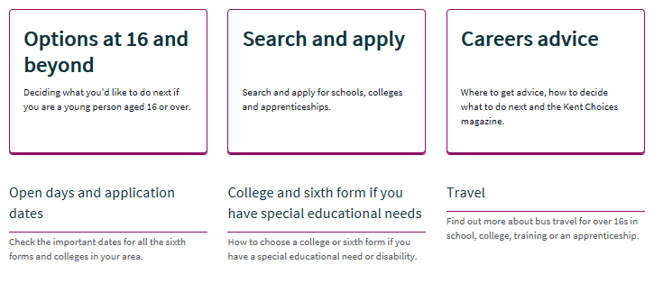

Slide 7
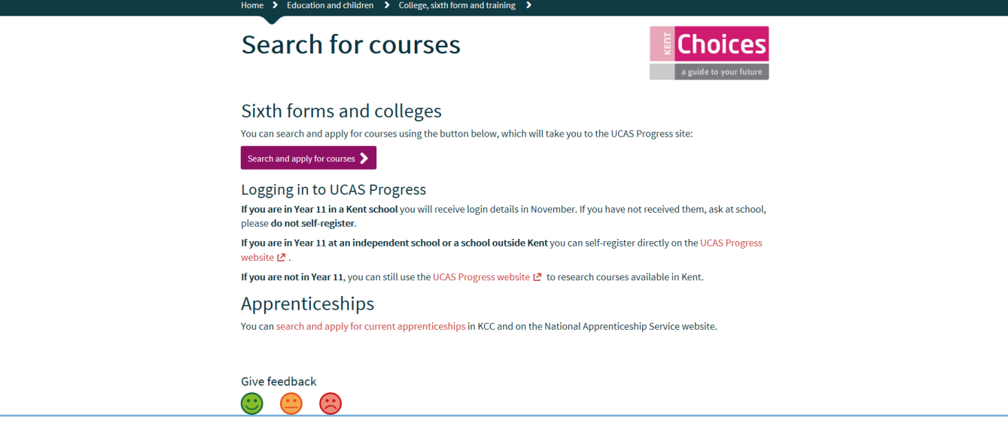

Slide 8
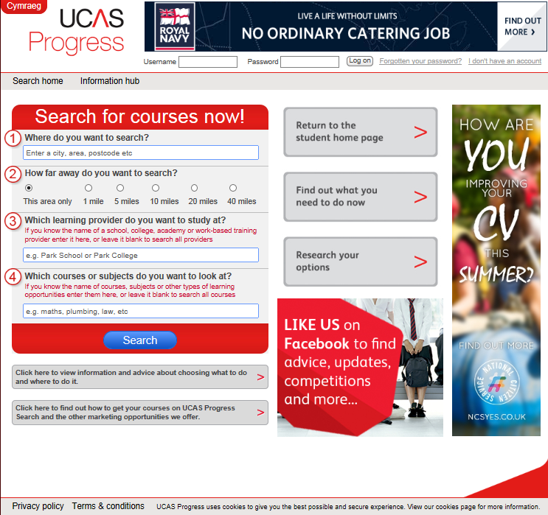

Slide 9
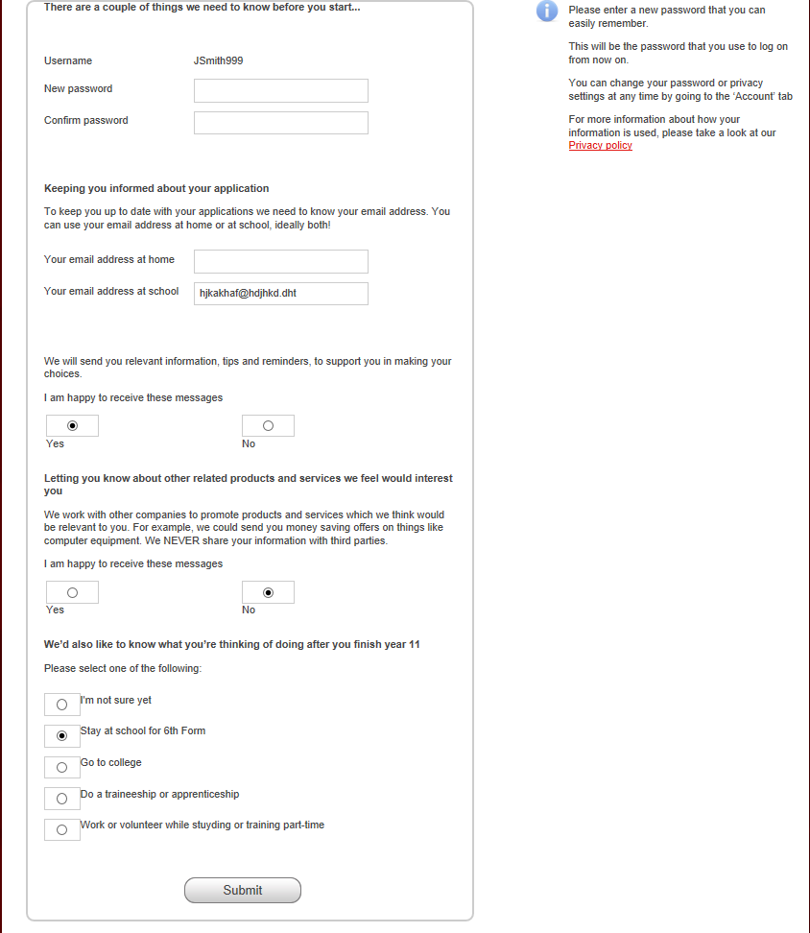

Slide 10
Five steps to applying
Step 1: Complete your profile
Step 2: Search for courses
Step 3: Favourite the courses that interest you
Step 4: Apply
Step 5: Track your applications

Slide 11
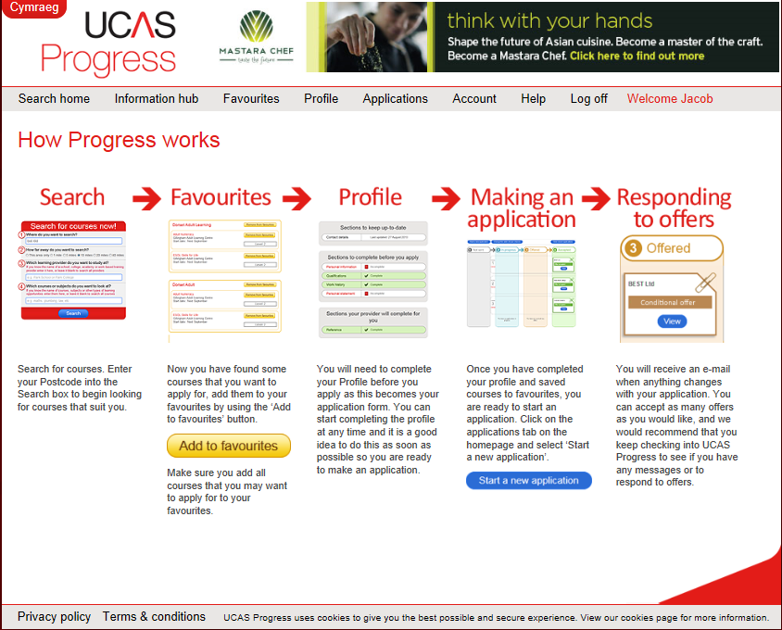

Slide 12
Step 1
Complete your profile

Slide 13
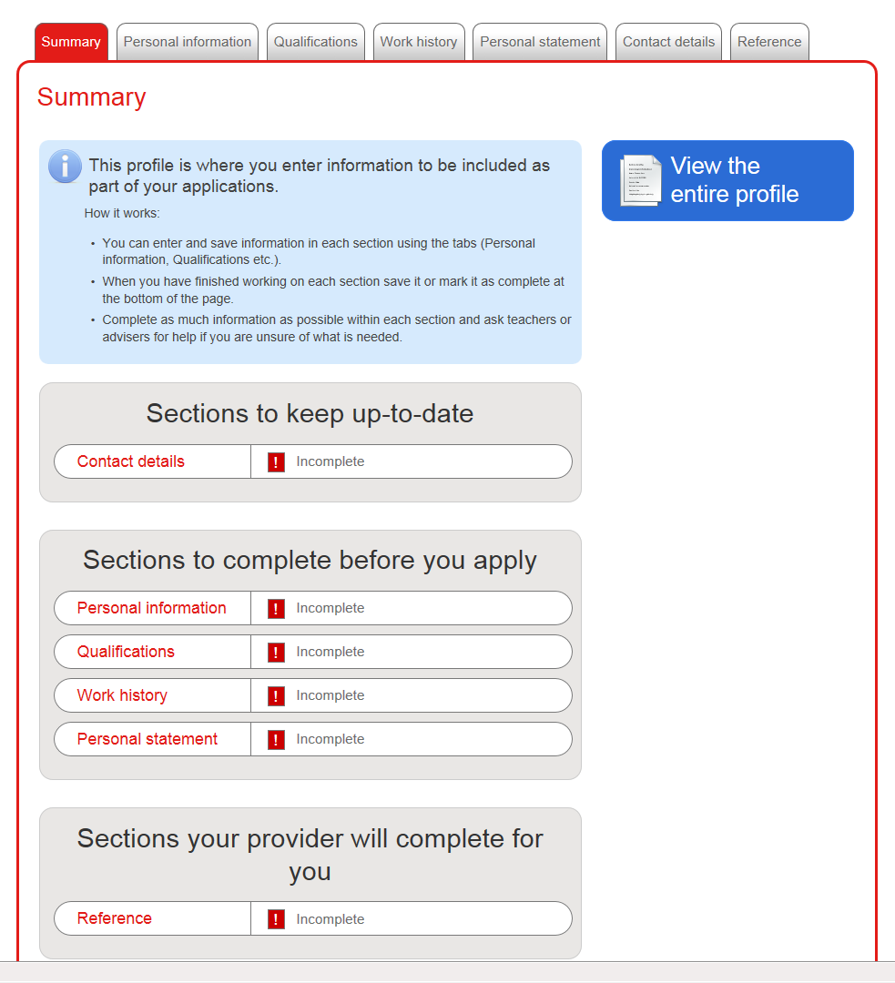

Slide 16
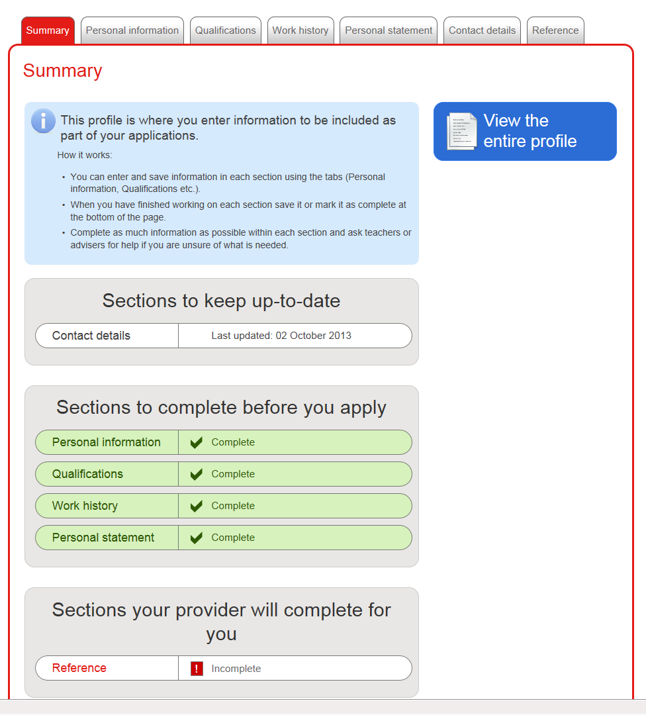

Slide 17
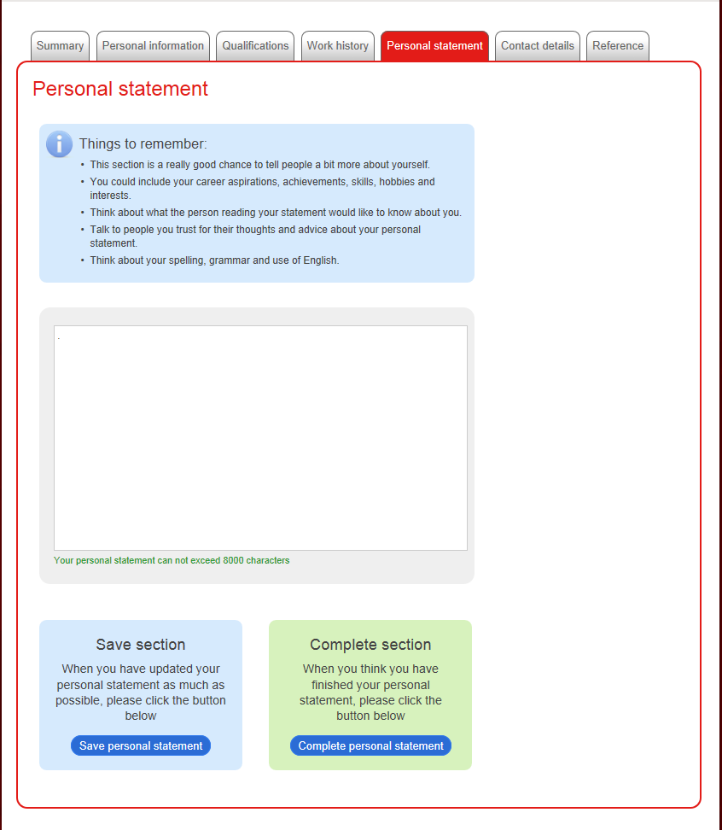

Slide 18
Step 2
Search for courses

Slide 20
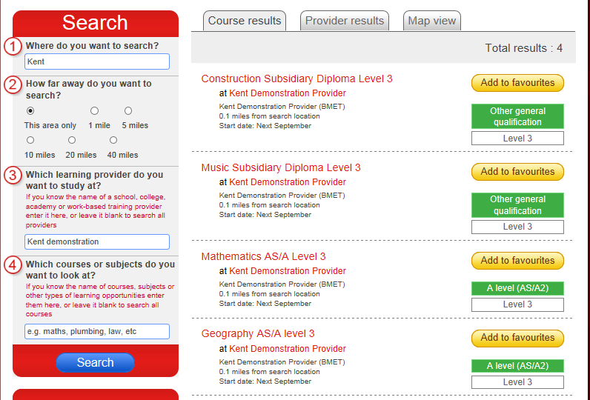

Slide 21
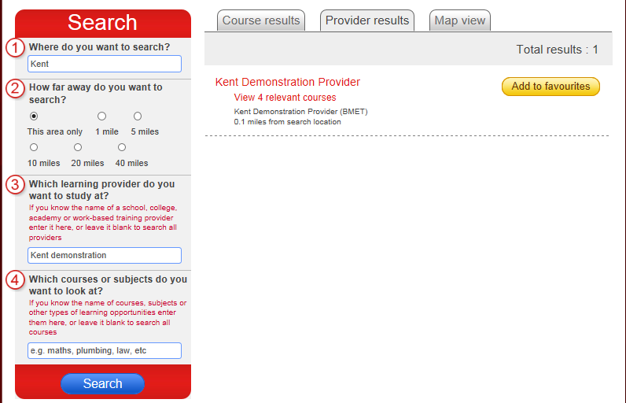

Slide 22
Step 3
Favourite all the courses that interest you

Slide 23
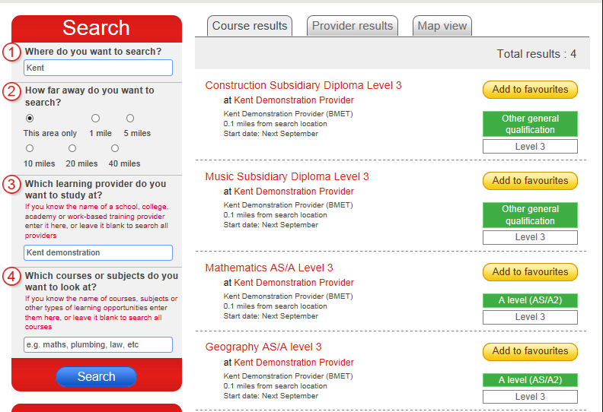

Slide 24
Step 4
Start your application

Slide 26
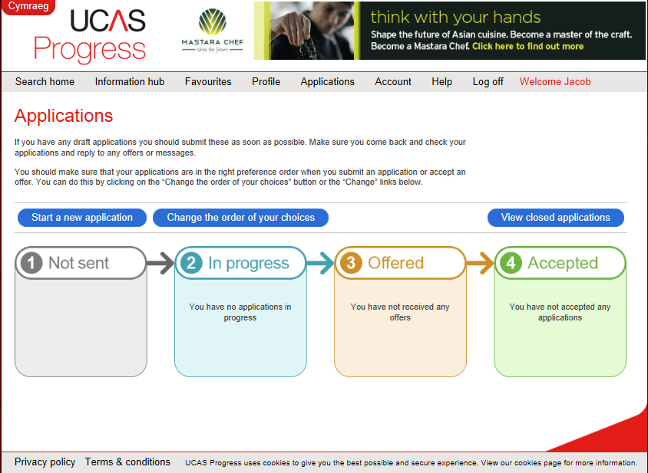

Slide 27
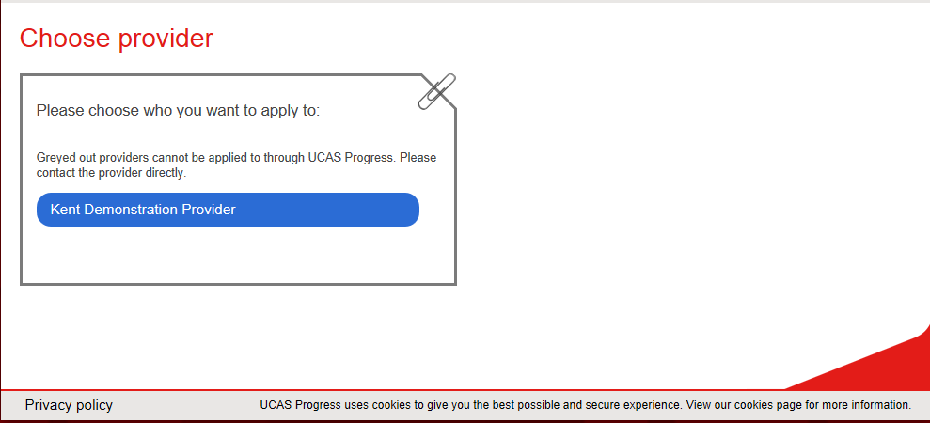

Slide 29
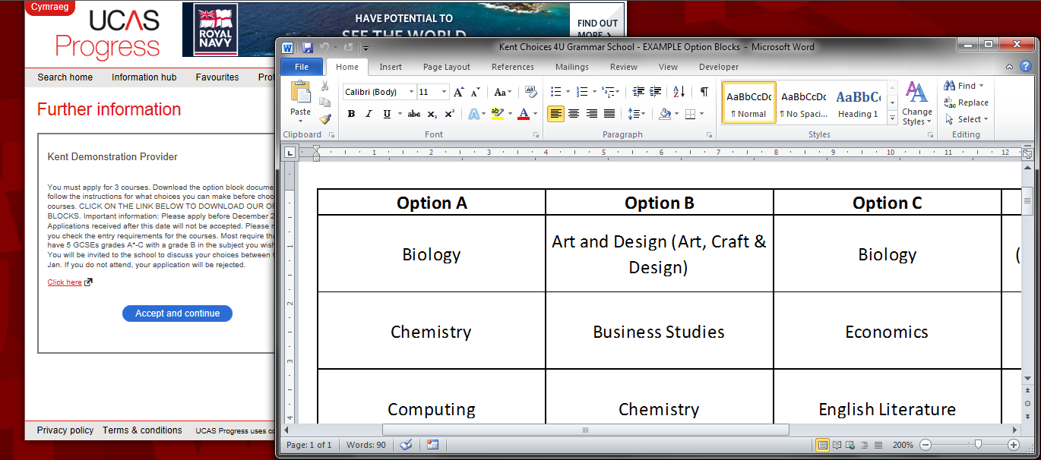
Notes:
Option Blocks slide

Slide 31
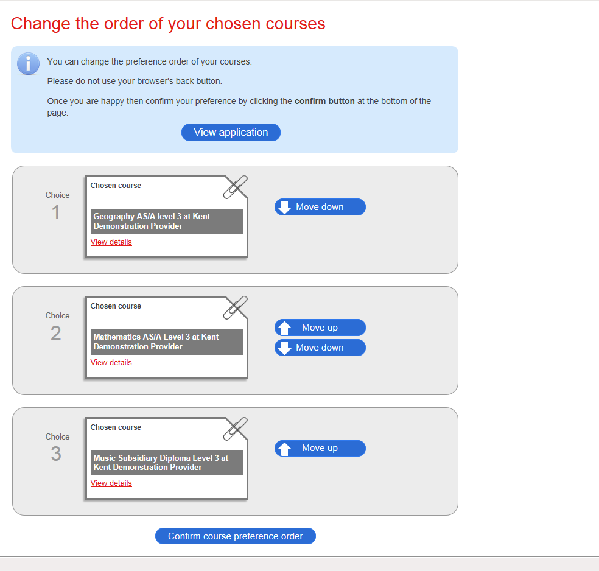

Slide 32
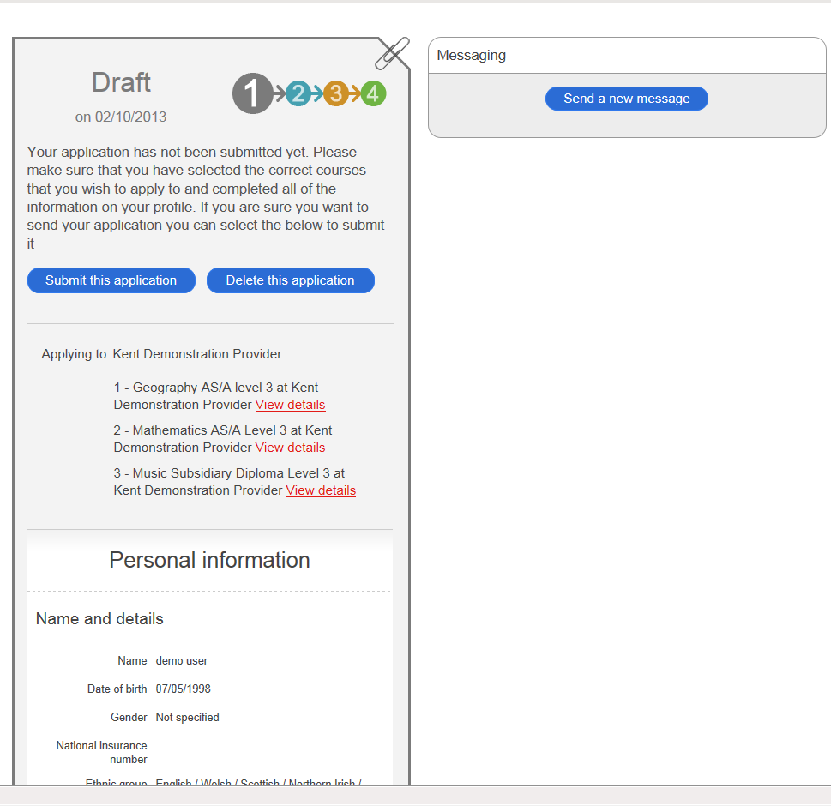

Slide 33
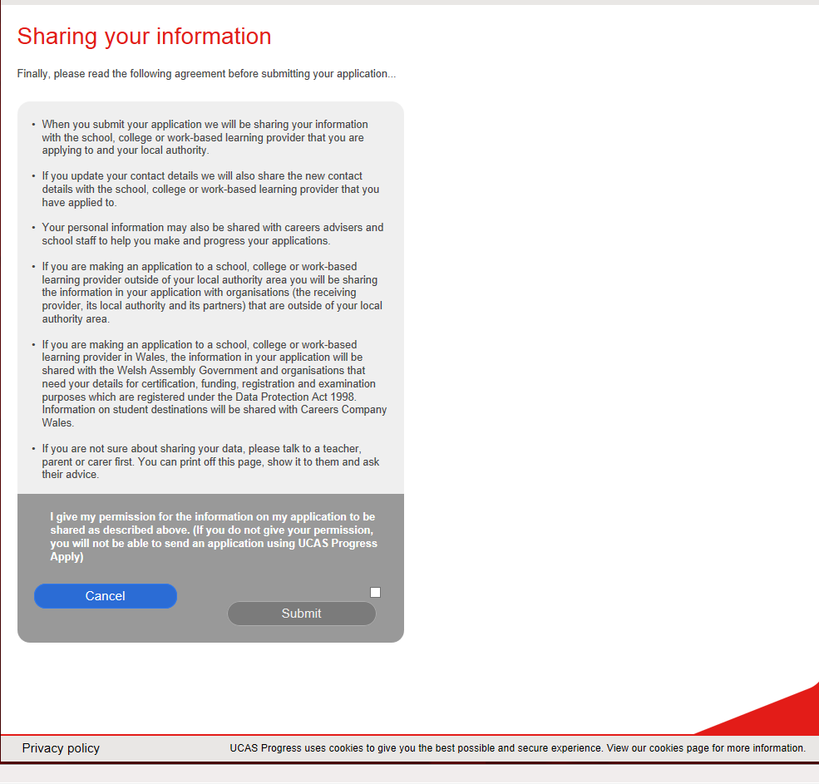

Slide 34
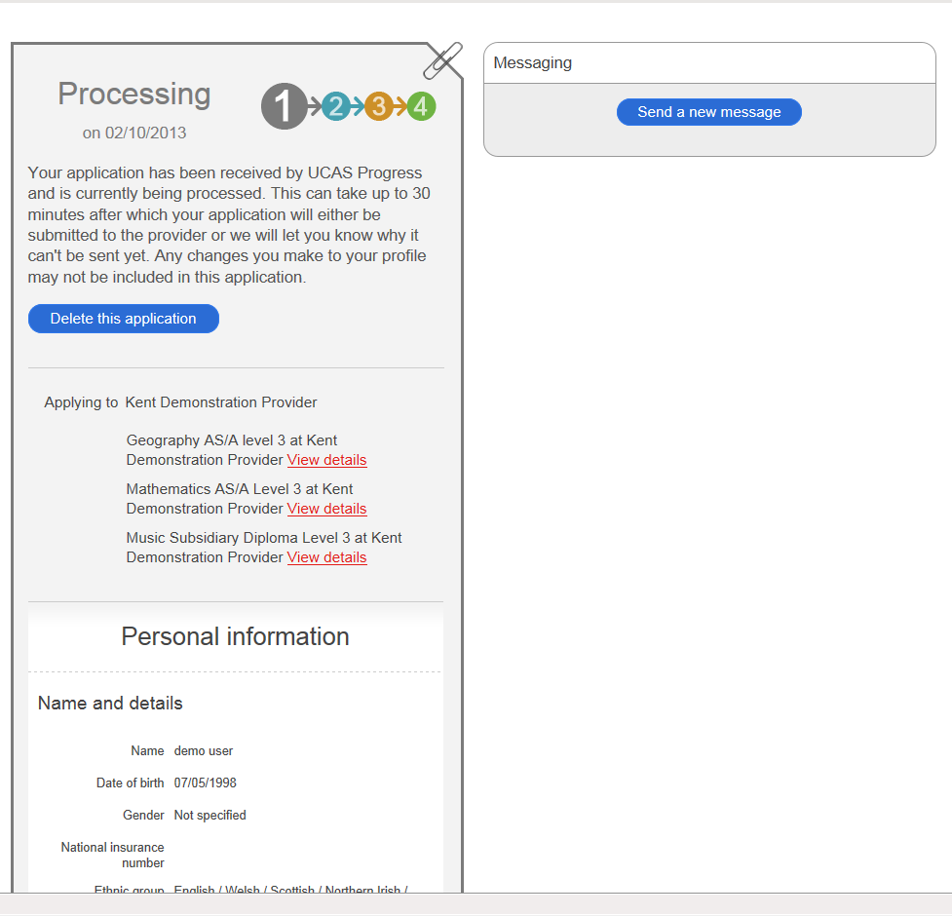

Slide 35
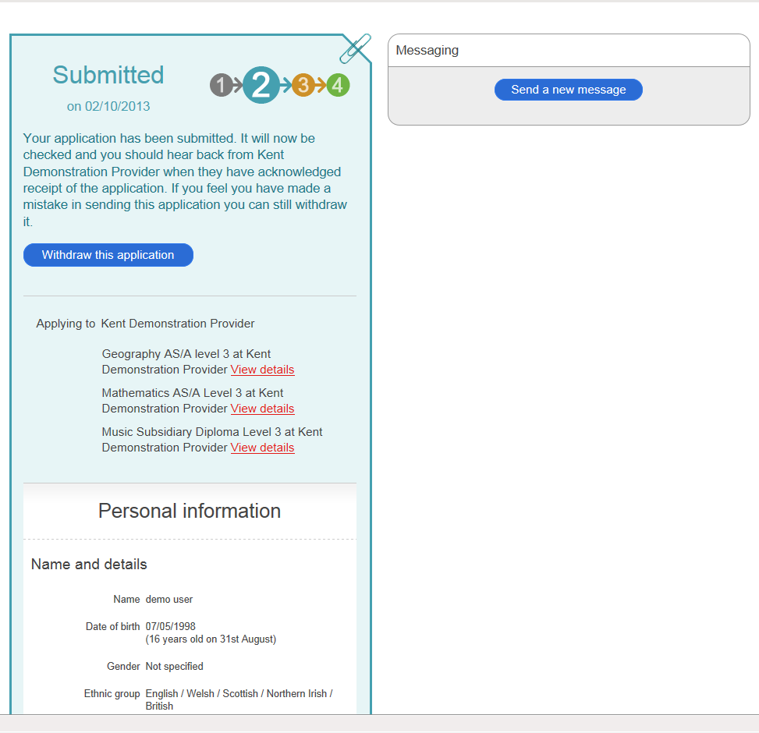

Slide 36
Step 5
Tracking your application

Slide 37
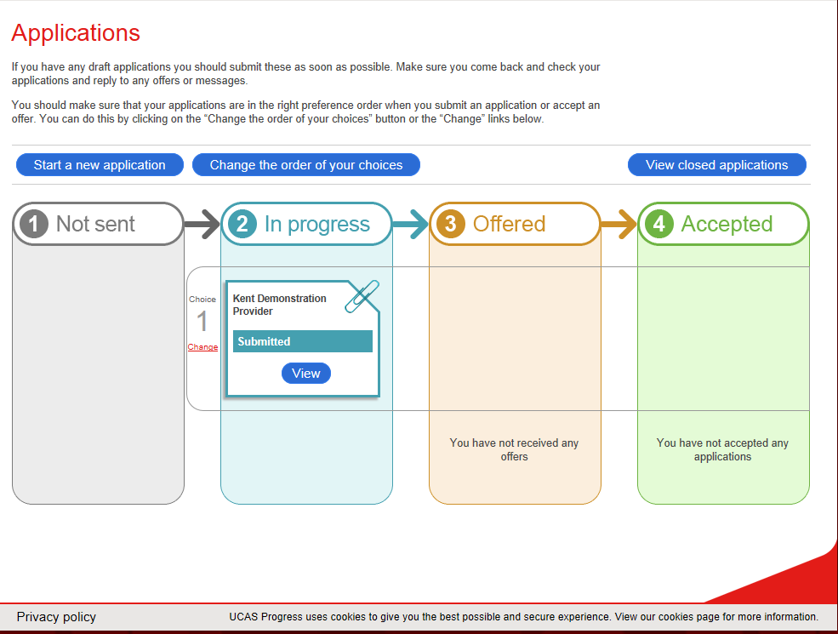

Slide 38
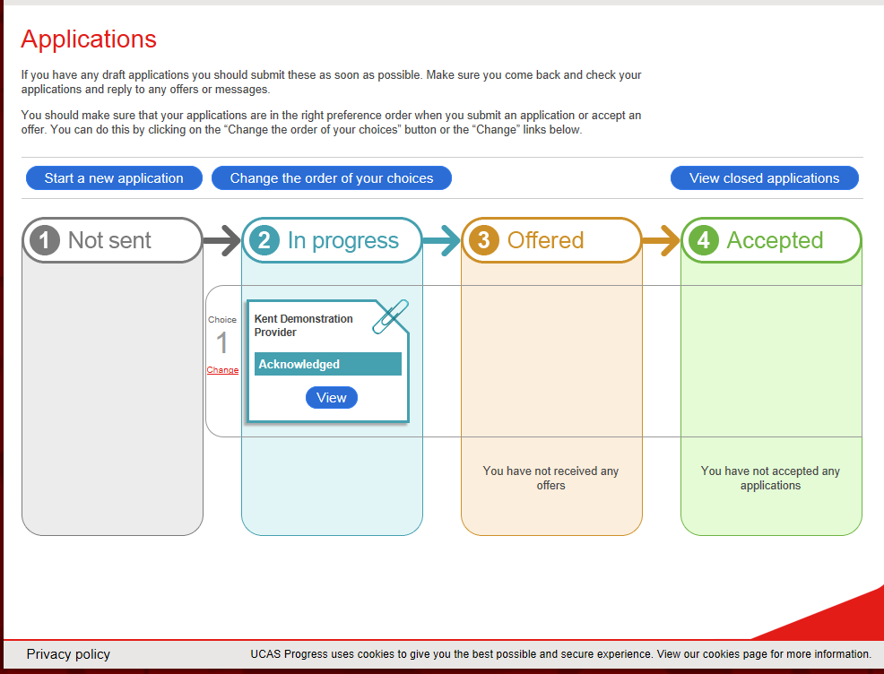

Slide 39
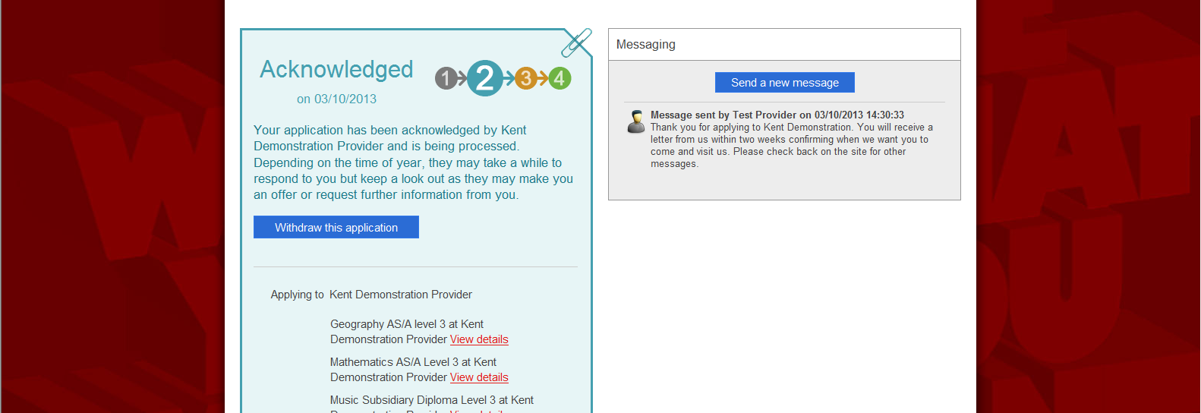

Slide 40
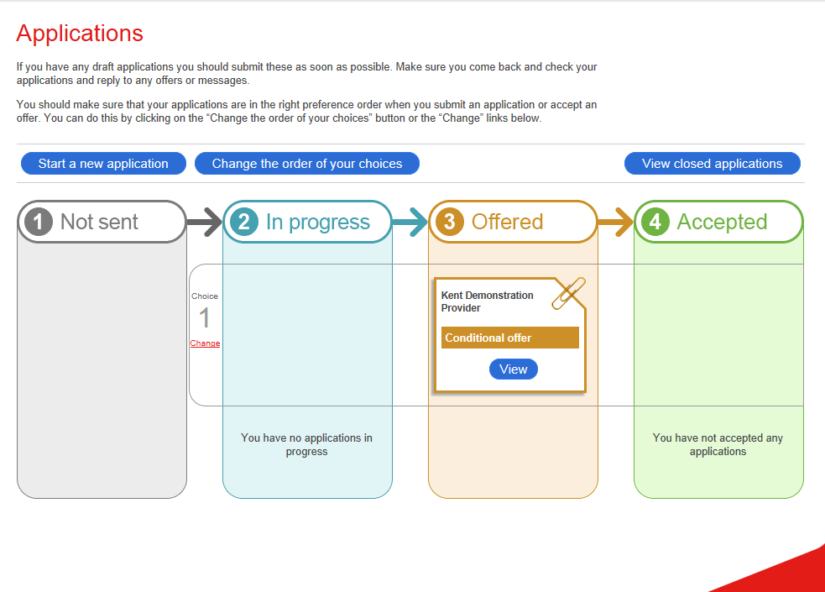

Slide 41
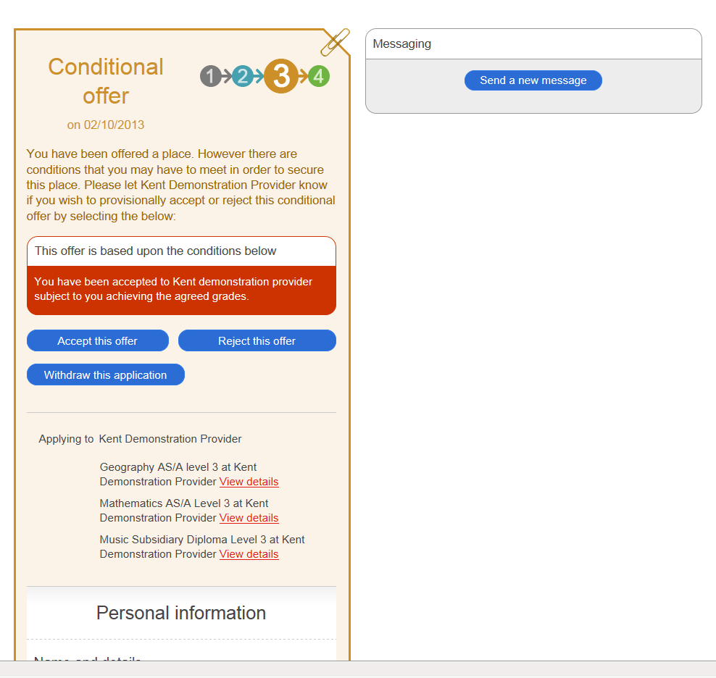

Slide 42
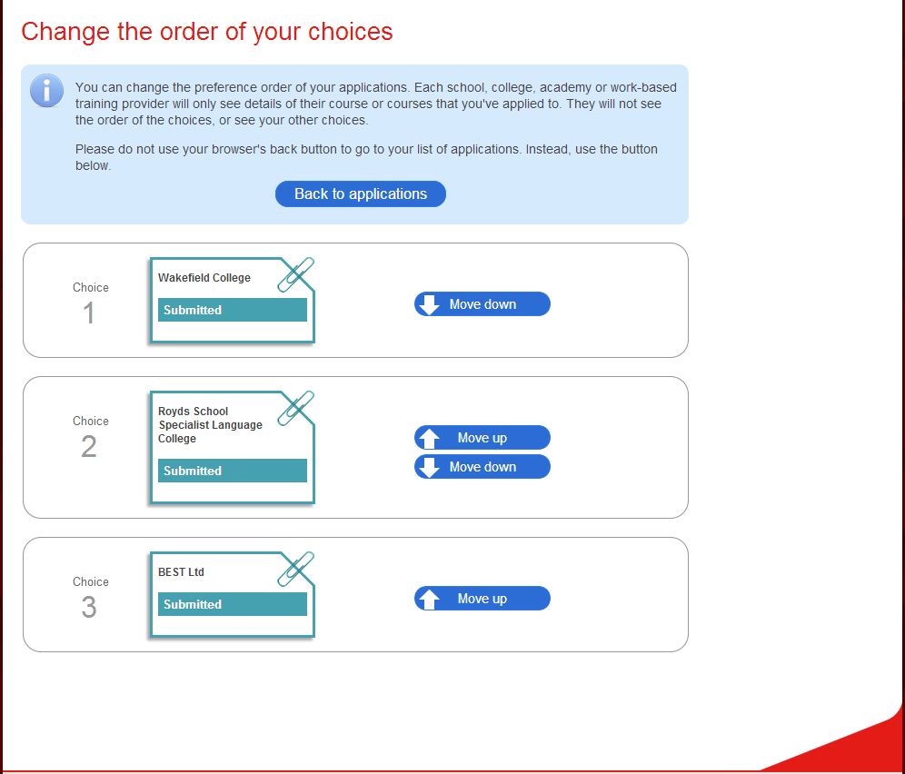
Notes:
Learner can move the applications up and down to show their preference order

Slide 43
What if I get stuck?
Always ask for help.
Prospectus@kent.gov.uk – 03000 414006

