Slide 1
Headteacher Briefings
July 2019
Matt Dunkley CBE
Corporate Director
Children, Young People and Education

Slide 2
Overview of today’s meeting
SEND
  an update on the finalised Written Statement of Action
  Table discussion on how we can work together to make our schools more inclusive for parents
The Education Endowment Foundation
  To outline the current position in Kent regarding attainment
  To provide an overview of an exciting Kent project with EEF
KAH
  to provide an update on developments

Slide 3
Ofsted/CQC SEND Inspection
Written Statement of Action
Keith Abbott
Director of Education, Planning and Access
Louise Langley
Head of SEN

Slide 4
Commitment to Children, Young People and their Families
Kent’s leaders in education, health and social care are committed to:
Being open and transparent with children, young people and their families.
Working in partnership with parents/carers to identify areas for improvement.
Ensuring we work together to review and design services for children with SEND.
Engaging CYP with the decision-making process and in planning their provision.
YP and parents/carers being fully involved in the development of the Local Offer.
Being open to challenge to enable better outcomes for CYP.

Slide 5
Task and Finish Workstreams
Workstreams A- E | 9 Areas of identified significant weakness
A - Parental Engagement and Co-production | The widely held concern of parents that the local area is not able, or in some cases not willing, to meet their children’s needs.
 | The limited role parents and carers have in reviewing and designing services for children and young people with SEND.
B - Inclusive Practice and the Outcomes, Progress and Attainment of Children and Young People | The variable quality of provision and commitment to inclusion in schools, and the lack of willingness of some schools to accommodate children and young people with SEND.
 | The poor standards achieved, and progress made, by children and young people with SEND.
 | The lack of effective systems to track and improve outcomes for those children and young people whose progress to date has been limited by weaknesses in provision.
C - Quality of Education, Help and Care Plans | The inconsistent quality of the EHC process; the lack of up to date assessments and limited contributions from health and care professionals; the poor processes to check and review the quality of EHC plans.
D - Joint Commissioning and Governance | The inability of current joint commissioning arrangements to address known gaps and eliminate longstanding weaknesses in the services for children and young people with SEND.
 | The governance of SEND arrangements across the EHC system at strategic and operational level and absence of robust action plans to address known weaknesses.
E - Service Provision | The unacceptable waiting times for children and young people to be seen by some health services, particularly CAMHS, tier two services, SALT, the wheelchair service, and ASD and ADHD assessment and reviews.

Slide 6
B - Inclusive Practice and the Outcomes, Progress and Attainment of Children and Young People
Senior responsible officer: Keith Abbott – Director of Education, Planning and Access
3 - Area of Weakness:
The variable quality of provision and commitment to inclusion in schools, and the lack of willingness of some schools to accommodate children and young people with SEND.
Outcome:
Improved inclusion and quality of SEND provision in schools.
4 - Area of Weakness:
The poor standards achieved, and progress made, by children and young people with SEND.
Outcome:
Improved attainment and progress made, by children and young people with SEND.
5 - Area of Weakness:
The lack of effective systems to track and improve outcomes for those children and young people whose progress to date has been limited by weaknesses in provision.
Outcome:
Systems are effective in tracking and improving outcomes for children and young people with SEND.

Slide 7
Ofsted’s findings
“Children and young people with special educational needs and/or disabilities (SEND) do not get the support they need in Kent.
“Parents and carers who contributed to the inspection are overwhelmingly negative about their dealings with the local area. Some told inspectors that Kent did not care about their children.”
“Not all schools and settings are willing to accommodate children and young people with SEND. One parent explained that eight of the ten schools she contacted to discuss her disabled son did not want to offer him a place. The local area, including school and academy leaders, does not ensure that they reliably meet their duties in this regard”.

Slide 8
Ofsted’s findings
“Education outcomes for children and young people with SEND are not good enough.”
“Many parents said that primary schools do not understand their child’s difficulties”.
Outcomes for children and young people with SEND are limited because leaders have not prioritised their needs”.

Slide 9
ISOS Partnership Project
Aims;
engage mainstream school leaders and SENCOs and colleagues involved in supporting mainstream inclusion;
explore the barriers and challenges to including young people with additional needs in mainstream settings; and
work with school leaders, SENCOs, central services, LA leaders and other partners to inform the development of a new strategic approach to strengthening inclusive practice across Kent, as part of taking forward this strand of work following the local area SEND inspection.

Slide 10
Proposed Approach
Phase 1 –
A short online survey for school leaders and SENCOs (July)
Analysis of data and documents
Phase 2 -
Workshops to engage school leaders, SENCOs and other professionals (October)
The main set of activities during this phase would be a series of workshops to share key messages from the survey and our wider evidence-gathering, test our findings and gather suggestions about what is needed to strengthen inclusive practice across Kent.
Phase 3 -
Developing solutions (November onwards)

Slide 11
Table Discussion
‘With the existing resources we have, how can we work together to make our schools more inclusive?’

Slide 12


Kent
Headteachers
Stephen Fraser
Deputy Chief Executive, EEF
8 July, 2019

Slide 13
Kent EEF project session aims
In this session we aim to:
Review Kent outcomes data
Build understanding of the Education Endowment Foundation work
Consult on how Kent schools and the EEF might partner to raise standards and close the attainment gap in our schools
Gather feedback from Heads to tailor the EEF offer to Kent schools

Slide 14
Kent (98 schools) |  |  |  |  |  |  |  |  |  |  |  |  |  | Average
Progress 8 (unvalidated) by pupil group
Breakdown | Cohort | P8 unadjusted |  |  |  | English element |  |  |  | Maths element |  |  |  | EBacc element |  |  |  | Open element
 |  | Kent | National |  |  | Kent | National |  |  | Kent | National |  |  | Kent | National |  |  | Kent | National
All pupils | 14318 | -0.06 | -0.03 |  |  | -0.13 | -0.04 |  |  | -0.07 | -0.02 |  |  | -0.08 | -0.03 |  |  | 0.03 | -0.04
Male | 7224 | -0.26 | -0.26 |  |  | -0.54 | -0.44 |  |  | -0.04 | 0 |  |  | -0.22 | -0.18 |  |  | -0.27 | -0.41
Female | 7094 | 0.15 | 0.21 |  |  | 0.29 | 0.38 |  |  | -0.1 | -0.05 |  |  | 0.06 | 0.13 |  |  | 0.33 | 0.35
Disadvantaged | 3134 | -0.63 | 0.13 |  |  | -0.67 | 0.11 |  |  | -0.54 | 0.12 |  |  | -0.72 | 0.14 |  |  | -0.57 | 0.12
Other | 11184 | 0.1 | 0.13 |  |  | 0.02 | 0.11 |  |  | 0.07 | 0.12 |  |  | 0.09 | 0.14 |  |  | 0.19 | 0.12
Low overall | 1956 | -0.17 | -0.17 |  |  | -0.23 | -0.21 |  |  | -0.14 | -0.12 |  |  | -0.22 | -0.16 |  |  | -0.09 | -0.2
Middle overall | 5997 | -0.1 | -0.01 |  |  | -0.18 | -0.02 |  |  | -0.08 | -0.01 |  |  | -0.2 | -0.02 |  |  | 0.02 | -0.02
High overall | 6365 | 0.02 | 0 |  |  | -0.05 | 0 |  |  | -0.03 | 0 |  |  | 0.06 | 0 |  |  | 0.07 | 0
Average IMD score for schools 19.17 22% Disadvantaged
 | G | NS | T
Well Above Average | 12 | 1 | 13
Above Average | 7 | 7 | 14
Average | 11 | 20 | 31
Below Average | 1 | 21 | 22
Well Below Average | 1 | 17 | 18
 |  |  | 98
>0.5 below National
>0.1 below National
>0.1 above National
>0.5 above National

Slide 15
Grammar (32 schools) |  |  |  |  |  |  |  |  |  |  | Above Average
Progress 8 (unvalidated) by pupil group
Breakdown | Cohort | P8 unadjusted |  |  | English element |  |  | Maths element |  |  | EBacc element |  |  | Open element
 |  | GS | National |  | GS | National |  | GS | National |  | GS | National |  | GS | National
All pupils | 4447 | 0.37 | -0.03 |  | 0.26 | -0.04 |  | 0.28 | -0.02 |  | 0.53 | -0.03 |  | 0.34 | -0.04
Male | 2210 | 0.16 | -0.26 |  | -0.19 | -0.44 |  | 0.36 | 0 |  | 0.39 | -0.18 |  | 0.02 | -0.41
Female | 2237 | 0.57 | 0.21 |  | 0.7 | 0.38 |  | 0.2 | -0.05 |  | 0.67 | 0.13 |  | 0.65 | 0.35
Disadvantaged | 322 | 0.02 | 0.13 |  | -0.01 | 0.11 |  | 0.01 | 0.12 |  | 0.15 | 0.14 |  | -0.09 | 0.12
Other | 4125 | 0.4 | 0.13 |  | 0.28 | 0.11 |  | 0.3 | 0.12 |  | 0.56 | 0.14 |  | 0.37 | 0.12
Low overall | 4 | 2.07 | -0.17 |  | 1.95 | -0.21 |  | 2.75 | -0.12 |  | 2.51 | -0.16 |  | 1.25 | -0.2
Middle overall | 397 | 0.87 | -0.01 |  | 0.78 | -0.02 |  | 0.85 | -0.01 |  | 1.11 | -0.02 |  | 0.71 | -0.02
High overall | 4046 | 0.32 | 0 |  | 0.21 | 0 |  | 0.22 | 0 |  | 0.47 | 0 |  | 0.3 | 0
Average IMD score for schools 15.11 7% Disadvantaged
 | G |  | T
Well Above Average | 12 |  | 12
Above Average | 7 |  | 7
Average | 11 |  | 11
Below Average | 1 |  | 1
Well Below Average | 1 |  | 1
 |  |  | 32
>0.5 below National
>0.1 below National
>0.1 above National
>0.5 above National

Slide 16
Non-selectives (66 schools) |  |  |  |  |  |  |  |  |  |  | Below Average
Progress 8 (unvalidated) by pupil group
Breakdown | Cohort | P8 unadjusted |  |  | English element |  |  | Maths element |  |  | EBacc element |  |  | Open element
 |  | NSS | National | Rank | NSS | National |  | NSS | National |  | NSS | National |  | NSS | National
All pupils | 9871 | -0.25 | -0.03 |  | -0.3 | -0.04 |  | -0.22 | -0.02 |  | -0.36 | -0.03 |  | -0.11 | -0.04
Male | 5014 | -0.45 | -0.26 |  | -0.69 | -0.44 |  | -0.21 | 0 |  | -0.49 | -0.18 |  | -0.4 | -0.41
Female | 4857 | -0.04 | 0.21 |  | 0.1 | 0.38 |  | -0.23 | -0.05 |  | -0.23 | 0.13 |  | 0.18 | 0.35
Disadvantaged | 2812 | -0.7 | 0.13 |  | -0.75 | 0.11 |  | -0.6 | 0.12 |  | -0.82 | 0.14 |  | -0.63 | 0.12
Other | 7059 | -0.06 | 0.13 |  | -0.13 | 0.11 |  | -0.07 | 0.12 |  | -0.18 | 0.14 |  | 0.09 | 0.12
Low overall | 1952 | -0.17 | -0.17 |  | -0.23 | -0.21 |  | -0.15 | -0.12 |  | -0.23 | -0.16 |  | -0.09 | -0.2
Middle overall | 5600 | -0.17 | -0.01 |  | -0.25 | -0.02 |  | -0.14 | -0.01 |  | -0.29 | -0.02 |  | -0.03 | -0.02
High overall | 2319 | -0.49 | 0 |  | -0.49 | 0 |  | -0.47 | 0 |  | -0.65 | 0 |  | -0.33 | 0
Average IMD score for schools 21.34 28% Disadvantaged
 |  | NS | T
Well Above Average |  | 1 | 1
Above Average |  | 7 | 7
Average |  | 20 | 20
Below Average |  | 21 | 21
Well Below Average |  | 17 | 17
 |  |  | 66
>0.5 below National
>0.1 below National
>0.1 above National
>0.5 above National

Slide 17
West Kent (31 schools) |  |  |  |  |  |  |  |  |  |  | Above Average
Progress 8 (unvalidated) by pupil group
Breakdown | Cohort | P8 unadjusted |  |  | English element |  |  | Maths element |  |  | EBacc element |  |  | Open element
 |  | Area | National | Rank | Area | National | Rank | Area | National | Rank | Area | National | Rank | Area | National | Rank
All pupils | 4175 | 0.23 | -0.03 | 1 | 0.15 | -0.04 | 1 | 0.2 | -0.02 | 1 | 0.24 | -0.03 | 1 | 0.28 | -0.04 | 1
Male | 2114 | -0.05 | -0.26 | 1 | -0.28 | -0.44 | 2 | 0.17 | 0 | 1 | 0.03 | -0.18 | 1 | -0.12 | -0.41 | 2
Female | 2061 | 0.5 | 0.21 | 1 | 0.59 | 0.38 | 1 | 0.22 | -0.05 | 1 | 0.46 | 0.13 | 1 | 0.68 | 0.35 | 1
Disadvantaged | 638 | -0.47 | 0.13 | 1 | -0.43 | 0.11 | 1 | -0.39 | 0.12 | 1 | -0.53 | 0.14 | 1 | -0.49 | 0.12 | 2
Other | 3537 | 0.35 | 0.13 | 1 | 0.26 | 0.11 | 1 | 0.3 | 0.12 | 1 | 0.38 | 0.14 | 1 | 0.42 | 0.12 | 1
Low overall | 519 | 0.05 | -0.17 | 1 | 0.07 | -0.21 | 1 | 0.09 | -0.12 | 1 | 0.05 | -0.16 | 1 | 0.02 | -0.2 | 2
Middle overall | 1575 | 0.19 | -0.01 | 1 | 0.15 | -0.02 | 1 | 0.2 | -0.01 | 1 | 0.15 | -0.02 | 1 | 0.25 | -0.02 | 1
High overall | 2081 | 0.29 | 0 | 1 | 0.18 | 0 | 1 | 0.22 | 0 | 1 | 0.36 | 0 | 1 | 0.36 | 0 | 1
Average IMD score for schools 12.92 Rank 4/4 (least deprived) 15% Disadvantaged
 | G | NS | T
Well Above Average | 8 | 1 | 9
Above Average | 1 | 5 | 6
Average | 2 | 5 | 7
Below Average | 0 | 5 | 5
Well Below Average | 0 | 4 | 4
 |  |  | 31
>0.5 below National
>0.1 below National
>0.1 above National
>0.5 above National
Areas of focus
Boys, especially in English in non-selective schools
Boys, in EBacc
Disadvantaged pupils, especially in non-selective schools

Slide 18
North Kent (21 schools) |  |  |  |  |  |  |  |  |  |  | Average
Progress 8 (unvalidated) by pupil group
Breakdown | Cohort | P8 unadjusted |  |  | English element |  |  | Maths element |  |  | EBacc element |  |  | Open element
 |  | Area | National | Rank | Area | National | Rank | Area | National | Rank | Area | National | Rank | Area | National | Rank
All pupils | 2807 | 0.02 | -0.03 | 2 | 0.01 | -0.04 | 2 | 0.02 | -0.02 | 2 | -0.03 | -0.03 | 2 | 0.07 | -0.04 | 2
Male | 1408 | -0.05 | -0.26 | 1 | -0.21 | -0.44 | 1 | 0.15 | 0 | 2 | -0.05 | -0.18 | 2 | -0.09 | -0.41 | 1
Female | 1399 | 0.09 | 0.21 | 2 | 0.23 | 0.38 | 3 | -0.12 | -0.05 | 2 | -0.01 | 0.13 | 2 | 0.22 | 0.35 | 2
Disadvantaged | 611 | -0.5 | 0.13 | 2 | -0.51 | 0.11 | 2 | -0.42 | 0.12 | 2 | -0.63 | 0.14 | 2 | -0.43 | 0.12 | 1
Other | 2196 | 0.16 | 0.13 | 2 | 0.15 | 0.11 | 2 | 0.14 | 0.12 | 2 | 0.14 | 0.14 | 2 | 0.21 | 0.12 | 2
Low overall | 368 | -0.09 | -0.17 | 2 | -0.07 | -0.21 | 2 | -0.14 | -0.12 | 2 | -0.21 | -0.16 | 2 | 0.05 | -0.2 | 1
Middle overall | 1157 | -0.01 | -0.01 | 2 | -0.07 | -0.02 | 2 | 0.01 | -0.01 | 2 | -0.09 | -0.02 | 2 | 0.1 | -0.02 | 2
High overall | 1282 | 0.07 | 0 | 2 | 0.1 | 0 | 2 | 0.07 | 0 | 2 | 0.08 | 0 | 2 | 0.04 | 0 | 2
Average IMD score for schools 19.87 Rank 3/4 (3rd most deprived) 22% Disadvantaged
 | G | NS | T
Well Above Average | 2 |  | 2
Above Average | 3 | 1 | 4
Average | 1 | 8 | 9
Below Average |  | 5 | 5
Well Below Average |  | 1 | 1
 |  |  | 21
>0.5 below National
>0.1 below National
>0.1 above National
>0.5 above National
Areas of focus
Boys, especially in English
Disadvantaged pupils, especially those in non-selective schools
Humanities in non-selective schools

Slide 19
South Kent (21 schools) |  |  |  |  |  |  |  |  |  |  | Below Average
Progress 8 (unvalidated) by pupil group
Breakdown | Cohort | P8 unadjusted |  |  | English element |  |  | Maths element |  |  | EBacc element |  |  | Open element
 |  | Area | National | Rank | Area | National | Rank | Area | National | Rank | Area | National | Rank | Area | National | Rank
All pupils | 3278 | -0.21 | -0.03 | 3 | -0.18 | -0.04 | 3 | -0.26 | -0.02 | 4 | -0.26 | -0.03 | 3 | -0.15 | -0.04 | 4
Male | 1643 | -0.49 | -0.26 | 4 | -0.68 | -0.44 | 3 | -0.29 | 0 | 4 | -0.5 | -0.18 | 4 | -0.48 | -0.41 | 4
Female | 1635 | 0.06 | 0.21 | 3 | 0.32 | 0.38 | 2 | -0.24 | -0.05 | 3 | -0.03 | 0.13 | 3 | 0.18 | 0.35 | 3
Disadvantaged | 811 | -0.66 | 0.13 | 3 | -0.64 | 0.11 | 3 | -0.6 | 0.12 | 3 | -0.76 | 0.14 | 3 | -0.63 | 0.12 | 3
Other | 2467 | -0.07 | 0.13 | 3 | -0.03 | 0.11 | 3 | -0.16 | 0.12 | 4 | -0.1 | 0.14 | 3 | 0.01 | 0.12 | 4
Low overall | 460 | -0.37 | -0.17 | 4 | -0.46 | -0.21 | 4 | -0.3 | -0.12 | 4 | -0.39 | -0.16 | 4 | -0.33 | -0.2 | 4
Middle overall | 1457 | -0.29 | -0.01 | 4 | -0.28 | -0.02 | 3 | -0.26 | -0.01 | 4 | -0.38 | -0.02 | 3 | -0.21 | -0.02 | 4
High overall | 1361 | -0.09 | 0 | 3 | 0.01 | 0 | 3 | -0.26 | 0 | 4 | -0.1 | 0 | 3 | -0.03 | 0 | 3
Average IMD score for schools 21.06 Rank 2/4 (2nd most deprived) 25% Disadvantaged
 | G | NS | T
Well Above Average | 1 |  | 1
Above Average | 2 | 1 | 3
Average | 4 | 2 | 6
Below Average |  | 4 | 4
Well Below Average |  | 7 | 7
 |  |  | 21
>0.5 below National
>0.1 below National
>0.1 above National
>0.5 above National
Areas of focus
Boys, especially in English
Disadvantaged pupils, especially boys and those in non-selective schools
Maths, in non-selective schools
Humanities, in non-selective schools

Slide 20
East Kent (25 schools) |  |  |  |  |  |  |  |  |  |  | Below Average
Progress 8 (unvalidated) by pupil group
Breakdown | Cohort | P8 unadjusted |  |  | English element |  |  | Maths element |  |  | EBacc element |  |  | Open element
 |  | Area | National | Rank | Area | National | Rank | Area | National | Rank | Area | National | Rank | Area | National | Rank
All pupils | 4058 | -0.27 | -0.03 | 4 | -0.46 | -0.04 | 4 | -0.23 | -0.02 | 3 | -0.32 | -0.03 | 4 | -0.12 | -0.04 | 3
Male | 2059 | -0.45 | -0.26 | 3 | -0.91 | -0.44 | 4 | -0.18 | 0 | 3 | -0.38 | -0.18 | 3 | -0.39 | -0.41 | 3
Female | 1999 | -0.08 | 0.21 | 4 | 0 | 0.38 | 4 | -0.28 | -0.05 | 4 | -0.25 | 0.13 | 4 | 0.16 | 0.35 | 4
Disadvantaged | 1074 | -0.77 | 0.13 | 4 | -0.92 | 0.11 | 4 | -0.65 | 0.12 | 4 | -0.86 | 0.14 | 4 | -0.65 | 0.12 | 4
Other | 2984 | -0.09 | 0.13 | 4 | -0.3 | 0.11 | 4 | -0.08 | 0.12 | 3 | -0.12 | 0.14 | 4 | 0.08 | 0.12 | 3
Low overall | 609 | -0.25 | -0.17 | 3 | -0.4 | -0.21 | 3 | -0.22 | -0.12 | 3 | -0.33 | -0.16 | 3 | -0.08 | -0.2 | 3
Middle overall | 1808 | -0.28 | -0.01 | 3 | -0.46 | -0.02 | 4 | -0.22 | -0.01 | 3 | -0.42 | -0.02 | 4 | -0.05 | -0.02 | 3
High overall | 1641 | -0.27 | 0 | 4 | -0.49 | 0 | 4 | -0.25 | 0 | 3 | -0.2 | 0 | 4 | -0.2 | 0 | 4
Average IMD score for schools 24.66 Rank 1/4 (most deprived) 26% Disadvantaged
 | G | NS | T
Well Above Average | 1 |  | 1
Above Average | 1 |  | 1
Average | 4 | 5 | 9
Below Average | 1 | 7 | 8
Well Below Average | 1 | 5 | 6
 |  |  | 25
Areas of focus
Boys, especially in English
Disadvantaged pupils, especially boys and those in non-selective schools
Maths, in non-selective schools
High ability pupils in non-selective schools
Humanities, in non-selective schools
>0.5 below National
>0.1 below National
>0.1 above National
>0.5 above National

Slide 21
EYFSP FSM Attainment Gaps
 | 2016 | 2017 | 2018
EYFSP Good level of Development | Gap (Non FSM-FSM) | Gap (Non FSM-FSM) | Gap (Non FSM-FSM)
 | % Expected Standard | % Expected Standard | % Expected Standard
Kent | 19 | 21 | 17
England | 18 | 17 | 17
Kent's Statistical Neighbour Ranked Position (1=top, 11=bottom) | 5 | 4 | 10

Slide 22
EYFSP FSM Attainment Gaps
Note: Data is for the gap between non FSM pupils attainment minus FSM pupils attainment

Slide 23
KS1 FSM Attainment Gaps
 | 2016 | 2017 | 2018
KS1 Reading | Gap (Non FSM-FSM) | Gap (Non FSM-FSM) | Gap (Non FSM-FSM)
 | % Expected Standard | % Expected Standard | % Expected Standard
Kent | 21 | 19 | 21
England | 17 | 17 | 18
Kent's Statistical Neighbour Ranked Position | 9 | 4 | 8
 | 2016 | 2017 | 2018
KS1 Writing | Gap (Non FSM-FSM) | Gap (Non FSM-FSM) | Gap (Non FSM-FSM)
 | % Expected Standard | % Expected Standard | % Expected Standard
Kent | 23 | 22 | 24
England | 18 | 19 | 20
Kent's Statistical Neighbour Ranked Position | 9 | 5 | 8
 | 2016 | 2017 | 2018
KS1 Mathematics | Gap (Non FSM-FSM) | Gap (Non FSM-FSM) | Gap (Non FSM-FSM)
 | % Expected Standard | % Expected Standard | % Expected Standard
Kent | 21 | 20 | 19
England | 17 | 18 | 18
Kent's Statistical Neighbour Ranked Position | 7 | 5 | 2

Slide 24
KS1 FSM Attainment Gaps
Note: Data is for the gap between non FSM pupils attainment minus FSM pupils attainment

Slide 25
KS1 FSM Attainment Gaps
Note: Data is for the gap between non FSM pupils attainment minus FSM pupils attainment

Slide 26
KS1 FSM Attainment Gaps
Note: Data is for the gap between non FSM pupils attainment minus FSM pupils attainment

Slide 27
KS2 FSM Attainment Gaps
 | 2016 | 2017 | 2018
KS2 Reading, Writing & Maths | Gap (Non FSM-FSM) | Gap (Non FSM-FSM) | Gap (Non FSM-FSM)
 | % Expected Standard | % Expected Standard | % Expected Standard
Kent | 25 | 26 | 24
England | 21 | 22 | 22
Kent's Statistical Neighbour Ranked Position (1=top, 11=bottom) | 4 | 8 | 4
Kent’s gaps are larger than national, though there was some slight improvement in 2018
Reasonable performance compared to our Statistical Neighbours
Lack of movement in Kent but also nationally

Slide 28
KS2 FSM Attainment Gaps
Note: Data is for the gap between non FSM pupils attainment minus FSM pupils attainment

Slide 29
KS4 FSM Attainment Gaps
 | 2016 | 2017 | 2018
KS4 Attainment 8 Gap | Gap (Non FSM-FSM) | Gap (Non FSM-FSM) | Gap (Non FSM-FSM)
Kent | 16.2 | 18.4 | 18.8
England | 12.7 | 13.1 | 13.9
Kent's Statistical Neighbour Ranked Position (1=top, 11=bottom) | 11 | 11 | 11
 | 2016 | 2017 | 2018
KS4 Progress 8 Gap | Gap (Non FSM-FSM) | Gap (Non FSM-FSM) | Gap (Non FSM-FSM)
Kent | 0.65 | 0.77 | 0.81
England | 0.50 | 0.52 | 0.58
Kent's Statistical Neighbour Ranked Position (1=top, 11=bottom) | 9 | 10 | 11
Kent’s gaps are larger than national, though they are reducing year on year
Poor performance compared to our Statistical Neighbours

Slide 30
KS4 FSM Attainment Gaps

Slide 31




Who we are …
The Education Endowment Foundation is an independent grant-making charity dedicated to breaking the link between family income and educational achievement.
The EEF was founded in 2011 by lead charity the Sutton Trust, in partnership with Impetus, with a £125m founding grant from the UK Department for Education.
In 2013, the EEF and the Sutton Trust joined the What Works Network, as the designated What Works Centre for Improving Education Outcomes for School-aged Children.
190
children and young people reached
1,300,000
EEF-funded projects
£114
13,000+
million
schools, nurseries, colleges involved
total funding committed to date

Slide 32

Why evidence …?

Slide 33
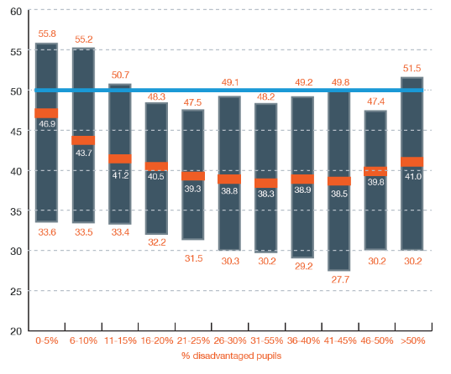
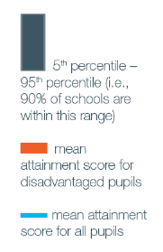
Why Evidence … ?
There are 272 secondary schools in England – 8% of all secondaries – where disadvantaged pupils at GCSE perform above the national Attainment 8 score for all 16 year-olds.
Of these 272, 108 (40%) are schools with an above average proportion of disadvantaged pupils
Notes:
Schools make a difference – could delete

Slide 34

“New research finds that kids aged 4-6 perform better during boring tasks when dressed as Batman”
Quartz, May 2017

Slide 35
Why evidence?
Project 1
A reading initiative that aims to increase a child’s motivation to read.
Weekly 1-hour sessions where pupils read and discussed an age-appropriate book.
Delivered by trained graduates to pupils who had not achieved expected level at the end of primary school.
Project 2
A whole-group programme that aims to foster the habit of independent reading.
Online system screens pupils according to their reading levels, and suggests books that match their reading age and interests.
Pupils take computerised quizzes on the books they have read and earn ‘points’ related to difficulty.

Slide 36
Why evidence?
Project 1
A reading initiative that aims to increase a child’s motivation to read.
Project 2
A whole-group programme that aims to foster the habit of independent reading.
Group | Months’ progress
All pupils | -2 months
Disadvantaged pupils | -4 months
Group | Months’ progress
All pupils | +3 months
Disadvantaged pupils | +5 months

Slide 37
So what …?
Despite our best intentions:
Some things don’t work as we expect.
Some can do harm.
Some things work better for some pupils than others.
And everything has an opportunity cost.

Slide 38

What we do … and how we do it.
We support teachers, school leaders and policy makers to use evidence to inform their decision-making
We believe evidence can make the biggest difference in the hands of skilled practitioners
We believe the evidence is best used to support and guide professional judgement, not to replace it.
1. Synthesis
2. Generation
3. Mobilisation

Slide 39
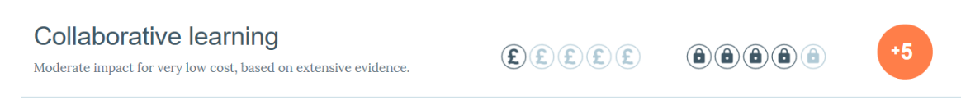
1. Evidence Synthesis – starting with what we know
Estimate the size of the effect
  Standardised Mean Difference = ‘months of gain’
Estimate the costs of adopting the practice.
Estimate the quality of the evidence – what level of confidence does it justify?

Slide 40


Slide 41
Bacon
Beef
Bread
Butter
Carrot
Cayenne
Celery
Cheese
Cinnamon
Coffee
Corn
Duck
Egg
Flour
Lamb
Lemon
Lobster
Mace
Milk
Mushroom
Mustard
Nuts
Olive
Onion
Orange
Parsley
Peas
Pepper spice
Pork
Potato
Raisins
Rum
Salt
Sherry
Sugar
Tea
Tomato
Tripe
Veal
Wine

Slide 42
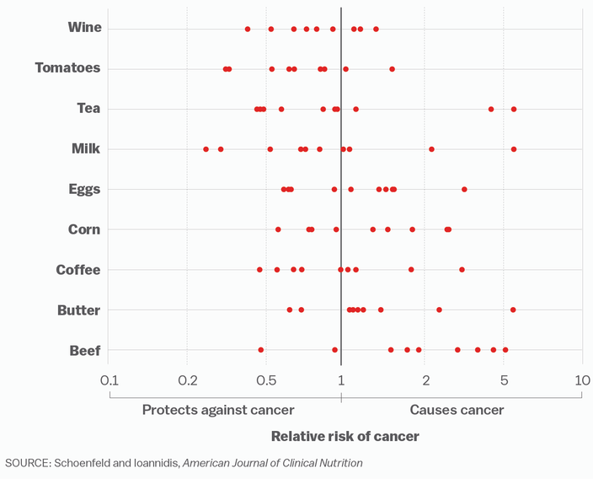
= one medical study

Slide 43

1. Evidence Synthesis: The Teaching and Learning Toolkit
35 summaries of the research findings from over 10,000 studies in 200 meta-analyses and systematic reviews, grouped by type.
The Toolkit gives ‘best bets’ based on what has worked, and what hasn’t worked, through others’ experiences.
It doesn’t tell schools what will work – but is a good starting point for professional dialogue informed by the evidence.

Slide 44
2. Generating evidence through disciplined innovation
We fund ideas that:
Focus on raising outcomes to narrow the poverty related attainment gap
Build on existing evidence or widespread practice
Can be scaled up cost-effectively if shown to work.
We favour stringent trial conditions:
Randomised Controlled Trials (RCTs) or QEDs
Independence
Separation of developers and evaluators
We report without fear or favour.

Slide 45
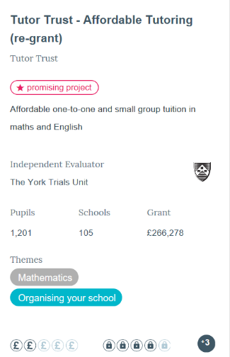
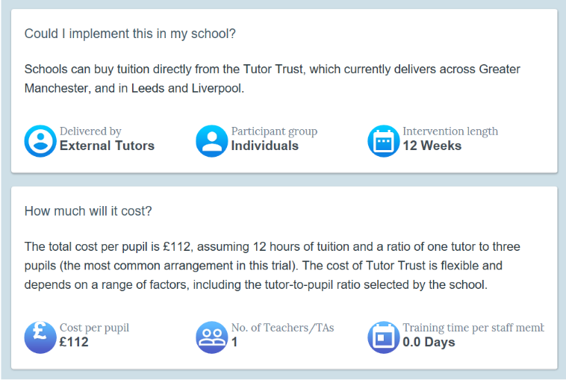
2. Generating evidence through disciplined innovation

Slide 46
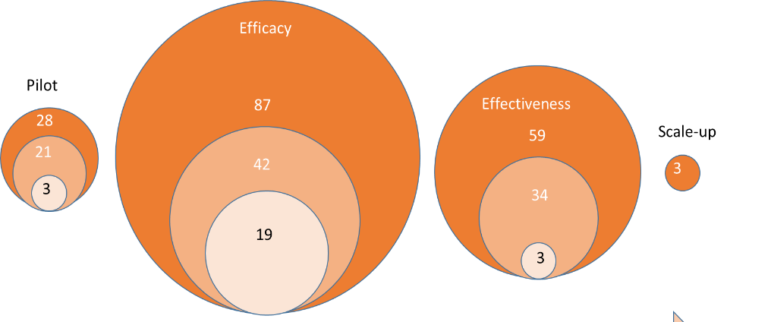
2. Generating evidence through disciplined innovation
Progression

Slide 47
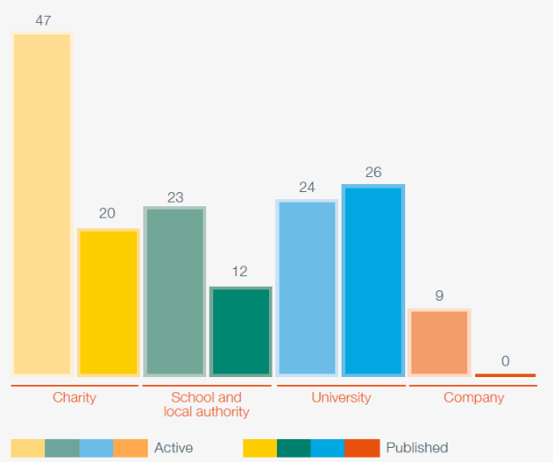
2. Generating evidence through disciplined innovation
Where do the ideas come from?
The ideas from schools tend to:
  be more feasible to implement
  be easier to recruit to.

Slide 48



3. Mobilisation: putting evidence into practice
Guidance reports combine the global research evidence with our own learnings from trials.
They make clear, practical and evidence-based recommendations to help teachers translate the evidence into practice.
Guidance reports are supported by a range of resources (self-assessment tools, audit tools, etc) to help with successful implementation.

Slide 49
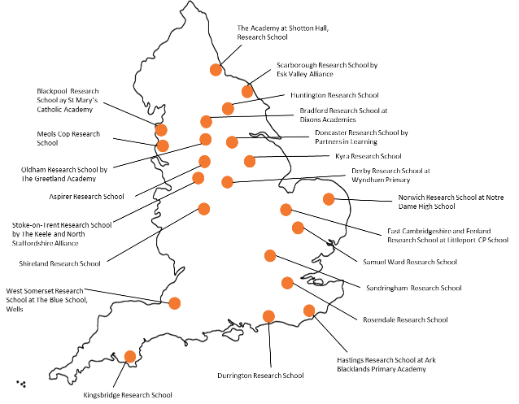



3. Putting evidence into practice – Research Schools
The Research Schools Network is a partnership between the EEF & the IEE.
There are now 22 Research Schools in England, providing school-led support for the use of evidence to improve teaching practice.

Slide 50
What have we learned?
Education is amenable to robust empirical evaluation
With evidence, positive change is possible
Evidence can help free up time, space and resources for more effective work
The work must be focussed on the day-to-day challenges of teachers, school and system leaders
Partnerships are essential – with practitioners, policy makers and the research community – we can’t work alone
Trust, rigour, independence.
Acceptable, accurate, accessible, appropriate.

Slide 51












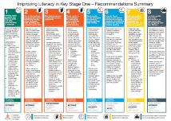






Who we work with…
1. Synthesis
2. Generation
3. Mobilisation

Slide 52
Context: local gaps - different decisions lead to different outcomes
There are 272 secondary schools in England – 8% of all secondaries – where disadvantaged pupils at GCSE perform above the national Attainment 8 score for all 16 year-olds.
Of these 272, 108 (40%) are schools with an above average proportion of disadvantaged pupils
Notes:
Schools make a difference – could delete

Slide 53
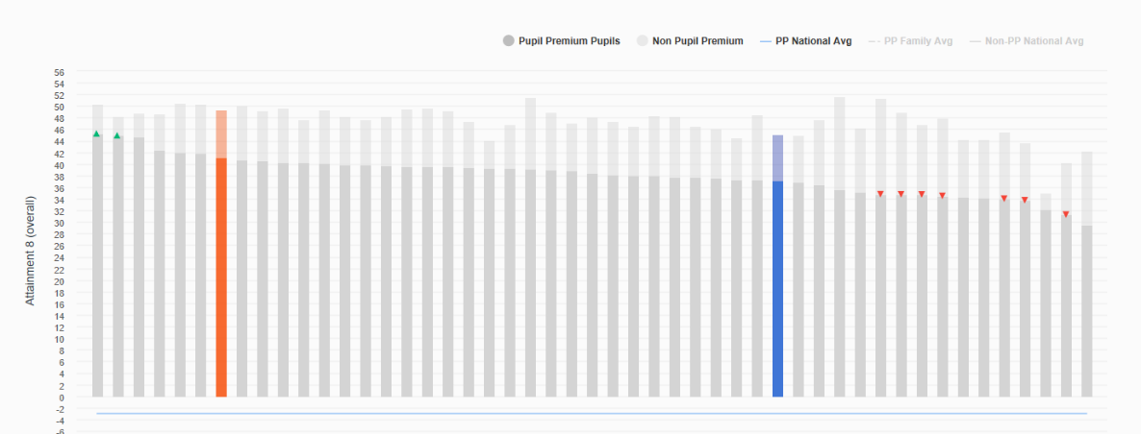
FSM: 20.2%
EAL: 3.4%
IDACI: 11.9%
Kent: example 1
Notes:
Schools make a difference – could delete

Slide 54
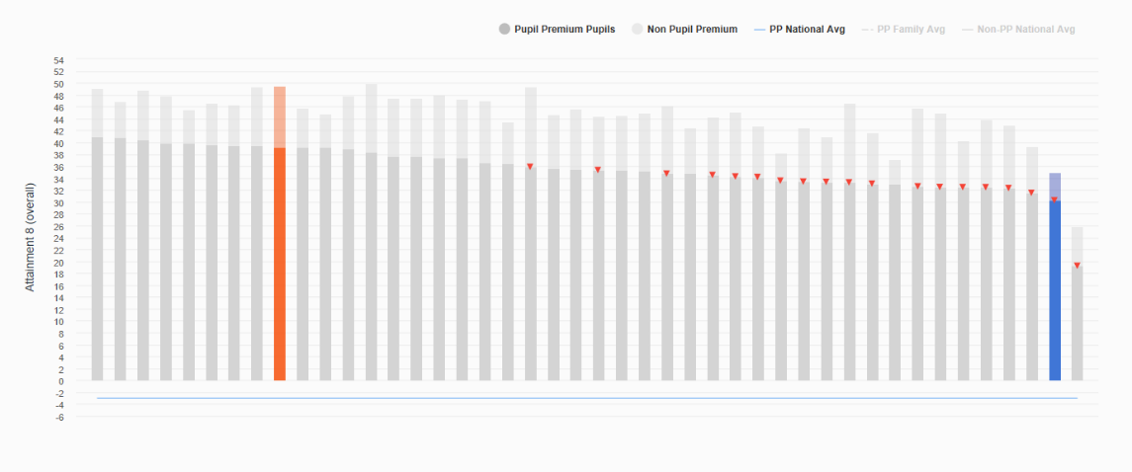
FSM: 33.8%
EAL: 7.3%
IDACI: 17.3%
Kent: example 2
Notes:
Schools make a difference – could delete

Slide 55
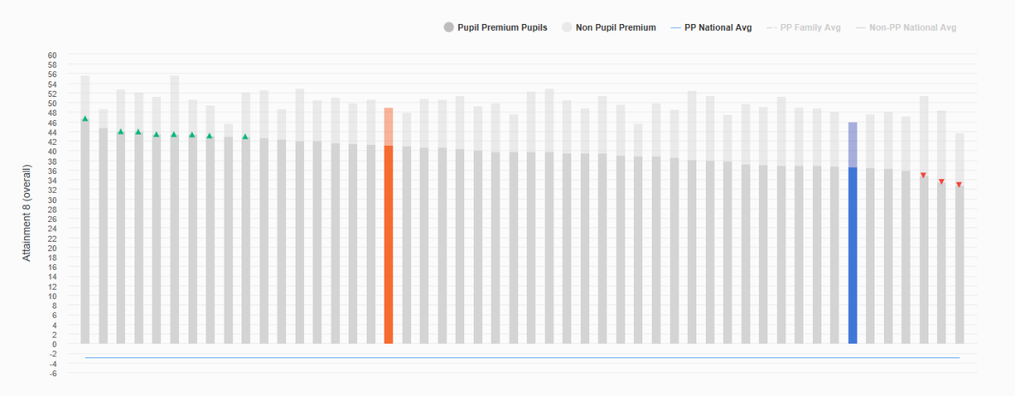
FSM: 23.8%
EAL: 8.1%
IDACI: 21.8%
Kent: example 3
Notes:
Schools make a difference – could delete

Slide 56

A possible response

Slide 57
Aims
raise educational standards in Kent
support schools to use evidence based approaches
close gaps and target particular issues
encourage a collaborative Kent wide education system
bring funding into the Kent system
Using the expertise of the EEF, this project will explore and identify key issues faced by Kent schools then offer targeted part-funded projects that aim to respond to these issues.

Slide 58
Project stages
Consultation with schools and stake holders
Identification of key issues and projects that might address them
EEF project offer made to Kent schools
Schools apply to participate
Projects take place in schools
Project impact is evaluated

Slide 59
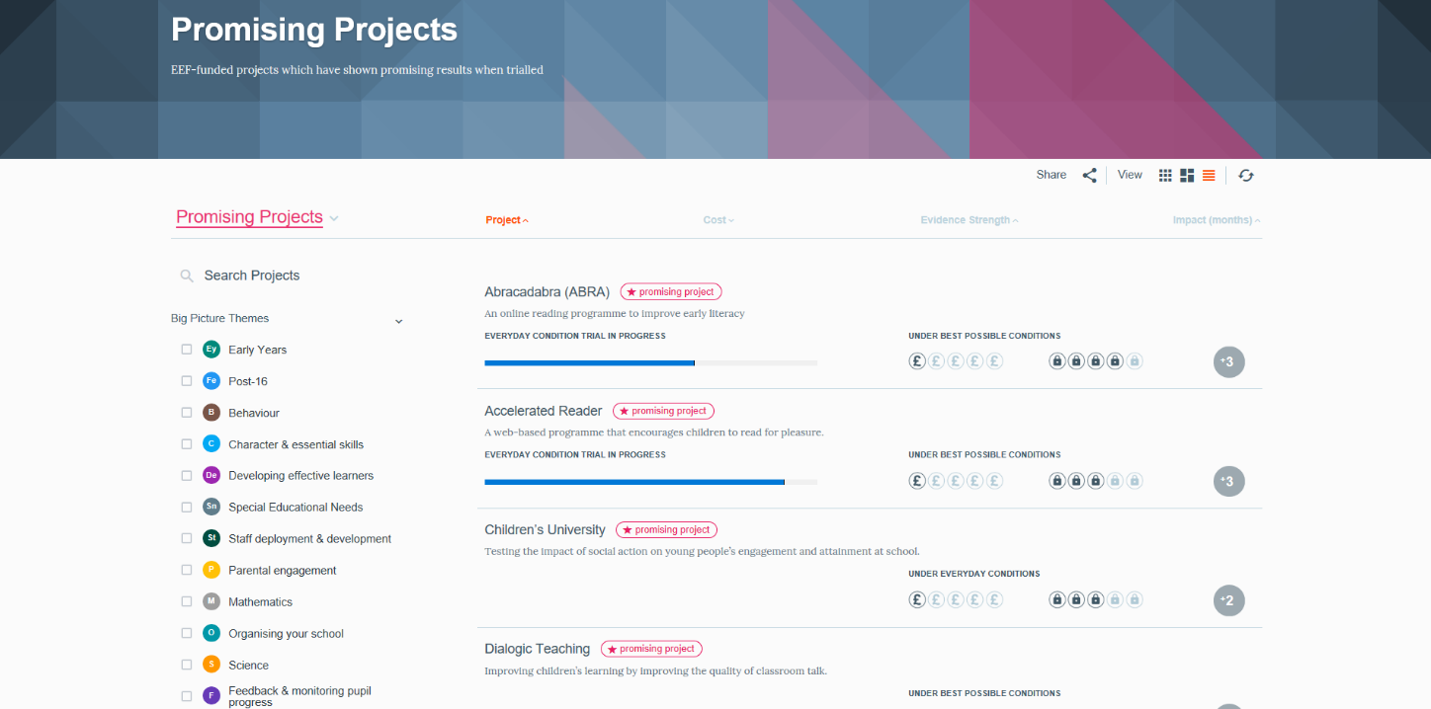

Slide 60
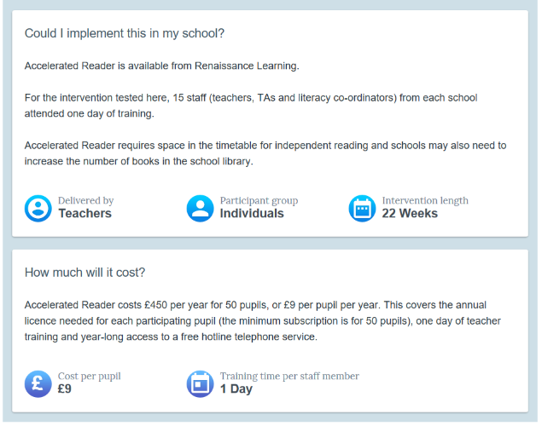
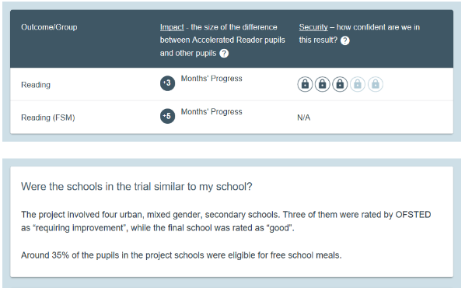
Accelerated Reader
Notes:
Schools make a difference – could delete

Slide 61
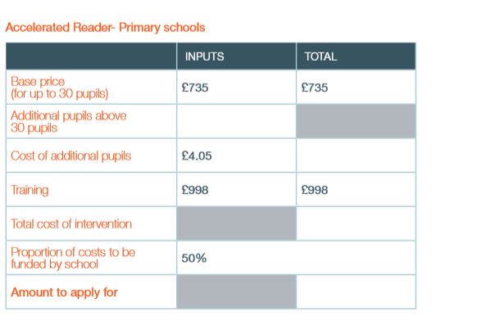
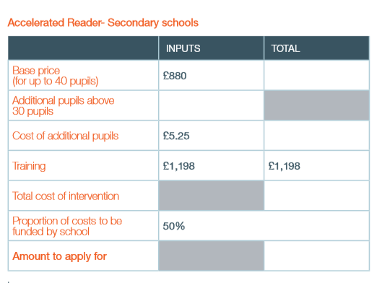
Calculating Costs - examples
Notes:
Schools make a difference – could delete

Slide 62
Project options - pros and cons
Participate in a ‘promising project’
  Some evidence of impact
  Set processes for implementation
Participate in a randomised controlled trial
  Less evidence of impact and chance of being in the control group
  Could be trialling something new and exciting

Slide 63
Consultation questions – table discussion
What issues do you face in your school/s?
Do the ‘Promising Projects’ address the issues you’ve identified? Which ones and if not, where are the gaps?
What else needs to be considered to ensure this project is successful in your school?
Any other feedback?

Slide 64

Thank you

Slide 65
Kent Association of Headteachers
Update

Slide 66

Thank you for attending
www.kelsi.org.uk
Please continue to visit the Kelsi website for key legislation, guidance and latest news and events available to educational professionals.

