Slide 1
30 Hours of Free Childcare
District Seminars March 2017
Swale

Slide 2
Early Years and Childcare in Swale
Key Facts and Figures
 | Kent | Swale
EYFS GLD 2016 | 74.8% | 73.4%
EYFS FSM Achievement Gap 2016 | 19% | 23.8%
Percentage of providers good or outstanding (December 2016) | 96.8% | 100%
Percentage of childminders good or outstanding | 97% | 97.5%
FF2 Take up (December 2016) | 74% | 71.2%
Percentage of providers in a collaboration | 62% | 61%

Slide 3
30 Hours of Free Childcare
The scale of the challenge in Swale
Predicted take up of 15 Hours by three/four year olds
Autumn 2017 1,884
Spring 2018 2,475
Summer 2018 2,929
Estimated eligibility for 30 hours of Free Childcare
Autumn 2017 1,078 children
Spring 2018 1,416 children
Summer 2018 1,676 children
N.B. The demand/supply maps in this presentation should only be used as an indicator of potential need and anyone considering setting up or expanding their existing childcare provision should carry out their own market research to establish the likely demand.

Slide 4
Swale – Demand Model
The three areas which requires a significant increase in capacity are:
Sittingbourne South
Sittingbourne East
Sheerness

Slide 5
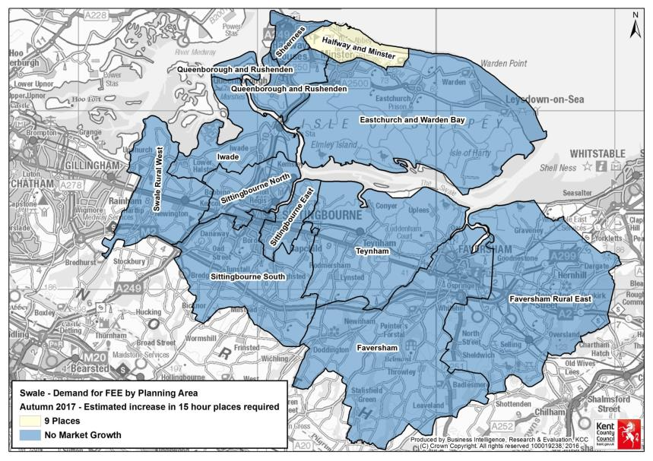
Swale Demand – Autumn 2017

Slide 6
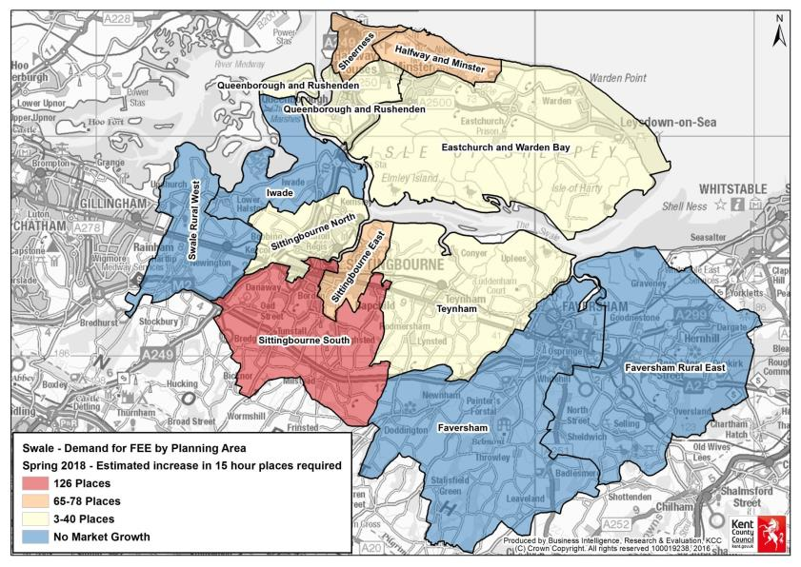
Swale Demand – Spring 2018

Slide 7
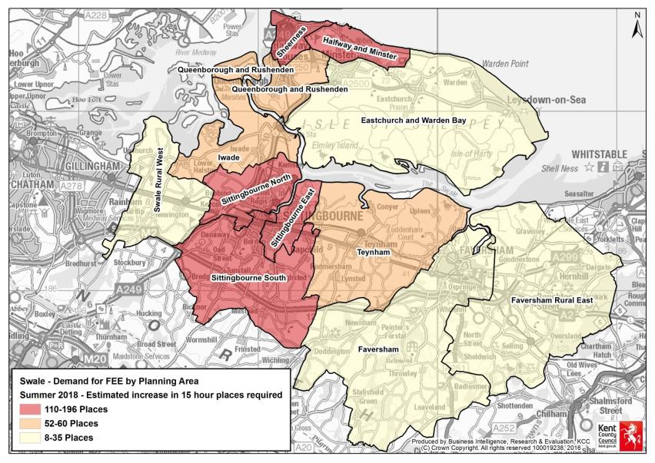
Swale Demand – Summer 2018

Slide 8
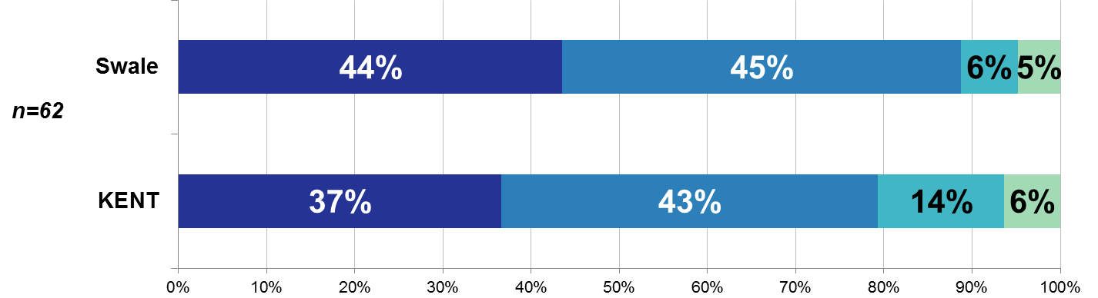

Swale
Establishments: 71
Childminders: 80
Total Childcare providers: 151
Survey Responses: 62
Response Rate: 41%
Are you considering offering the 30 hours of nursery funding when it is implemented for working parents?
Yes
No
Not Sure
Don’t Know
Survey responses as at 23rd Feb 2017

Slide 9
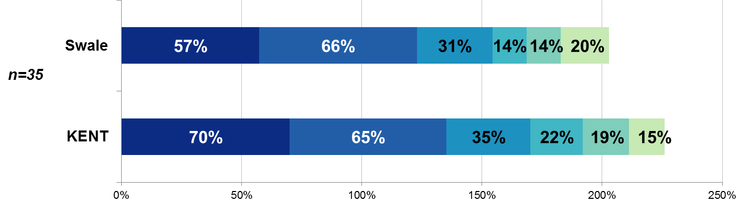
Swale
Establishments: 71
Childminders: 80
Total Childcare providers: 151
Survey Responses: 62
Response Rate: 41%
What are your reasons for not considering offering the 30 hours of nursery funding when it is implemented for working parents?
Reduced revenue/income
Lack of staff
KCC funding unknown
Facilities/building issues
Restrictions with opening hours
Impact on places for FF2
Survey responses as at 23rd Feb 2017

Slide 10
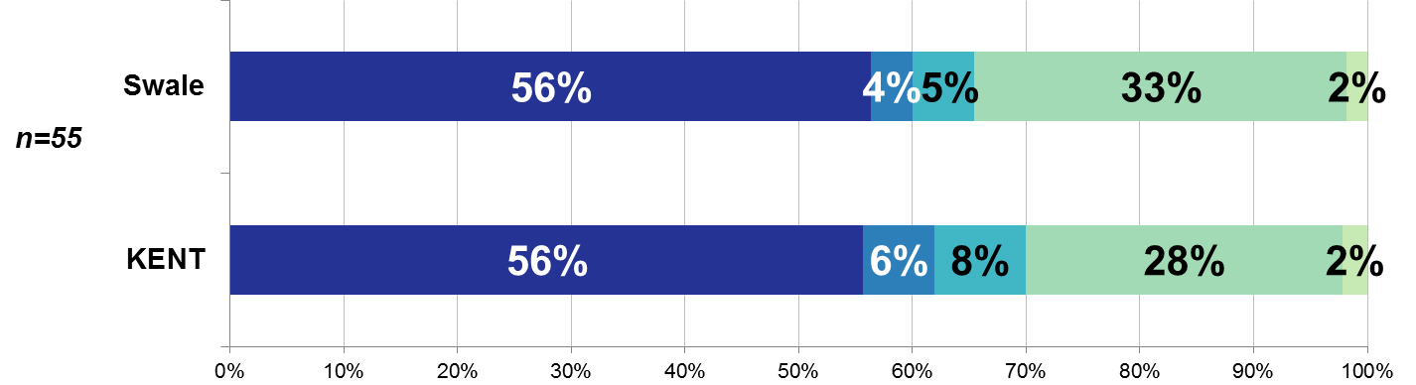
Swale
Establishments: 71
Childminders: 80
Total Childcare providers: 151
Survey Responses: 62
Response Rate: 41%
For those that said yes or were not sure, how do you plan to offer the 30 hours funded places?
Over 38 weeks
Don’t know
Stretched places
Not applicable
Over 38 weeks & stretched places
Survey responses as at 23rd Feb 2017

