Slide 1
Funding Energy Efficiency for Schools September 2014
Deborah Kapaj
Sustainability & Climate Change
Kent County Council

Slide 2
FACTS
Total schools energy spend is 7.4m per annum
Costs increased by 11% since 2010-11
Energy use decreased by 3.6%
Schools need to do more to offset rising prices
Many schools are already reducing their bills by using the Energy Efficiency Investment Fund (EEIF)

Slide 3
EEIF – Why use this fund?
Funded by Salix Finance and KCC
Interest free invest-to-save loan
Free technical advice and support to identify potential projects and assist with procurement
Approved by KCC finance
Lower energy bill + loan repayment
= existing energy bill or less

Slide 4
EEIF – How does it work?
We support you to identify suitable projects
We can assist with quotations
We calculate the savings, £’s and Carbon
If payback is 7 years or less, loan approved
Loan agreement issued – flexible repayment plan
Loan agreement signed by school
Procure technology
KCC pay the invoice
Repay loan – starts the financial year after install

Slide 5
Energy Efficiency & Renewables
Energy Efficiency
Low cost
Shorter payback
Easier to install
Tried & tested
Renewables
High cost
Longer payback
Energy generated is wasted if building is not energy efficient

Slide 6
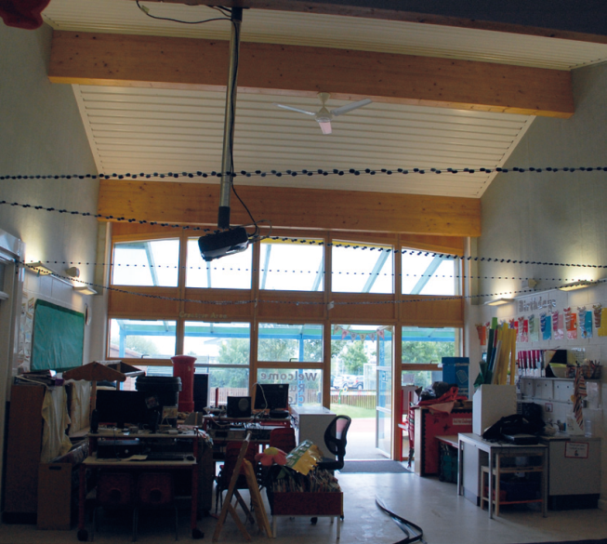
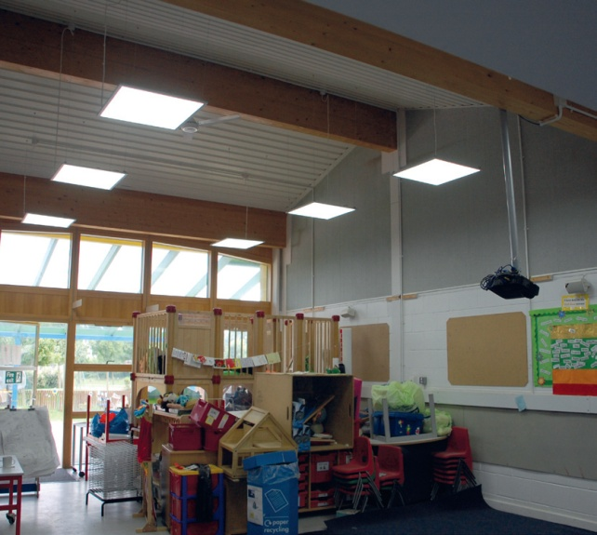
Case studies
BEFORE
Churchill School - LED Lighting
Monthly energy consumption reduced by 19%
Energy savings amounting to £1,200 a year
Payback in 7 years
Lux levels were significantly increased from 190 LUX to 330 LUX
Underused, dark cloakroom spaces have been transformed into light additional teaching and ‘mini library dens’.
Staff sickness levels were reduced – headaches from lighting are less frequent
AFTER

Slide 7
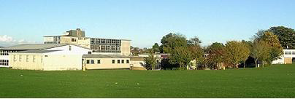
Case studies
Simon Langton School for Boys – Draught proofing crittal windows
Payback 5 years
Reduced thermostat by 2-3 degrees saving at least 10% on energy
Faster warm up times and longer heat retention
Increase in comfort levels and reduction in draught driven complaints
Reduction in noise up to 10db in city areas with single glazing

Slide 8
Watch out for
Companies offering project support and
access to Salix funding
Your project could cost you more
These companies will add on a management fee
KCC can provide the same service for FREE
Our scheme has KCC finance approval
Contact us first to discuss your project ideas

Slide 9
Contact
For free, technical support and advice:
Steve Baggs, Sustainable Projects Manager
Call 07786 191587 or
Steven.Baggs@kent.gov.uk

