Slide 1
What’s stopping you? Book to donate blood today - Mike and Mabel's story

Slide 2
Why donate blood?
Current blood stock levels for the NHS are critically low
It takes 3 blood donations every minute to handle emergencies, childbirth and critical treatments such as cancer treatments
400 new donors are needed each day just to meet the current demand for blood
Each donation helps 3 adults, or 6 children

Slide 3
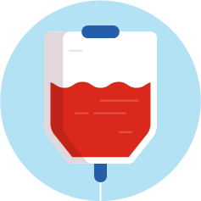
Who might need a blood transfusion?
Anyone! You could need a transfusion one day
Someone experiencing blood loss (for example, from an accident, surgery or childbirth)
Someone with cancer may receive platelets that come from blood
Someone with an immune disorder may receive medicines made from plasma

Slide 4
Who can give blood?
You need to be generally fit and well
01
You need to be aged between 17 and 65
02
You need to weigh between between 7 stone 12 lbs (50kg) and 25 stone (158kg)
03

Slide 5
How long does it take to give blood?
It takes up to an hour in total but only around 10 minutes to actually donate the blood.
https://youtu.be/FXmkVg8a2Mo

Slide 6
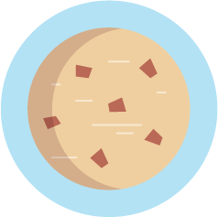
After the donation
Get crisps and biscuits and your job is done!

Slide 7
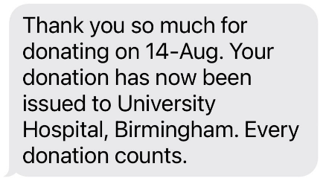
What happens next?
You blood is then distributed to hospitals across England and given to patients in need.
Donors even get a text when their red cells are issued.

Slide 8
Afterwards you will receive a digital donor card and will find out your blood group!

Slide 9
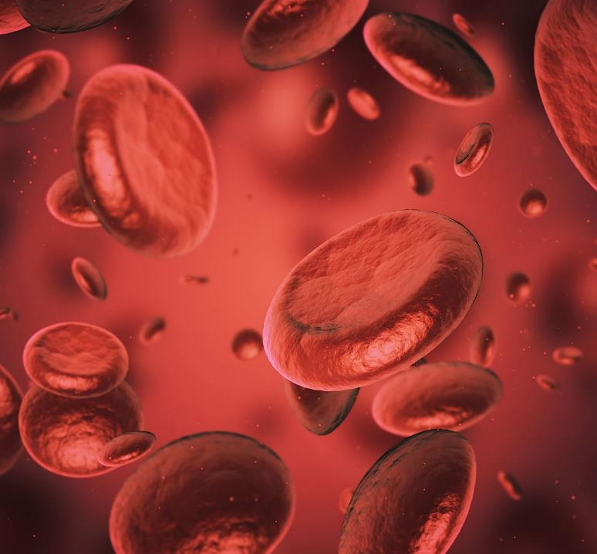
Be like Colin!
Generous Colin Harrison has given 400 pints over the last 30 years.
Colin, aged 64, has helped save the lives of a staggering 1,200 adults or 4,800 children since 1983 when he first started donating.

Slide 10
Follow @pintformike on Instagram
Follow ‘Pint for Mike’ on instagram help raise awareness of blood donation.
Feel free to message when you book to donate and/or when you donate so we can add you to the total number that have donated a pint for Mike. We want to hear from you!

Slide 11
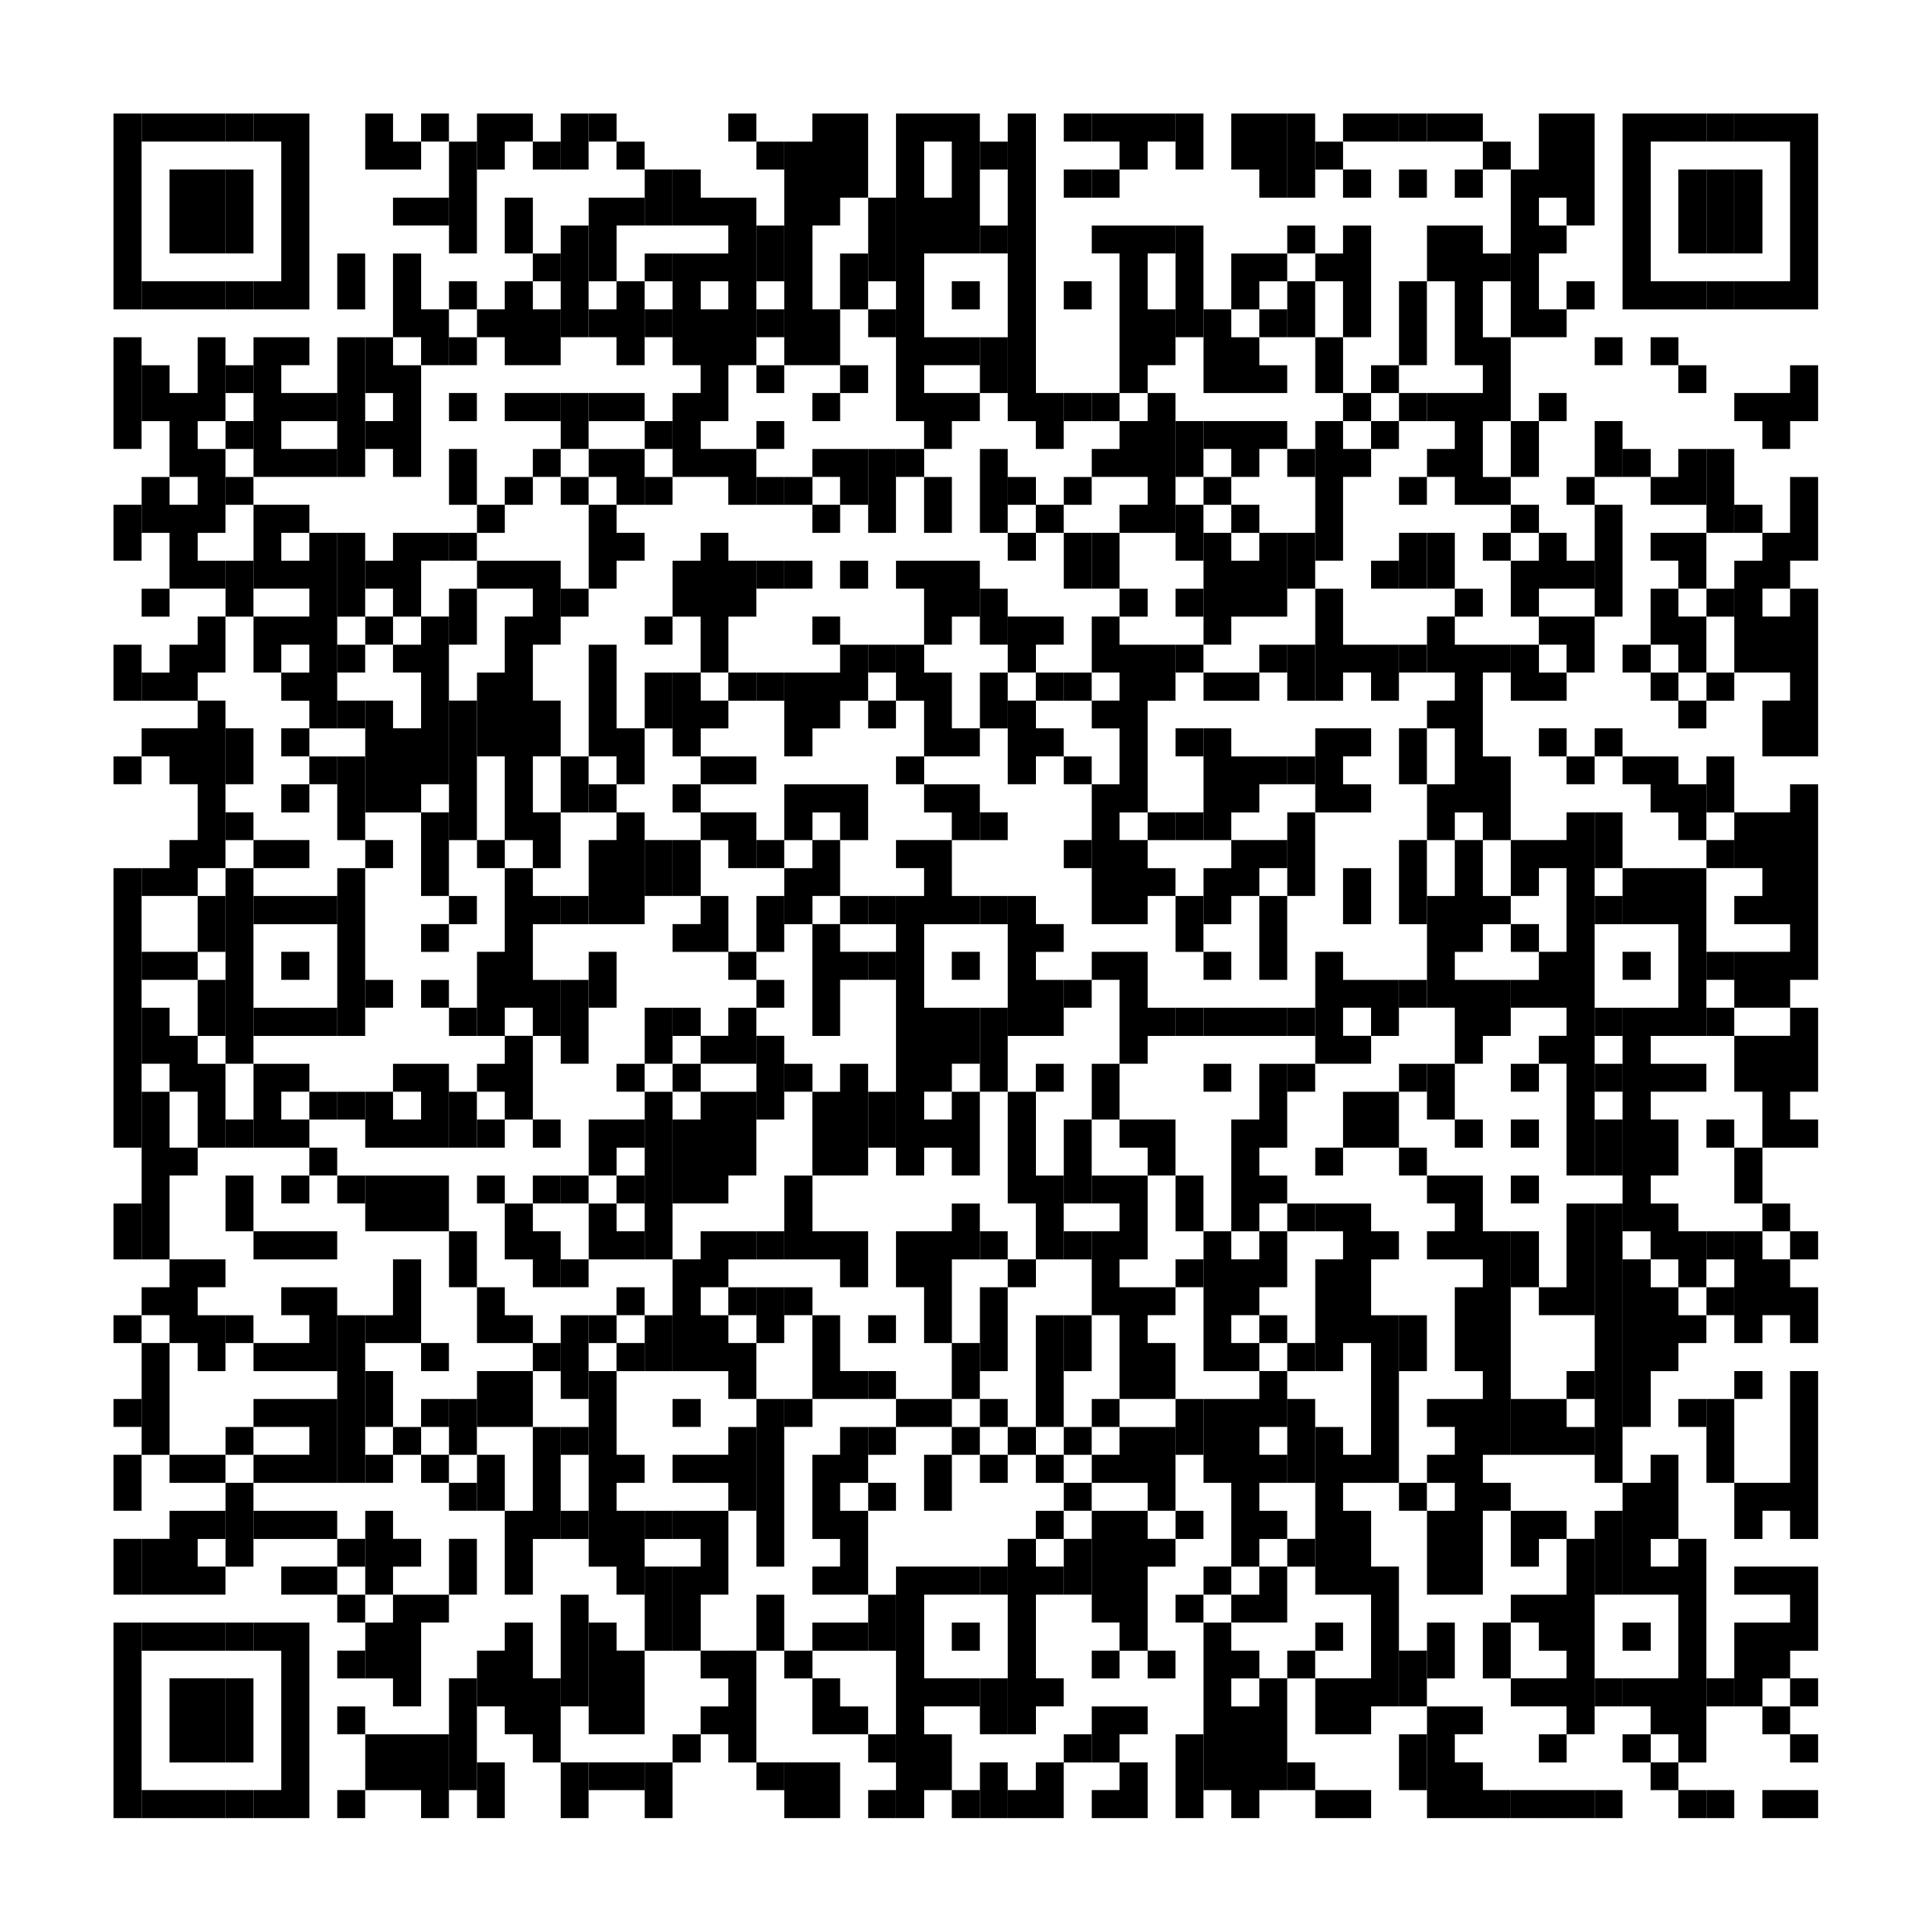
Book to donate blood… Save 3 lives with less than one hour of your time…
What’s stopping you?

Slide 12
