Slide 1
Integrated Review at Two (IR2)
Sue Denny

Slide 2
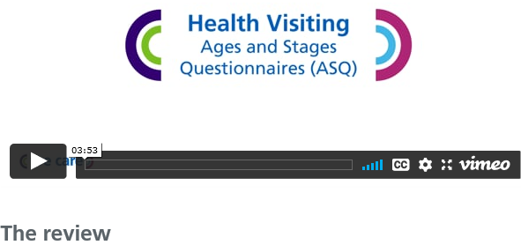
Health visiting ASQ Webinar
Integrated review at Two
https://www.kentcht.nhs.uk/service/kent-baby/faqs/#childdev
Notes:
Health have also produced a short presentation on the Ages and stages Questionnaire where a community nursery nurse demonstrates how health carry this out with the children and families.
For those that are interested you will find the presentation on the Kent Community Health, Kent Baby web page, if you use the following link on this slide. You will find the presentation on the FAQ page, scroll quite a way down near the bottom you will find this image. Click on Child Development and It’s the last heading
Integrated review at Two
The screen shot here gives you an idea of what to look out for.

Slide 3
Integrated Reviews
Family
Settings
Health
Notes:
A number of integrated reviews have already successfully taken place in settings.
Settings seem genuinely positive and excited to engage with health in this process to support their families.
We have seen a slow but steady uptake as expected during this time, and we are monitoring that take up. Early indicators are good, we have received really positive responses from parents as part of the evaluative process which uses a short questionnaire where they can respond using their phone.
Now to bring this process to life for those who might not have experienced this yet, we would like you to complete a quick activity this afternoon.
I am going to share 3 scenarios with you, and for each one ask you to complete a short poll.
We are hoping this might give you all a better idea of what the IR2 process really looks like in practice.

Slide 4
Scenario 1
Alfie is 2 years 1 month. Alfie has attended your setting for the past year. His mother has received an appointment for Alfie’s 2 year review with the health visiting service. Before the review Alfie’s mother completes the Ages and Stages Questionnaire/ ASQ ready for the appointment. At the review Alfie’s mum had no concerns regarding Alfie’s development and there were no concerns identified through observation and use of the ASQ . The health visitor records the outcome in the child’s Red book and asks the Mother to share this with the early year’s setting explaining they will be shortly completing their progress check on Alfie.
At the setting the Keyperson arranges to meet the family to discuss Alfie’s EYFS progress check at Two. There are no concerns identified about Alfie’s progress at nursery or home during the check
Notes:
So you will see Scenario 1 on your screen
We are now going to have a poll,
Q Following the current Kent Integrated Review at Two process, what would you expect to do next, which pathway would you follow in this case?
Poll
1.Green pathway – Universal. Record outcome of EYFS check in the Red book
2. Amber pathway - Refer to the Health service for support with a package of care
3. Red pathway - Refer to the Health service to request an Integrated Review meeting
……………… please share results

Slide 5
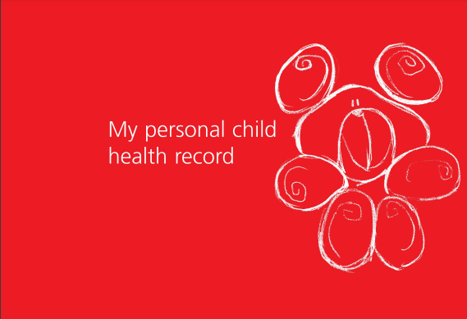
Green pathway
Check the Red book to see that the Health and development review has been completed
Record the outcome of the EYFS progress check in the Red book on the designated page.
No further action
Notes:
The correct answer would have been the Green pathway (animation)
1Check the Red book to see that the Health and development check has been completed.
2Record the outcome of the EYFS progress check in the Red book on the designated page.
3There would be No further action required

Slide 6
Scenario 2
Rosie is 2 years and 3 months. She started nursery three months ago and has settled well. Her father has met with you to discuss her EYFS progress check at 2.
Rosie is currently enjoying nursery and is developing well in most areas. She needs a little support with her personal and social development. You are currently helping her to practice taking turns and supporting her wellbeing when she becomes frustrated. You have noticed that Rosie gets very tired mid-morning which affects her behaviour. Her father expresses frustration over Rosie’s behaviour at home and has concerns around her sleep as she gets up several times in the night. Exploring further, you identify that it has been a difficult time for Rosie’s parents. They are both working from home and juggling child care between them. You identify that there has been no opportunity for Rosie to meet other people or children until she started nursery and that there are very few routines at home.
Notes:
Once again take a few minutes to read the scenario.
Launche Poll
Q Following the current Kent Integrated Review at Two process what would you expect to do next, which pathway would you follow in this case?
Poll
1.Green pathway – Universal. Record outcome of EYFS check in the Red book
2. Amber pathway - Refer to the Health service for support with a package of care
3. Red pathway - Refer to the Health service to request an Integrated Review meeting
……………….Share results please

Slide 7
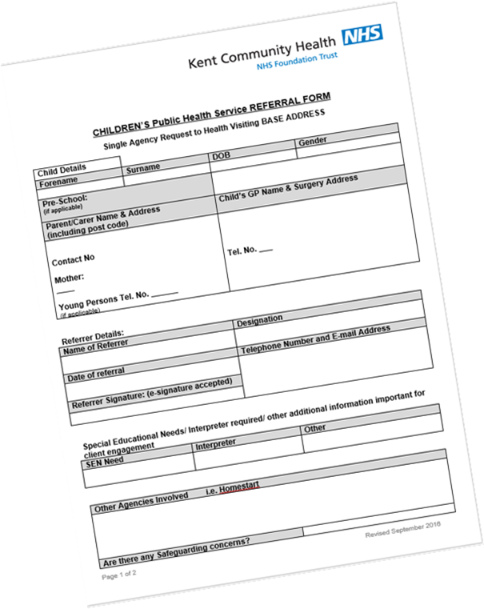
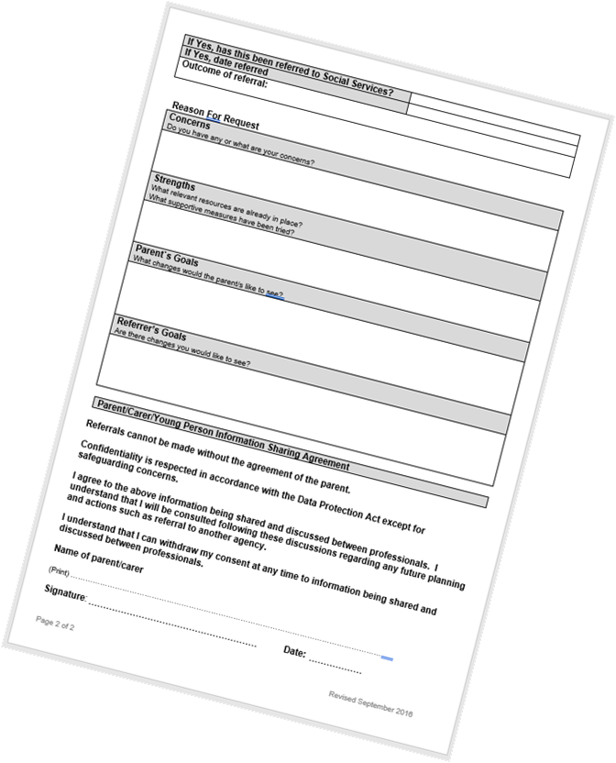
Amber pathway
Check the Red book for a record of the health review being completed and any action
Record outcomes of the EYFS Dev Check in the Red book on the designated page
Complete a referral to the Health visiting service to request a package of care.
Notes:
Once again for those of you that were not sure - you would follow the Amber pathway in this case
Answer
1As with universal Check the Red book for a record of the review being completed and any action being taken by health.
2Record outcomes of the EYFS Dev Check in the Red book on the designated page
3 But in addition, following the discussion with Rosies father about the benefits of support available from health, you would agree to make a referral to the Health visiting service to request a package of care around sleep and possible ideas to support the family with behaviours at home.
At this stage there is no further action to take in the setting, apart from the normal next steps, and continue to track and monitor progress

Slide 8
Scenario 3
Joseph is aged 2 year and 10 months. He has been attending the early year’s setting for 4 months. His key person has concerns in two areas of his development and Joseph’s development is now three months behind his peers. You have been talking to his parents about the adjustments you have made and shared some strategies that you are using. At the EYFS progress check you ask if children have attended their Two-year Health and Development review and ask to see the red book, there is nothing recorded in the book. The parents explain that they completed an ASQ questionnaire 8 months ago and the check was completed over the phone and he was fine. At that time, they didn’t really have any concerns. During the discussion with parent’s, you have agreed to start a Targeted Plan.
Notes:
Last scenario
launch Poll
Q Following the current Kent Integrated Review at Two process what would you expect to do next, which pathway would you follow in this case?
Poll
1.Green pathway – Universal. Record outcome of EYFS check in the Red book
2. Amber pathway - Refer to the Health service for support with a package of care
3. Red pathway - Refer to the Health service to request an Integrated Review meeting
Share results of Poll

Slide 9
Red Pathway
Record outcomes of the EYFS Dev Check in the Red book on the designated page
Complete the Health Visiting referral form requesting an Integrated Review meeting in your setting
Include 3 suggested dates and times
Notes:
Answer
1 again Record the outcome of the EYFS dev check in the red book
But You would also Discuss the benefits of having an integrated review meeting with the family and Health practitioner at the setting.
Seek parent agreement.
2Complete the Health Visiting referral form
3 making sure you include 3 suggested dates and times where this could take place.
Send the referral to your local Health Visiting team via a secure email.
Then Wait for confirmation of the allocated Health practitioner and an agreed meeting date.
Hopefully this was a helpful reminder and clarification of the process to follow and something you can take back to ensure this is happening in your setting.
For those of you that are making referrals already just a reminder to let the E&I team know by completing our simple electronic form on our kelsi, page find it on the progress check at two heading.
If you require any further information and support about the IR2 or you don’t think you have the documentation or this health service referral form on this slide please contact your E&I adviser as they will be able to support and redirect to what you need to do.

Slide 10
Which pathway would you follow in this case?
1.Green pathway – Universal. Record outcome of EYFS check in the Red book
2. Amber pathway - Refer to the Health service for support with a package of care
3. Red pathway - Refer to the Health service to request an Integrated Review meeting
Notes:
Following the current Kent Integrated Review at Two process what would you expect to do next, which pathway would you follow in this case?
1.Green pathway – Universal. Record outcome of EYFS check in the Red book
2. Amber pathway - Refer to the Health service for support with a package of care
3. Red pathway - Refer to the Health service to request an Integrated Review meeting

