Slide 1
Apprenticeships in Schools
Chris Homewood

Slide 2
The Apprenticeship Levy
From April 6 2017, any organisation with a payroll bill exceeding £3million must 0.5% into the apprenticeship levy. The funds sit in a digital account and can be spent from May 1 2017 on apprenticeship training for new recruits and existing employees.

Slide 3
Categories of School
With community and voluntary controlled schools the employer is the local authority and so for the purpose of the Levy calculation, these schools are included under the local authority responsibility. This means any school in this category will be liable to pay the Levy regardless of the size of its individual pay bill.

Slide 4
Categories of School
With voluntary aided, foundation, academies and multi-academy trust Schools the employer is considered to be the governing body and so they must assess the size of their pay bill and act accordingly based on the pay bill either being over £3m or under £3m.

Slide 5
Co-Investment
In the case of the latter category of schools not paying the levy, they would access funding through co-investment. This means paying 10% of the training costs while the Government funds the other 90%

Slide 6
Frameworks and Standards
apprenticeship standards - each covers a specific occupation and sets out the core skills, knowledge and behaviours an apprentice will need; they are developed by employer groups known as ‘trailblazers’
apprenticeship frameworks - a series of work-related vocational and professional qualifications, with workplace- and classroom-based training

Slide 7
Funding Bands
Every framework and standard has been allocated a funding band. Each funding band has a cap, this is the maximum amount that a provider can charge for delivery. There are 15 funding bands ranging form £1,500 to £27,000.

Slide 8


Slide 9
School Apprenticeship Opportunities
Laboratory Technician
Catering
Administration
Finance
Facilities
Sports Coach
Childcare
Teaching assistant

Slide 10
How can I help?
I can provide a free impartial support service
Understanding what is required
Identifying opportunities
Choosing training providers
Advertising
Accessing the levy

Slide 11
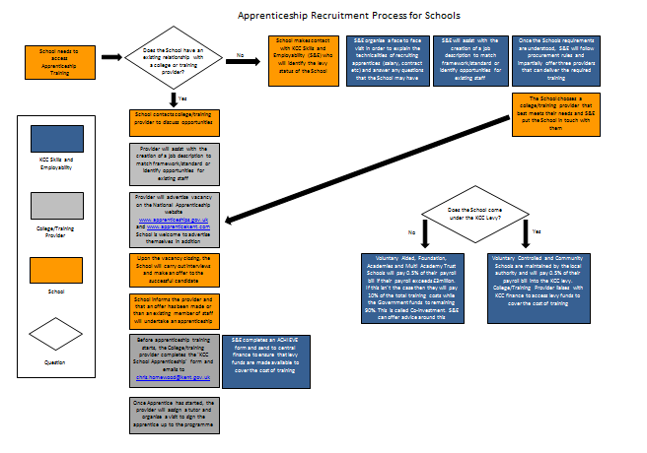

Slide 12
Chris Homewood
KCC Skills and Employability
03000 414005
KEP@kent.gov.uk

