Slide 1
Early Year End Closedown Pilot
2016/17
The results!

Slide 2
Background
The Accounts and Audit Regulations 2003 place a legal requirement on the LA and Schools to close the accounts (we have to meet their deadline)
Schools figures have to be added to KCC’s accounts earlier than previous years
Tighter deadline - To ensure we could meet the deadline for 2017/18 we ran a pilot with 16 schools (14 piloteers) in 2016/17

Slide 3
Be prepared
Contact external providers for information
Salary Provider
Direct debits
Check out potential creditors /debtors
Check out last years YE provision schedules
Health check
Ticklist

Slide 4
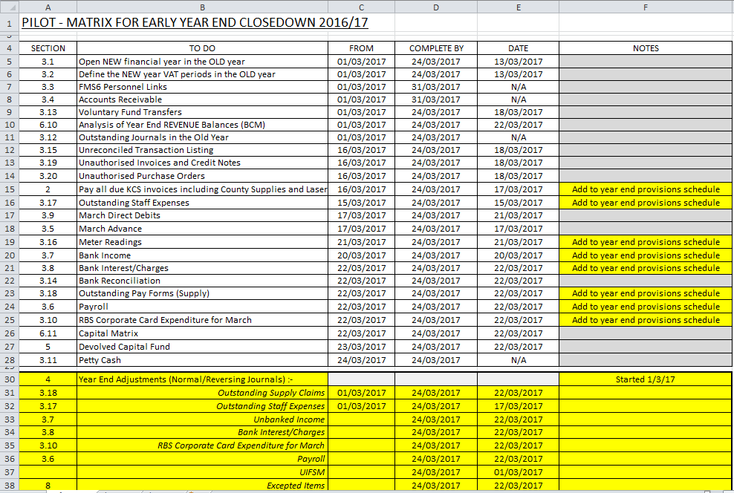
Pat’s schedule

Slide 5
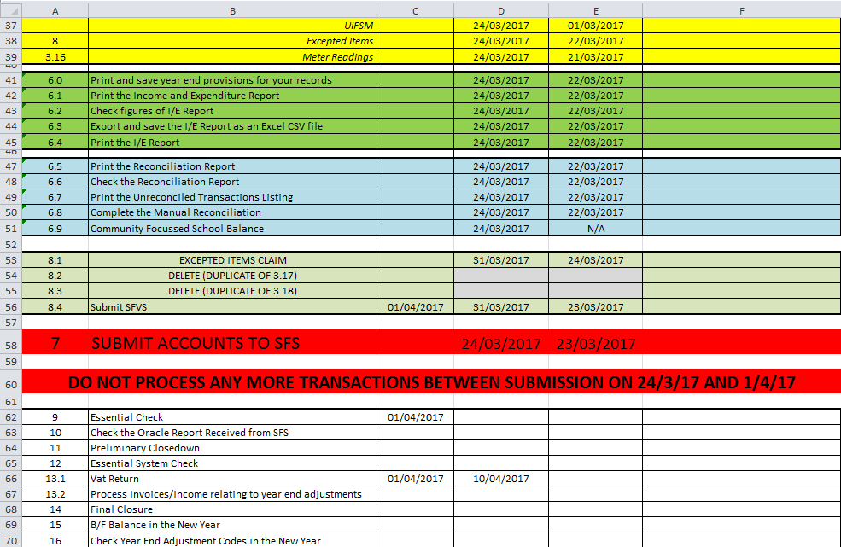
Page two

Slide 6
Timings
Sometime in February 2018
Health Check – will be emailed
1 March 2018
Edukent March Direct Debit notification (end of March)
16 March 2018
Edukent second March DD notification
March advance – Statement of Account
Final bank statement from Nat West
If not Nat West you will need to make arrangements
Online banking

Slide 7
Timings continued…..
20 March 2018
Capital Matrix and Year End Analysis forms on Kelsi
23 March 2018
Payday – may need to contact individual payroll providers
Closedown Deadline – 23 March 2018
Would be good if available in school the following week
(just in case)

Slide 8
still timings……..
30 March 2018
Good Friday
2 to 13 April 2018
Easter Holiday
From 16 April 2018
Oracle Outturn Report

Slide 9
To avoid disaster!
Ensure no changes are made to the OLD year after submission to SFS
Ensure everybody is aware of the importance of not making changes in the OLD year as two years will be open in FMS6
To prevent entries being made after 23 March in the OLD year:
Disable passwords if possible / necessary
(full instructions will be available)

Slide 10
Differences
Year – end adjustments – Creditors /Debtors etc.
Process in the OLD year, period 12 as:
Normal Reversing Journals
Reverse in the NEW year in period 1

Slide 11
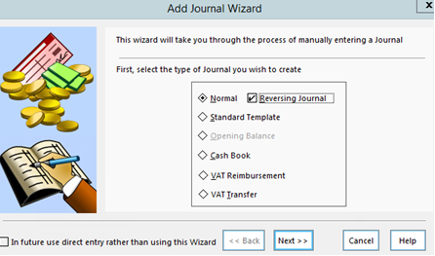
I knew you wouldn’t believe me

Slide 12
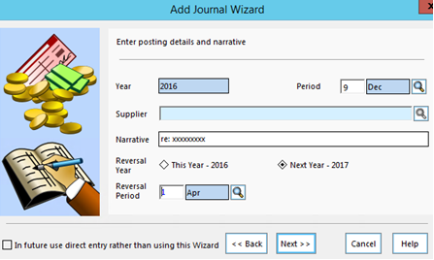
Next step
12
Mar
YE creditors

Slide 13
More differences
VAT for March 2018
Process in the NEW year from first working day in April (in normal way)
VAT submittal cannot be run in March
Most importantly
Be able to take Easter holidays off

Slide 14
Differences continued
Receive Oracle report in April
Run and compare Income & Expenditure and Reconciliation reports against submitted figures
Before running a Preliminary closure
Again between a Preliminary and Full closure
Reinstate password access if necessary

Slide 15
FAQ’s – Year End Adjustments
Q Do I have to cancel orders if I’ve raised a year end
creditor?
A Leave orders to roll into new year and pay invoices as normal
Q Non-invoiced income – what do I do with it in the NEW year?
A Process the same as usual in the NEW year
Q Amounts?
A Only raise adjustments for material amounts

Slide 16
FAQ’s – BACS / Cheque runs
Q Invoices were processed before closedown but I hadn’t paid them, can I then do a BACS or cheque run after submission?
A Yes – Inputting the invoices affects the final rollover figures (surplus/deficit) so it doesn’t matter if you’ve paid them or not. You can process a BACS / cheque run whenever the payments are due
Note: ZCC01 and BANK control codes will change

Slide 17
Feedback
Went very well
Smoothly
Very straight forward
Pack user friendly and easy to follow
Painless
Able to concentrate on getting the new budget up and running!
Now working happily in 2017/18!
I’m one very happy piloteer!

Slide 18
Feedback
Having done it now for eight years this was by far the easiest
It was good knowing I had a week before we closed for half term that I could tie up everything else and not stress about the closedown
It made my life easier:
(a) not having to come in over the holiday or have a mad dash on the first day back and…..
(b) it made the first few weeks back easier when there’s so much else going on

Slide 19
The last word………..
It was lovely to have two full weeks off at Easter
More time for Easter eggs!

Slide 20
Thank you
To all those that participated in the pilot for 2016/17
I couldn’t have done it without you!

