Slide 1
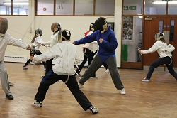
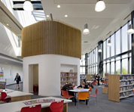
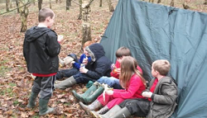
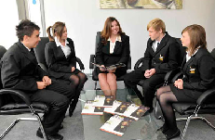
The roles
Kent Governors Association
March 2016
Dominic Herrington
Regional Schools Commissioner for South East and South London

Slide 2
The objectives of today’s presentation…
To explain briefly the role of RSCs
To share thoughts on the crucial role of governance and MATs
To answer questions and listen

Slide 3
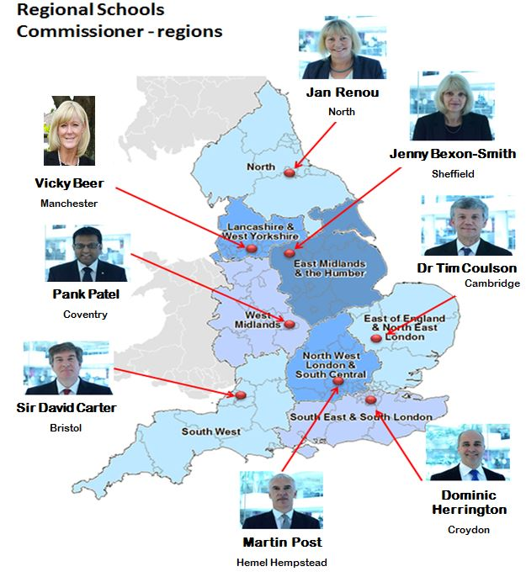
What do Regional Schools Commissioners do?
Help raise standards:
Take action when an academy is underperforming
Decide on the development of new academies
Address underperformance in maintained schools through sponsored academies
Make recommendations to Ministers about free school applications
Encourage organisations to become academy sponsors
Approve changes to open academies
Notes:
Chosen due their extensive knowledge as education practitioners
What do RSCs not do?
Intervene in well-performing academies: RSCs do not have a role in relation to academies that are performing well, except perhaps to encourage them to become a sponsor or support another school.
Provide improvement themselves: An RSC may encourage academies needing school improvement to access support from Teaching School Alliances, National Leaders of Education (NLEs), and other sector-led school improvement in their region.
Maintained schools: RSCs have no remit in relation to maintained schools, other than providing advice on sponsor matches. RSCs’ only interactions with good and outstanding LA maintained schools is to make decisions regarding any applications to convert to academy status.
Financial underperformance: RSCs do not have a direct role in tackling academy financial underperformance; this is led by the EFA. However RSCs can report any concerns about an academy’s finances to the EFA.
Preventing extremism: RSCs do not have a direct role in tackling extremism but will add local intelligence to strengthen the DfE due diligence process. RSCs will also work with local authorities, Ofsted and others to ensure that any concerns are identified and reported to the DfE.

Slide 4
New powers exercised by RSCs on behalf of the Secretary of State as a result of the Education and Adoption Bill
Maintained Schools
Inadequate schools – directive Academy Orders
Warning Notices to Maintained Schools
Coasting schools
Academies
Inadequate academies – all funding agreements
Coasting academies – all funding agreements
Parity of treatment of schools; notification to Diocese and consideration of representations; Coasting timelines later; RSC resourcing

Slide 5
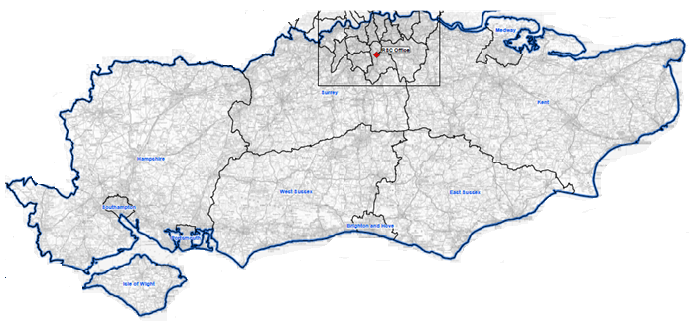
The South East and the South London (SESL) region
Covers 22 LA areas
10 Dioceses
439 Primary academies
309 Secondary academies
28 Special/AP academies
48 Free schools
125 sponsors
Notes:
439 primary academies (270 converters, 169 sponsored)
302 secondary academies (209 converters, 100 sponsored)
2 studio schools
4 UTCs
6 alternative provision academies (4 converters, 2 sponsored)
22 special academies (19 converters, 3 sponsored)
48 free schools (26 primary, 14 secondary, 1 16-19, and 4 all-through, 1 AP and 2 special)
10 Dioceses are made up of 7 Church of England and 3 Catholic

Slide 6
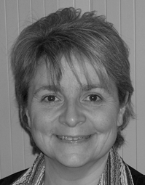
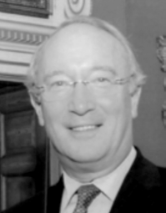
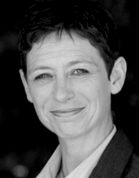
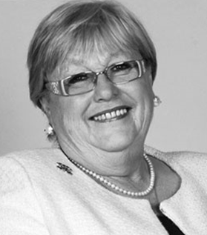
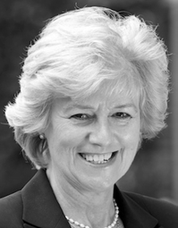
SESL Headteacher Board (HTB)
Angela Barry
Executive Head, Woodland Academy Trust
Sir Andrew Carter
Headteacher, South Farnham Primary Trust
Denise Shepherd
Executive Principal, The Rochester Grammar School
Ian Bauckham Executive Head, Bennett Memorial Diocesan School
Nikki King
Chair, Greenacre Academy Trust
Rhona Barnfield
Executive Head, Howard of Effingham School
Mark Ducker
Executive Principal, STEP Academy Trust

Slide 7
What is happening to academy numbers in SESL?
75% (349) of primary academies are in a MAT.
51% (166) of secondary academies are in a MAT.
Primary
Notes:
Chains data – January
Of the 465 primary academies (converter, sponsored and free schools), 349 are in a MAT of more than one academy. There are 16 primary academies that are standalone, but converted as a MAT.
166 secondary academies (including 16-19) are in a MAT of more than one academy. There are 18 secondary academies that are standalone, but converted as a MAT.
Both primary and secondary chains data included in pie charts include free schools, UTCs and studio schools.
Primary – 465
Secondary – 334

Slide 8
What do MATs in the South East tell us are the benefits of setting one up?
Opportunity to improve more children’s life chances
To share professional practice to improve education e.g. curriculum, data
To retain / develop leadership and staff e.g. succession planning
To drive out economies of scale e.g. procurement, appointments
To refresh and change governance
To standardise process and manage risk consistently
8

Slide 9
MATs can allow strength in numbers while retaining identity
Enable entitlement to better education e.g.
Systems and operating procedures
Use of data
Assessment and reporting
HR practice - one employer
Governance!
But not mandatory in every respect
Culture
Uniform
Relationship with local community
Educational networks unique to the school
9

Slide 10
The idea of governing boards as non-executive leaders is now established
3 Core Functions
Implications
Setting vision, ethos and strategic direction
Holding the head/ principal to account
Ensuring money is well spent
Accountability
Need for strategic framework
Skills required
Importance of relationship with executive leaders
Notes:
Over time and in different places, people have had and may still hold different views on the role and purpose of GBs. Some may see them as a forum for all key stakeholders to have a say in what happens in schools. Others may think of GBs as a filter translating national policy into the local context. Others may see GBs as ensuring the schools’ compliance with rules and regulations.
All of those models have value to a greater or lesser extent. But Ofsted and Ministers’ vision for the primary role of GBs is as non-executive boards – akin to the board of charity trustees or company directors, strategic leaders driving the success and effectiveness of their organisation. Their primary role is to set the long term vision and hold executive leaders to account for the school’s performance – both educational and financial. This role is now defined in legislation for maintained schools and described in the Governors’ Handbook for all schools and academies.
Being on the board of an organisation with a multi-million pound turnover is a demanding task. We need more professional standards of governance, with GBs that are skilled and confident to not only ensure schools’ compliance, but to also take the lead in shaping schools’ long-term goals and strategic priorities and establishing robust arrangements for holding heads to account for progress towards them. This applies both at individual school level, and more so at MAT level.
These are significant responsibilities, and they come with robust accountability. They require board’s to develop a robust strategic framework and to ensure they have all the necessary skills. It puts a premium on a good relationship with school leaders.

Slide 11
There is also broad consensus on the features of effective practice in non-executive leadership
Sources
Examples of accepted good practice
The right people with the right skills and clear roles
Clear separation between the strategic and operational
Constructive relationship with headteacher allowing constructive challenge
An effective chair; professional clerk
Regular self-evaluation and review
Governance Handbook
Toolkits for boards/ MATs to ask
Sector bodies
Codes of Governance
Notes:
There is strong agreement among those in the education governance sector, and across sectors on what good governance looks like….
Right People - with the necessary skills, time and commitment, including sufficient diversity to ensure internal challenge, all actively contributing in line with clearly defined roles and responsibilities under an effective chair and an explicit code of conduct, and with active succession planning. No bigger than necessary to have all the right skills.
Clear separation between the strategic and operational in terms of the role of the board and its executive leadership;
A positive relationship between the board and its executive leadership enabling robust constructive challenge on the basis of a good understanding of objective data particularly on pupil progress, staff performance and finances;
Chair – role: providing leadership; keeping the board focused, ensuring effective functioning of the board and all trustees are actively contributing from clear understanding of what is expected of them with honest conversations, as necessary, if trustees are not pulling their weight
Clerking – much more than admin: professional and independent to advise the board on its role and functions.
Self-review: Skills of trustees, constitution of the board, Impact of the Board, Effectiveness of chair, Contribution of each trustee. Plenty of tools: Ofsted framework, 20Qs, ERG guidance
So the challenge is not so much understanding what good governance looks like, but how to improve practice on the ground across all schools.

Slide 12
Our aim to support all MATs to develop professional standards of governance
The right people
More freedom to design Board with appointment and election focused on skills
Funding to Academy Ambassadors, SGOSS and Education & Employers Taskforce
The right role and structures
Governance Handbook defines role and responsibilities, and principles of good practice
More freedom to design governance structures that meet local needs
The right skills and capacity
NCTL training programmes for chairs and clerks
National Leaders of Governance
Accountability and oversight
Ofsted - External Reviews of Governance
Oversight by EFA & RSCs with intervention where necessary
Notes:
Our overarching objective is to professionalise the quality of governance. We want to see the right people, with a clear understanding of their role working within appropriate structures with the skills they need to be effective. And we need appropriate accountability and oversight.
So we have:
People
created more freedom on board constitution: almost total freedom for academies,
made sure people are appointed for what they can bring to the board, not just for who they are or may represent
continued to fund the recruitment of new governors/ trustees
Role & Practice
Developed the Governors’ Handbook as concise record of all duties and responsibilities – focusing boards on their core functions and advising against being distracted by matters of secondary importance; this sits alongside the Academies Financial Handbook that sets out academies’ formal accountability relationship with EFA
We’ve created greater freedom on governance structures – e.g. for LBGs in MATs to govern groups of schools, so that boards can design a structure that best suits their needs and circumstances
Skills
Developed and funded training programmes for chairs and for clerks – with scholarships to reduce the costs of participation, and free workshops on PRP, RAISE Online and financial efficiency
Expanded the NLG programme
Oversight
Promoted the use of External Reviews as a tool for diagnosing weak governance
Oversight by EFA and RSCs
Education Bill tougher focus on coasting schools

Slide 13
Thank you: Any questions or comments?
RSC.SESL@education.gsi.gov.uk
0207 783 8162
1st Floor, Trafalgar House, 1 Bedford Park, Croydon
13

