Slide 1
High Needs Update
Karen Stone, Interim Finance Business Partner

Slide 2
Update: Total Cost of High Need Placements & Top Up Funding
Cost of High Needs - By Institution Type
 | 2013-14 | 2014-15 | 2015-16 | 2016-17 | 2017-18 | 2018-19 | 2019-20 | 2020-21 | Movement |  | 2021-22
 | Actual | Actual | Actual | Actual | Actual | Actual | Actual | Forecast | 2019-20 to 2020-21 |  | Forecast
 | £'000 | £'000 | £'000 | £'000 | £'000 | £'000 | £'000 | £'000 | £'000 | % | £'000
Special Schools | 67,048 | 68,543 | 68,118 | 70,460 | 74,108 | 79,022 | 87,083 | 94,858 | 7,776 | 8.93% | 98,738
Resource Provision | 13,118 | 14,919 | 15,274 | 16,009 | 12,443 | 13,438 | 15,033 | 16,582 | 1,549 | 10.31% | 18,238
Mainstream Schools | 8,755 | 8,899 | 14,398 | 23,797 | 22,084 | 17,571 | 22,975 | 29,200 | 6,225 | 27.10% | 38,536
Independent and Non-Maintained | 17,581 | 19,840 | 22,588 | 24,384 | 29,461 | 35,717 | 39,773 | 51,500 | 11,727 | 29.49% | 55,000
ISP Post 16 Colleges | 6,000 | 5,359 | 4,281 | 4,561 | 5,225 | 5,270 | 4,358 | 4,100 | -258 | -5.91% | 4,100
Sub Total - Independent provision | 23,581 | 25,199 | 26,869 | 28,945 | 34,686 | 40,988 | 44,130 | 55,600 | 11,470 | 25.99% | 59,100
OLA Maintained | 2,295 | 2,531 | 2,661 | 3,160 | 4,165 | 5,275 | 5,591 | 6,800 | 1,209 | 21.63% | 6,500
FE Colleges | 4,229 | 4,980 | 6,867 | 8,081 | 8,724 | 8,944 | 9,116 | 9,742 | 626 | 6.87% | 4,286
SPI ILP & OLA FE | 0 | 0 | 0 | 366 | 1,728 | 2,227 | 2,541 | 3,348 | 807 | 31.77% | 4,000
TOTALS | 119,026 | 125,071 | 134,186 | 150,817 | 157,938 | 167,465 | 186,467 | 216,130 | 29,663 | 15.91% | 229,398

Slide 3
Update: Total Number of High Need Placements & Top Up Funding
High Needs Numbers - By Institution Type
 | 2013-14 | 2014-15 | 2015-16 | 2016-17 | 2017-18 | 2018-19 | 2019-20 | 2020-21 | 2021-22
 | Actual | Actual | Actual | Actual | Actual | Actual | Actual | Forecast | Forecast
Special Schools | 3,272 | 3,349 | 3,572 | 3,649 | 3,854 | 4,197 | 4,563 | 4,914 | 5,115
Resource Provision | 804 | 810 | 874 | 884 | 890 | 985 | 1,077 | 1,169 | 1,286
Mainstream Schools | 802 | 860 | 1,475 | 2,222 | 2,341 | 2,293 | 2,845 | 3,333 | 4,399
Independent and Non-Maintained | 458 | 491 | 521 | 562 | 726 | 796 | 907 | 1,107 | 1,182
ISP Post 16 Colleges | 87 | 71 | 64 | 61 | 70 | 72 | 66 | 57 | 57
Sub Total - Independent provision | 545 | 562 | 585 | 623 | 796 | 868 | 973 | 1,164 | 1,239
OLA Maintained | 95 | 103 | 87 | 107 | 121 | 152 | 188 | 205 | 196
FE Colleges | 467 | 570 | 636 | 800 | 805 | 805 | 805 | 816 | 359
SPI ILP & OLA FE | - | - | - | 55 | 250 | 169 | 325 | 350 | 418
TOTALS | 5,985 | 6,254 | 7,229 | 8,340 | 9,057 | 9,468 | 10,776 | 11,951 | 13,012

Slide 4
Update: Average Cost of High Need Placements & Top Up Funding
 | 2017-18 | 2018-19 | 2019-20 | 2020-21
 | £'000 | £'000 | £'000 | £'000
Special Schools | 19.2 | 18.8 | 19.1 | 19.3
Resource Provision | 14.0 | 13.6 | 14.0 | 14.2
Mainstream Schools | 9.4 | 7.7 | 8.1 | 8.8
Independent and Non-Maintained | 40.6 | 44.9 | 43.9 | 46.5
ISP Post 16 Colleges | 74.3 | 73.2 | 66.0 | 71.9
Sub Total - Independent provision | 43.6 | 47.2 | 45.4 | 47.8
OLA Maintained | 34.4 | 34.7 | 29.7 | 33.2
FE Colleges | 10.8 | 11.1 | 11.3 | 11.9
SPI ILP & OLA FE | 6.9 | 13.2 | 7.8 | 9.6
TOTALS | 17.4 | 17.7 | 17.3 | 18.1

Slide 5
DSG Reserve Position
Block | 2018-19 £ms | 2019-20 £ms | 2020-21 £ms
High Needs Block | 7.5 | 22.0 | 35.8
Schools block | -3.8 | -6.3 | -2.4
Early Years block | 0.7 | -0.7 | 0.5
Central block | 0.0 | 0.0 | 0.0
In-year Surplus (-) or Deficit (+) | 4.4 | 15.0 | 33.9
TTO Pay Settlement |  |  | 12.0
2017-18 B/fwd | 2.2
Cumulative Deficit at year end | 6.5 | 21.5 | 67.3

Slide 6
DSG Deficit Recovery Plan: December 2020 Information
Karen Stone, Interim Finance Business Partner

Slide 7
DFE & MHCLG Guidance: DSG Deficits
Legislation was changed so Councils must:
Carry all DSG deficits forward to set against the schools budget in the next financial year; or future years (where that is not possible).
Not use general funds to eliminate any part of the deficit, or top up its schools budget, without express consent of the Secretary of State
Where a council is facing cashflow problems as a result of holding the accumulative deficit within their overall reserves, the DFE will consider applications for forward funding future DSG allocations.
Further legislative change: Statutory Override
Introduced following concerns raised by auditors
Councils will move the DSG deficit into an unusable reserve however, the deficit will still remain within the councils overall finances.
will apply for the next 3 financial years – covering 2020-21, 2021-22 and 2022-23.

Slide 8
DFE Guidance: DSG Deficit Plans
The Council must:
Provide information as and requested by the department abouts its plans for managing its DSG account
provide information as and when requested by the department about pressures and potential savings
meet with officials of the department as and when requested to discuss the local authority plans and financial situation
keep the schools forum regularly updated about the local authority’s DSG account and future plans including HN pressures and savings
It is expected the plans should set out how to bringing the DSG spend back into balance
Where there is a substantial in-year overspend or cumulative DSG deficit balance at the end of the financial year, its management plan should look to bring the overall DSG account into balance within a timely period (where possible)
The plan needs to focus on bringing the in-year spending in line with in-year funding.
The department will need convincing an LA is unable to pay off its deficit over a period of time.

Slide 9
A Summary of Actions Being Taken
Previous discussions at the Schools Funding Forum and within the Council (Scrutiny Committee July 2019) have referred the three-legged stool analogy as the solution to addressing the high needs deficit. The three-legged stool consists of;
a) lobbying central government on two matters; increased funding in both the short and medium term, and structural changes to government policy to help reduce the demand.
b) transferring funding between the blocks within the DSG.
c) review of KCC policies and processes to deliver savings locally

Slide 10
High Needs Funding Formula
Current Formula Allocations:
a High Needs national funding formula
Uses a basket of indices; pupil population, disability living allowance, children in bad health, low prior attainment, free school meals and deprivation (IDACI).
Not beneficial for Kent – formula provides a lower level of funding
Historic spending factor - tops the funding to better reflect historic levels of spend.
Floor Authority – minimum increases each year
The funding floor = minimum funding guarantee applied to schools
Kent’s ranking national:
Schools block: 31th lowest funded authority,
Kent HN block: 106th (or 43rd highest) based on pupil numbers or 38th lowest funded based on total no of EHCPs

Slide 11
A Summary of Actions Being Taken
Has to be looked at in conjunction with Written Statement of Action
Inclusion Fund Actions
The council has invested in SEN commissioning support:
- to advise on the overall commissioning approach to SEN across the County
- Review of key SEN contracts and commissioning arrangements, including Specialist Teaching and Learning Service (STLS), independent and non-maintained, home tuition and therapy services.
- review of Post 16 provision is also being undertaken.
Completion of a high needs funding review: Special, SRPs, Mainstream. Ensure funds are focused on the most cost effective way and provide improved outcomes
Invest in additional specialist provisions including increasing the number of special school places to reduce the reliance on external placements

Slide 12
A Summary of Actions Being Taken
Centred around supporting more children in mainstream schools
KCP 2021-25: Aim to reduce percentage of children with an EHCP attending specialist provision by 5%
 | 2017-18 | 2018-19 | 2019-20 | 2020-21
 | £'000 | £'000 | £'000 | £'000
Special Schools | 19.2 | 18.8 | 19.1 | 19.3
Resource Provision | 14.0 | 13.6 | 14.0 | 14.2
Mainstream Schools | 9.4 | 7.7 | 8.1 | 8.8
Independent and Non-Maintained | 40.6 | 44.9 | 43.9 | 46.5
ISP Post 16 Colleges | 74.3 | 73.2 | 66.0 | 71.9
Sub Total - Independent provision | 43.6 | 47.2 | 45.4 | 47.8
OLA Maintained | 34.4 | 34.7 | 29.7 | 33.2
FE Colleges | 10.8 | 11.1 | 11.3 | 11.9
SPI ILP & OLA FE | 6.9 | 13.2 | 7.8 | 9.6
TOTALS | 17.4 | 17.7 | 17.3 | 18.1

Slide 13
Scenario Planning
Future uncertainties mean a range of scenarios need to be modelled
Further modelling is being developed

Slide 14
Scenario Planning
Assumptions:
EHCPs continue to rise in line with national average throughout the period
Funding continues to increase by 8% per year.
General Inflation set at 1%.
Up to 5% of those in specialist provision are avoided and supported in mainstream
There will continue to be an ongoing shortfall in funding of around £10m

Slide 15
Scenario Planning
Assumptions:
EHCPs for under 19s start to rise in line with estimated population growth after January 2022 – there is no evidence this will happen
Funding continues to increase by 8% per year.
General Inflation set at 1%.
Up to 5% of who would have previously been supported in specialist provision are avoided and supported in mainstream by Jan 24 (1% less Jan 22, 2.5% less Jan 23, 2.5% less Jan 24)
Can achieve breakeven by 2023-24

Slide 16
Benchmarking Summary: December 2020 Information
Karen Stone, Interim Finance Business Partner

Slide 17
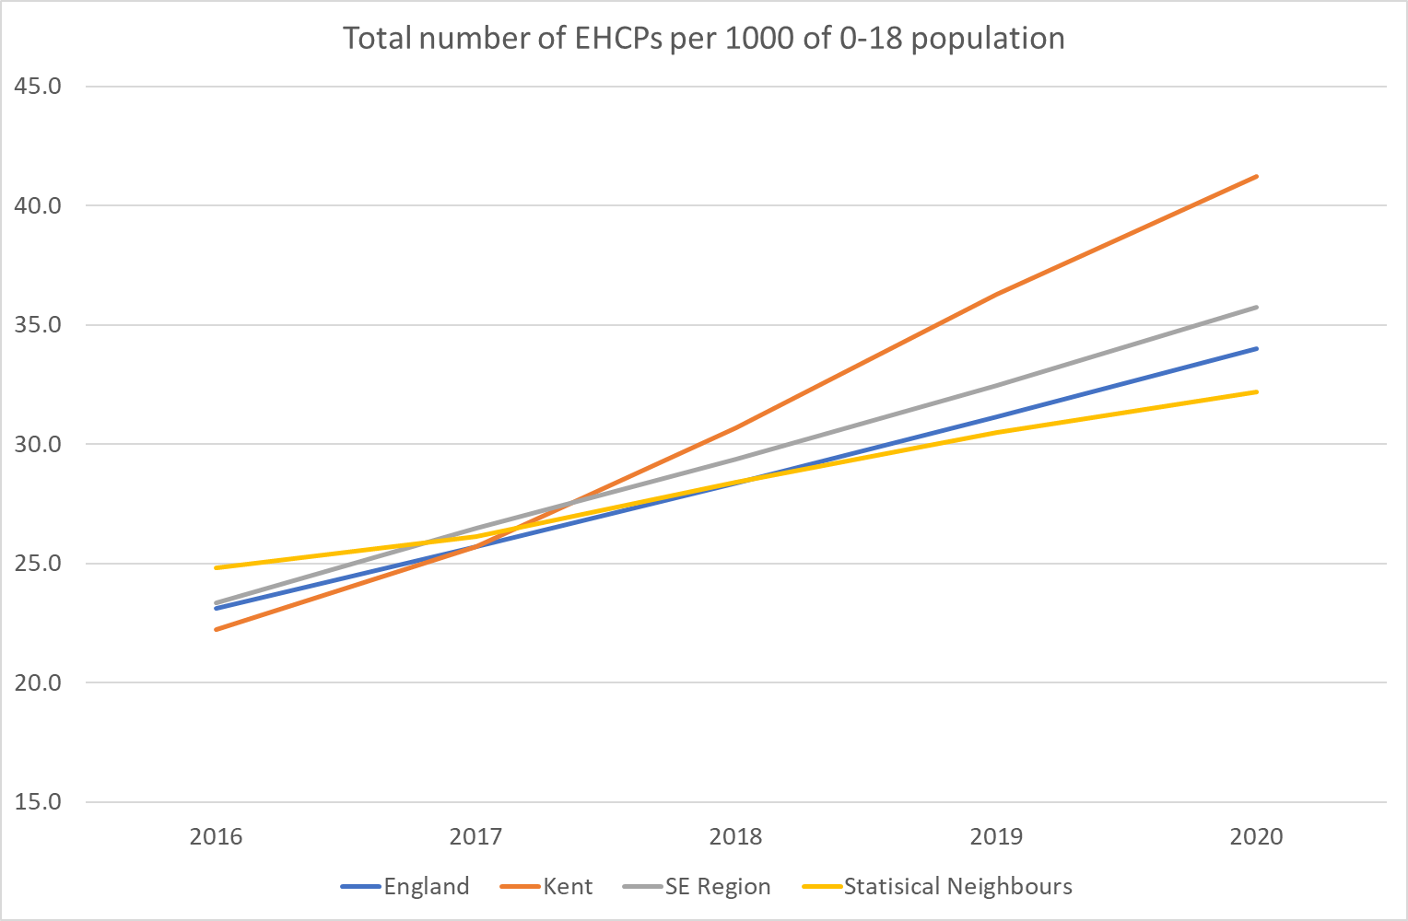
Benchmarking Summary
All EHCPs up to the age of 25 compared to 0-18 population
Benchmarking used by DFE

Slide 18
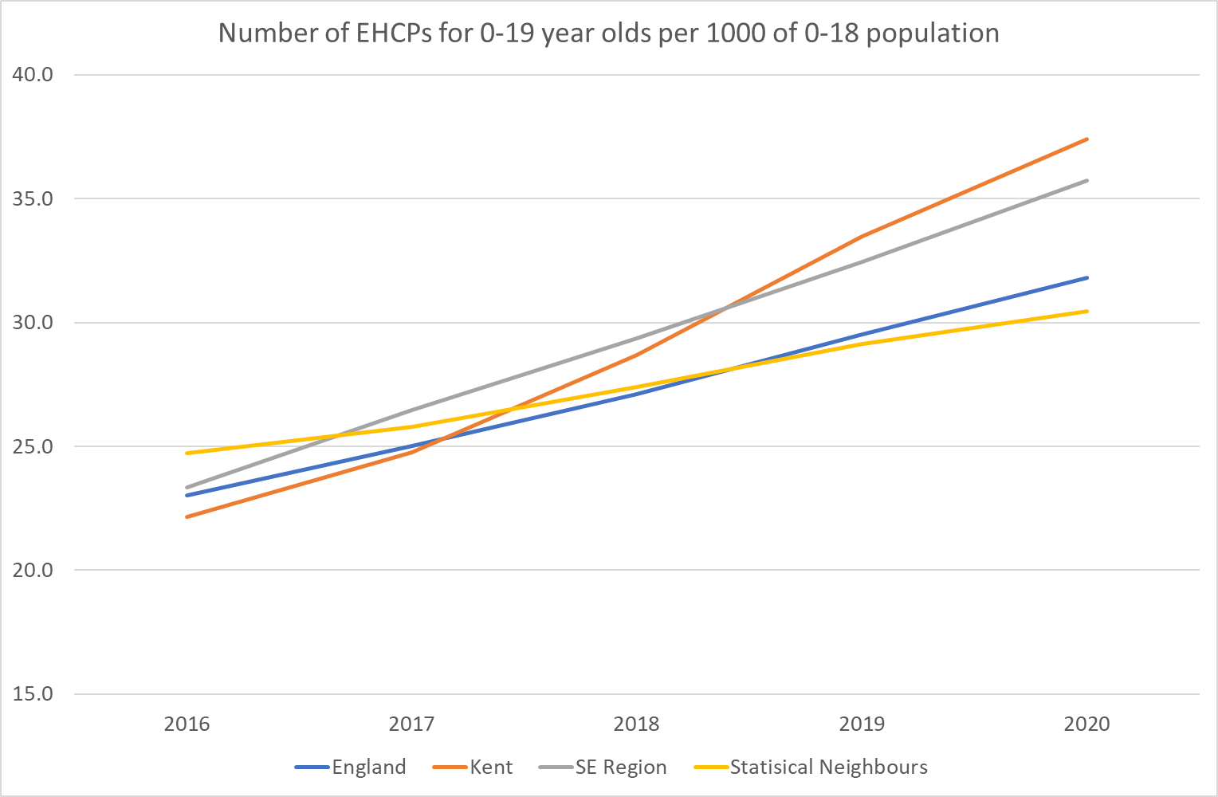
Benchmarking Summary
Excluding 20-25 age group

Slide 19
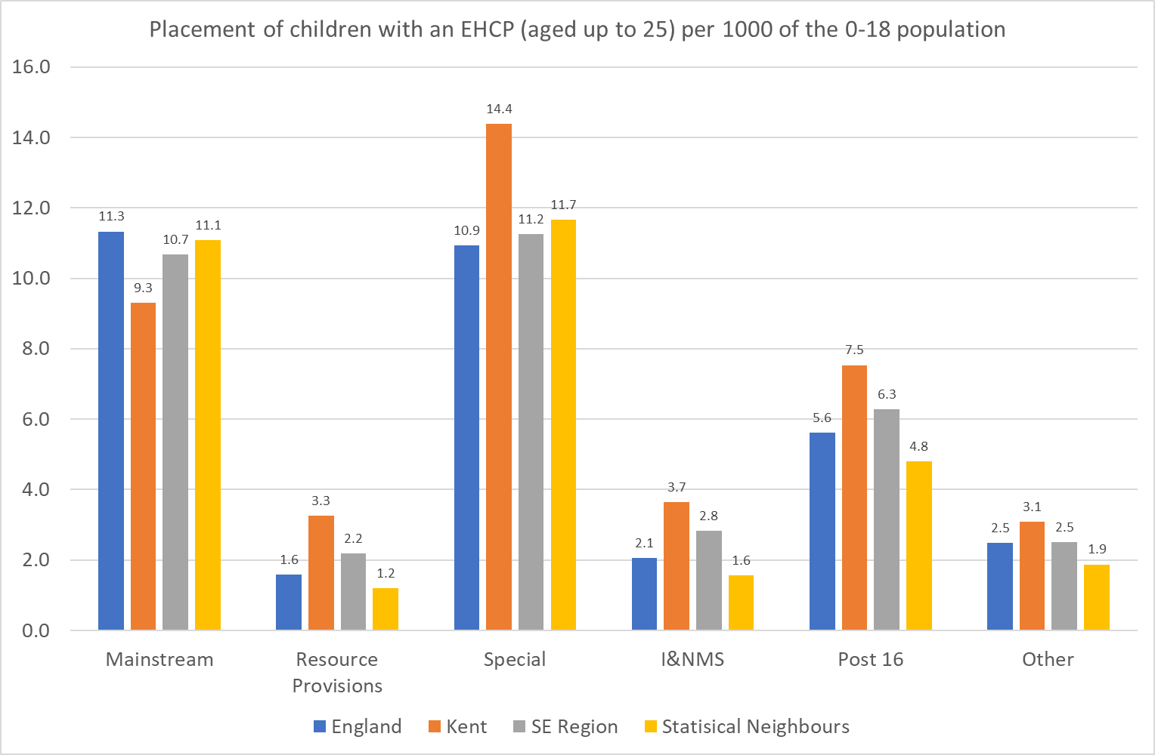
Benchmarking Summary
Based on January 2020 national data

Slide 20
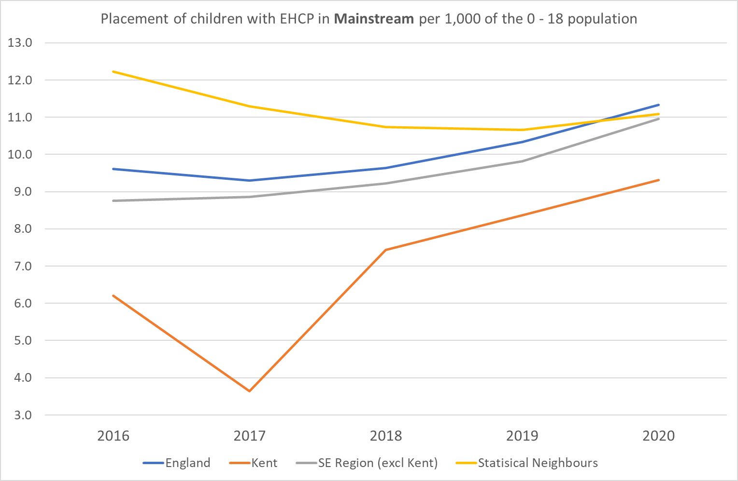
Benchmarking Summary

Slide 21
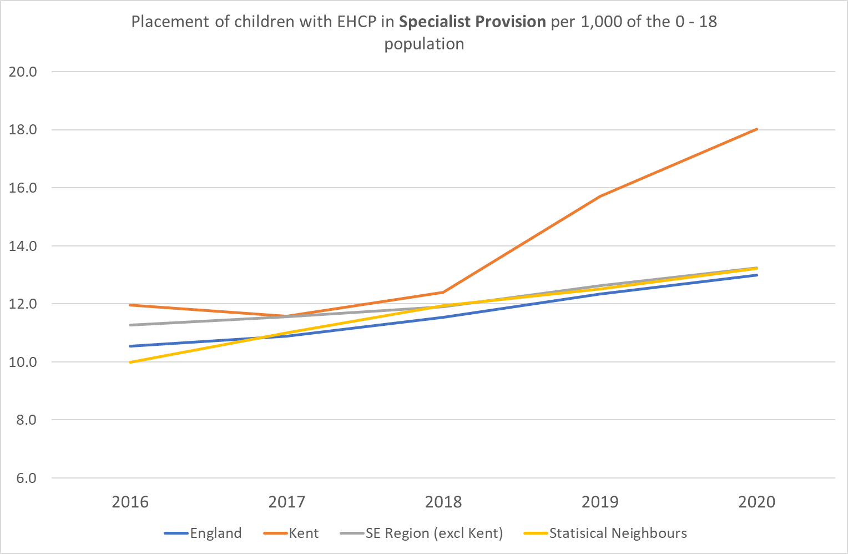
Benchmarking Summary

Slide 22
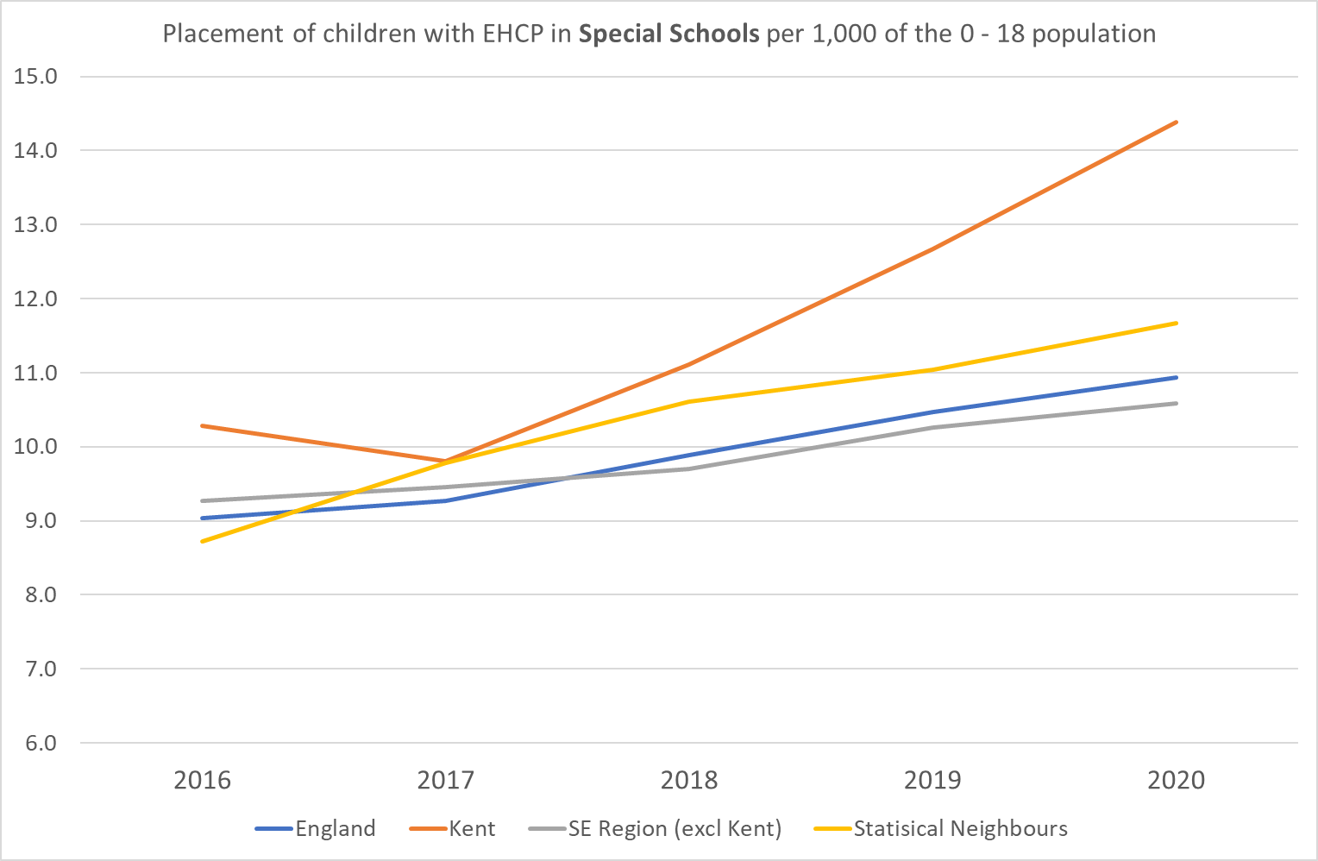
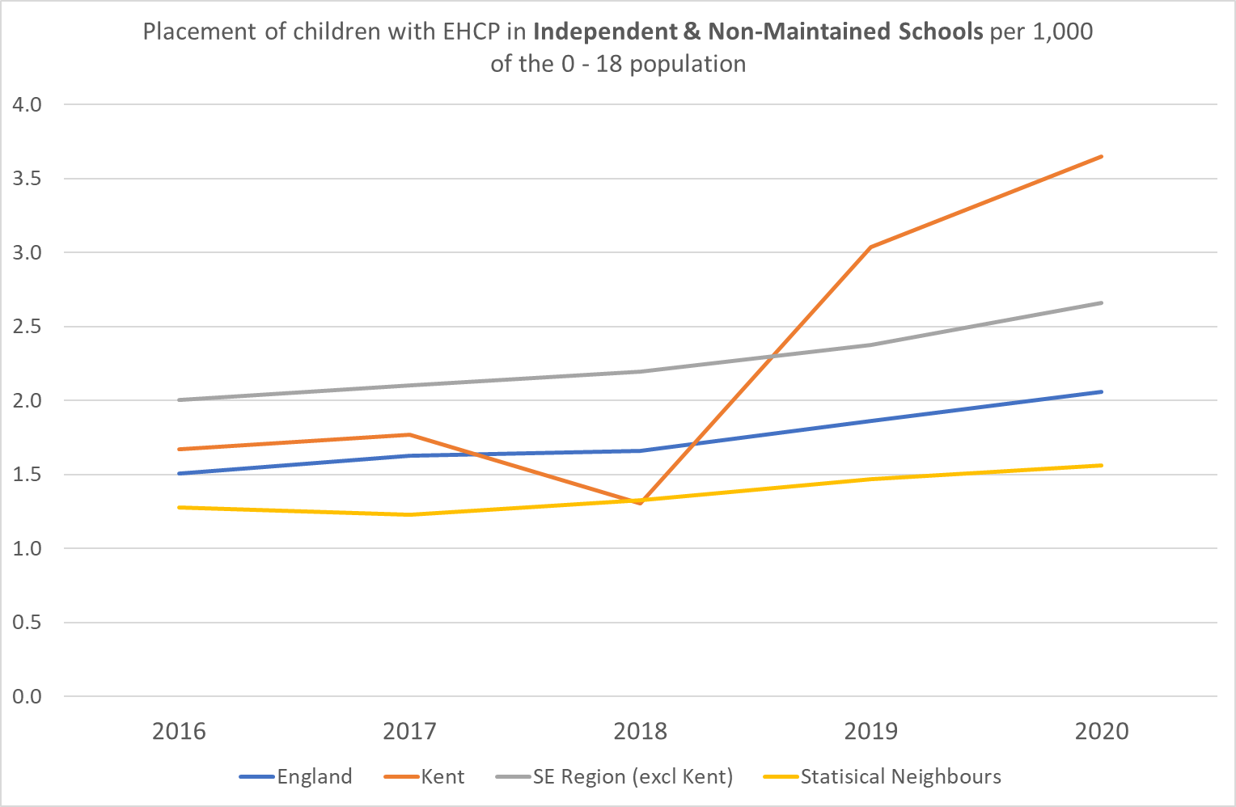
Benchmarking Summary

