Slide 1
Skills and Employability Service County Briefings
Tracking and KentChoices 2019/20

Slide 2
Agenda
2019/20 Tracking update
KentChoices roll out 2019/20
Questions

Slide 3
Tracking
 | NEET |  | Not Known
 | Yr12 | Yr13 | Yr12 | Yr13
Canterbury | 38 (2.53%) | 39 (2.64%) | 24 (1.59%) | 46 (3.12%)
Swale | 47 (2.90%) | 81 (5.05%) | 35 (2.16%) | 53 (3.31%)
Thanet | 65 (4.21%) | 107 (6.95%) | 41 (2.65%) | 55 (3.57%)
Ashford | 42 (2.75%) | 55 (3.69%) | 11 (0.72%) | 45 (3.02%)
Dover | 13 (1.12%) | 44 (3.81%) | 18 (1.55%) | 23 (1.99%)
Folke & Hythe | 34 (3.08%) | 68 (6.05%) | 20 (1.81%) | 40 (3.56%)
Countywide | 412 (2.53%) | 637 (3.93%) | 255(1.56%) | 453 (2.79%)

Slide 4
Tracking
 | NEET | Not Known
 |  | Yr12 | Yr13
Maidstone | 86 (2.47%) | 13 (0.75%) | 42 (2.4%)
T and M | 95 (3.35%) | 25 (1.73%) | 35 (2.52%)
T Wells | 60 (2.46%) | 11 (0.93%) | 27 (2.14%)
Dartford | 48 (2.14%) | 19 (1.67%) | 27 (2.44%)
Gravesham | 92 (3.77%) | 16 (1.29%) | 35 (2.91%)
Sevenoaks | 35 (1.57%) | 22 (1.99%) | 25 (2.23%)
Countywide | 412 (2.53%) | 255(1.56%) | 453 (2.79%)

Slide 5
Tracking
Background information
Destinations Data – Good practice guide for schools. October 2018, DfE
https://assets.publishing.service.gov.uk/government/uploads/system/uploads/attachment_data/file/748165/Destinations_good_practice_guide_for_publishing.pdf
Careers guidance and access for education and training providers – Statutory guidance for governing bodies, school leaders and school staff. October 18, DfE
https://assets.publishing.service.gov.uk/government/uploads/system/uploads/attachment_data/file/748474/181008_schools_statutory_guidance_final.pdf
Participation of young people in education, employment or training – Statutory guidance for local authorities. September 2016, DfE
https://assets.publishing.service.gov.uk/government/uploads/system/uploads/attachment_data/file/561546/Participation-of-young-people-in-education-employment-or-training.pdf

Slide 6
Sharing data with The Education People
I can confirm that The Education People, a KCC-owned company, is contracted by KCC to undertake the tracking of young people aged 16-18, and to provide them with advice and guidance, to reduce the number of young people not in education, employment and training.
This is a statutory responsibility of KCC, and The Education People are the contracted provider of this service on behalf of KCC. The contract between KCC and The Education People is GDPR-compliant, and requires them to process information on our behalf. Additionally, we have an information sharing protocol in place to ensure best practice standards are adhered to.
Katherine Atkinson | Assistant Director - Management Information & Intelligence | Integrated Children’s Services | Children, Young People & Education | Kent County Council

Slide 7
Sharing phone numbers and information on young people at risk of becoming NEET
46. All schools (including academies and other state-funded educational institutions) must continue to provide relevant information about all pupils to local authority support services. This includes:
i) basic information such as the pupil’s name, address and date of birth;
ii) other information that the local authority needs in order to support the young person to participate in education or training and to track their progress. This includes for example: young people’s contact details including phone numbers, information to help identify those at risk of becoming NEET post-16, young people’s post-16 and post-18 plans and the offers in post-16 or higher education.*
* Careers Guidance and access for education and training providers – Statutory guidance for governing bodies, school leaders and school staff, DfE October 2018

Slide 8
Gatsby benchmark 3 considerations
37. An indicator for Benchmark 3 is for schools to collect and maintain accurate data for each pupil for at least three years after they leave the school or from the end of key stage 4, whichever is the earlier. We appreciate that this may be difficult for schools to do at this time. However, for now, we encourage schools to begin to put processes in place that will help them to make better use of destinations data. Schools can do this by working with local authorities to establish effective data-sharing agreements, and by making more use of the published Government data on longer-term outcomes (for example, the experimental statistics on destination measures).*
* Careers Guidance and access for education and training providers – Statutory guidance for governing bodies, school leaders and school staff, DfE October 2018

Slide 9
Gatsby Benchmark 3 considerations
33. Local authorities have a statutory duty to record the destinations of 16 year olds and to track and support all young people in their area (16 and 17 year olds). This duty extends to young people with special educational needs and disabilities up to the age of 25. Local authorities can share this information with the school that the young person attended. Schools and post-16 educational institutions also have a statutory duty to provide data to local authorities to support these duties. As these are statutory duties, local authorities and schools / educational institutions do not need consent to collect this data. *
Destination data currently shared with schools by Management Information in February each year: what Year 11, and 12 went on to do after September and is a snapshot of 1st November. Schools are required to have a data sharing agreement in place to receive information.
* Destination data – Good practice guide for schools, DFE, October 2018

Slide 10
Gatsby benchmark 3 considerations
However, for a school to track a student’s destinations after 16 years old, they will need the young person’s consent (unless the student is at a school sixth form, in which case the school does not need consent). It is recommended that schools routinely seek consent from their students in Year 11 to collect and maintain information on them once they have left school. It is vital that this consent is obtained in order to collect information about past students. An example of a data consent form is attached at Annex C. This is for guidance only and should not be considered to be legal advice.*
*Destination data – Good practice guide for schools, DFE, October 2018

Slide 11
Gatsby benchmark 3 considerations
If you decide to follow up the Gatsby benchmark 3 requirement to track for 3 years, you may wish to consider:
reviewing your school’s privacy notice, the current KCC exemplar is available at the link below
https://www.kelsi.org.uk/school-management/data-and-reporting/access-to-information/the-general-data-protection-regulation-gdpr
And…
develop a consent form for your learners to sign before they leave school.

Slide 12
School tracking responsibilities

Slide 13
Tracking key messages
Term 6
Please ensure:
that your September Guarantee spreadsheets are returned by 28th June and
you have provided information on learners you consider at risk of becoming NEET.
2019/20
The Management Information data collection templates have been updated, please download new ones from:
https://www.kelsi.org.uk/school-management/data-and-reporting/management-information/tracking-young-people
Please include contact telephone numbers

Slide 14
The New KentChoices
Areas to be covered…..
Our ambition
First media
What’s new?
How it will work with colleges
How we will support you.
Software demonstration
Next steps

Slide 15
Our ambition
To have a user friendly system that provides schools with a simple way to:
advertise their post 16 offer;
manage internal and external applications;
get data that informs provision and staff planning;
communicate in bulk with applicants and the LA;
demonstrate transparency when dealing with applicants;
support Year 11s make applications and track what they are doing and;
evidence Gatsby benchmarks 3, 5 and 7
To have all Kent FE colleges:
Acknowledge applications and make offers through KentChoices
To have a system used by all Year 11 students, schools and colleges.

Slide 16
Why First Media?
Their system is very similar to UCASprogress, so easy to adopt in Kent and has:
newer technology, so is more efficient, easier to use and is mobile friendly;
tackled some of the inherent problems with UCASprogress and
the capacity to interact with college MI systems.
As a company they have:
a proven track record, are already established in a number of other local authorities;
been selected by eight other authorities as a replacement for UCASprogress;
been chosen by a procurement team made up of Kent schools and a college and
an appetite to grow their business, using Kent as a development partner

Slide 17
How is it going to work with colleges?
Application data can be electronically transferred from First Media into college MI systems and with some support the data can be transferred back into the First Media system. This will allow schools to view the progress of their learners external applications.
To facilitate this, some initial development work is required by the colleges, they are currently reviewing the system and a series of planning meetings are scheduled to push it forward.
A support contract for each college is being funded by The Education People.

Slide 18
How will we support school staff?
Training will be provided in September for all schools and colleges.
School and college data is currently being transferred.
Jackie.Lovell@theeducationpeople.org will provide online and telephone support, 03000 416401.
User guides will be created in preparation for training.
The four Engagement Officers will be available to visit schools to support school staff.

Slide 19
The Student View

Slide 20
Searching for a Course

Slide 21
Search Results

Slide 22
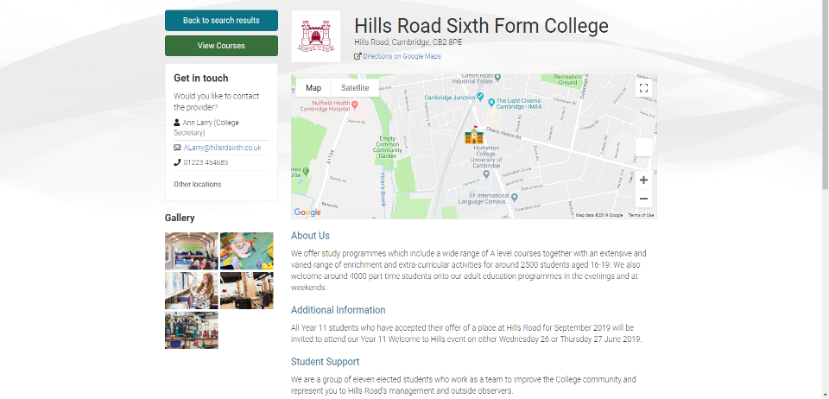
Provider Description

Slide 23
Course Description

Slide 24
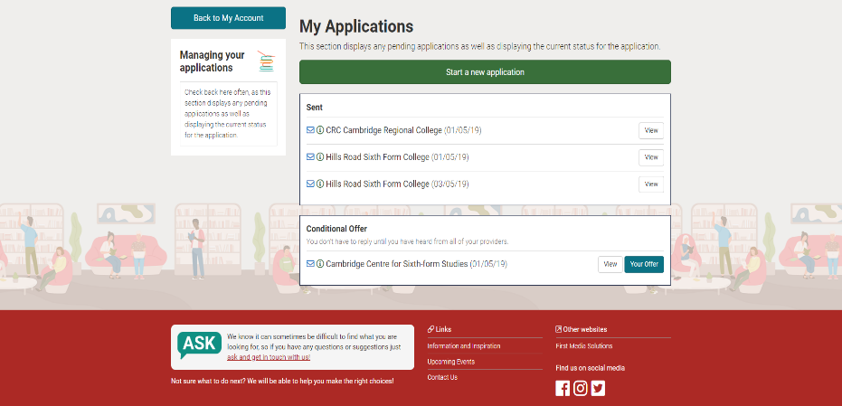
Applications

Slide 25
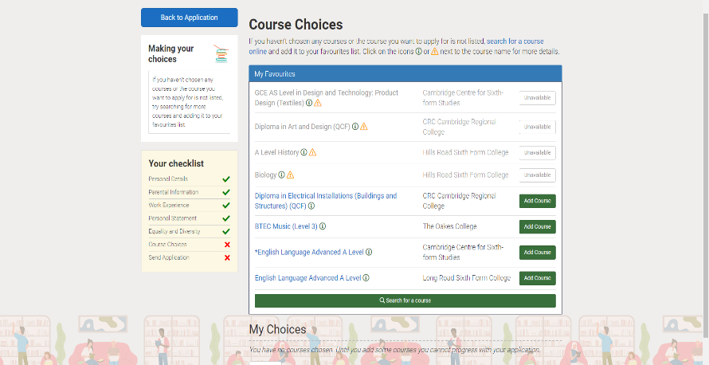
Adding Courses to Applications

Slide 26
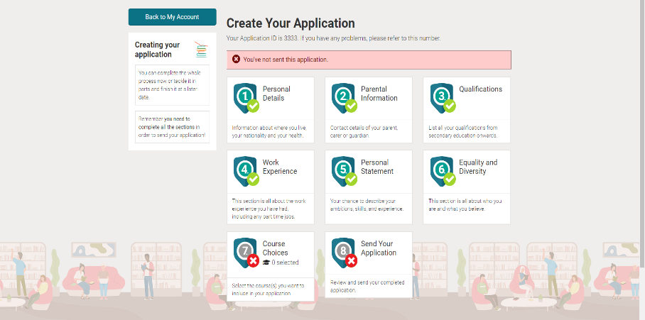
Student Profile

Slide 27
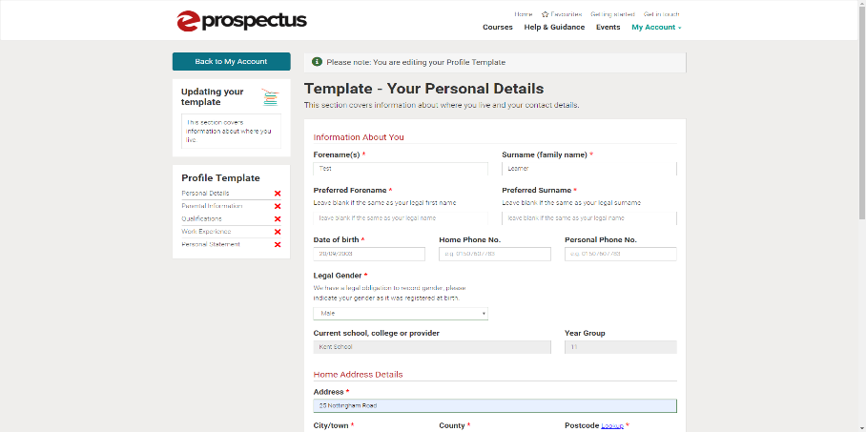
Student Profile

Slide 28
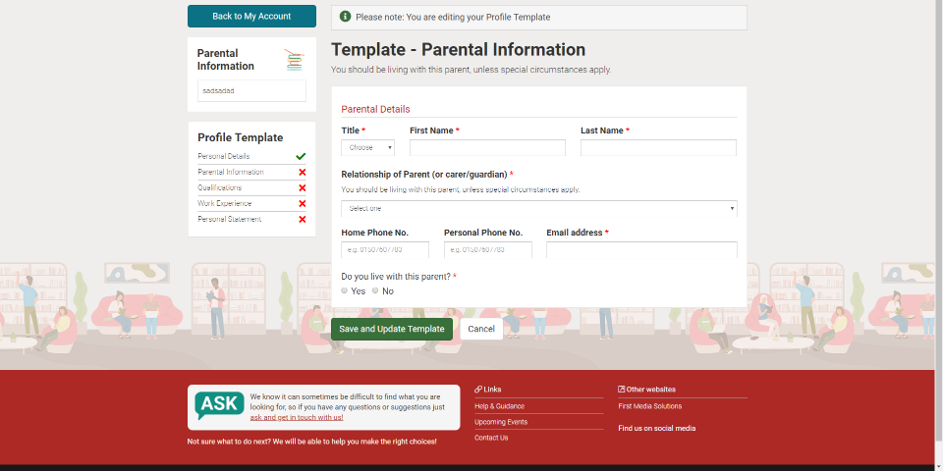
Student Profile

Slide 29
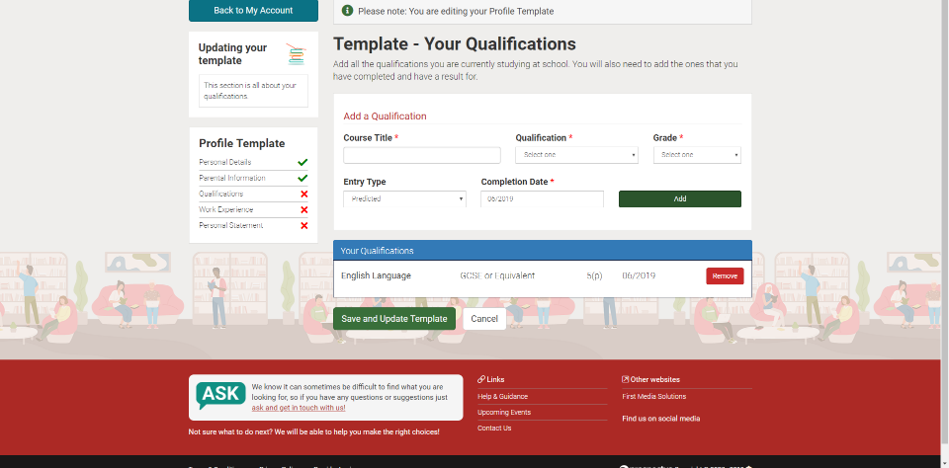
Student Profile

Slide 30
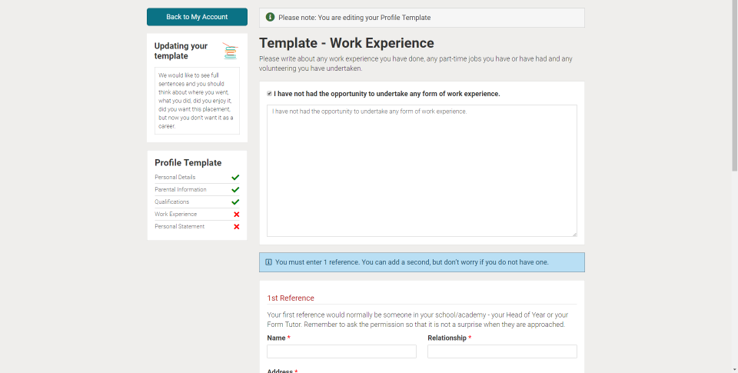
Student Profile

Slide 31
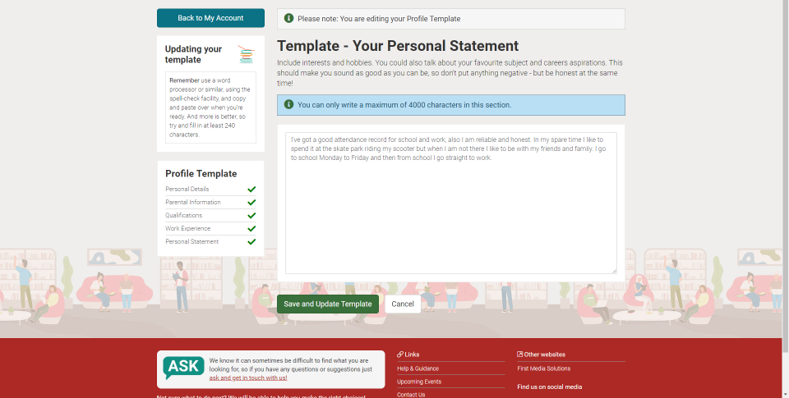
Student Profile

Slide 32
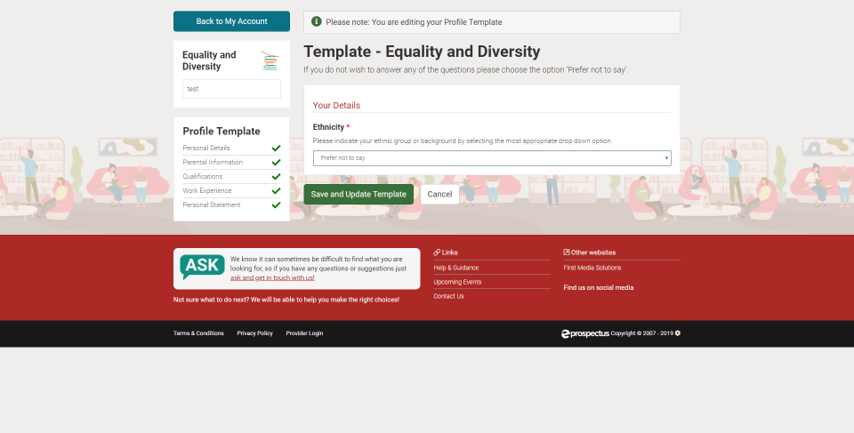
Student Profile

Slide 33
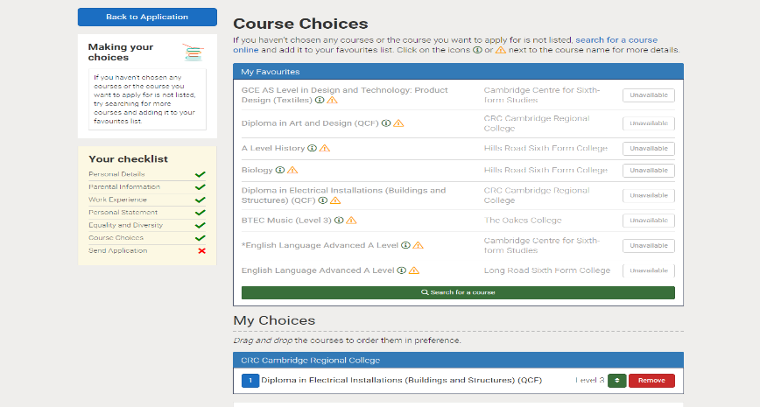
Tracking Applications

Slide 34
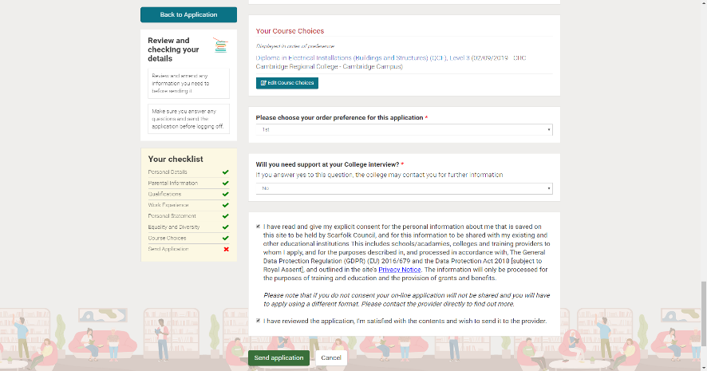
Course and Application Preferencing

Slide 35
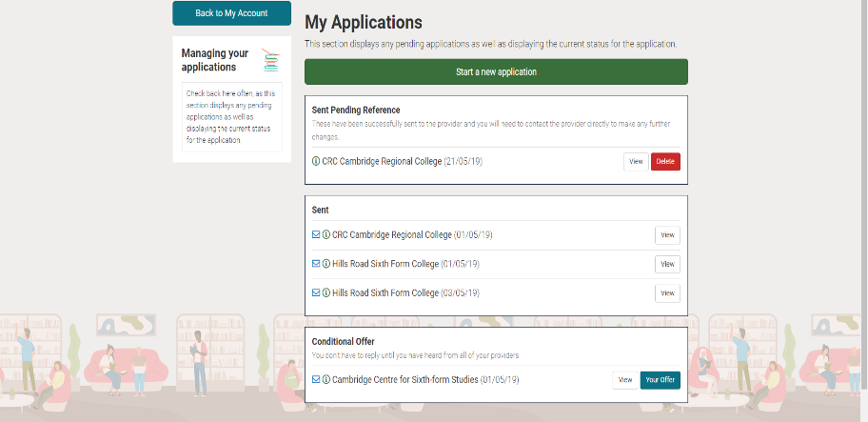
Tracking Offers

Slide 36
Admin View

Slide 37
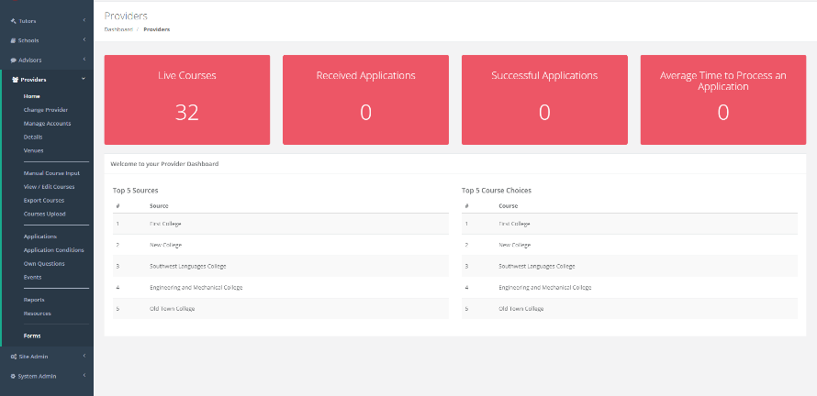
Admin Dashboard

Slide 38
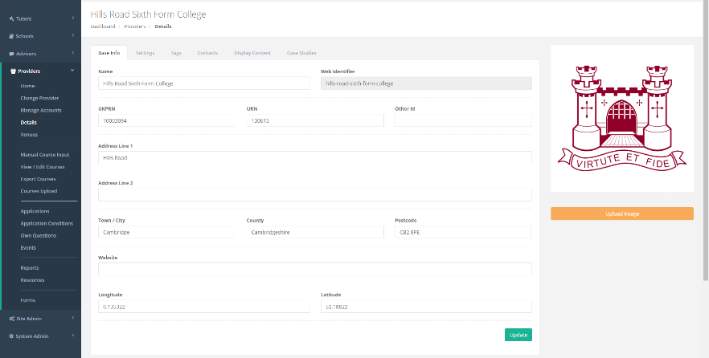
Provider Set Up

Slide 39
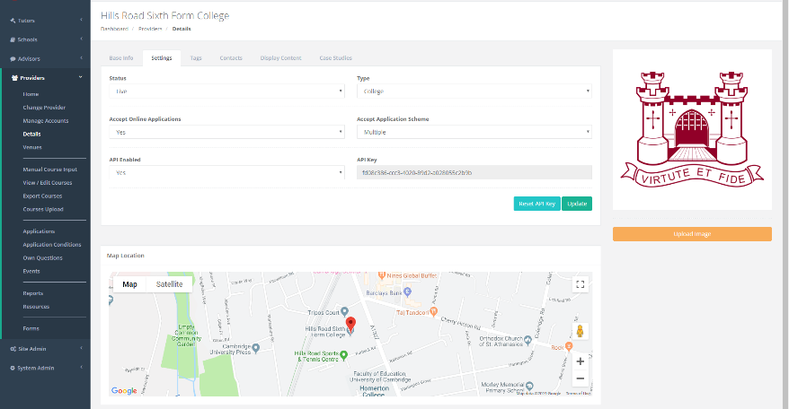
Provider Set Up- Settings

Slide 40
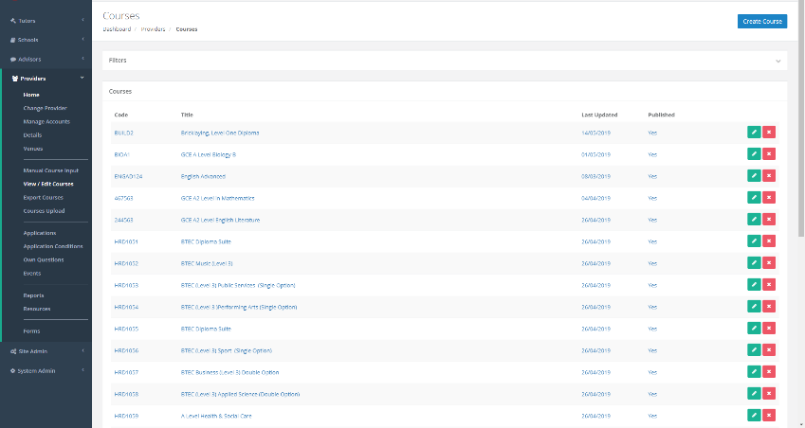
Course Management

Slide 41
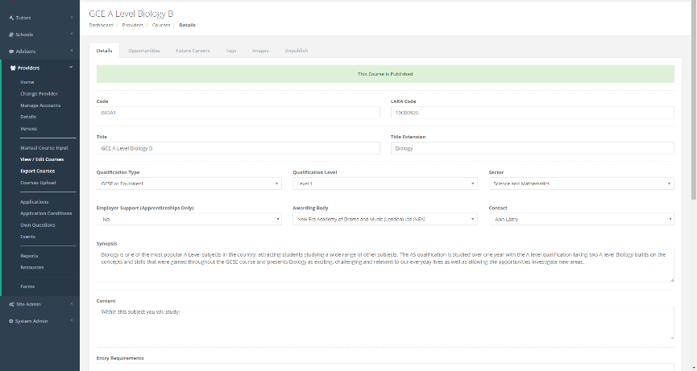
Course Editing

Slide 42
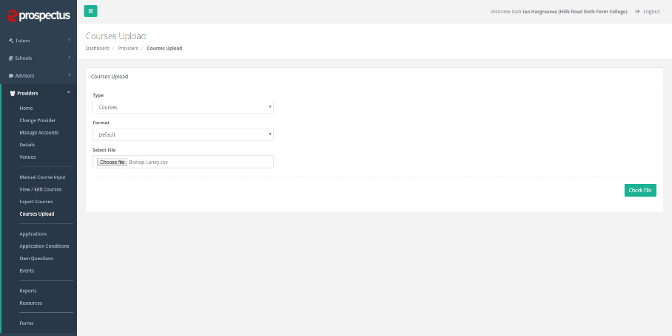
Course Upload

Slide 43
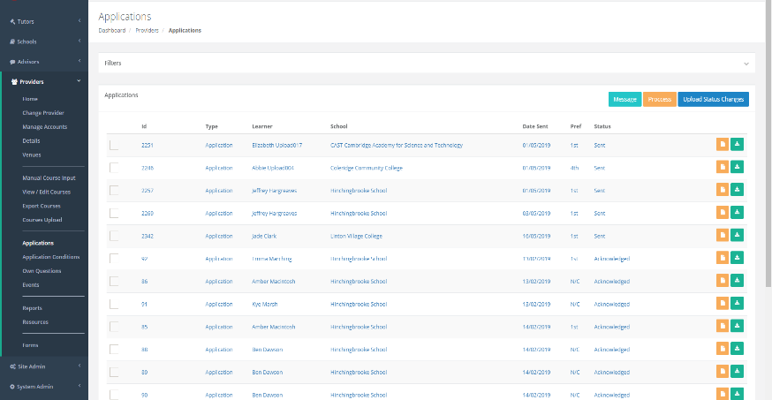
Application Management

Slide 44
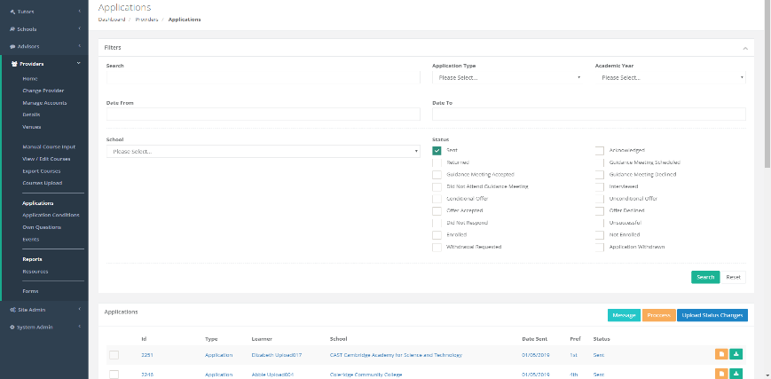
Applications Management – Search and Filter

Slide 45
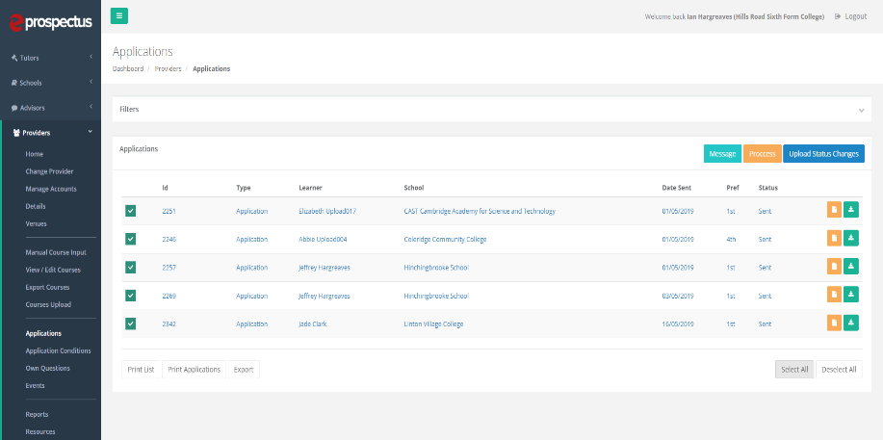
Bulk Operations

Slide 46
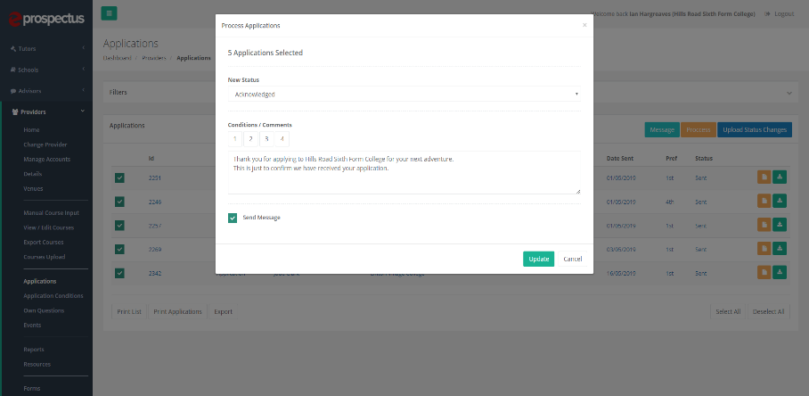
Bulk Messaging/Acknowledging

Slide 47
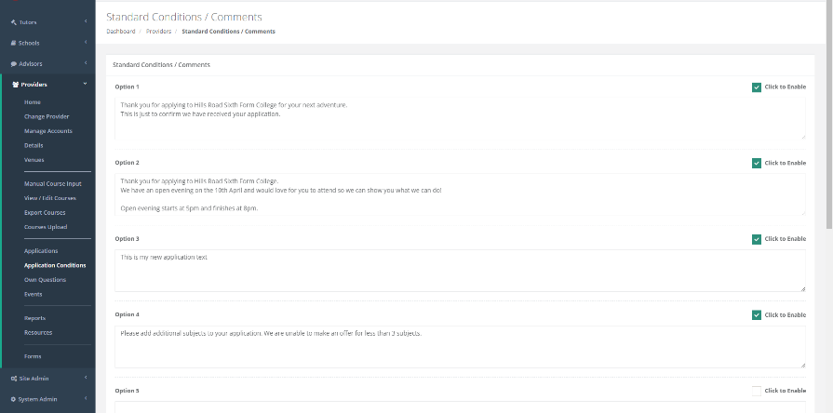
Making Offers

Slide 48
Adding Your Own Options

Slide 49
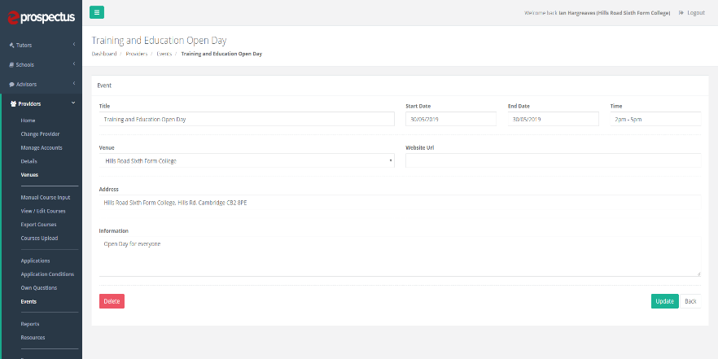
Events

Slide 50
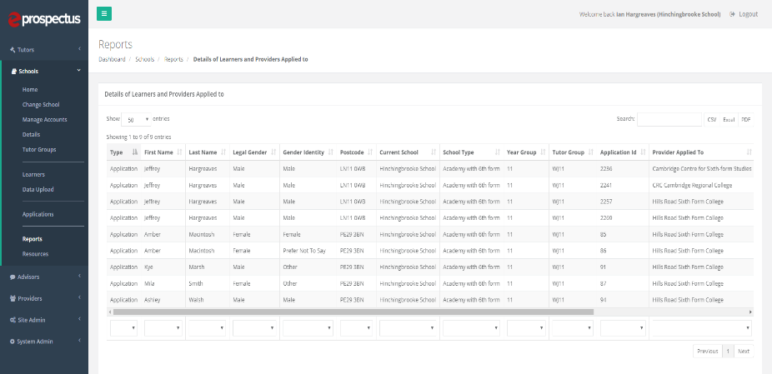
Reports

Slide 51
KentChoices Roll Out

Slide 52
Thank You For Coming
Jackie Lovell- KentChoices Development Officer
Jackie.lovell@theeducationpeople.org
03000 416401
Mike Rayner- Principal Post 16 Lead
Mike.Rayner@theeducationpeople.org
03000 416599
Rory Abbott- Deputy Area Lead- South and East
Rory.abbott@theeducationpeople.org
07795 036707

