Slide 1
30 Hours of Free Childcare
District Seminars March 2017
Canterbury

Slide 2
Early Years and Childcare in
Canterbury
Key Facts and Figures
 | Kent | Canterbury
EYFS GLD 2016 | 74.8% | 75.6%
EYFS FSM Achievement Gap 2016 | 19% | 25.7%
Percentage of providers good or outstanding (December 2016) | 96.8% | 96.7%
Percentage of childminders good or outstanding | 97% | 98.4%
FF2 Take up (December 2016) | 74% | 88.1%
Percentage of providers in a collaboration | 62% | 71.4%

Slide 3
30 Hours of Free Childcare
The scale of the challenge in Canterbury
Predicted take up of 15 Hours by three/four year olds
Autumn 2017 1,498
Spring 2018 2,000
Summer 2018 2,385
Estimated eligibility for 30 hours of Free Childcare
Autumn 2017 945
Spring 2018 1,261
Summer 2018 1,503

Slide 4
Canterbury – Demand Model
The three areas which requires a significant increase in capacity are:
Canterbury
Whitstable
Herne Bay

Slide 5
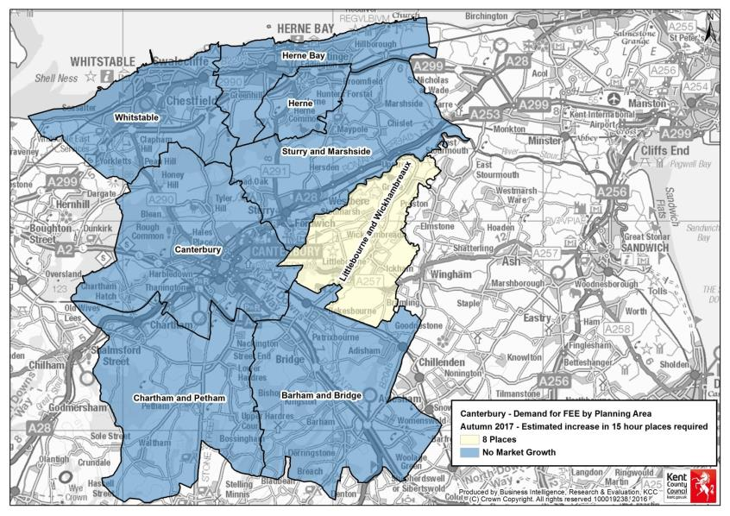
Canterbury Demand – Autumn 2017

Slide 6
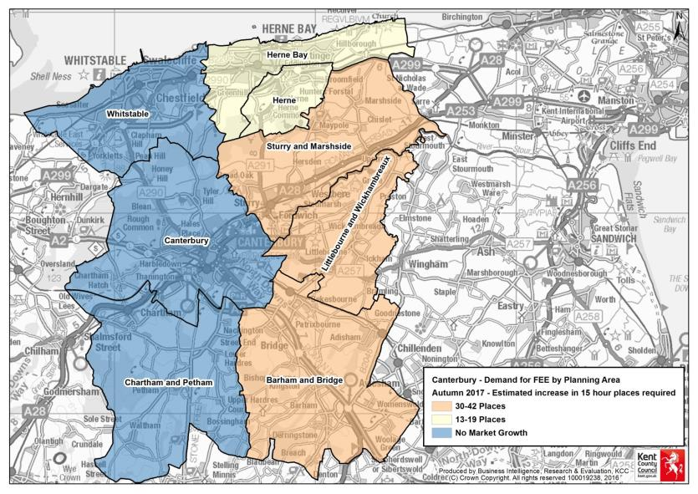
Canterbury Demand – Spring 2018

Slide 7
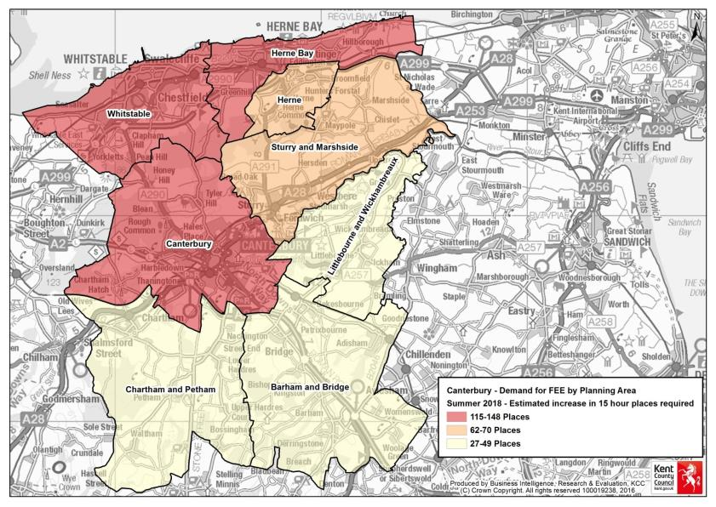
Canterbury Demand – Summer 2018

Slide 8
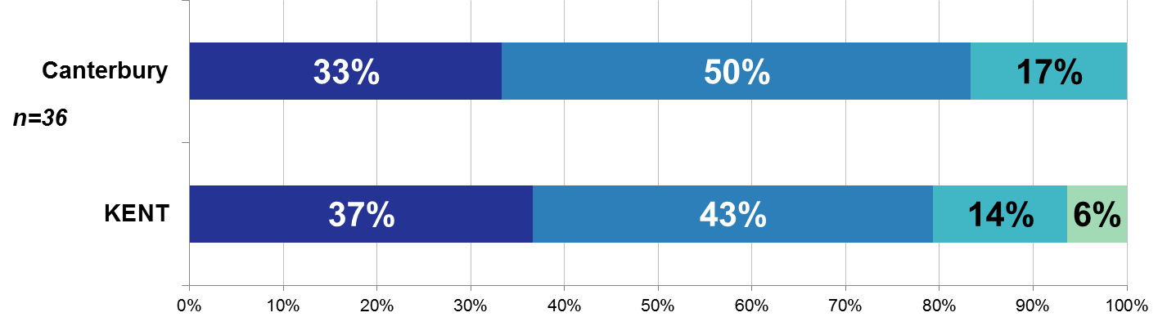
Canterbury
Establishments: 65
Childminders: 44
Total Childcare providers: 109
Survey Responses: 36
Response Rate: 33%
Are you considering offering the 30 hours of nursery funding when it is implemented for working parents?
Yes
No
Not Sure
Don’t Know
Survey responses as at 23rd Feb 2017

Slide 9
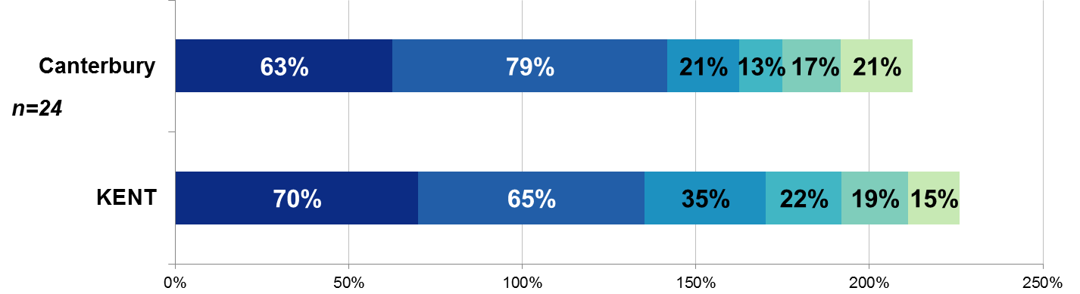
Canterbury
Establishments: 65
Childminders: 44
Total Childcare providers: 109
Survey Responses: 36
Response Rate: 33%
What are your reasons for not considering offering the 30 hours of nursery funding when it is implemented for working parents?
Reduced revenue/income
Lack of staff
KCC funding unknown
Facilities/building issues
Restrictions with opening hours
Impact on places for FF2
Survey responses as at 23rd Feb 2017

Slide 10
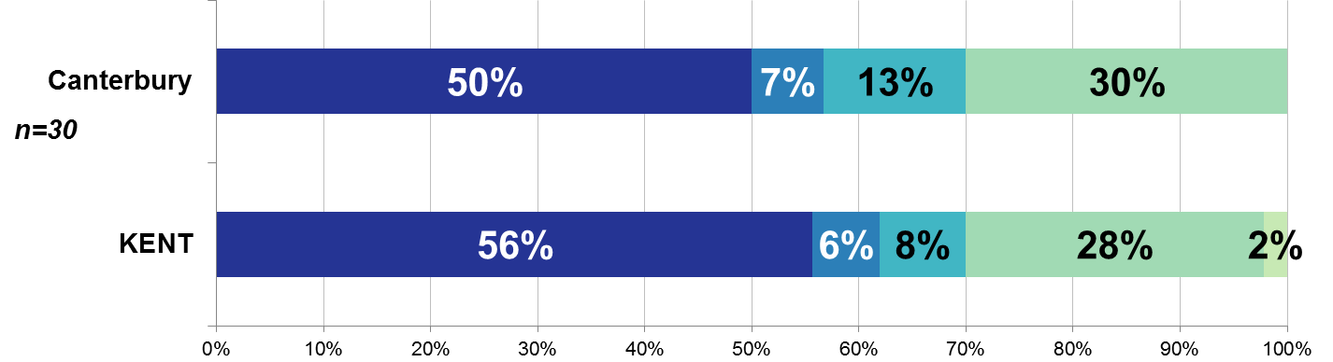
Canterbury
Establishments: 65
Childminders: 44
Total Childcare providers: 109
Survey Responses: 36
Response Rate: 33%
For those that said yes or were not sure, how do you plan to offer the 30 hours funded places?
Over 38 weeks
Don’t know
Stretched places
Not applicable
Over 38 weeks & stretched places
Survey responses as at 23rd Feb 2017

