Slide 1
Prevent and Child Sexual Exploitation
Nick Wilkinson, Head of Youth Justice and Safer Young Kent, EHPS

Slide 2
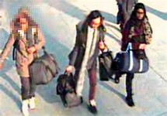
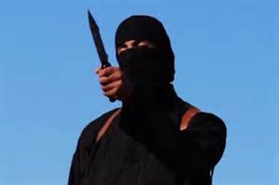

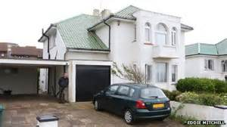

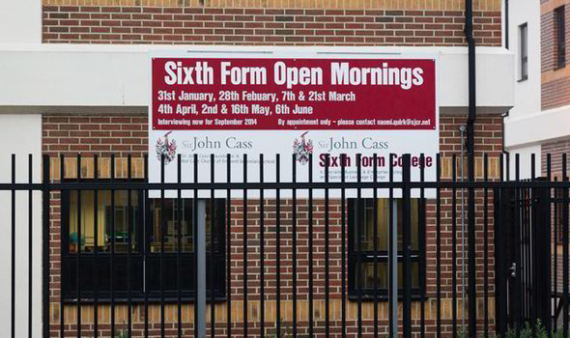

Context

Slide 3
Government Counter Terrorism
Strategy
CONTEST
Prepare
Protect
Pursue
Prevent - Individuals, Institutions, Ideology

Slide 4
Counter Terrorism Security Act 2015
Requires KCC and others to act to prevent people from being drawn into terrorism, ensuring awareness of risks of terrorism
Demonstrate leadership
Work in partnership
Staff capabilities – frontline staff clear role
Share information

Slide 5
Channel
Pre-criminal space
Kent Police co-ordinate referrals to Channel Panel
Proposals for County Channel Panel to Joint Kent Chief Meeting – KCC to chair
Identify vulnerable – violent extremism/terrorism
Assess nature and extent of risk through multi-agency panel
Develop most appropriate support to safeguard individuals at risk

Slide 6
Existing good practice
Schools self-assessment
NCALT on line training
Zak – Kent University Centre for Child Protection
Community Learning and Skills
Strong existing partnerships
Excellent links with south east counter terrorism unit
Member of National Prevent Challenge Panel

Slide 7
Challenging questions
British values
Girls travelling to Syria
Returners
Ideology
Social media – 50k active IS twitter accounts
Vulnerabilities – links to gangs, grooming
Professional challenge
Safeguarding v community safety v national security

Slide 8






Why do I need to know?
The Definition and types of CSE
Why is it relevant for me to know?

Slide 9

What should I do if I suspect something is wrong in what I have observed?
Spot the signs, make a call, stop the abuse Central Referral Unit (CRU) 03000 41 11 11

Slide 10

KCC’s duty to safeguard and promote welfare
Vulnerability Indicators
Kent and Medway CSE toolkit & assess risk
Key risk areas - going missing, sexual activity, drug misuse, exclusion from school, poor self image, external expressions of despair

Slide 11
CSE: Kent’s Response
Team approach – Operation Lakeland
KSCB Trafficking Children and Child Sexual Exploitation sub-group
Actions for all organisations within the safeguarding partnership
KSCB is running CSE training both multi-agency and delivered in-house via ‘train the trainers’; training is mandatory for front-line Early Help and SCS staff.

Slide 12
CSE: Kent’s Response
Missing children are particularly vulnerable to harm
Single Point of Contact (SPOC) for all missing children notifications to the Central Referral Unit from the 5 May 2015.
A joint report from Kent Police and KCC on missing children will be produced quarterly.
A Multi Agency Crime and Sexual Exploitation Panel (MACSE) has been set up to provide a strategic, county-wide, cross agency response to CSE.
Co-located CSE team

Slide 13



Questions and Comments
Remember to keep up to date with the latest information
Use Kelsi and Kent.gov websites
Read the EYPS Newsletter on KNet
Subscribe and read the weekly E-bulletin

