Slide 2
A year of events and workshops to inspire digital innovation in Kent

Slide 3
What is digital.together?
http://life-longlearner.com/wp-content/uploads/2013/02/opportunity-magnet.jpg
Notes:
digital.together is a pioneering year of awareness and inspiration, focussing on the huge opportunity that digital creates for all communities and sectors in Kent.

Slide 4
What is Kent Connects?
17 Partners including all of Kent’s Local Authorities, Kent Fire & Rescue, Kent Police and SECSU (NHS)
Established for 13+ years.
Award winning.
Nationally Recognised.
Notes:
Partners include:
Ashford Borough Council Canterbury City Council
Dartford Borough Council Dover District Council
Gravesham Borough Council Kent County Council
Kent Fire & Rescue Service Kent Police
Maidstone Borough Council Medway Council
South East Commissioning Support Unit (SECSU) Sevenoaks District Council
Shepway District Council Swale Borough Council
Thanet District Council Tonbridge & Malling Borough Council
Tunbridge Wells Borough Council
Awards:
Nominations:
Nationally recognised – one of the few remaining strategic IT partnerships that emerged from e-gov programme. Often heralded as an example of good partnership working.

Slide 5
Why Kent Connects?
Kent Connects is committed to:
Removing barriers that hinder the joining up and sharing of public services.
Leading this transformation through the application of cost effective and innovative technology.

Slide 6
What can you expect from digital.together
http://exsell7.co.uk/wp-content/uploads/2014/12/Inspiration-words.jpg
Notes:
Over the next 12 months Kent Connects will be developing a range of activities as well as working with others to create a series of events, workshops, and collaborative opportunities to position Kent as one of the most progressive and inclusive digital counties in the country. From improving access to public services, supporting digital buddies and community hacks to advocating greater equality in the use of IT and helping young people find code clubs, we want to show that Kent is leading the way in technology innovation.

Slide 7
Principles
Notes:
Inspire people to contribute and collaborate in creating solutions
Explore how we can complement existing digital initiatives, rather than duplicate or compete
Be generous in sharing insights, experience and resources - whether part of a large organisations or an individual
Encourage curiosity and learn from people with new perspectives
Empathise with others when designing services to tackle a common challenge
Empower people by ensuring that every activity be it a website or a workshop – is inclusive.

Slide 8
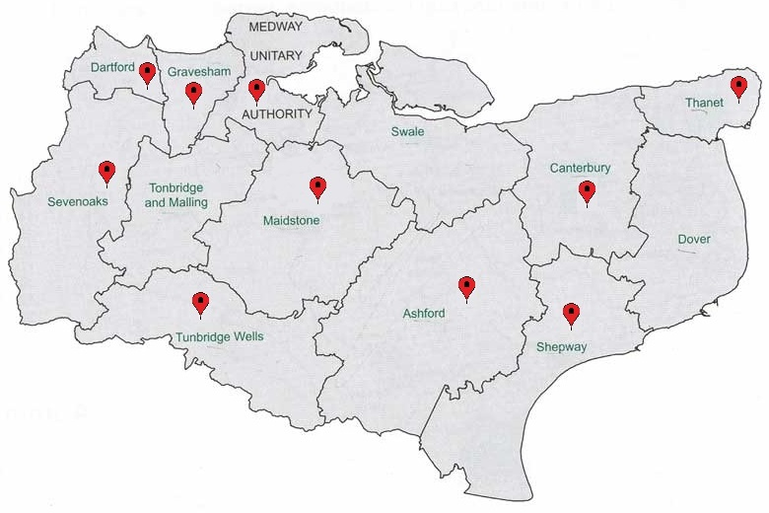
Events and Activities
Notes:
Events currently agreed:
What are digital skills and where can I get some ?
Code Camps - Date TBC
Transformed by you – June to November
digital.together Really Useful Day – 17th September
digital.connects (Digibury lite) - October
Think Nation – Supported by Kent Connects – 5th December
All of these along with a host of partner only events

Slide 9
Kent Connects Digital Envoys
Enthusiastic and skilled individuals.
Live, work, or study, and are associated with the County.
Passionate about promoting local digital activity.
Volunteer to give time to spread the word and get involved.

Slide 10
Participation not partitioning!
Become a Digital Envoy.
Get involved with events and projects.
Connect with us on social media.
Promote digital.together
Img Source - http://www.siobhandowdtrust.com/wp-content/uploads/2011/09/get_involved.png
Notes:
This year, we need you and your organisation to participate in this exciting, challenging and original initiative. Whatever your background or interest, you’re all invited.

Slide 11
Contact Us
Email: Enquire@kentconnects.gov.uk
Web: www.digitaltogether.net
Twitter: @digi_together

